Slide 1
The swallows
Created by Maria Colța

Slide 2
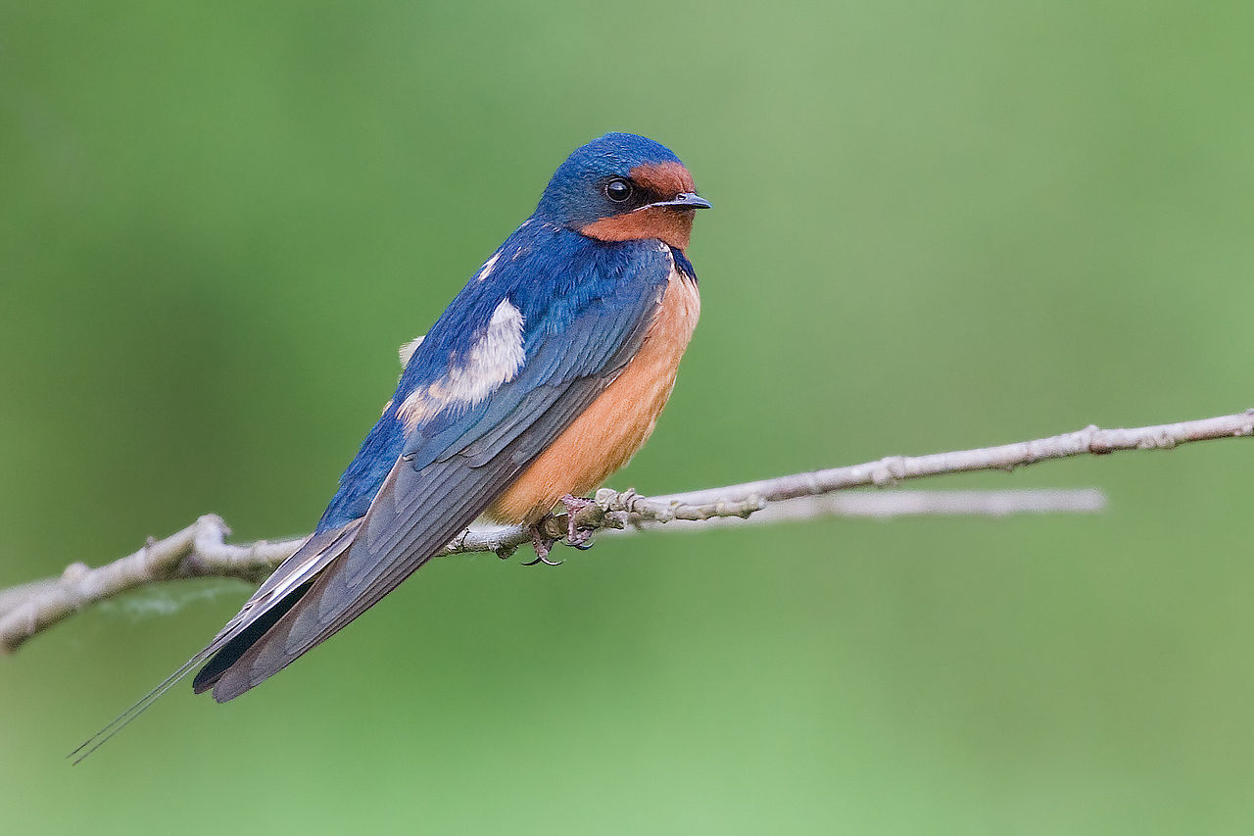
The bird of freedom – it cannot endure captivity

Slide 3
The swallow is a refugee
Since it cannot endure captivity, the swallow is a refugee, forced to go abroad each autumn. So similiar its destiny with the one of refugees – she has to travel over the seas, to search for freedom and better life, the same way the refugees do.

Slide 4
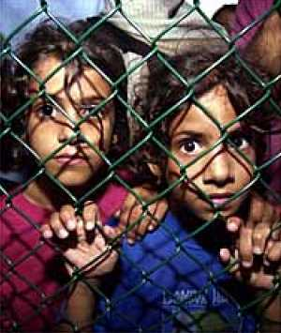
I only wish people would be more sensitive...

