Slide 1
A story of the Vistula Storytellig Tree
By Polish kids from Rzeszow

Slide 2
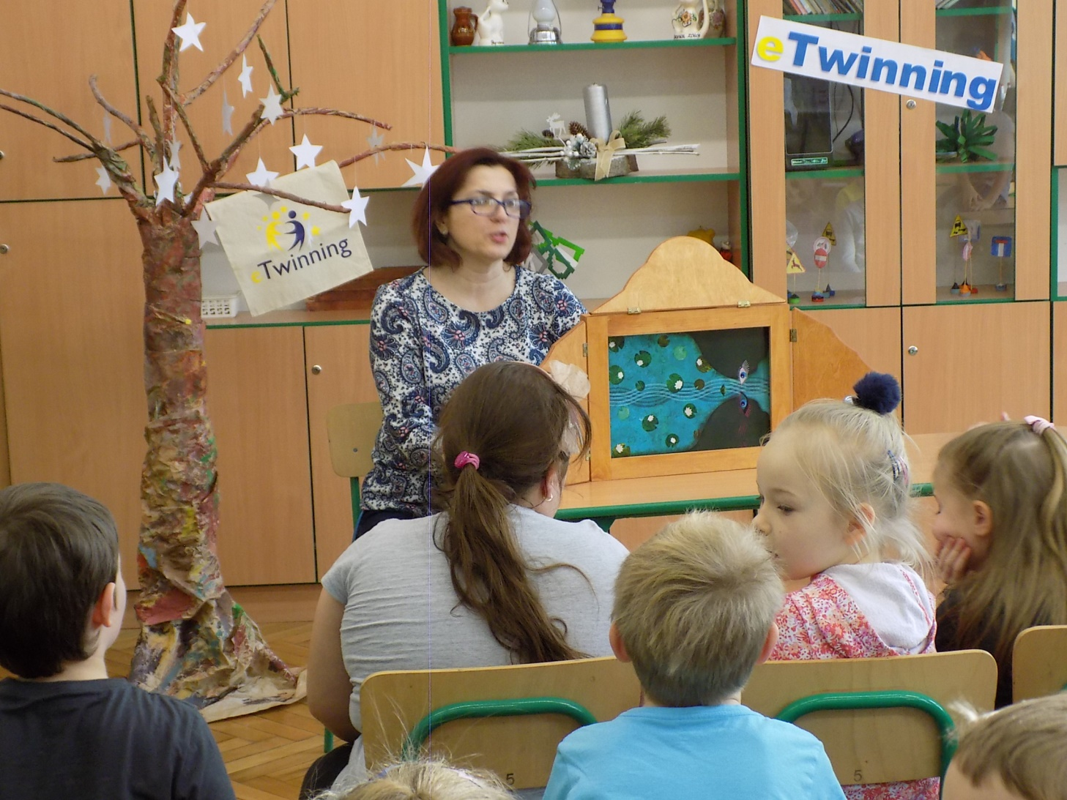
While sitting at our story tree, we listened to a story about the Vistula - the largest Polish river

Slide 3
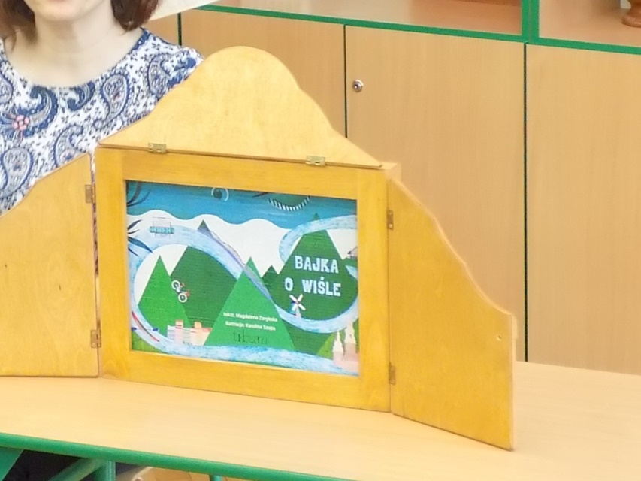
Kamishibai theatre

Slide 4
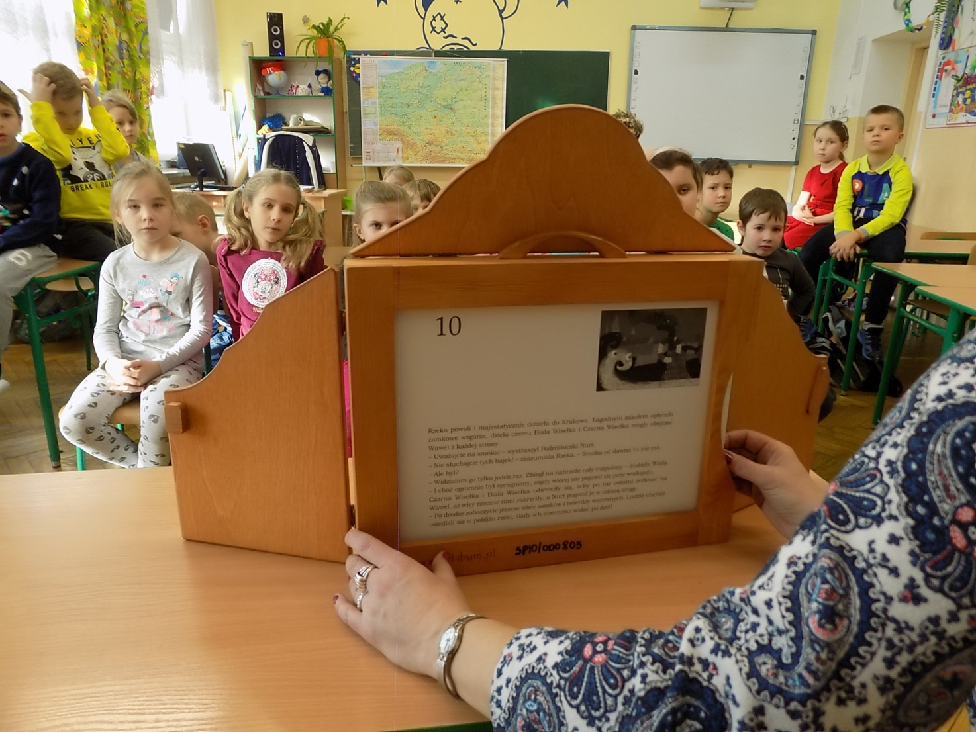

Slide 5
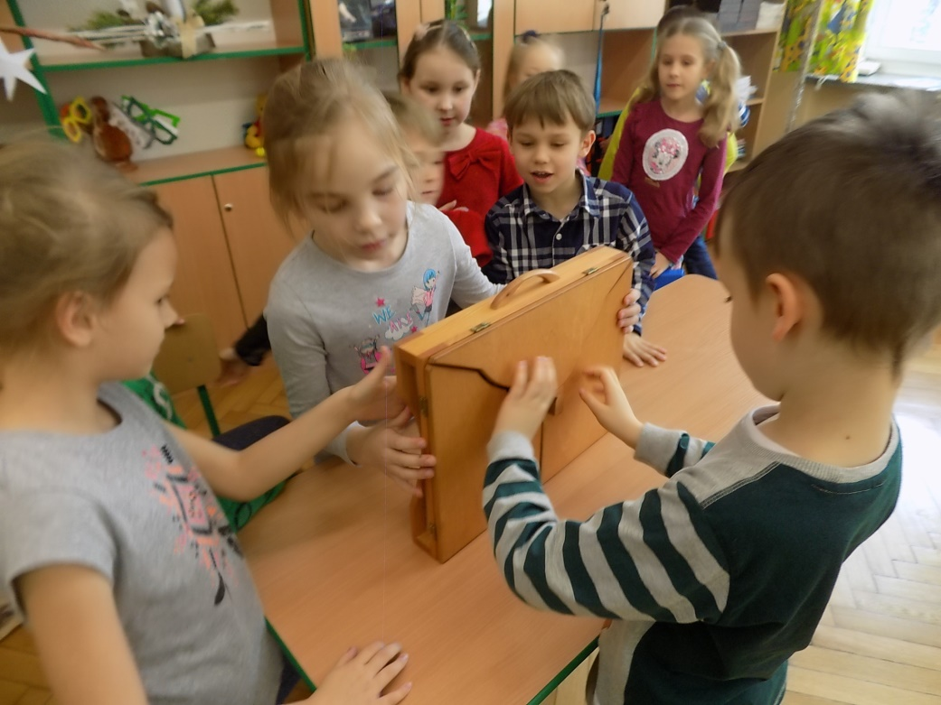
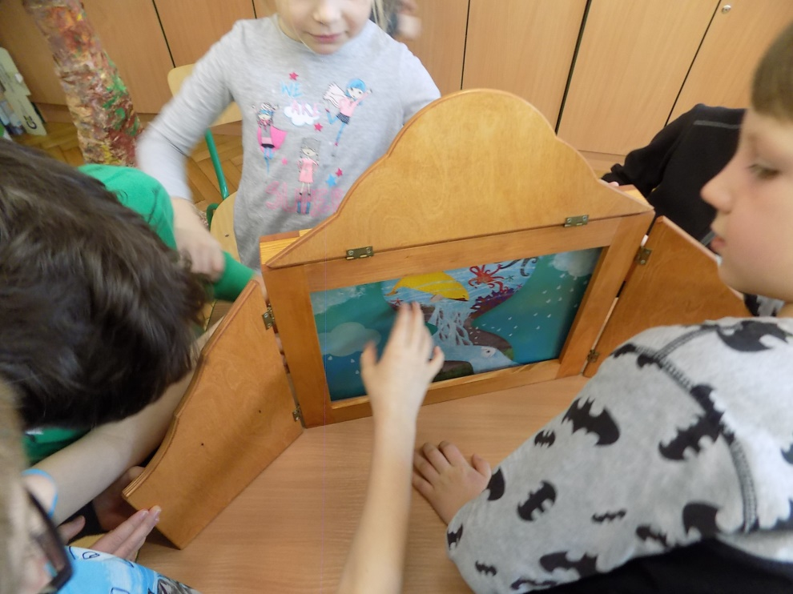
This story has aroused great interest, because we have watched such a theater for the first time ever

Slide 6
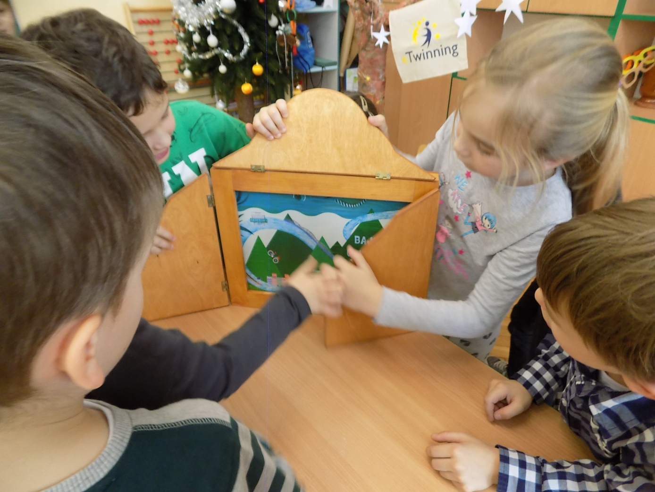

Slide 7
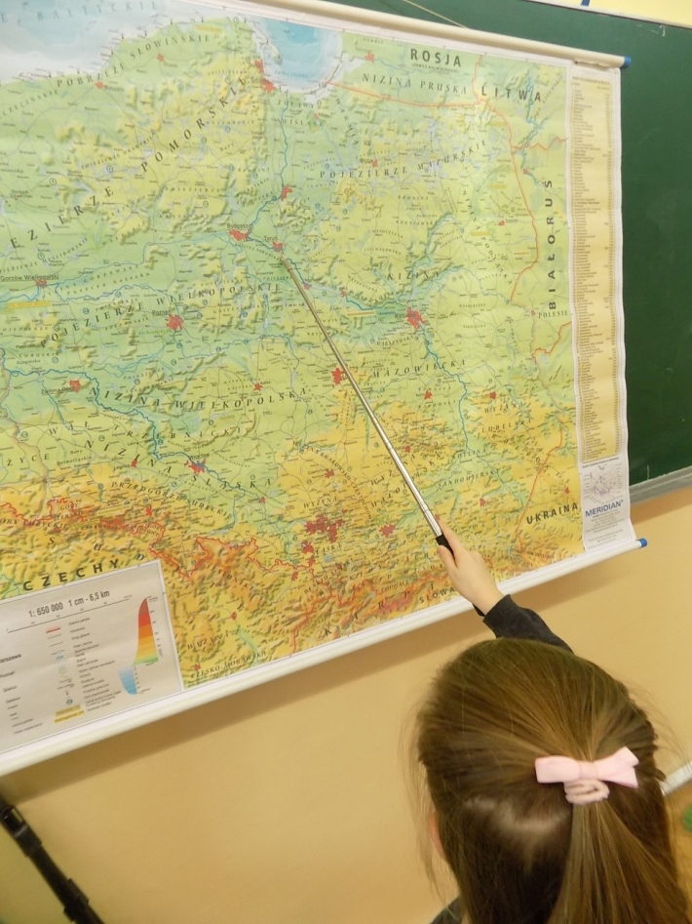
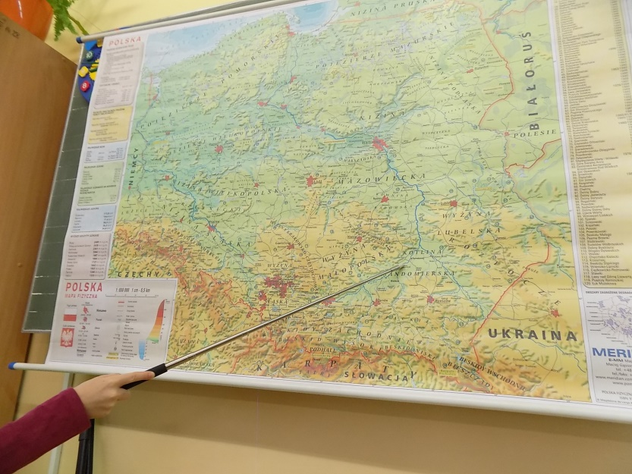
Then we were working with a map. We got to know the course of the Vistula, its tributaries, cities it goes through, and
the Baltic Sea which it falls into

Slide 8
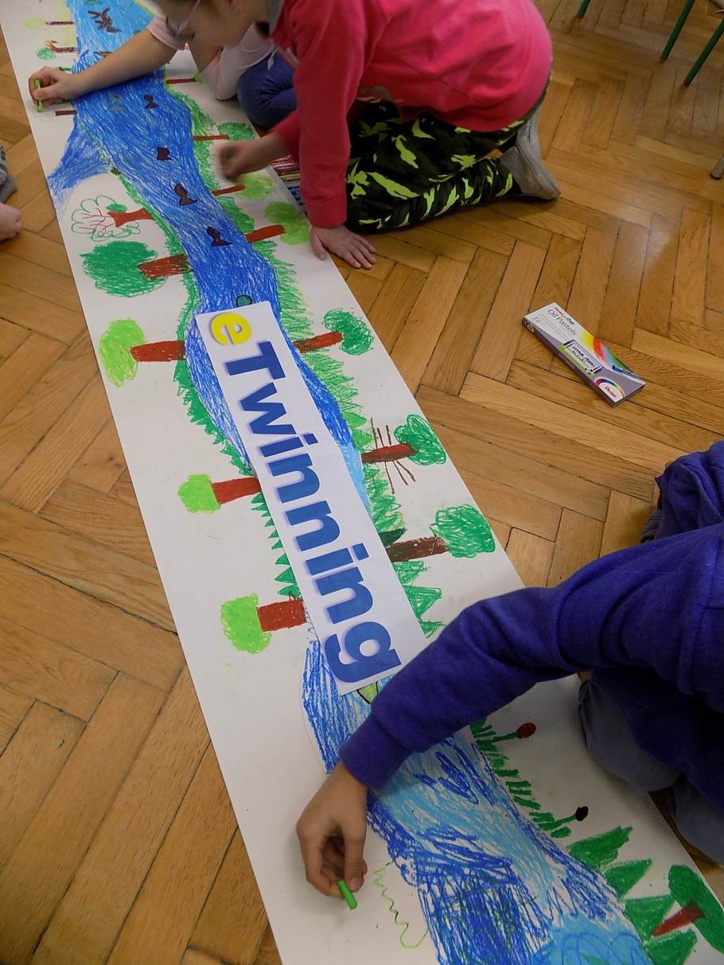
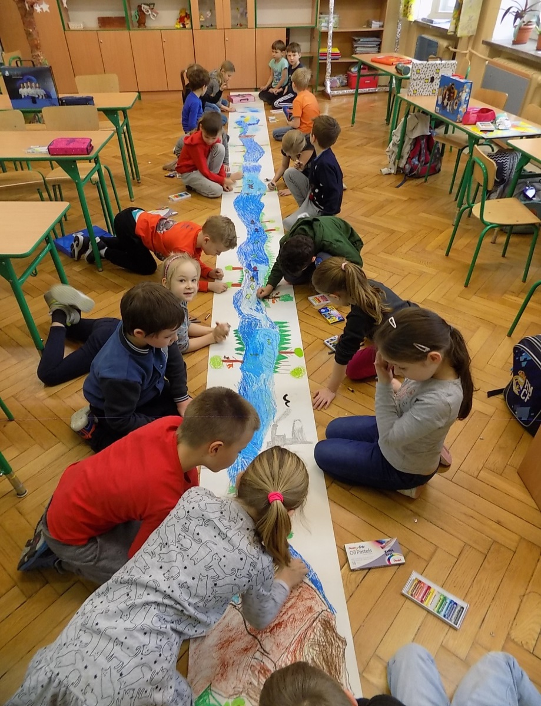
Then we drew the Vistula from the spring to the estuary. We told as long a story as the river itself is ... and so was our drawing :-)

Slide 9
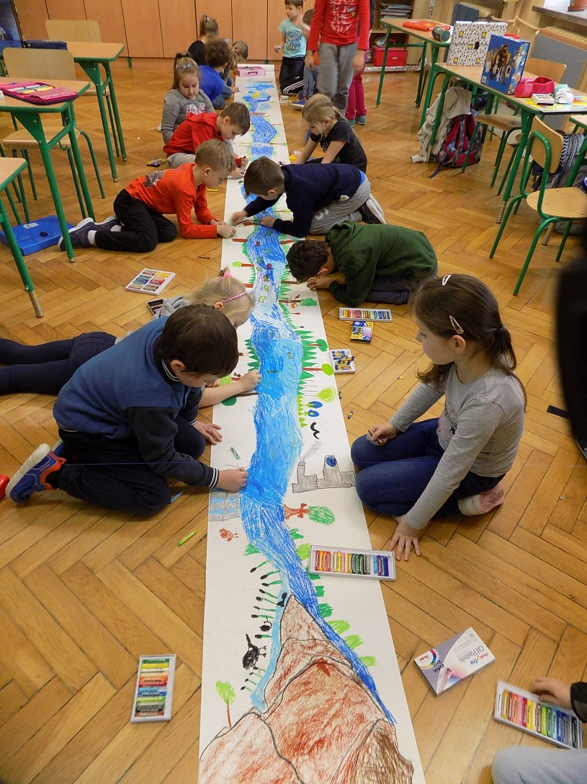
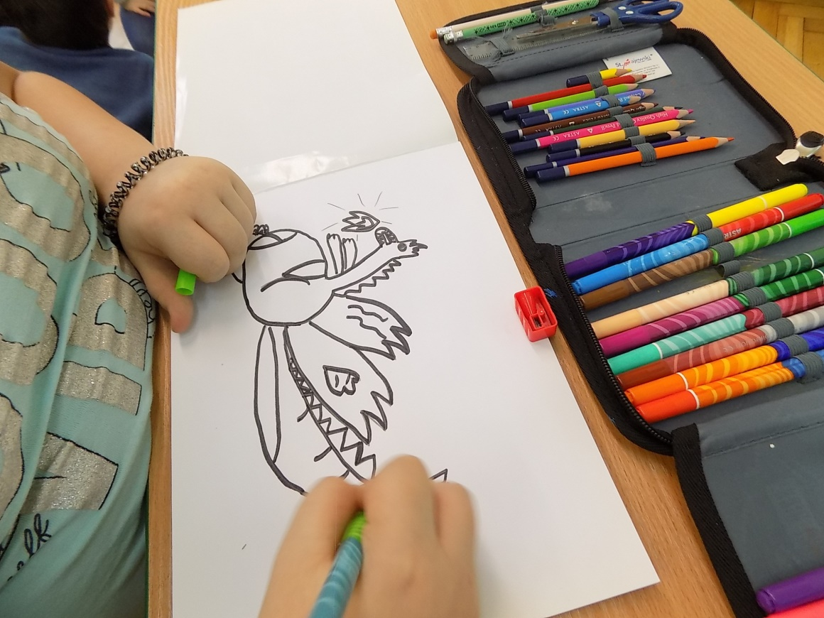

Slide 10
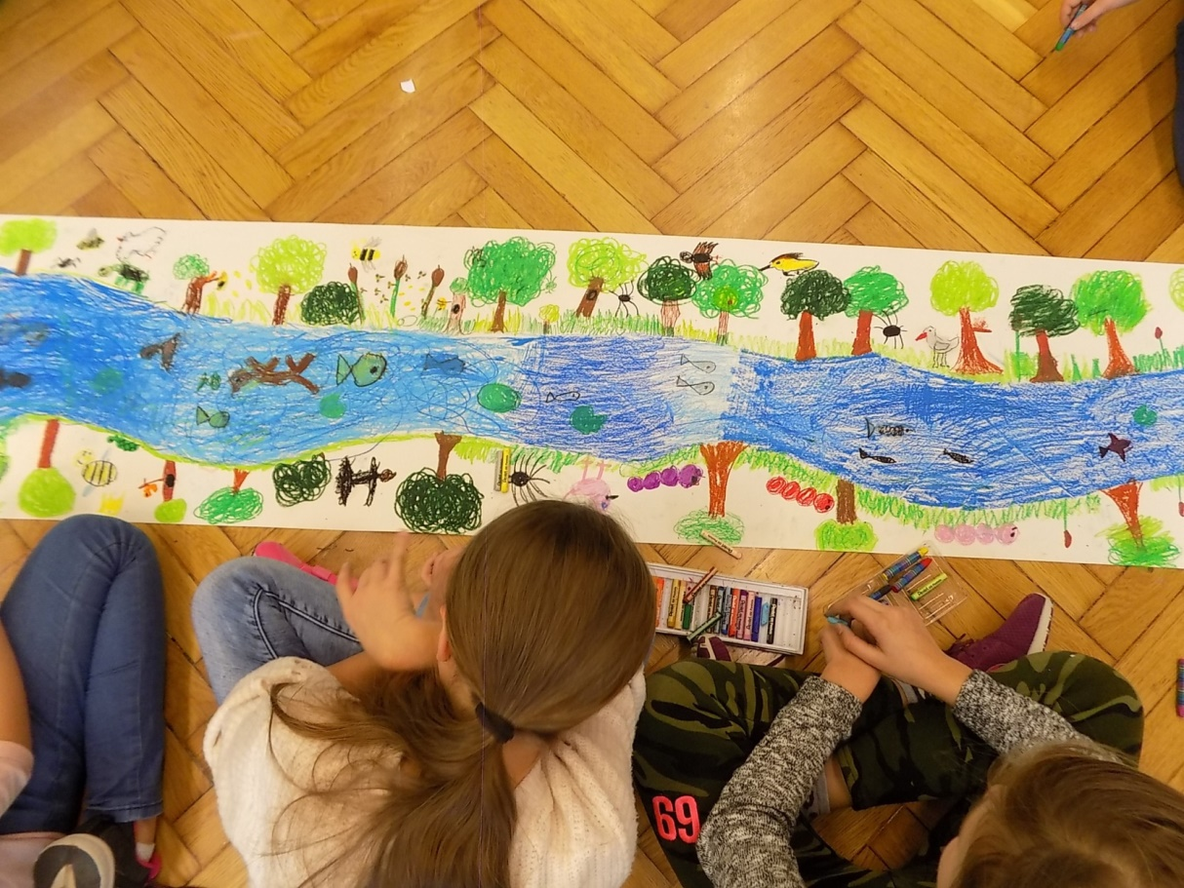
We also learned a popular Polish song about the Vistula river and we encourage you to listen to it

Slide 11
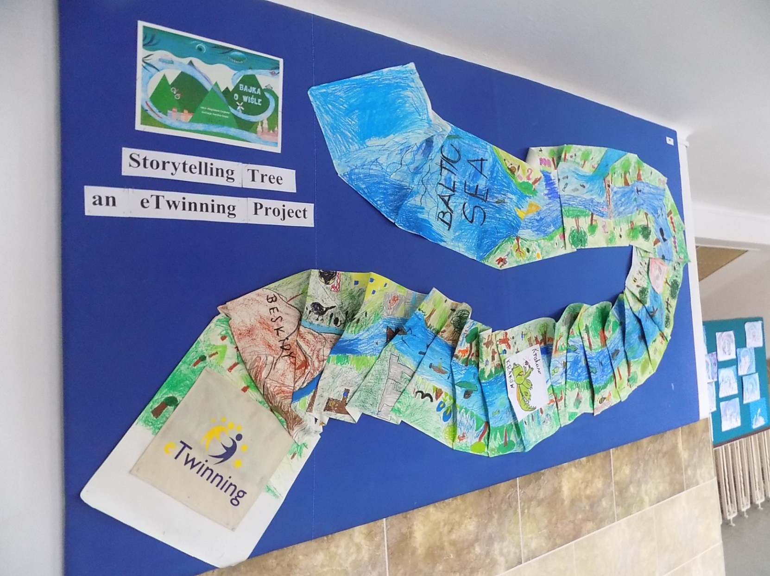
At the end, we pinned our work to the exhibition board in our school corridor

Slide 12
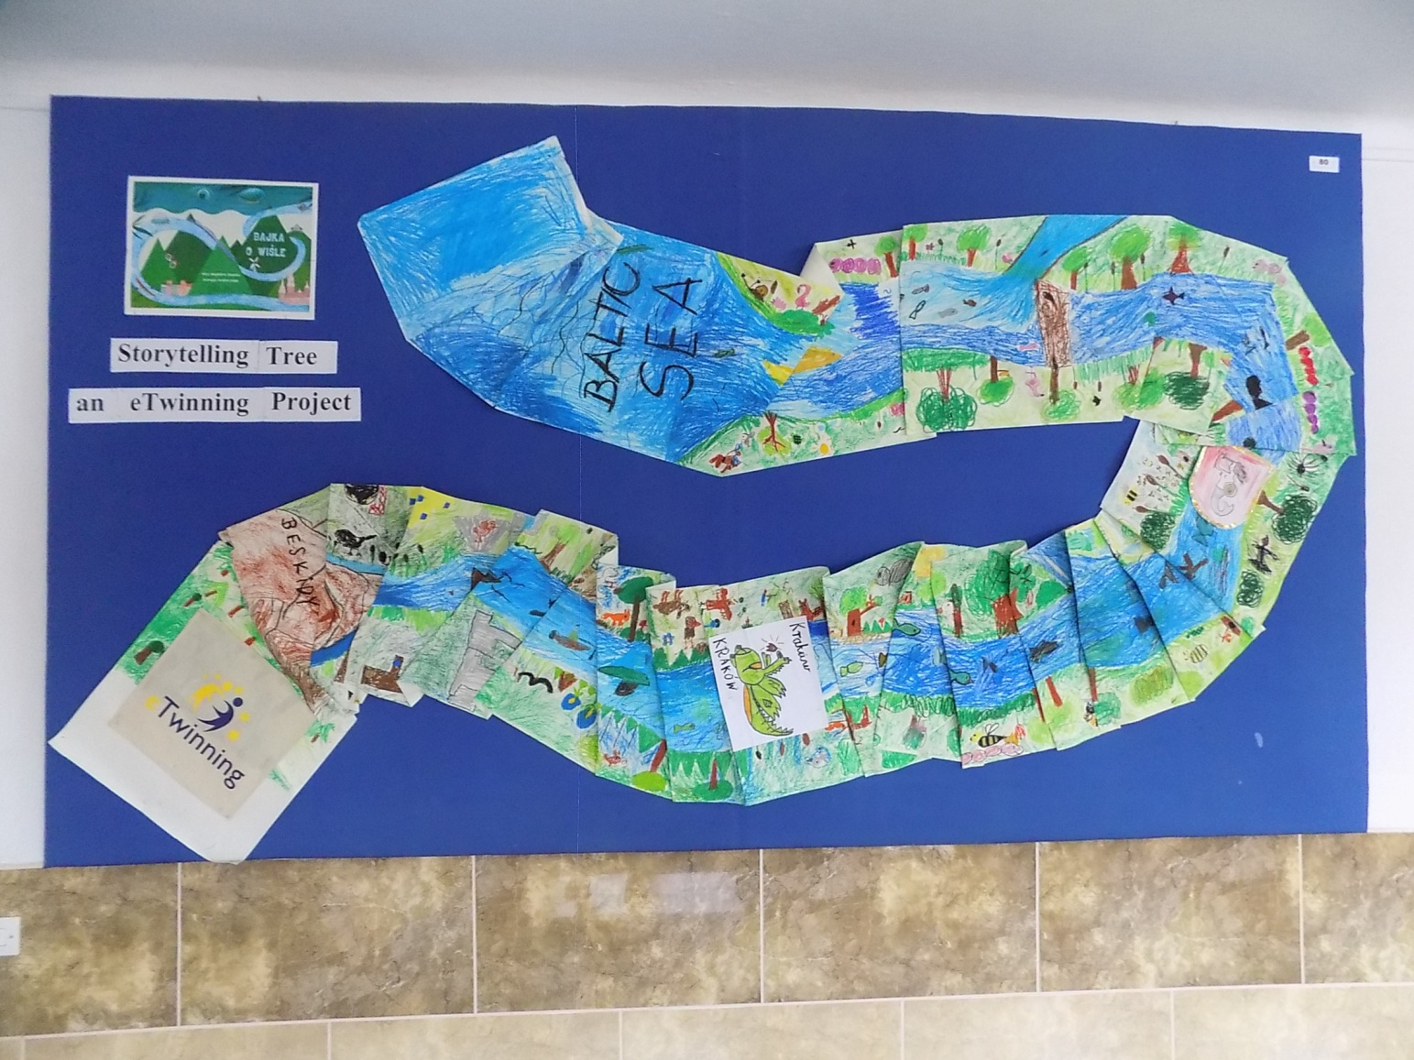
Thank you ☺

