Slide 1
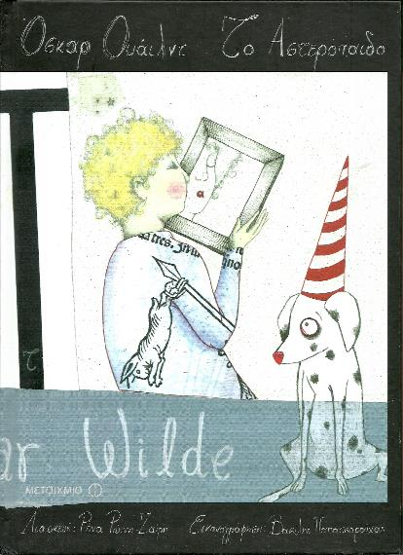
The Star child
A lesson with Second Grade students, taught creatively in collaboration with the special education teacher and attended by their parents

Slide 2
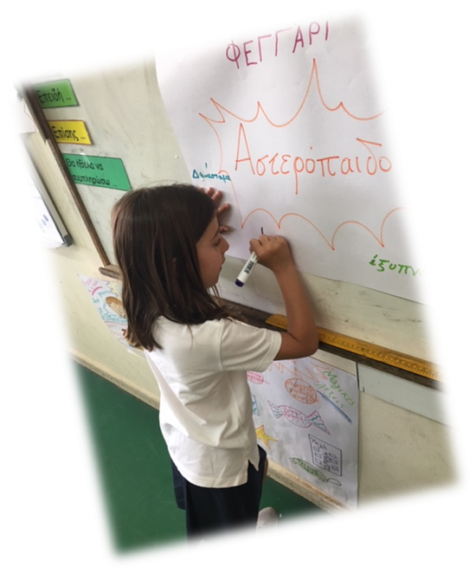
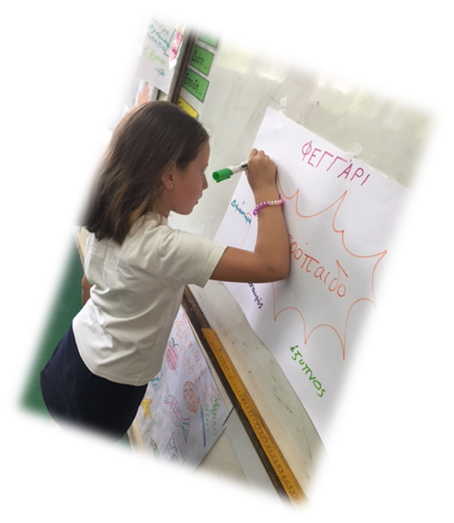
Brainstorming
Diamond
treasure
moon
pearl
The starchild
clever
space

Slide 3
This is us, writing the story!

Slide 4
Then our parents came to our class

Slide 5
And together we built “The storytelling mountain”

Slide 6
We worked in groups

Slide 7
And we wrote our feelings on post-it notes and placed them on our mountains

Slide 11
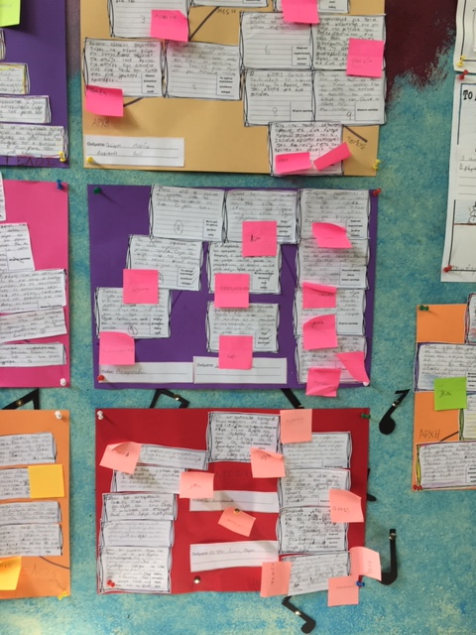

Slide 12
Then we drew the figure of the starchild

Slide 15
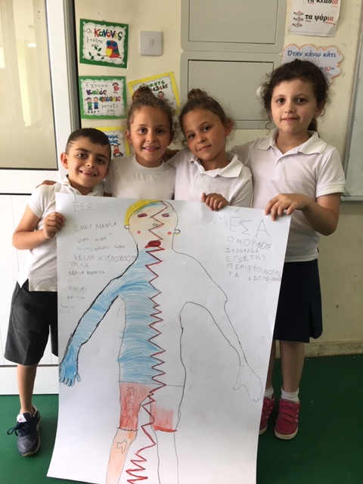
You should have a look!

Slide 16
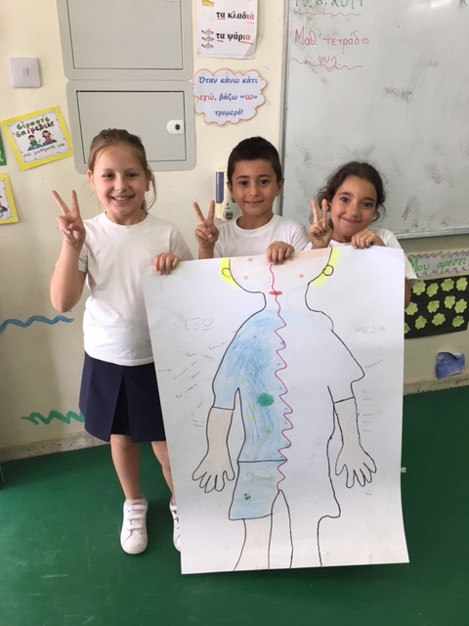

Slide 17
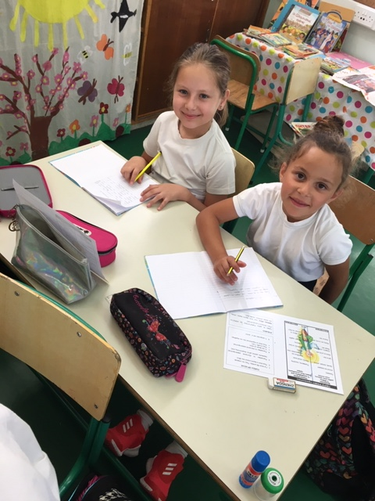
A few days later we wrote the description of the starchild!

Slide 18
We did a great job!

Slide 19
