Slide 1
The Legend of Melusine
How does France and Cyprus are connected
Students of Arediou Primary School, Cyprus
February 2019

Slide 2
The Legend of Melusine, the first Queen of Cyprus
Once in Poitiers, France, there lived a royal family, the king, the queen and the beautiful daughter, Melusine.
But the queen had put a curse on Melusine because he betrayed her father. Thus, Melusine was banished from the palace.
Free PowerPoint Templates

Slide 3
Then, she decided to go to the castle of the king, Raymonde. When she came there, there were many people, all waited in line to see the king, Raymonde.
After many hours passing by, the turn of Melusine came. When the beautiful Melusine approached the king, the king, dazzled by her beauty and asked:
- Do you want to be my wife?
- I accept, my king, but with a condition. Every Saturday and Sunday I'll be living on my own in my room.
- But for what reason?
- Because I have a curse and you won't have to see me on the Weekends. Don't ever ask why. If you ever see me, I'll have to leave the palace and walk away from you forever.
Free PowerPoint Templates

Slide 4
The king accepted the terms and conditions of Melusine and in a few days were married. In the years that followed acquired eleven children. Their kids were kind of weird and ... different. Others had tails, others had three eyes, or three arms or three legs. The king was sure that this happened because of the curse of the Melusine.
Free PowerPoint Templates

Slide 5
After the years passed, the curiosity of the king was growing and was in a great dilemma. He wonder if he should see the Melusine and find out the secret, or maybe he stayed faithful to his promise? Since he couldn't decide himself, he called one day, all his workers: servants, knights, cooks, counselors, even the jesters.
Free PowerPoint Templates

Slide 6
- Well, what do you think? Shall I see Melusine or not? He asked.
- No, you shouldn’t, everyone told.
Everyone, except one counselor, who was jealous and wanted to steal the throne. He advised him to break the promise he made to his wife and she finally knows what's going on with her.
- Me, my king, I'm telling you, you have to see Melusine to ease your anxiety and to calm down finally.
But if something happens to Melusine, I will follow her, wherever she goes.
The counselor, upon hearing this, smiled slyly and said:
- Then, definitely go see her. Tonight.
Free PowerPoint Templates

Slide 7
The king was just outside the window and all that was left was to pull the curtain. Once he opened it, he saw ... Melusine. But what did he see in front of him? His wife was a ...mermaid! Then the Melusine jumped into the sea and she disappeared from the palace. After swimming for days and days, she reached a beautiful island, Cyprus.
Free PowerPoint Templates

Slide 8
The King followed her, as he said, along with all of their children. They melted forty pairs of iron shoes, when they finally arrived in Cyprus. Thus, Melusine became the first queen of Cyprus, and the first kings were named Lusignan, while the period that followed was called Frankish Rule.
Free PowerPoint Templates

Slide 9
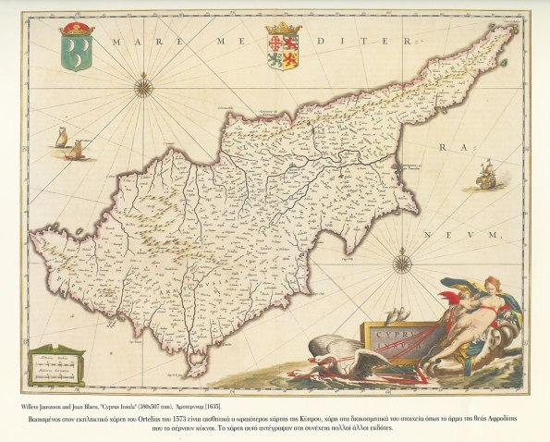
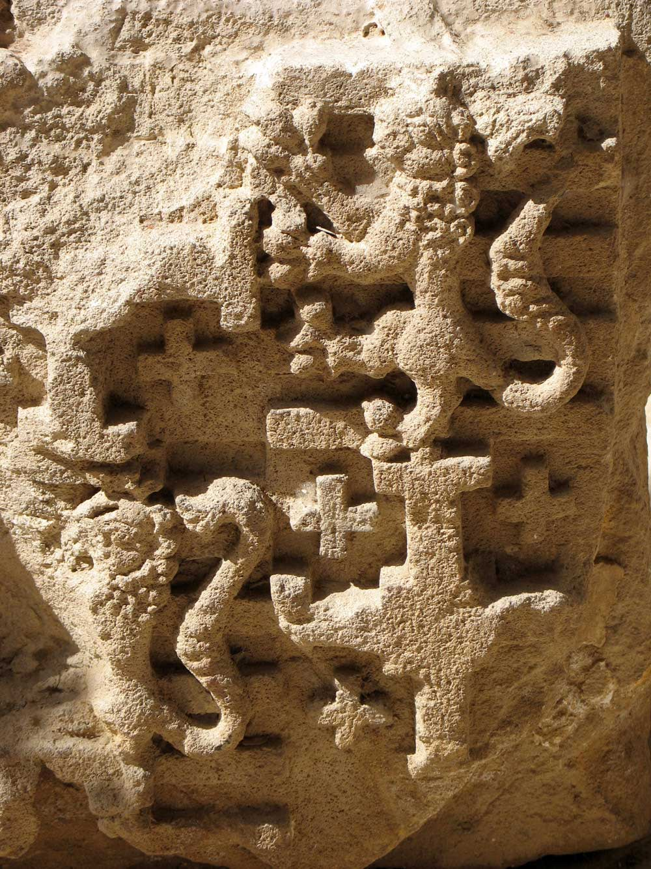
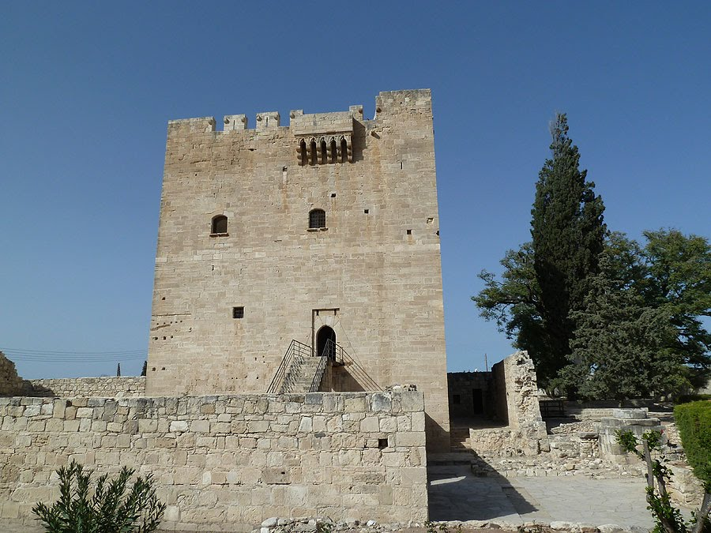
A little bit of … History
In 1191, with the occupation of Cyprus by Richard Lionheart, an important period of the history of Cyprus, centered around Nicosia, began. The Island ends after a very short time from the Order of the Templars in the hands of a family of French nobles from the Poitiers in Central Central France, who set up a Nicaraguan feudal kingdom known as the Medieval Kingdom of Cyprus.
The period of Frankish rule (1191-1489) was an important period in the history of Cyprus. It linked Cyprus with the European civilization, which at that time was in its absolute development, without disconnecting it from its Greek, Byzantine and eastern origins.
Despite the fact that the people of Cyprus lived under very difficult conditions, the Lusignans left their traces in toponyms, in art, in the soul of the people, but eventually assimilated and gave the place a more cosmopolitan spiritual and cultural character.
Free PowerPoint Templates

