Slide 1
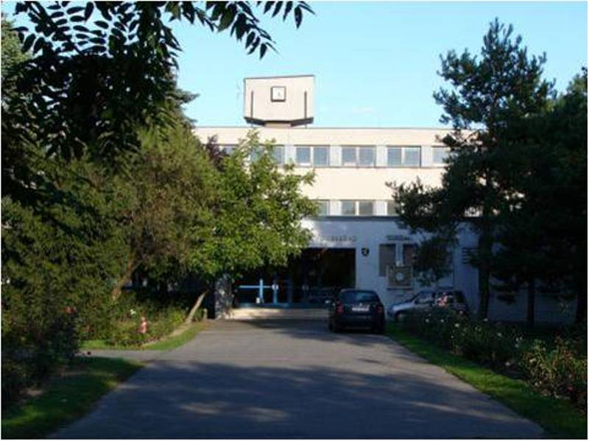
Gymnázium Ladislava Novomeského
By: Alex Rusňák, Viki Kaľavská, Jakub Srogoň, Sofia Mačurová, Branislav Udič

Slide 2
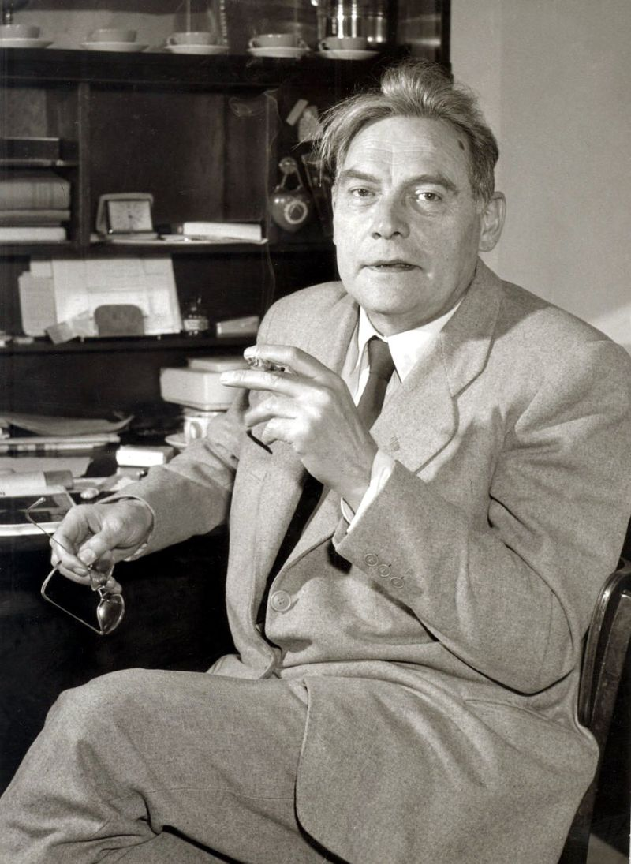
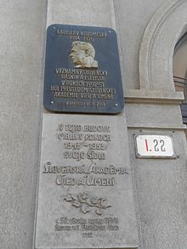
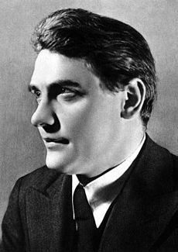
Ladislav Novomestský
He was born in Budapest, capital city of Hungary.
He was a Slovak politician, left-wing intellectual, poet, editor, redactor and journalist.

Slide 3
History
The school was founded in 1964.
There have been two headmasters: Jozef Filan (1964–1991), Ing. Norbert Kyndl since 1991
It has been involved in many activities like the Green School program

Slide 4
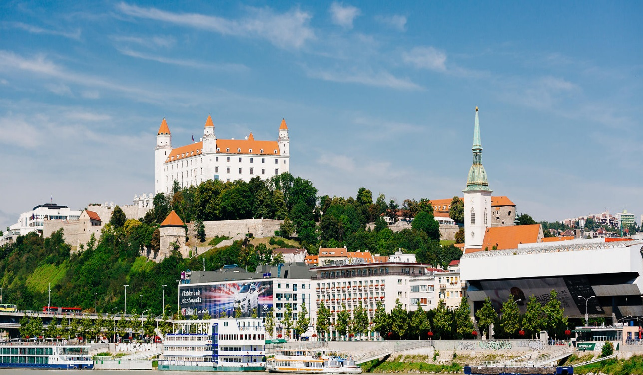
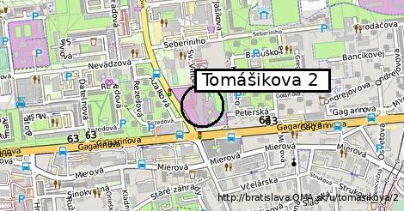
Location
Our Gymnasium is situated in Bratislava, part called Ružinov.
Our school is on Tomašíkova 2 street.

Slide 5
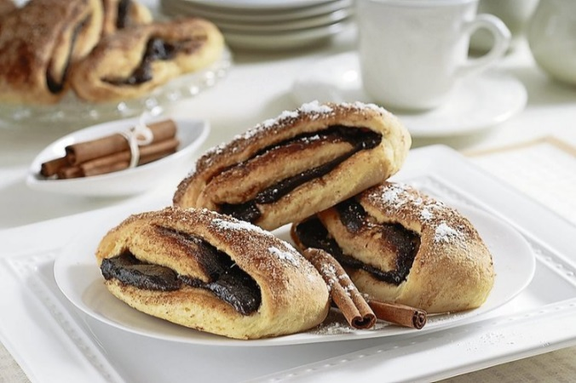
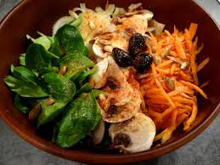
CANTEEN
Every day we can
choose
from
3 tasty meals.

Slide 6
Events
Happening
Dance break
Sport day
School olympics
Swim day
Pie contest
Healthy breakfast
Recycling of papers and batteries

Slide 7
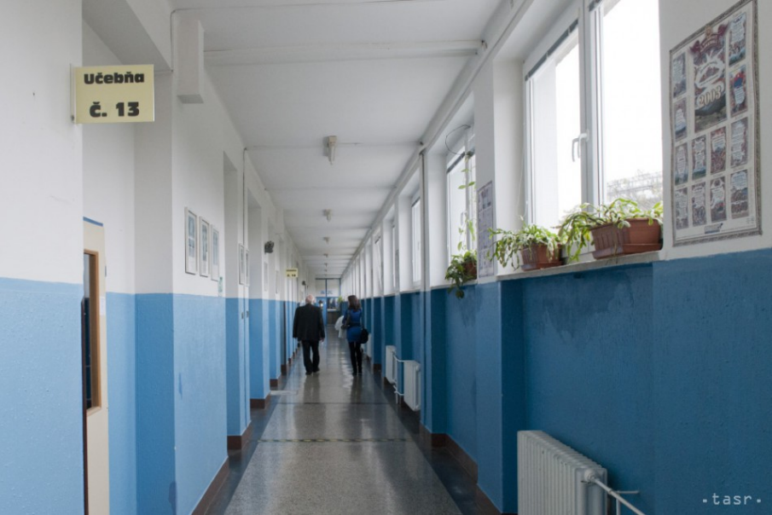
Classes
3 labs
7 language classrooms
3 computer classrooms
19+ total classrooms

Slide 8
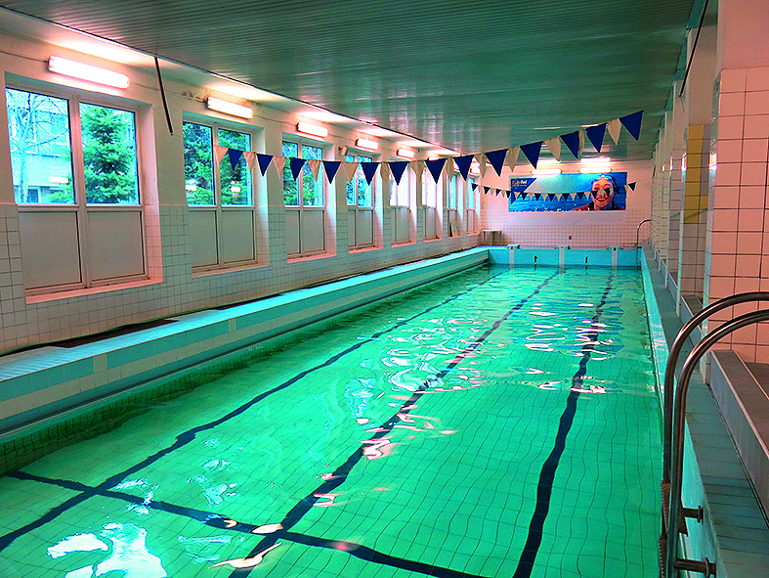
SWIMMING POOL
We are the only school with a swimming pool in Bratislava. Swimming is mandatory for every student.

Slide 9
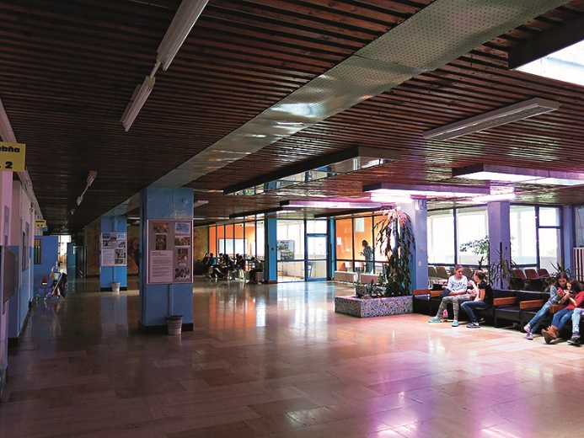
If you enter our school you will see this

Slide 10
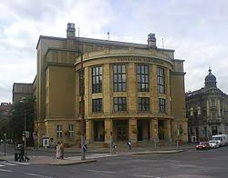
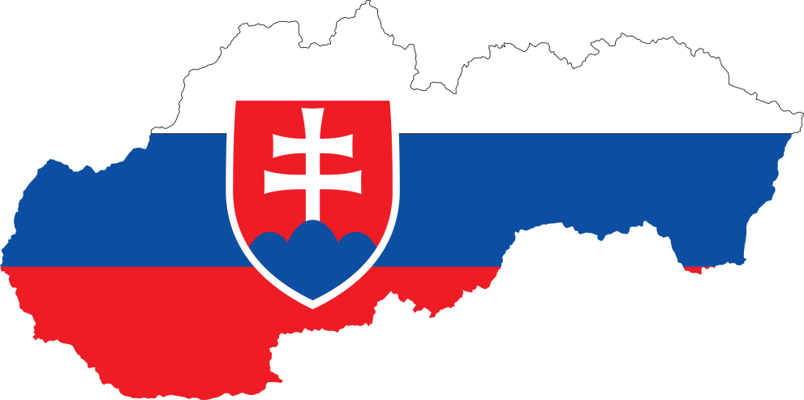
Slovakian schooling
by Filip Kemp

Slide 11
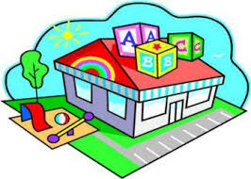
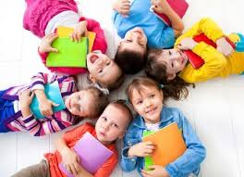
Kindergarden
children from 3-6 y.o.
Voluntary, but a child has to visit Kindergarden at least the last year
if neccesary, a child can go to Day Care, voluntary
In Kindergarden children can join activities like a language or sport training

Slide 12
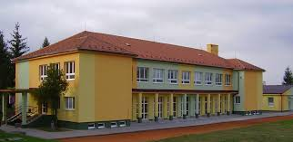
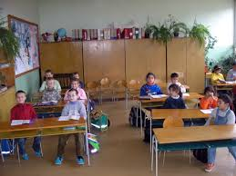
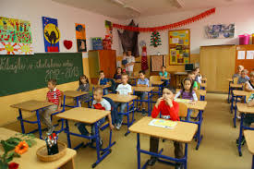
Elementary school
when a kid reaches the age of 6, it becomes a pupil of an Elementary School
the duration is 9 years
after that the pupil can choose to continue learning at following types of schools:
Apprehensive School, Secondary[High] School, Secondary Grammar School, Secondary Art School called „Konservatorium“

Slide 13
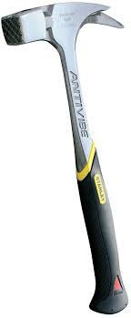
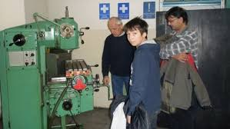
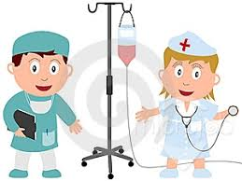
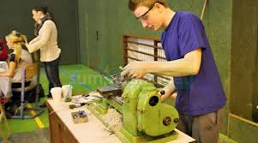
Apprehensive and Secondary (High) Schools (SS)
focused on practical education in various fields: gastronomy, technical sphere, etc.
most popular SGS (High) Schools are Secondary Pedagogical Schools, S. Medical S., S. Hotel S., S. Technical S., S. Electrotechnical S., S. Economy S.

Slide 14
Secondary Grammar Schools [SGS]
prepares students for University [College]
8 years SGS – for children reaching excellent results after a special exam, covers second level of an Elementary School and SGS [end by graduation]
compulsory school attendance is in the Slovak legislative system defined as 10 years

Slide 15
Universities (U)
divided generaly into 2 main fields – technical or philosophycal - managed through special faculties
university education can be finalized by Bachelor or Master degrees [Bc., Mgr., Ing...]
university education can be extended up to the PhD. level/degree
university education ends by the State Exam
main universities in Slovakia: U of Comenius (UK Bratislava), U Mateja Bella (UMB Banská Bystrica), U Konštantína Filozofa (UKF Nitra), U Pavla Šafárika (UPŠ Prešov and Trnavská U (TU)

