Slide 1
lEGENDS

Slide 2
What is a legend?
Legend is a traditional story, that contains narrative, sometimes popularly considered as historical but not verified.
Legend is a genre of folklore, that features human actions or pleas, that are believed to take place in human history
Legends are retelled by tellers to their listeners
Each legend has an educational message

Slide 3
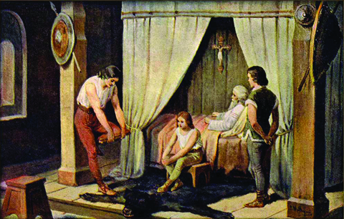
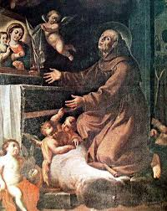
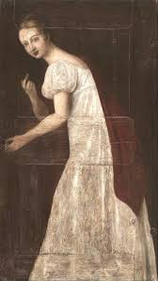
TYPES OF LEGENDS:
1.Historical
2.Religious
3.Urban

Slide 4
SLOVAK LEGENDS
The White Lady of Levoča
Elizabeth Bathory
Juraj Jánošík- our favourite
Three Twigs of King Svätopluk
The Well of Love
The Virgin Tower
Bratislava Castle
Hedviga

Slide 5
JURAJ JÁNOŠÍK-OUR FAVOURITE LEGEND
Juraj Jánošík is a Slovak national hero, called also the Slovak Robin Hood for stealing from the rich to give to the poor
He was an outlaw
Janosik is a beloved figure in Slovak folk art.
Janosik’s origins lies in Terchova – a town in Northern Slovakia.
This legend however doesn´t have a happy end, Janosik is caught and executed for stealing money.

Slide 6
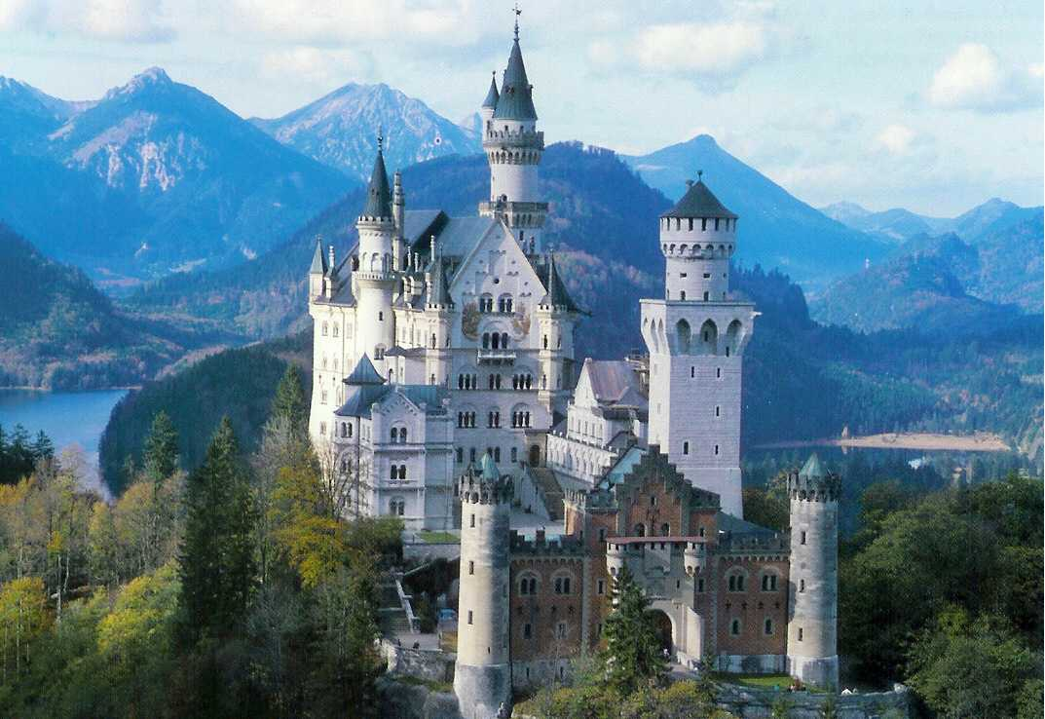
Fairy tales

Slide 7
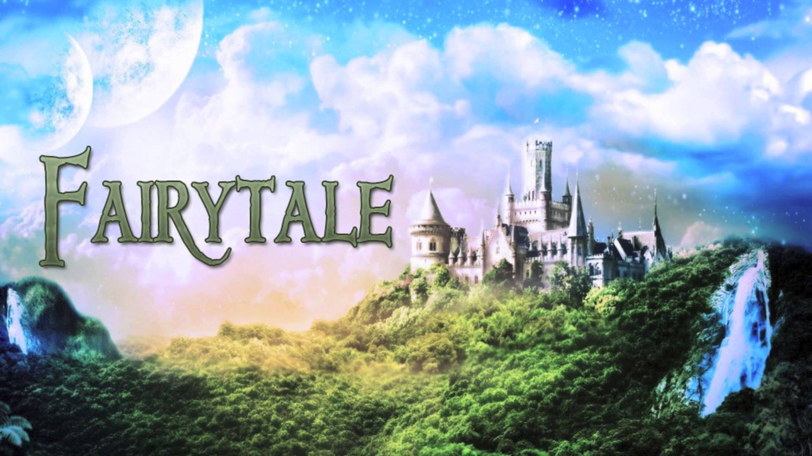
A fairy tale, wonder tale, magic tale, is a folklore genre . These stories typically have things such as dwarfs, dragons, elves, fairies, giants, mermaids, talking animals, trolls, unicorns, or witches, and usually magic

Slide 8
Sometimes the term fairytale is used to describe something happy. For example ´´fairytale ending´´ which means happy ending, or ´´ fairytale romance´´.
Fairytales have always good ending, the goodness is fighting against badness.
They have gnomic time, which means, that you don´t know when it´s happening.

Slide 9
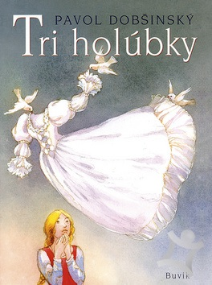
Slovak fairytales
Our fairy tales are:
1. Tri holúbky (three pigeons)

Slide 10
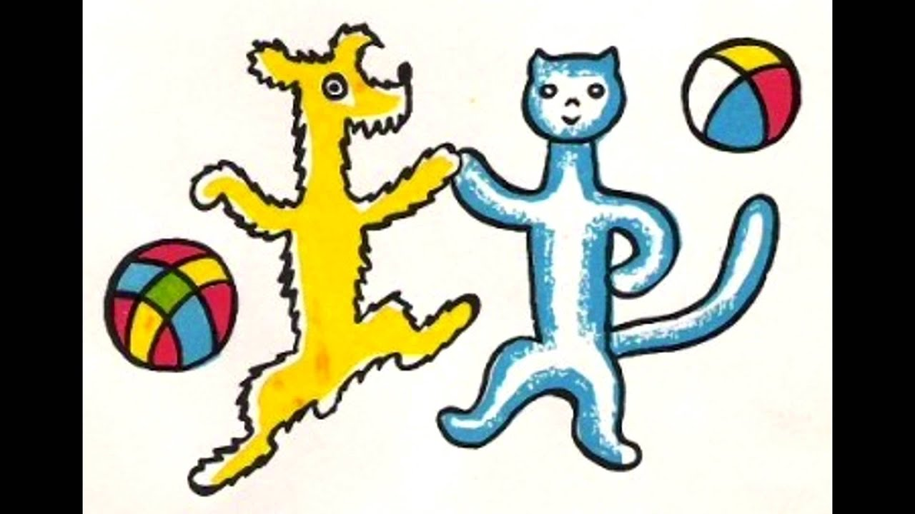
2.Psíček a mačička (The dog and the cat)

Slide 11
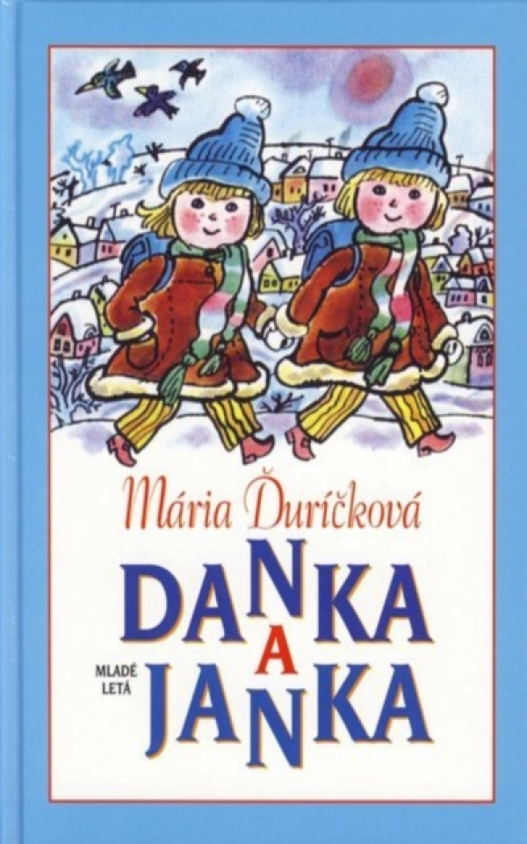
3. Danka a Janka (Danka and Jane)

Slide 12
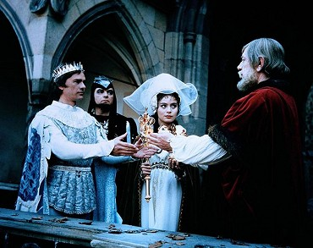
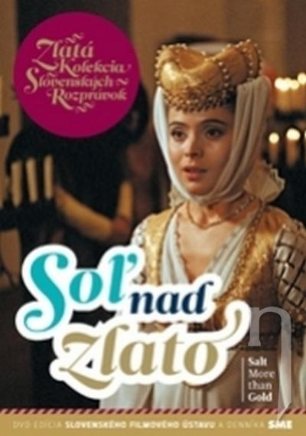
4. Soľ nad zlato (Salt more than gold)

Slide 13
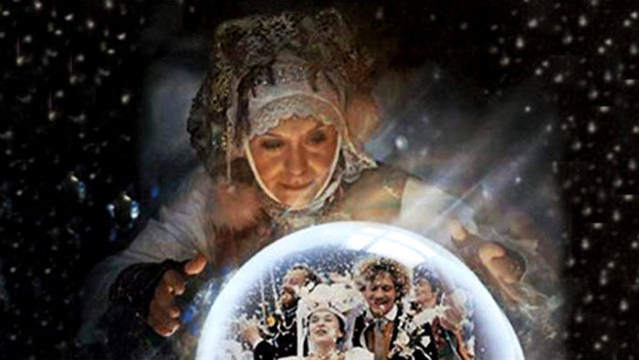
5. Perinbaba ( The Feather Fairy)
And a lot more...

Slide 14
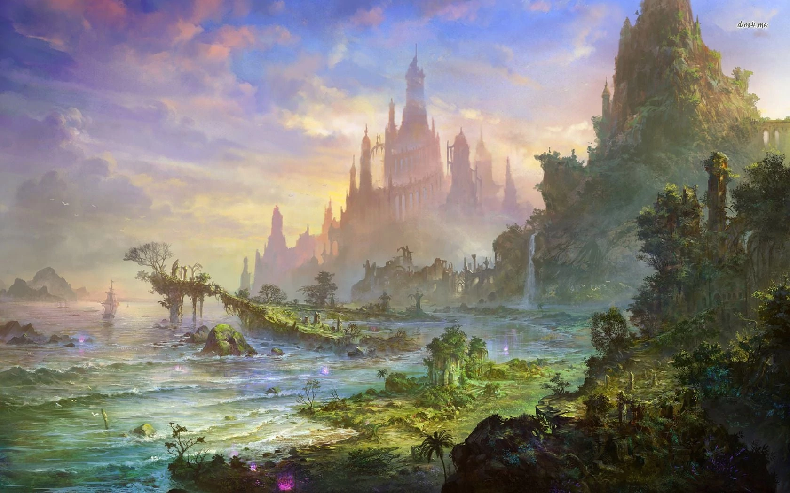
Here are links for some trailers:
The feather fairy : https://www.youtube.com/watch?v=dB-O5UMFTZk
Salt more than gold : https://www.youtube.com/watch?v=v9vCh06PoZc

Slide 15
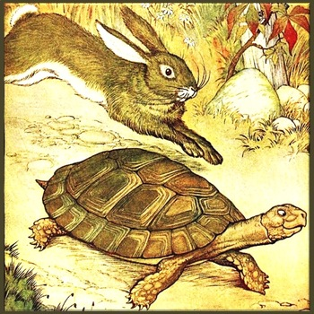
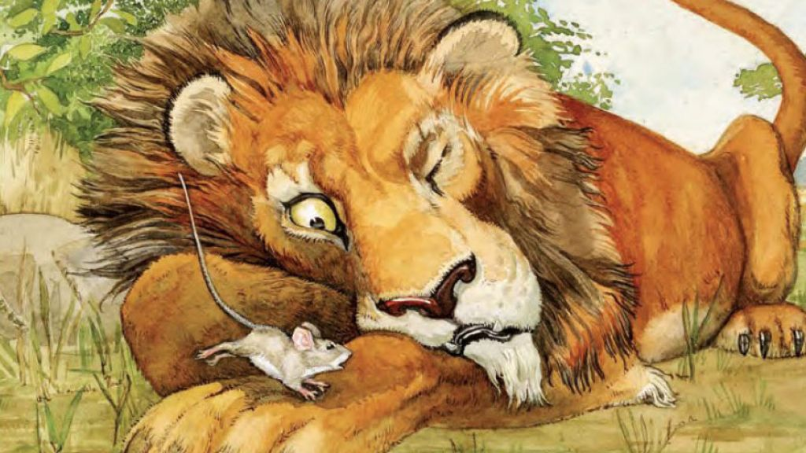
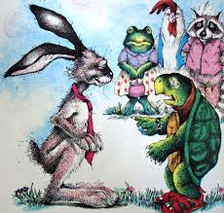
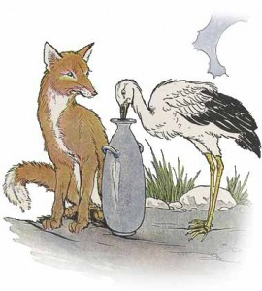
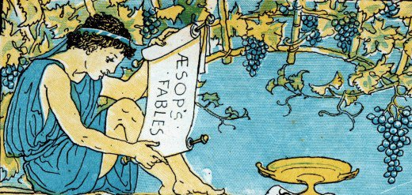
Bajka
Fabulă
Bájka
Fables
μύθος
Fábula
Petra Lukovicsová
Ester Hlaváčiková
Kvarta B

Slide 16
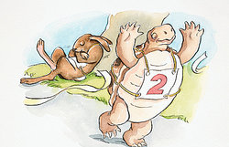
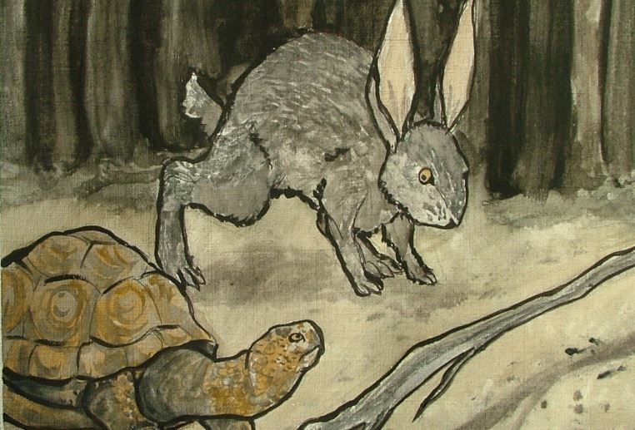
WHAT are Fables?
Fables are short, simple, fictional and traditional tales with a moral or lesson.
They were told thousands of years ago by storytellers in countries like Greece and Persia.
Characters are usually animals that behave and speak as human
Animals often have special qualities.

Slide 17
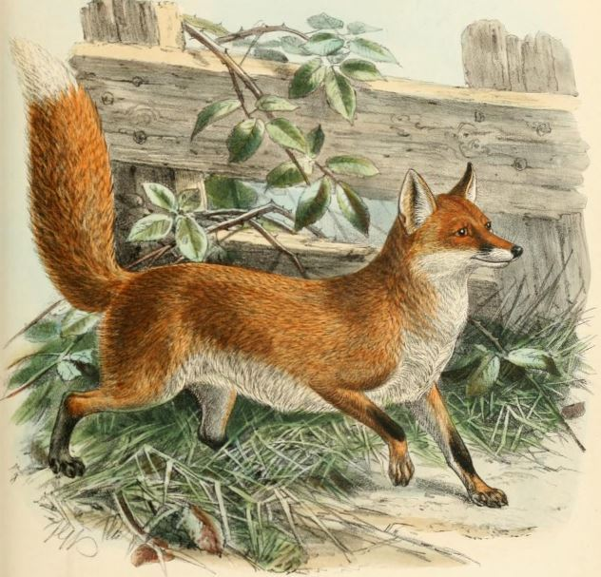
Elements of Fables
Satire
Irony
Allegory
Personification
Moral and lesson
Animals
Short story

Slide 18
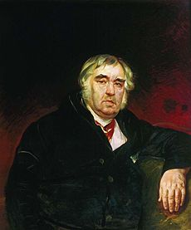
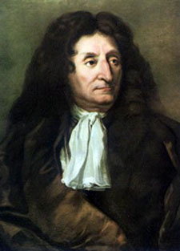
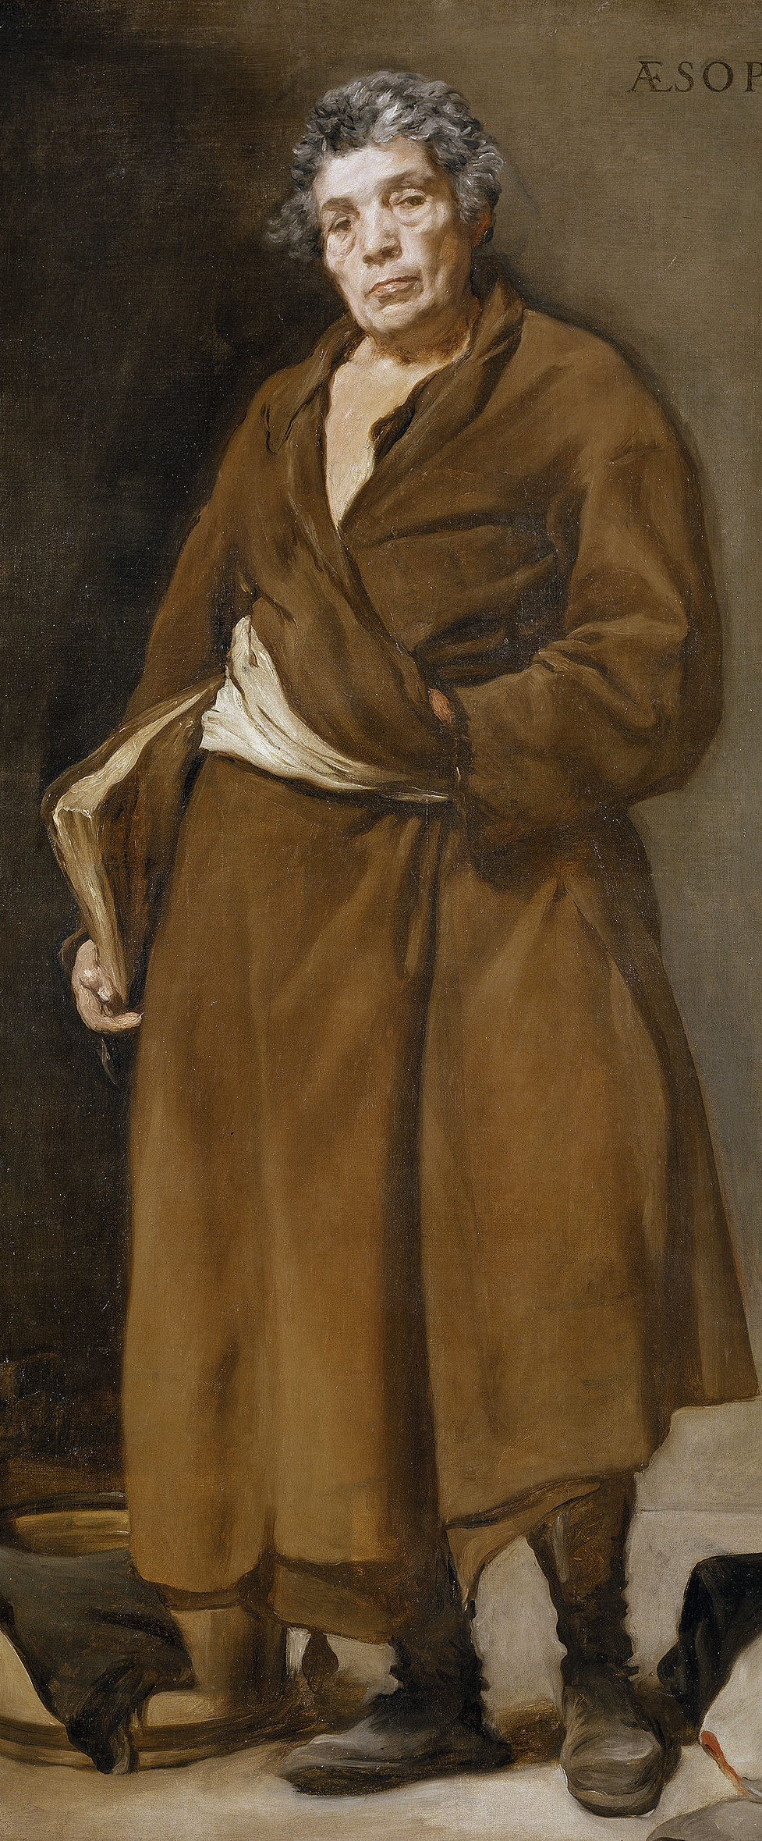
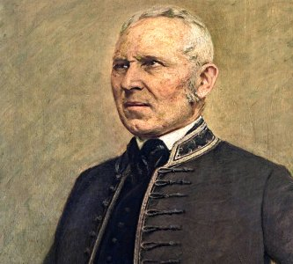
The most famous fabulists
Aesop
Jonáš Záborský
Jean de La Fontaine

Slide 19
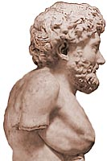
Greek fabulist- AESOP
Aesop was an Ancient Greek writer, fabulist and storyteller credited with a number of fables now known as Aesop's Fables.
He lived in the 6th century BC in Athens, Greece
Aesop was a slave of Frygia or Lydia
In his journeys he spoke and invented the fables that spread across the Aegean islands and Helade.
He wrote about 350 fables
All of the fables contain lessons at the end.
The heroes of his fables are mainly animals, but he also wrote fables in which people appeared, pointing to greed.
His works has become famous all over the world

Slide 20
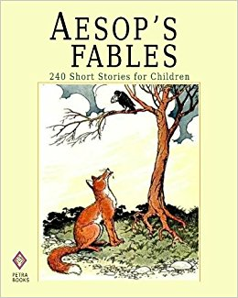
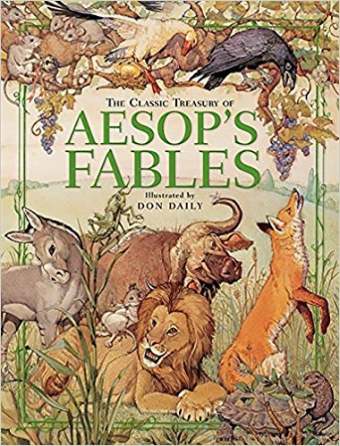
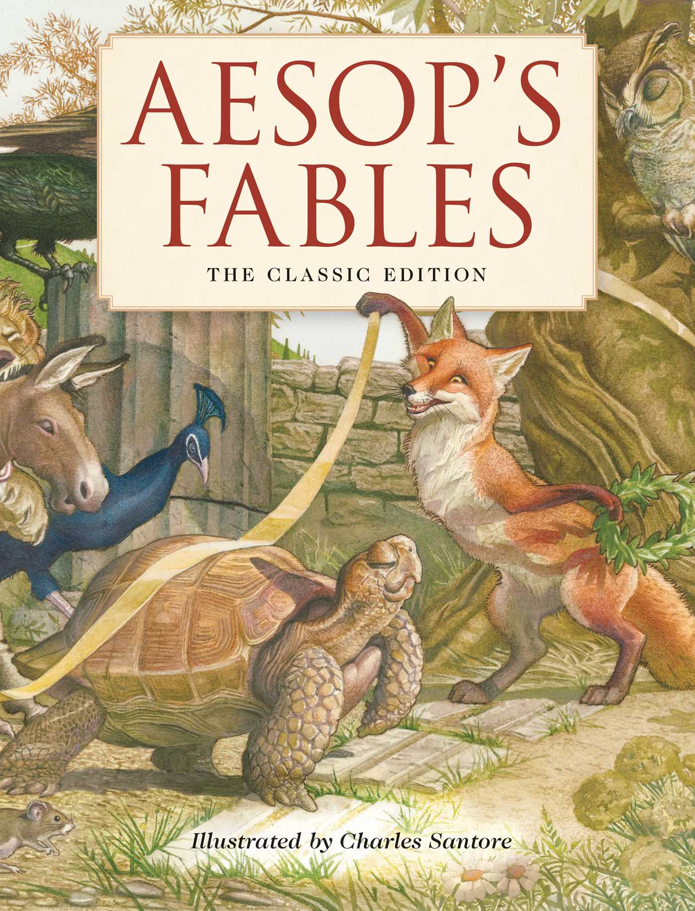

Slide 21
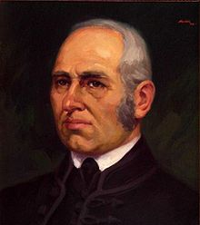
Slovak fabulist- Jonáš Záborský
Jonáš Záborský (1812-1876), Slovakia
He was a Slovak author, poet, prose writer, playwright, historian, journalist, who wrote a lot of fables, tales, epigrams, historical dramas, comedies and stories

Slide 22
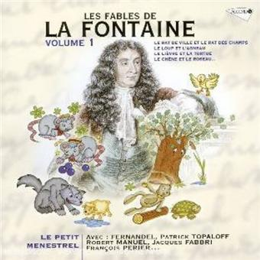
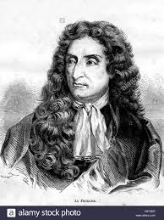
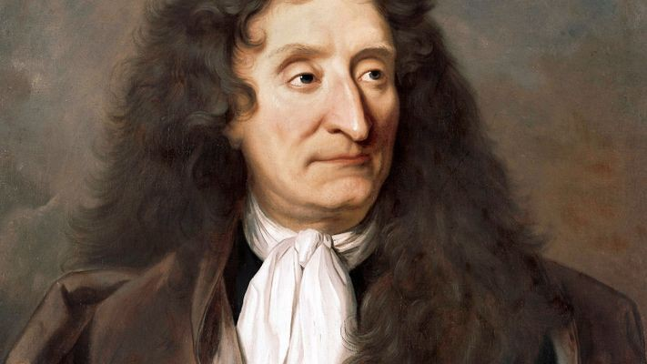
Jean de La Fontaine
(1621 – 1695), France
Was a French fabulist and one of the most widely read French poets of the 17th century.
He is the author of fables, fairytales, poems, theatrical plays, and operatic libraries.
He was inspired by antique writers and mainly Aesop, which led him to write fables.
His work „Les fables“ is considered as one of the greatest works of French literature

Slide 23
Mythology Jakub srogoň and Braňo Udič

Slide 24
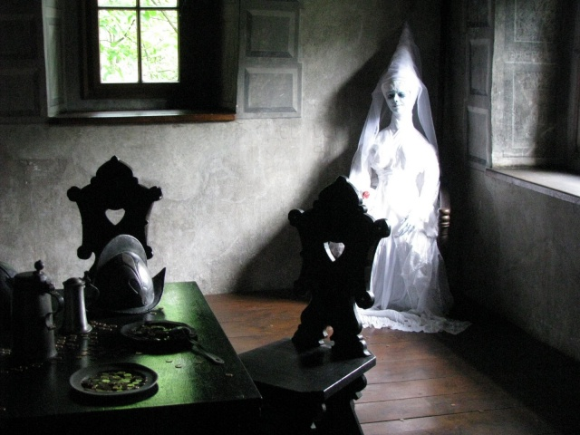
What is a myth?
a traditional story, about the early history of people, explaining a natural or social phenomenon, typically involving supernatural beings or events.

Slide 25
Types of myth
Creation myths describe how the Earth or a group of people came to be
Nature myths describe why something in nature is the way it is
Hero myths describe the quest of a hero or heroine
Greek and Roman myths describe the actions of gods and godesses

Slide 26
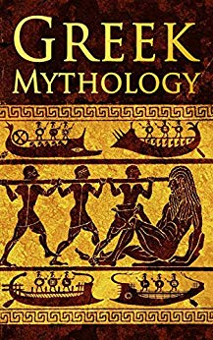
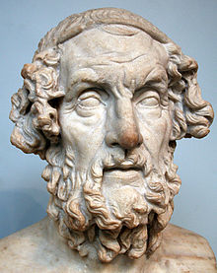
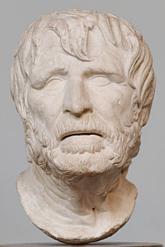
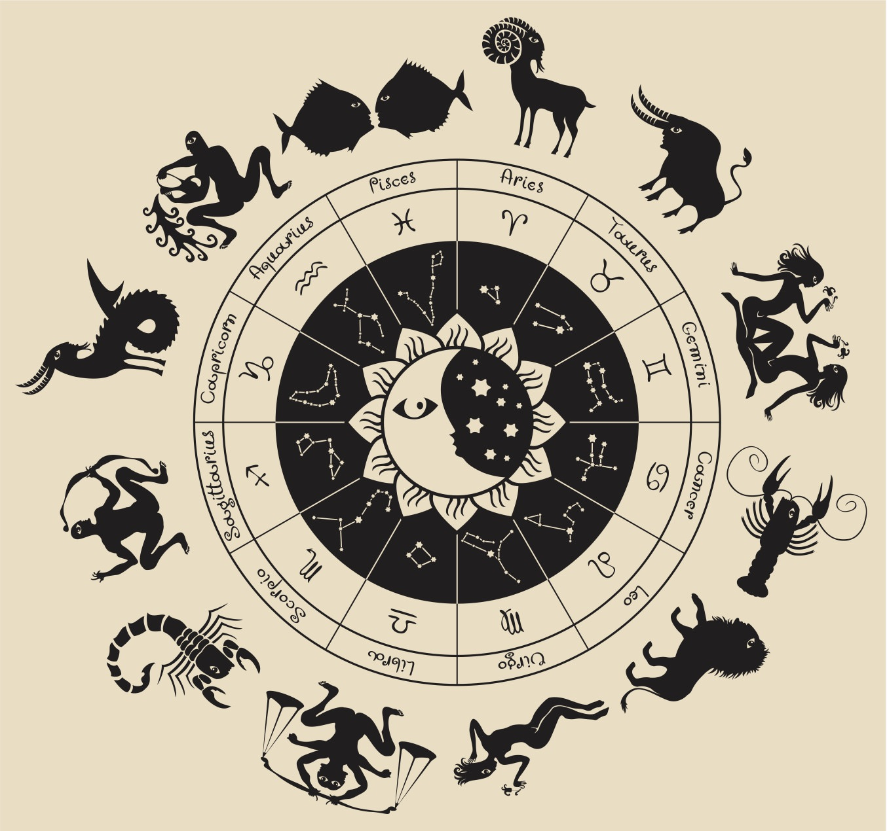
Greek Mythology
Are traditional stories of gods, kings, and heroes. They show the relations between gods and people. Mythology was a form of early science to Greeks because it helped explain the unexplainable
Greek mythology was fully developed by about 700 B.C. Homer and Hesiod are generally considered the earliest Greek poets whose work has survived

Slide 27
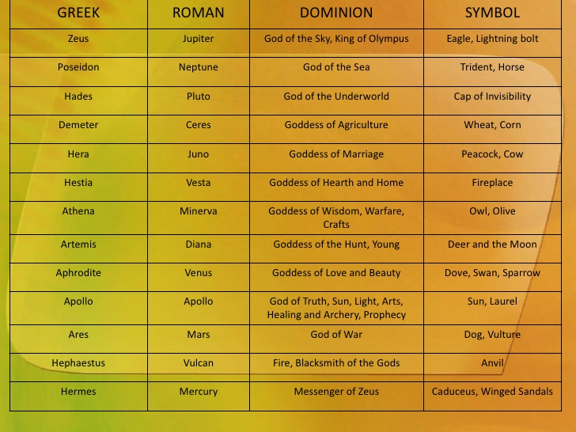
Here you can compare Gods from diffrent mythology

Slide 28
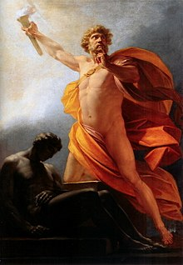
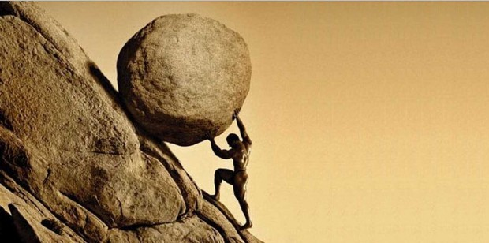
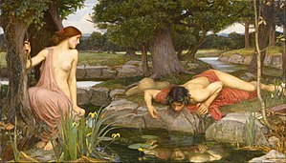
Most famous mythology stories
Heracles and the 12 labors
Prometheus and the theft of fire
Narcissus and Echo
Sisyphus
Perseus and Medusa

Slide 29
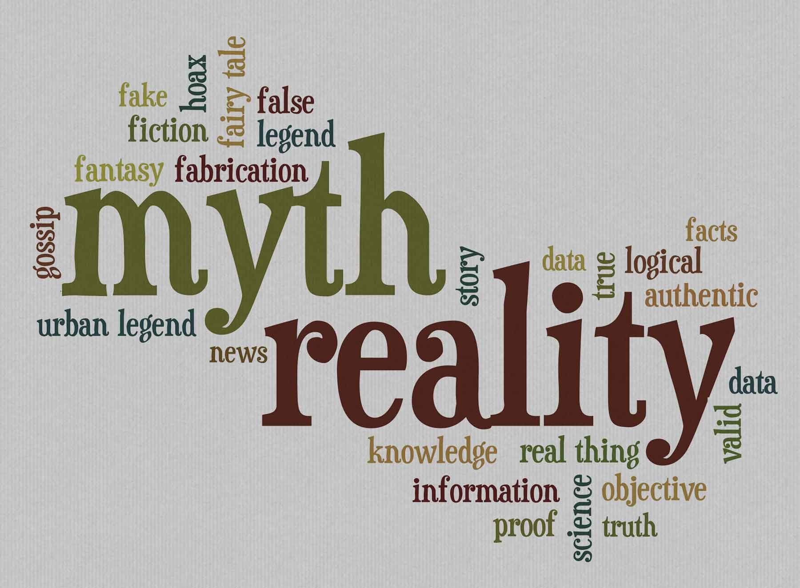
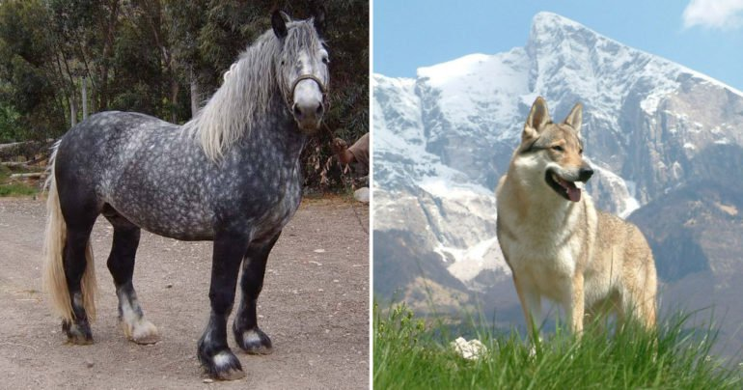
Mythology in our country
Our ancestors Slavs thought that natural forces were godlike beings.
Each Slavic tribe usually had its own God, whom they built a temple, where they venerated the God by sacrifing to it the most beautiful virgin of the tribe and also animlas.
Very important for our ancestors were animals.
Animals represented each tribe on their coat of arms
Horse symbol of war, wolf symbol of brave and
dog symbol of loyality

Slide 30
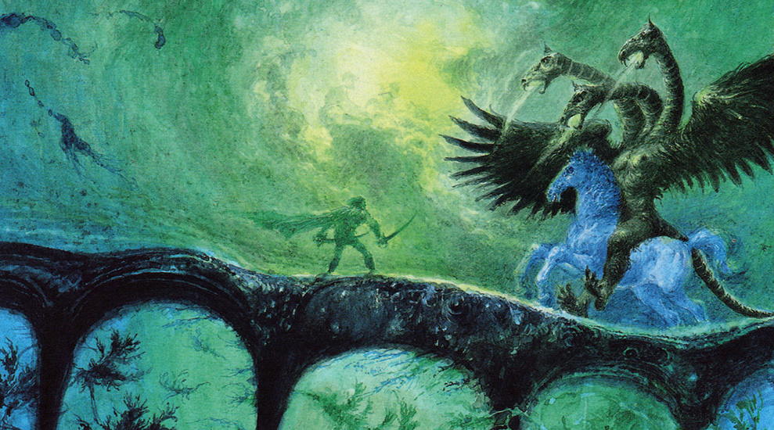
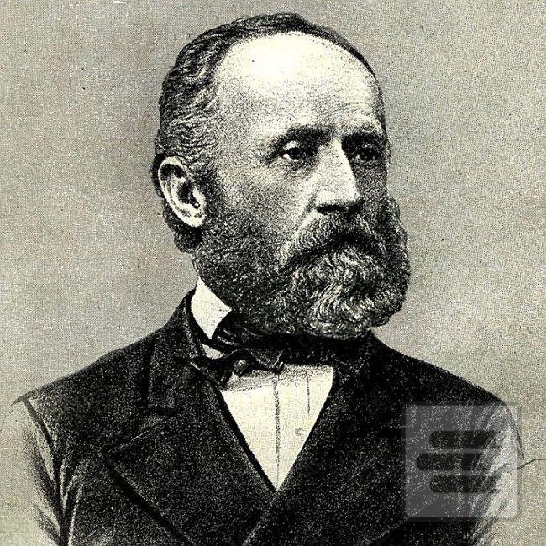
Pavol Dobšinský
16.03.1828 – 22.10.1885
He is said to by the writer of myths in our country
He collected many myths and legends about Slovakia
Pavol has released four books about slovak literature during his life

Slide 31
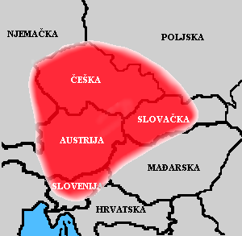
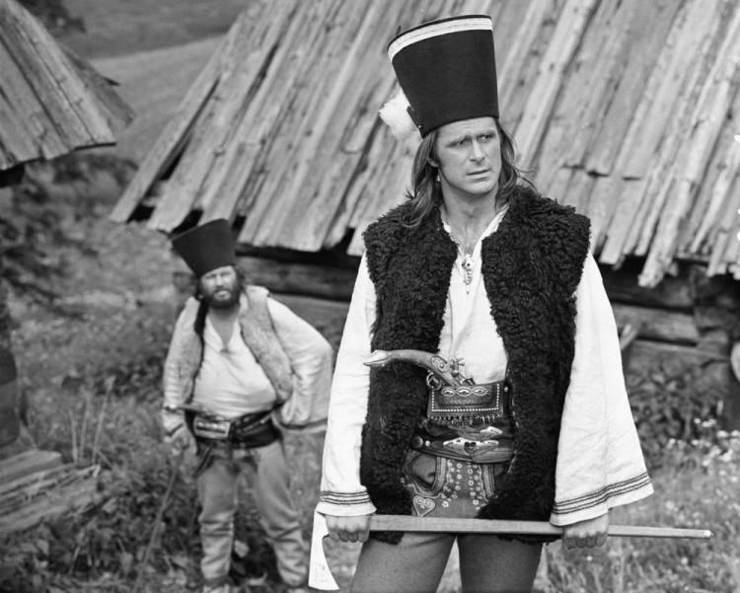
Eduard Krekovič Elena Mannová and Eva Krekovičová
This are the authors of this book. Book contains most known
myths in our country like: Jánošík, period of Great Moravia and
a lot more...

Slide 32
THANK YOU FOR YOUR ATTENTION

