Slide 1
Myth
Group 1: Jakub, Kristián, lívia, kLUKNAVA

Slide 2
What is it
A myth or a myth is an epic form in which a folk explanation is given about the phenomenon or thing that encourages man to think and is not obvious. Myths focus on an inner relationship with deities or "unknown." They reflect both individual and collective aspirations, needs and concerns. A collection of myths (especially of a particular ethnic or nationality) is called mythology or mythology.

Slide 3
According to R. Scruton, the myth of faith is:
symbolic meaning in the believer's emotional life
is based on the need to believe rather than on rational conviction
it is associated with stories that are received not only as historical facts (or can not be historically documented), but as illustrations or parables,
is endowed with "sacredness," which it can itself deliver to social relationships, institutions, and political arrangements that bind it together, thereby providing them with legitimacy

Slide 4
Semantics
The myth often reflects not only reality, but at the same time, it outlines, as a rule, different, unrealistic possibilities of cases. The idea of the fact of the myth is based on the determination of the relationship between the world and one or more of the possibilities of deflation. The myth often connects different contexts to context, for example, it provides practices and rules in the field of family, society, economy, nature, geography, Myth interprets the different circuits accordingly.
For more information: myth

Slide 5
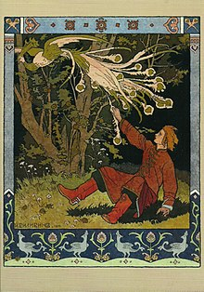
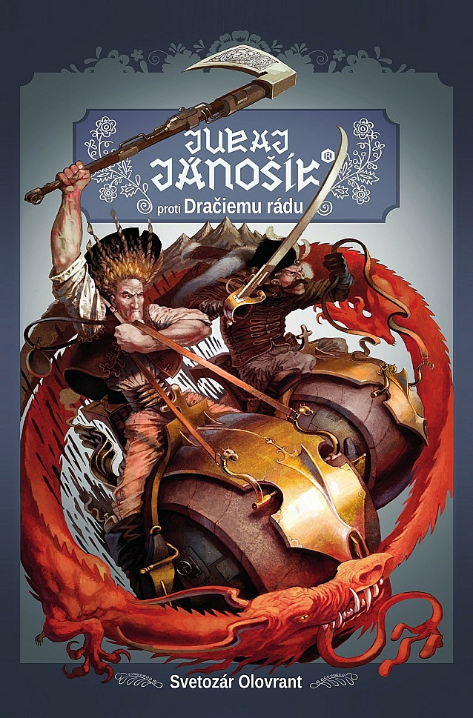
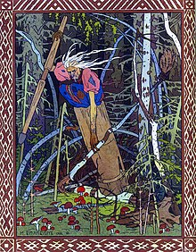
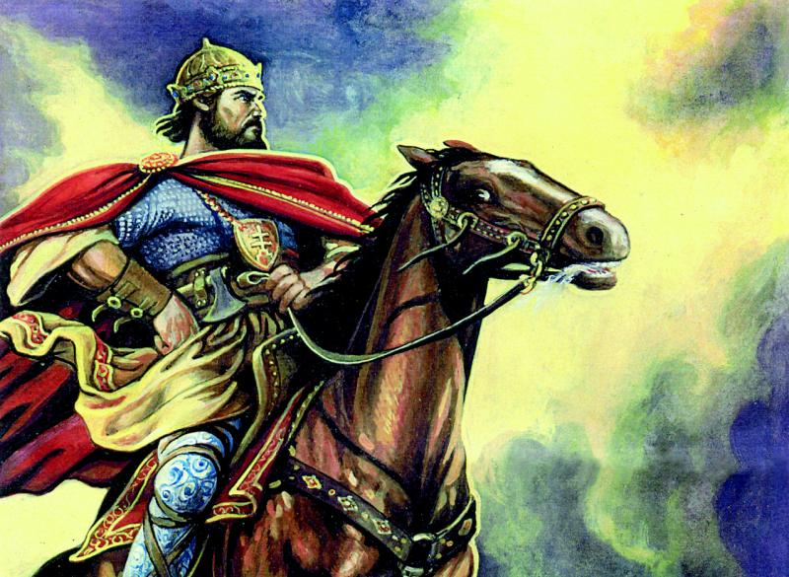
Slovak myths
Vták ohnivák
Jánošík
Baba Jaga
Svätopluk

Slide 6
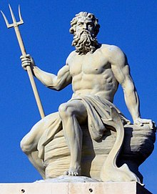
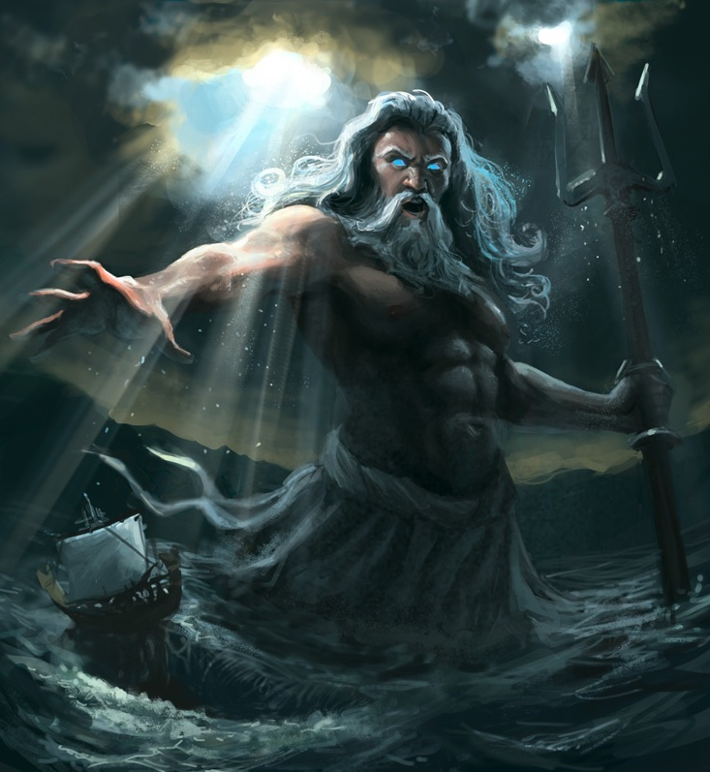
Poseidon
Poseidon was god of the sea, son of Kronos and Rhea. He became the ruler of the sea when the universe was divided after the Titans fell. Poseidon was badly tempered, and when he was angry, he caused an earthquake. He could even upset Rid, the ruler of the underworld. Poseidon was most often portrayed by his trident and sometimes by horse (sometimes claimed to be the horse's creator).
Natural disasters still leave us flummoxed. How can we explain the earthquake in ancient times? The angry god that shook the earth is one of the ways.

