Slide 1
Slovakia

Slide 2
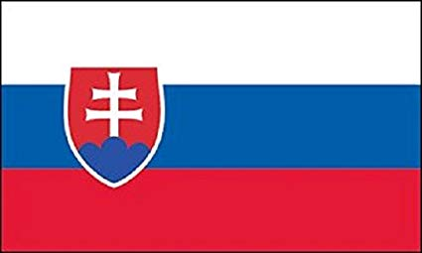
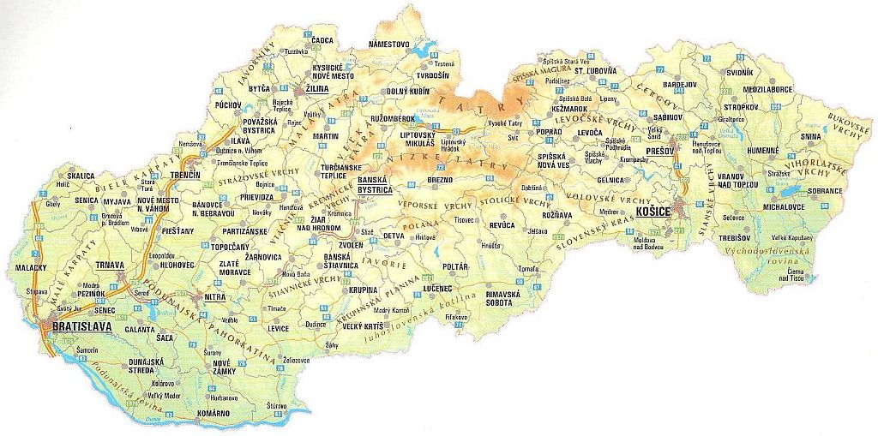
Slovakia, is an inland state in Central Europe. It has an area of 49 036 km² and has about 5 443 000 inhabitants. Neighbour with Czech, Austrian, Polish, Ukrainian and Hungarian. The main and most populous city is Bratislava.
Our president is Andrej Kiska

Slide 3
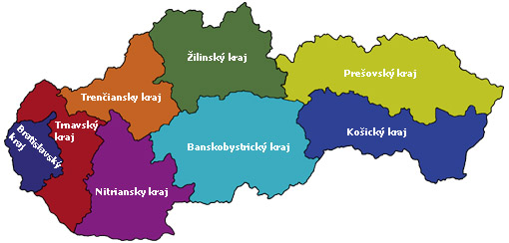
Slovakia is divided into regions
Each regions has its own: regional courts, regional directorates regional police corps, regional directorates of the Fire and Rescue Corps, etc

Slide 4
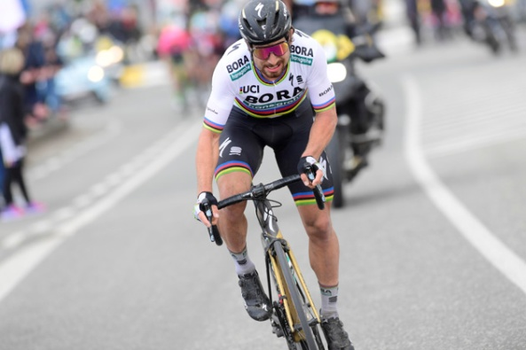
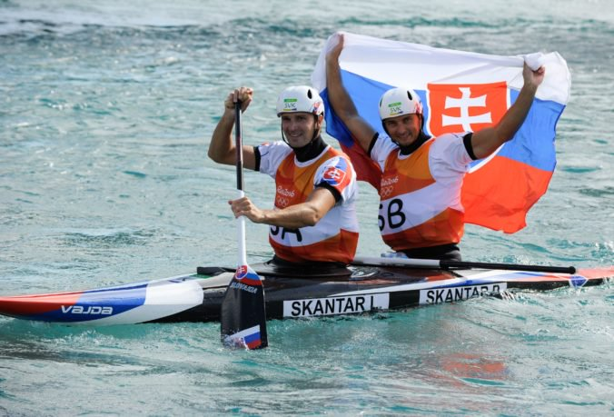
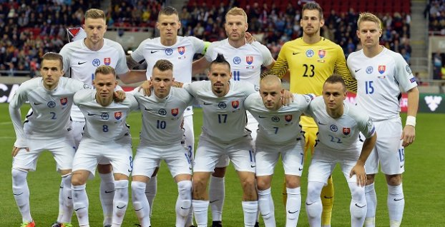
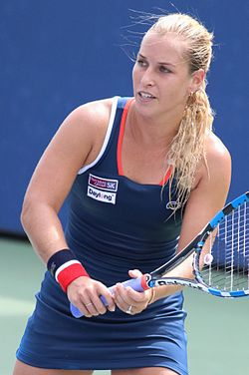
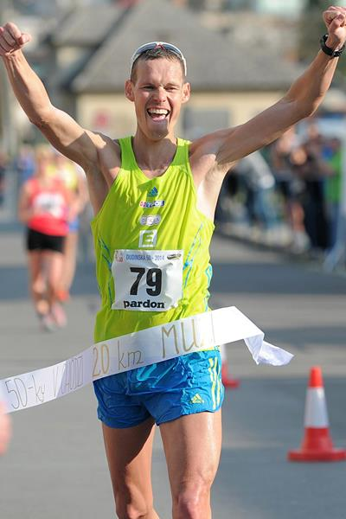
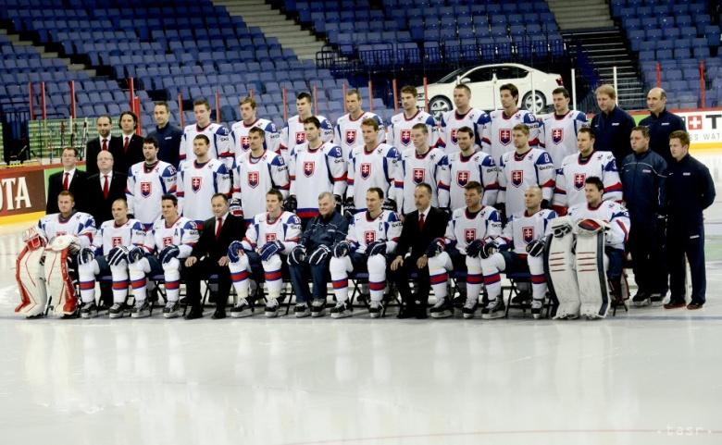
Our Slovakia athletes
Peter Sagan
cousins Škantarovci
slovak football representation
Dominika Cibulkova
slovak hockey representation
Matej Tóth

Slide 5
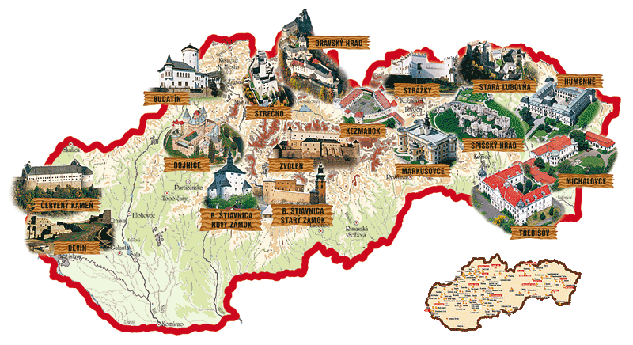
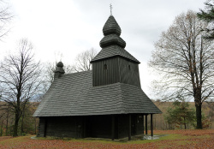
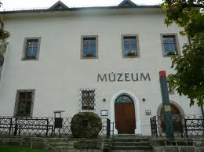
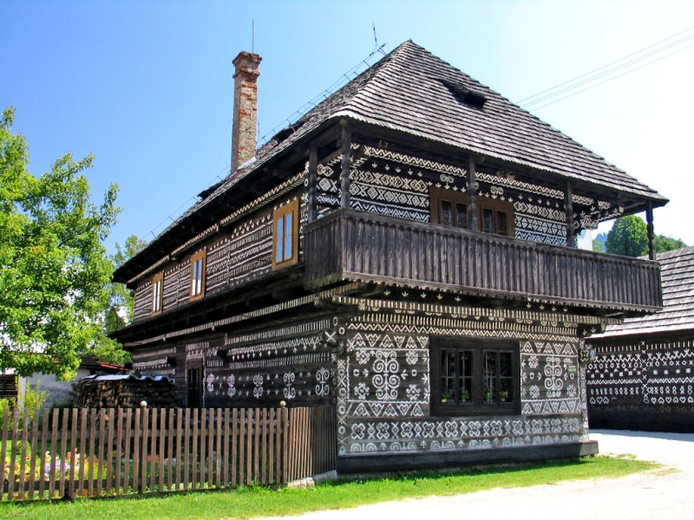
In Slovakia we can see:
wooden churches
castels
museum
open-air museums and folk architecture
and other monuments

