Slide 1
Slovak Products

Slide 2
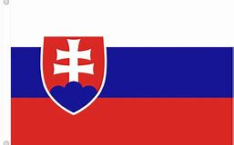
Slovakia is not only a producer of food and cars. There are still factories which have a long traditon of producing their goods. How do you know the product comes from Slovakia? The barcode starts with 858, there is a Slovak flag on the package, or it says Made in Slovakia. As you travel around Slovakia with your parents, you can see factories in these towns, for example: Ružomberok (paper), Púchov (tyres), Žiar nad Hronom (aluminium), Trenčín (clothes), Poprad (washing machines).

Slide 3
Name of the souvenir | Material | Region
Dolls | Sheep cheese | Poltár
Mug | wood | Liptov
Pottery | glass | Liptov
Crystal | clay | All Slovakia
Bryndza cheese | Corn husk | All Slovakia

Slide 4
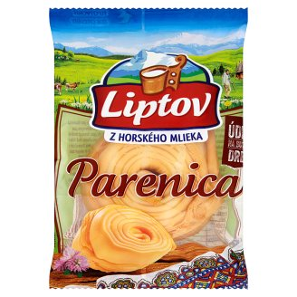
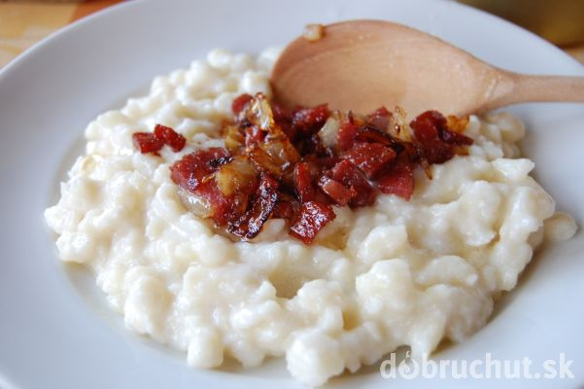
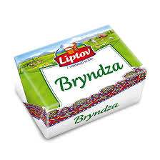
Slovakia national foods, products
Parenica
Bryndzové cheese
halušky
Bryndza

