Slide 1
Fables
Ľudka
Liliana
Erika
GROUP 4

Slide 2
Aesope Fables
Ezop (old-timeAisopus) was a greek old-fashioned writer. It belongs today to the best known fable. He worked in Greece in the 6th century. before Kr. His work was initially lectured only verbally and he collected it only in the 3rd century BC before Christ Demetrios Falérsky. The author of Latin verse processing is Phaedrus. His life is not much known, he was born probably around 620 BC. as a slave in Sardinia in Asia Minor, later lived in Athens and Samos. He traveled a lot in his life. Other sources report that he was a cripple and physically ill. The second version is more likely because they did not kill him as a physically ill but let him live because he was educated as a writer. At that time rich people hired educated slaves. In his fables there are animals, objects or plants that are attributed to human qualities. All of the fables at the end contain mostly didactic lessons. The heroes of his beasts are mainly animals and are generally known. But he also wrote fables in which simple people appeared, pointing to greed or greed. His work became known throughout the world. Ezop died in 564 BC. in the city of Delphi.

Slide 3
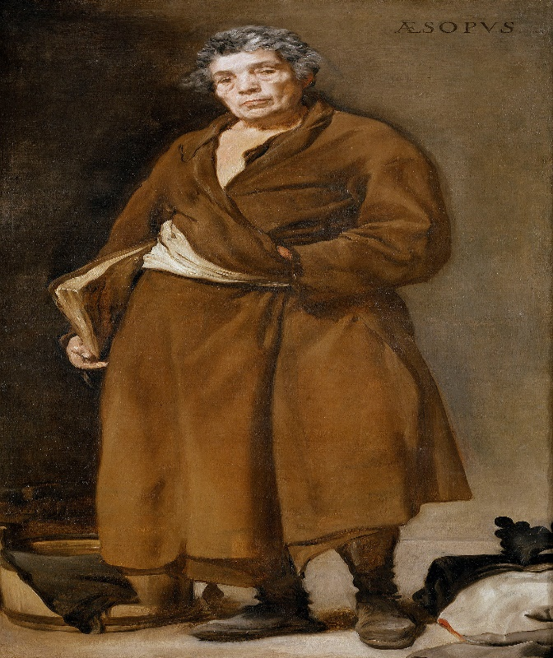
Aesop

Slide 4
Fables
A fable is a story that usually uses animals to teach a valuable life lesson, or moral. This story is typically short and states its moral at the very end. Some of the most popular fables were told by a man known as Aesop who was born a slave in Greece thousands of years ago. The Tortoise and the Hare, The Town Mouse and the Country Mouse, and The Ant and the Grasshopper are just a few of Aesop's notable fables.

Slide 5

Fables in Slovak

Slide 6
Thanks for attention

