Slide 1
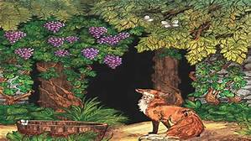
Try our Quiz about fables just click on link or put it into the browser
https://www.quizony.com/users-quizzes/what-do-you-know-about-fables/index.html?qisrc=search

