Slide 1
LEGENDS
Patrik
Maximilián
Filip
GROUP 2

Slide 2
The Legend of Makahiya
Long time ago, there was a couple in Barangay Masagana (Pampanga today) who wanted a daughter. Their wish was granted and the wife gave birth to a baby girl. They called her Maria. Maria was very beautiful but very shy and she wouldn't go out from their house. Weeks later, Spaniards came to their town. The Spaniards were very cruel and they got everything they wanted. They robbed houses and killed everyone who came in their way and who refused to give what they wanted. The couple was very frightened of losing their daughter. They hid Maria in the bushes so the Spaniards couldn't find her. After the Spaniards left their town, the couple tried to look for Maria but they couldn't find her even in the bushes where they hid her, instead of her they found a little plant that is very sensitive. When they touched it, it would immediately close. So they thought it was their daughter, Maria. They called the plant "Makahiya" that means "touch me not," like their daughter who was very shy.

Slide 3
What is a legend?
A legend is a semi-true story, which has been passed on from person-to-person and has important meaning or symbolism for the culture in which it originates. A legend usually includes an element of truth, or is based on historic facts, but with 'mythical qualities'. Legends usually involve heroic characters or fantastic places and often encompass the spiritual beliefs of the culture in which they originate.

Slide 4
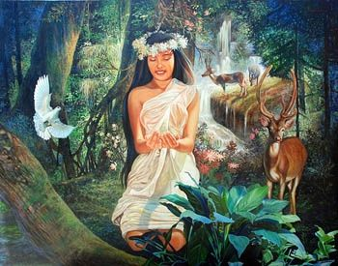
The Legend of Makahiya

Slide 5
Thanks for attention

