Slide 1
WATER FROM PROBLEMS TO SOLUTIONS
ERASMUS + PROJECT
eS2- Grantorto

Slide 2
RECYCLING IN EUROPE in 2014
Best result: Germany
Average rate: 37.5% (not all countries of Europe have been considered)

Slide 3
INCINERATORS IN ITALY
Incineration is a waste treatment process that involves the combustion of organic substances to get energy.
PRO: less waste in the rubbish dump; energy production
CONS: air pollution

Slide 4
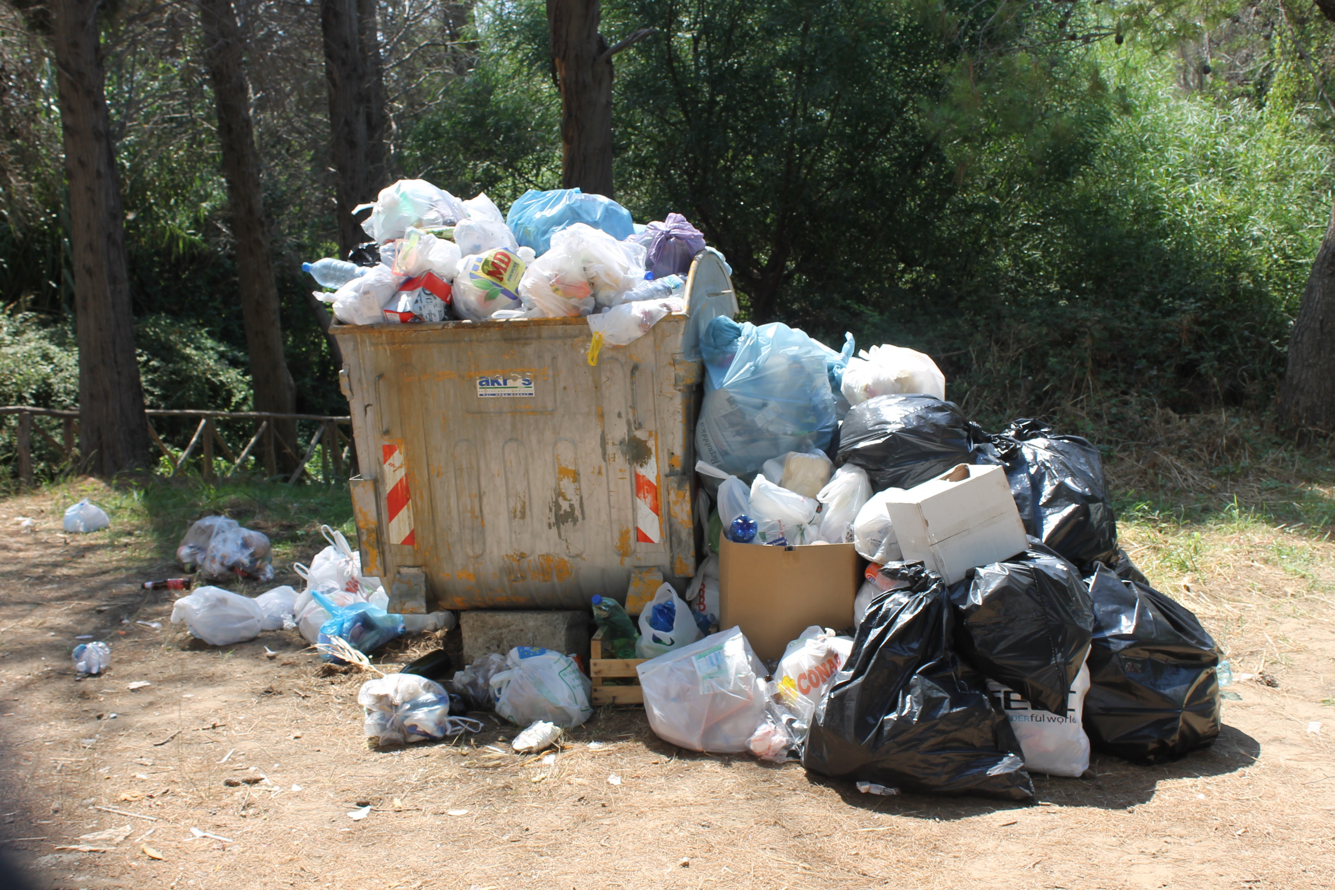
THIS is How waste generated in italy in 2014 was distributed:
In 2014 each Italian citizen generated 488 kg of waste
THERE ARE STILL TOO MUCH WASTE THAT GOES TO THE DUMP

Slide 5
RECYCLING IN THE ITALIAN REGIONs IN 2017
In 2017 Veneto reached the best result in recycling
The national average rate of waste recycled is 54%. The goal for 2025 is to reach 55%. We are almost there…

Slide 6
2017
RECYCLING IN OUR REGION in 2017

Slide 7
OUR MUNICIPALITIES AND THE SURROUNDING ONES: RECYLING RATES
All surrounding municipalities have reached a better result than the national average one: 54% of waste has been recycled

Slide 8
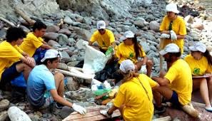
In addition to recycling, we can also help clean our rivers, parks, river banks…

