Slide 1
LIFESTYLES
ADDICTIONS AND
HEALTHY LIFESTYLES
Authors: Antonella Ramacciotti, Riccardo Salotti, Micol Feron

Slide 2
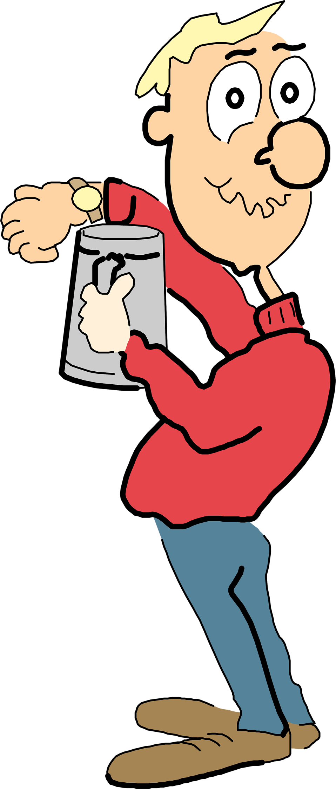
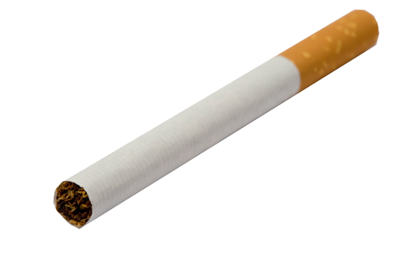
INTRODUCTION
This webquest is part of the dissemination activities of the SEITI project, which was granted within Erasmus+ (KA1).
It will help you learn something more about different lifestyles, in order to make your choices consciously

Slide 3
INTRODUCTION
Each group will be given one of these topics:
Group 1: Alcohol;
Group 2: Nicotine;
Group 3: Junk food;
Group 4: Gambling;
Group 5: Social media;
Group 6: Healthy lifestyle.

Slide 4
TASK
Your class is going to organise a seminar about lifestyles. So you should prepare a poster and find an attractive slogan on the topic. Don’t forget that your poster should be attractive and raise the awareness of your friends.

Slide 5
Process (groups 1 to 5)
Step 1: Form a group of 4 members.
Step 2: Read the given links and gather information about the topic. You can also visit additional websites
Step 3: In your poster the following parts should be included:
- Definition of the addiction.
- The reasons behind becoming addicted.
- The effects of addiction.
- The ways of getting rid of your addiction.
Step 4: Take relevant notes and attractive pictures.
Step 5: Find a slogan for your poster.
Step 6: Design a poster using your slogan.
Step 7: Present your poster orally in the class.

Slide 6
Process (group 6)
Step 1: Form a group of 4 members.
Step 2: Read the given links and gather information about the topic. You can also visit additional websites
Step 3: In your poster the following parts should be included:
- food;
- exercise;
- hygiene;
- unhealthy habits.
Step 4: Take relevant notes and attractive pictures.
Step 5: Find a slogan for your poster.
Step 6: Design a poster using your slogan.
Step 7: Present your poster orally in the class.

Slide 7
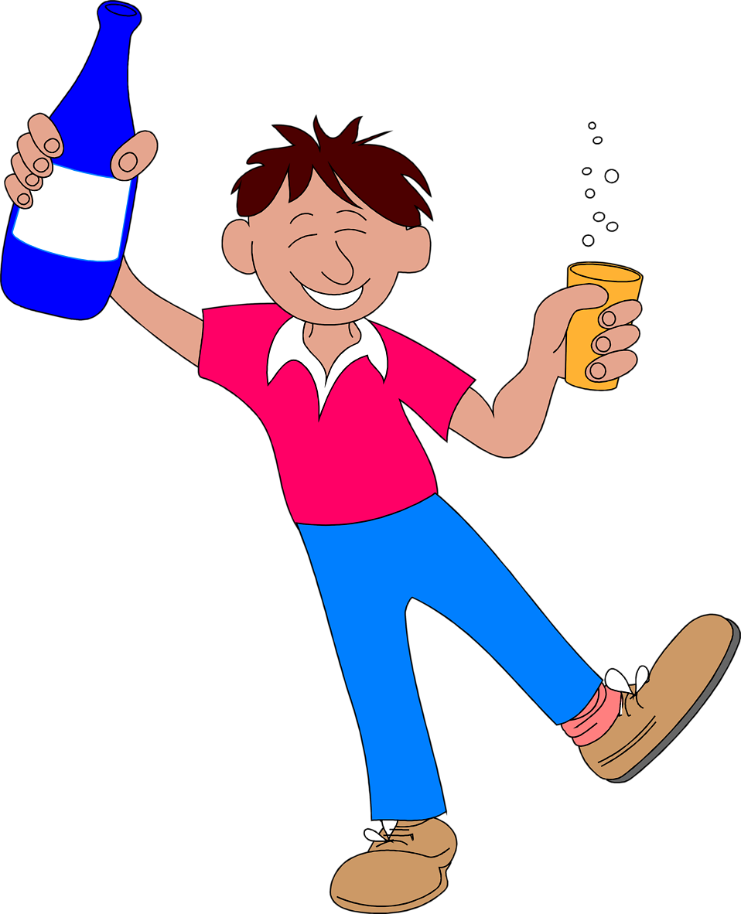
Group 1: Alcohol
http://www.wordreference.com
http://www.anxiety-and-depression-solutions.com/wellness_concerns/addiction/what_is_addiction.php
http://www.jakeshealthsolutions.com/what-causes-addiction-324
http://www.beatingaddictions.co.uk/PhysiologicalEffectsAddiction.html
http://www.inspirational-quotes-and-thoughts.com/alcohol-addictions.html

Slide 8
Group 2: Nicotine
http://www.wordreference.com
http://www.hbo.com/addiction/understanding_addiction/18_what_is_addiction.html
http://www.jakeshealthsolutions.com/what-causes-addiction-324
http://www.beatingaddictions.co.uk/PhysiologicalEffectsAddiction.html
http://www.inspirational-quotes-and-thoughts.com/cigarette-addiction.html

Slide 9
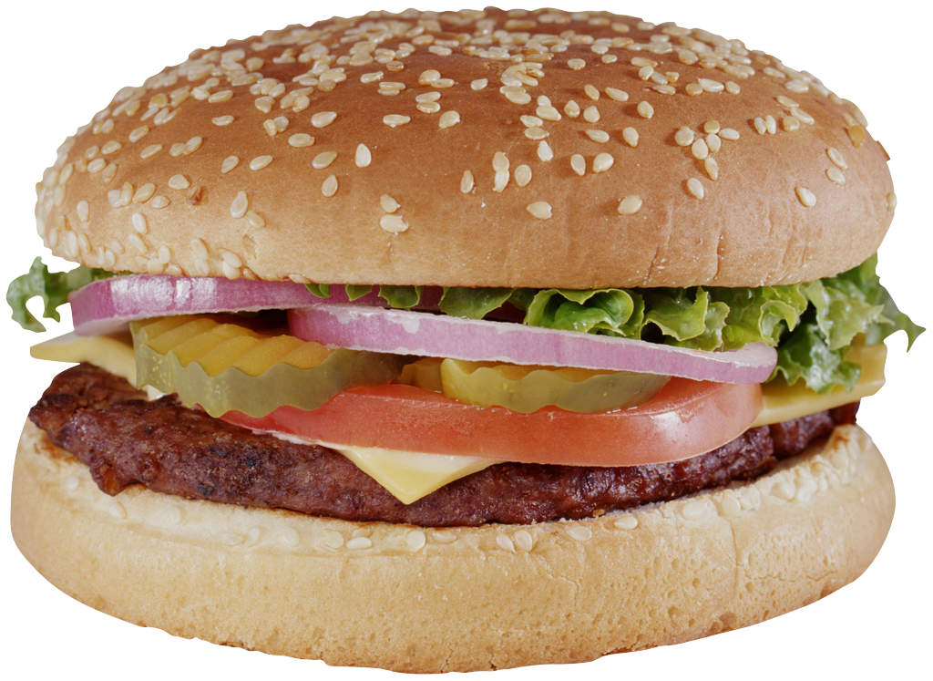
Group 3: Junk food
http://www.wordreference.com
http://www.anxiety-and-depression-solutions.com/wellness_concerns/addiction/what_is_addiction.php
http://www.wikihow.com/Overcome-an-Addiction-to-Fast-Food
http://www.healthline.com/health/fast-food-effects-on-body

Slide 10
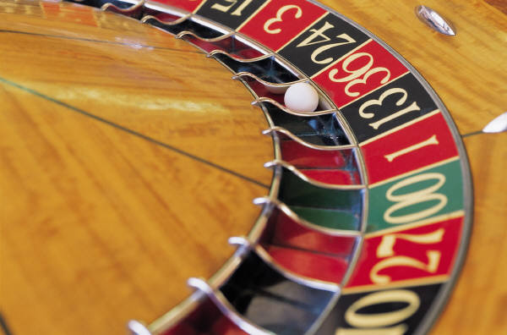
Group 4: Gambling
http://www.wordreference.com
http://www.hbo.com/addiction/understanding_addiction/18_what_is_addiction.html
http://www.jakeshealthsolutions.com/what-causes-addiction-324
http://rehab-international.org/gambling-addiction/effects
http://www.wikihow.com/Help-a-Compulsive-Gambler

Slide 11
Group 5: Social Media
http://www.wordreference.com
http://www.anxiety-and-depression-solutions.com/wellness_concerns/addiction/what_is_addiction.php
http://www.jakeshealthsolutions.com/what-causes-addiction-324
https://www.linkedin.com/pulse/positive-negative-effects-social-media-society-ali-kingston
http://performancing.com/negative-effects-of-social-networking-sites-for-students/
http://www.wikihow.com/Overcome-Internet-Addiction

Slide 12
Group 6: Healthy Lifestyle
http://www.wordreference.com
http://www.wikihow.com/Live-a-Healthy-Lifestyle#Getting_Some_Exercise_sub
http://www.hbo.com/addiction/understanding_addiction/18_what_is_addiction.html
http://www.healthykids.nsw.gov.au/parents-carers/5-ways-to-a-healthy-lifestyle.aspx

Slide 13
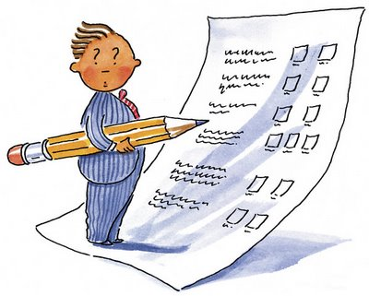
Evaluation

Slide 14
 | Poor 1 | Average 2 | Good 3 | Excellent 4 | Score
Partecipation in work and interaction with the group | The student is passive and has an uncooperative attitude (P. 1-2) | The student is not very active and has a submissive attitude. (P. 3-5) | The student is active but sometimes has an authoritarian attitude (P. 6-8) | The student is active and has a cooperative attitude (P. 9-10) | 10
Completed the task on time | The task wasn’t completed (P. 1-5) | The task was completed on time, but it is inadequate (P. 6-10) | The task wasn’t completed on time, but it is adequate (P. 11-15) | The task was completed on time, and it is adequate (P. 16-20) | 20
Information research; persuasive slogan | Copy/ paste information (P. 1-5) | Relevant information was selected, but it is inadequately summarised. (P. 6-10) | Relevant information was selected, but not using their own words. (P. 11-15) | Relevant information was selected using their own words. (P. 16-20) | 20
Coherence of gathered information and the given parts in step 3 | The gathered information aren’t suitable for the given parts in step 3. (P. 1-6) | The gathered information are suitable for only a few parts in step 3 (P. 7-13) | The gathered information are suitable for most of the parts in step 3 (P. 14-19) | The gathered information are suitable for all the parts in step 3 (P. 20-25) | 25
Attractive and poster. Presentation. | They are quite simple and unattractive Presentation is ineffective (P. 1-6) | They are good but not appropriate for the audience’s level. Presentation is comprehensible (P. 7-13) | They are good summarised but it needs to be developed more Presentation is effective (P. 14-19) | They are synthesized well and designed originally. Presentation is effective and fluent (P. 20-25) | 25

Slide 15
Conclusion
Congratulations!!! You have finished your task. You improved your writing, vocabulary and reading skills. You also became more sociable with your group members.
In addition, with the help of this task, you had an idea and enough information about addiction-related problems and you raised other people’s awareness about this topic.

Slide 16
Teacher’s page
This Webquest is designed for Italian 15-year-old students in second grade of a Technical Institute
It is designed according to CLIL methodology
It is a cross-curriculum task
It takes 2 hours to create the posters + 1 hour to present the posters to the whole class
It makes a contribution to the development of a health and safety culture.
In addition, it should help learners to use their language skills (reading, writing, listening, speaking, interaction)

Slide 17
Learners’ needs
They need to
reflect on their lifestyle and improve their knowledge of addictions
consider English as a communication key
improve their ability to work in groups and negotiate

Slide 18
Planning
we mixed the four Cs:
- Content
- Communication
- Cognition
- Culture
and used the three As
- Analyse content for the language of learning
- Add to content language for learning
- Apply to content language through learning

Slide 19
Interaction
The webquest is designed as a cooperative learning task: the students work in groups of four and inside the group each student has a role
- coordinator
- time controller + summariser
- writer
- speaker
They need to share ideas and negotiate

Slide 20
Multimodality
To solve the webquest the learners have some links to websites where they can find texts and images
To create their poster they are required to use a software (i.g. Word, Publisher)
In the poster they need to include texts and images
Each group is expected to take the floor and present their poster to the whole class

Slide 21
Context and Culture
The learners need to use authentic materials
The learners are going to improve their interaction skills and use the correct communication register
The webquest makes a contribution to the development of a health and safety culture

Slide 22
Literacy
The task is meaningful and closely connected to real life
The learners are supposed to learn the jargon of the topic
They need to use the correct communication register

Slide 23
Collaboration and Reflection
After attending a course in London within the Erasmus + project (KA1), Ms Feron, an Electronics teacher, Ms Ramacciotti, a Chemistry teacher and Mr Salotti, a Mechanics teacher, created this webquest
Reflection in action: during the activity the teachers need to perceive learners’ difficulties and scaffold them on the spot
Reflection on action: after testing the webquest with the class, the teachers will reflect on the experience and review the planning in order to improve it

Slide 24
Evaluation and Assessment
Evaluation (formative): Students will be given feedback during their activity
Assessment (marks): after the presentation of their posters, students will be given marks according to the attached table
The learners will not be assessed for their use of the language

