Slide 1
GLOBAL ISSUES
JIRI, JAVI, DANIEL AND JAROSLAV

Slide 2
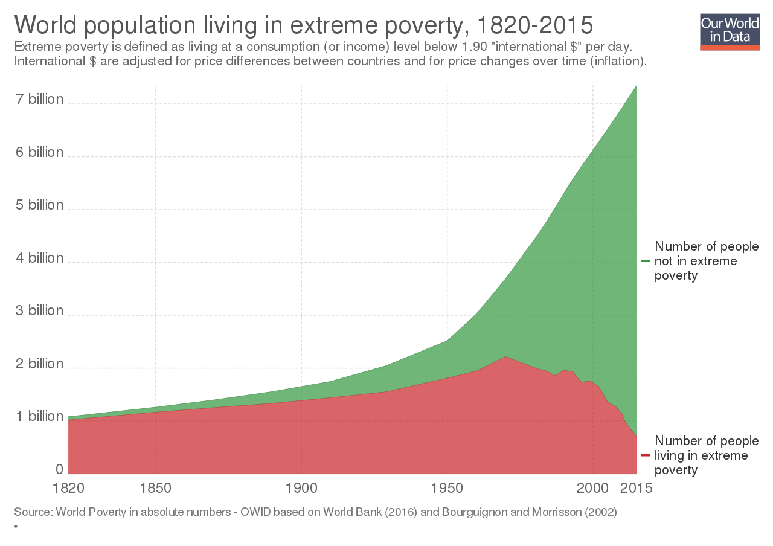
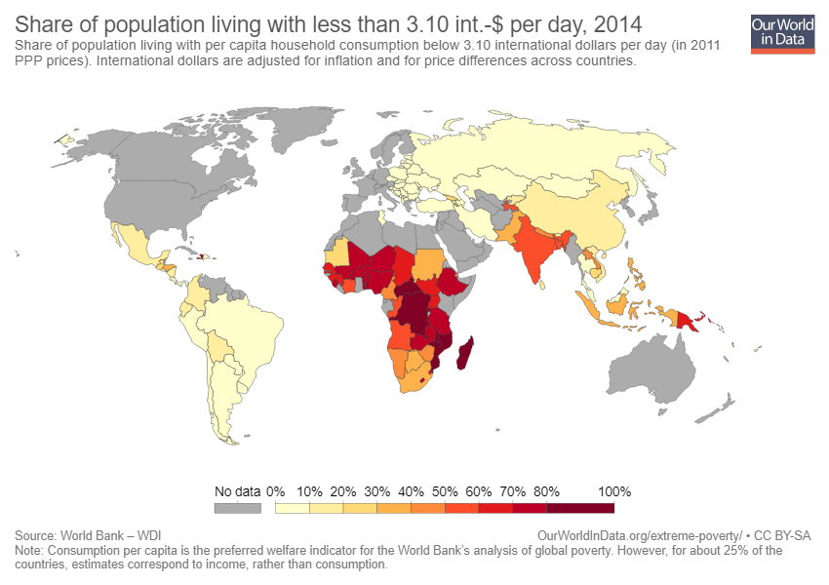
POVERTY
Poverty is not having enough material possessions or income for a person's needs. Poverty may include social, economic, and political elements
Absolute poverty is the complete lack of the means necessary to meet basic personal needs, such as food, clothing and shelter

Slide 3
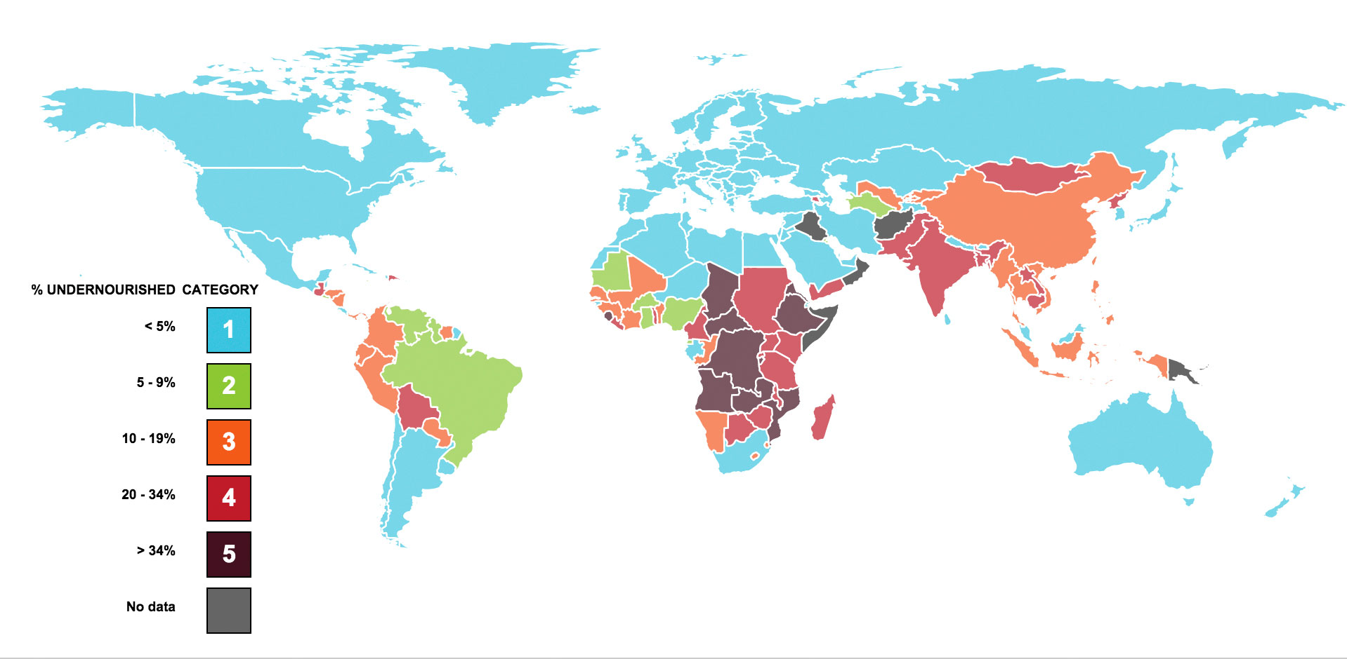
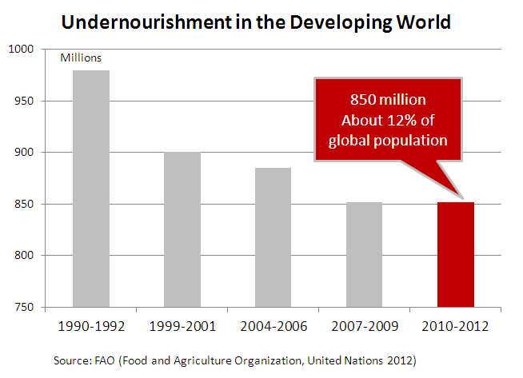
HUNGER
Hunger is a condition in which a person, for a sustained period, is unable to eat sufficient food to meet basic nutritional needs
Throughout history, portions of the world's population have often suffered sustained periods of hunger. In many cases, this resulted from food supply disruptions caused by war, plagues, or adverse weather

Slide 4
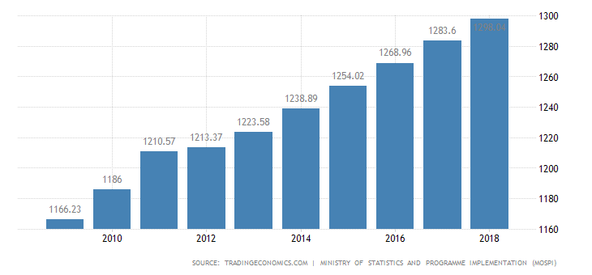
HUMAN OVERPOPULATION
Human overpopulation is when there are too many people for the environment to sustain (with food, drinkable water, breathable air, etc.)
Overpopulation can result from an increase in births, a decline in mortality rates, an increase in immigration

Slide 5
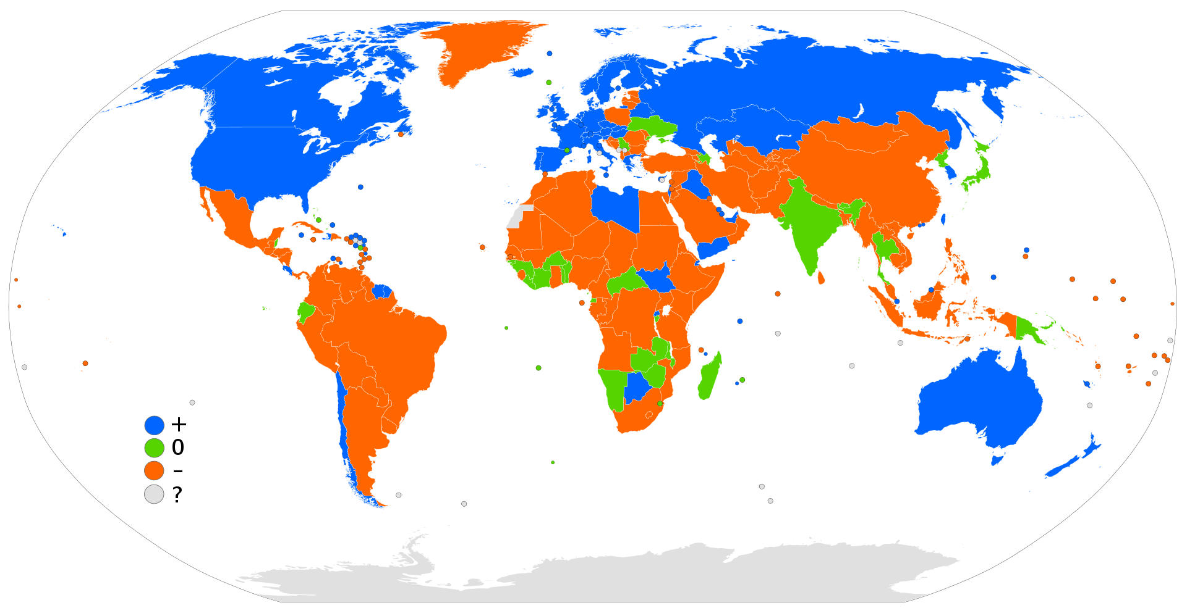
IMMIGRATION
Immigration is the international movement of people into a destination country of which they are not natives or where they do not possess citizenship in order
the number of international migrants has reached 244 million worldwide, which reflects a 41% increase since 2000
Net migration rates for 2016: positive (blue), negative (orange), stable (green), and no data (gray)

Slide 6
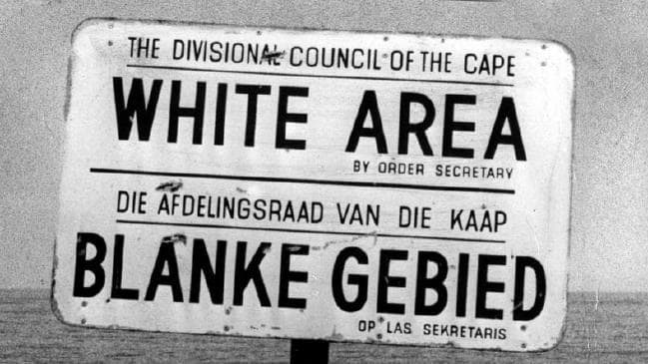
RACISM
Believing that one race is better than another one
Color blindness
Cultural racism - xenophobia
Institutional racism - by governments
- 1960s
- apartheid

Slide 7
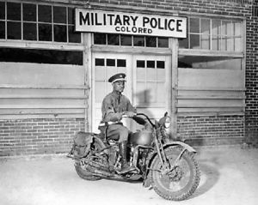
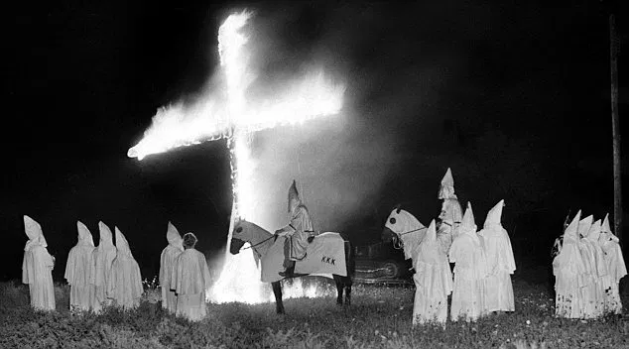
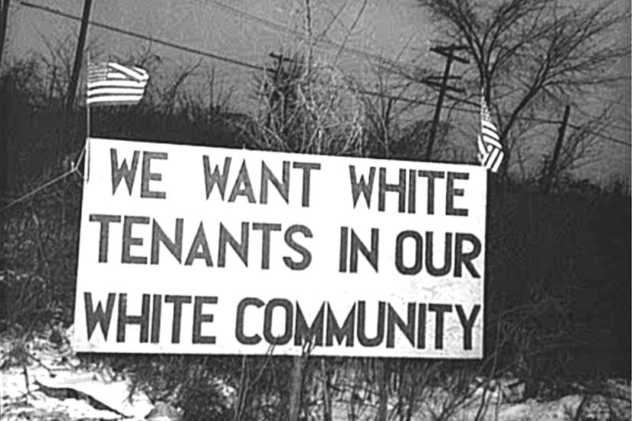
RACISM IN THE USA

Slide 8
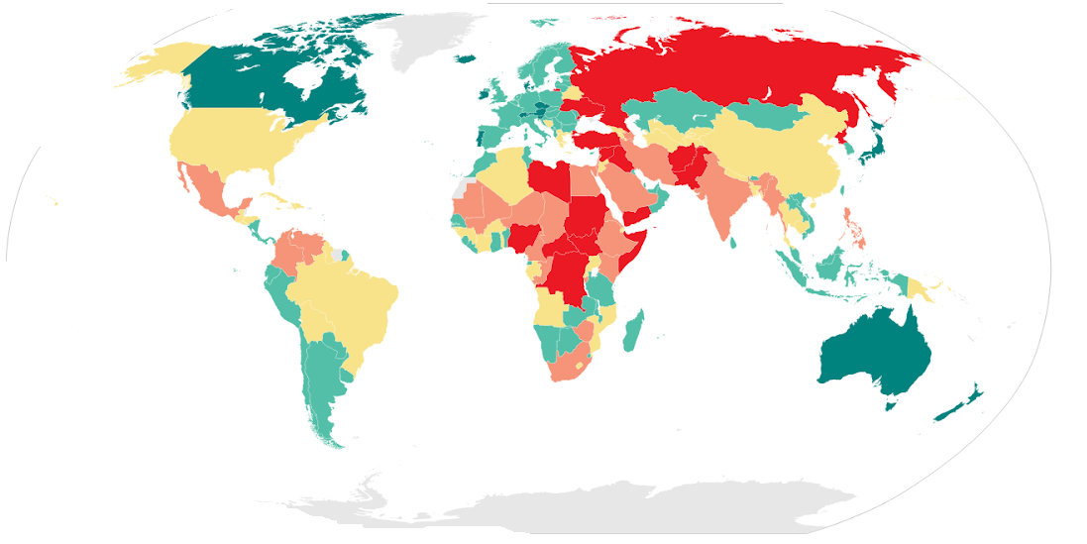
CRIME AND VIOLENCE
planned x unplanned
money, revange, adrenaline, fear
social instable people, psychological disordered people
property crimes, drug abusing, violent crimes, fraud
Green – the best Red – the worst Grey – no data

Slide 9
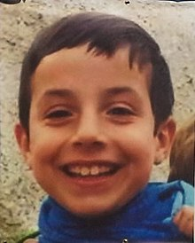
ANA JULIA
Ana Julia murdered her son
She tried to hide the body in a property of her family
They were looking for his body for 12 days
Finally they found boy’s body in the car of Ana Julia

Slide 10
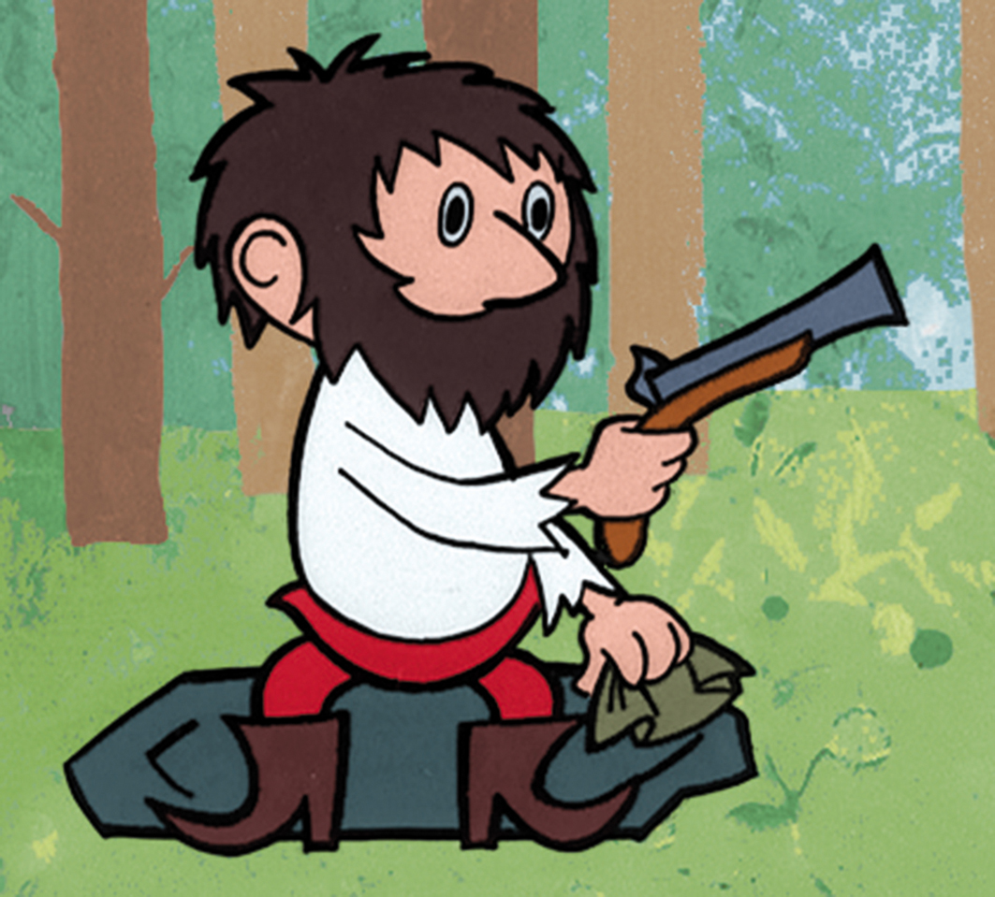
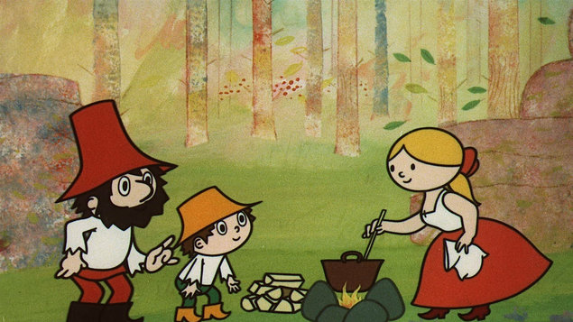
RUMCAJS
The most famous bandit in Czech Republic
Written by Václav Čtvrtek
Manka, Cipisek
1960s

