Slide 1
THE ENVIRONMENT
Unai-Honza-Alejandro-Mikulas

Slide 2
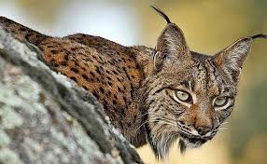
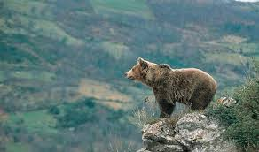
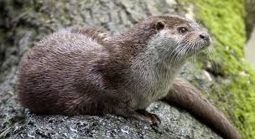
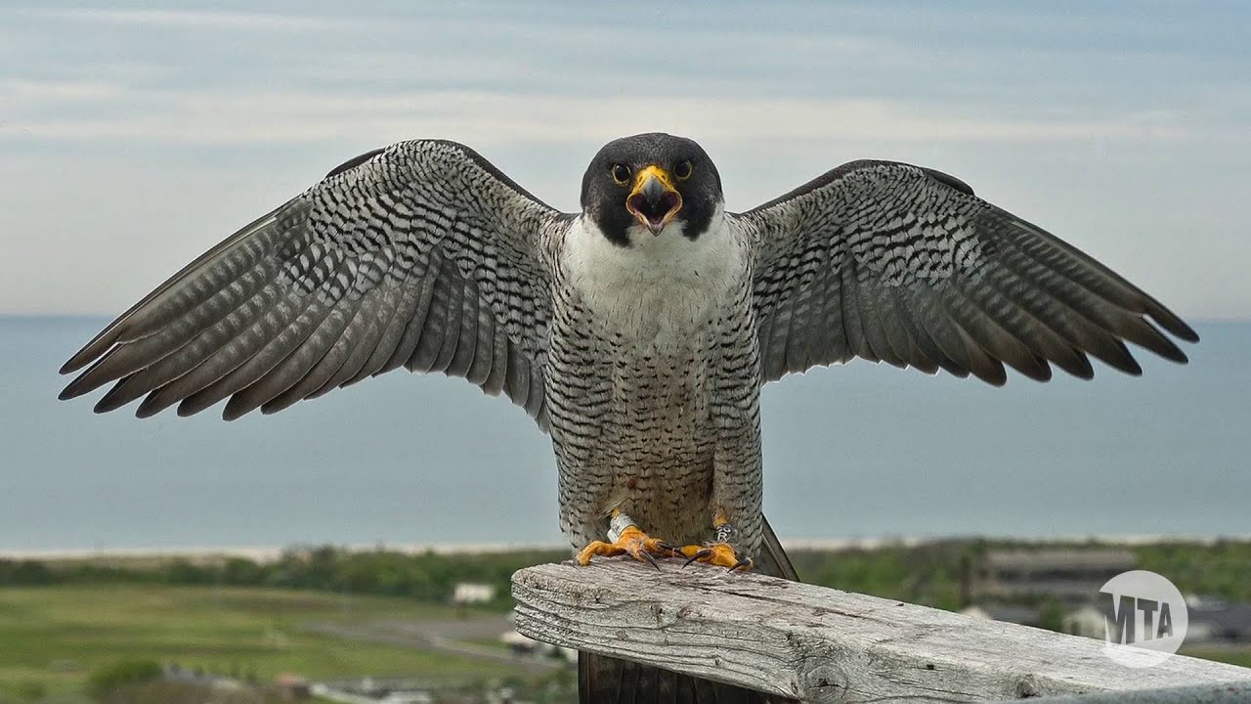
Endangered species
Iberian Lynx:
Cantabrian Brown bear:
Eurasian Otter:
Eurasian Peregrine Falcon:

Slide 3
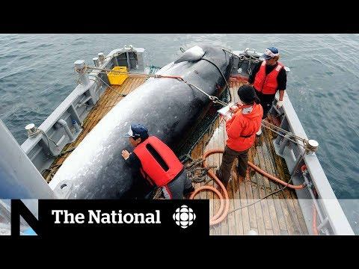
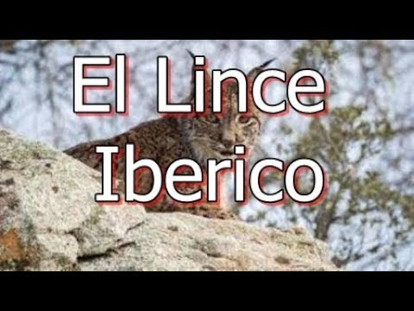
ENDANGERED SPECIES
Why?: Because people hunt animal for trophy and for feel like alpha animal.
Humans take animal to slavery {zoo,circus or private collection}
Because people want make money from nature.
Deforestation kill a lot of animals.
How to save them?: The humans has to respect the animals live places (forests, mountain, ……). They must control furtive hunter.
Stop use and produce palm oil.

Slide 4
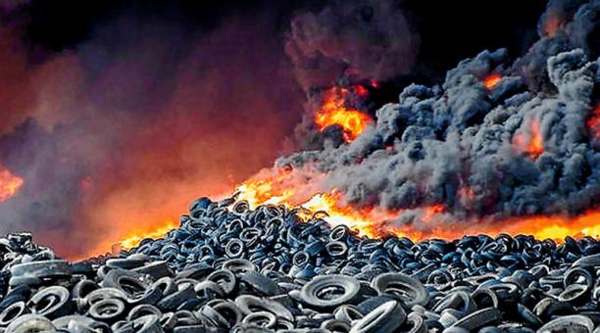
WASTES
In Spain, 33.9% of waste has been recycled in 2018, a rate which is very low comparing with the European half.

Slide 5
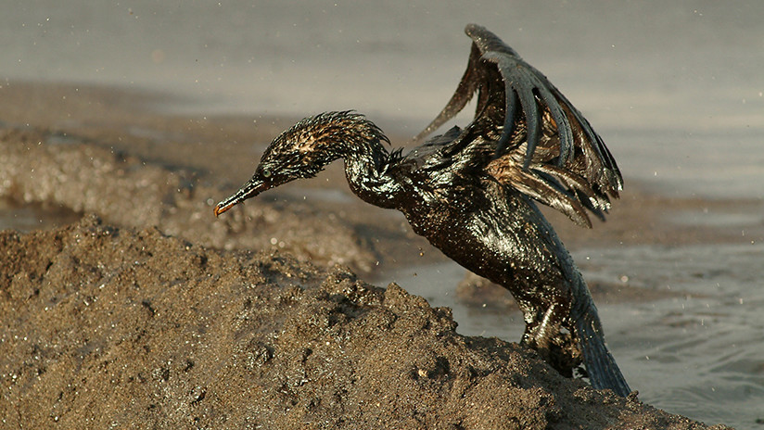
POLLUTION
Some important Spanish cities contain air classified as contaminated by the European Union, in total about 15 million Spaniards breathe polluted air. This entails a series of measures by the EU which involve fines and restrictions.
In the Czech Republic there are also
restrictions on the part of the European
Union, its problem is mainly the emission
of CO2 caused by public transport and
heating machines.

Slide 6
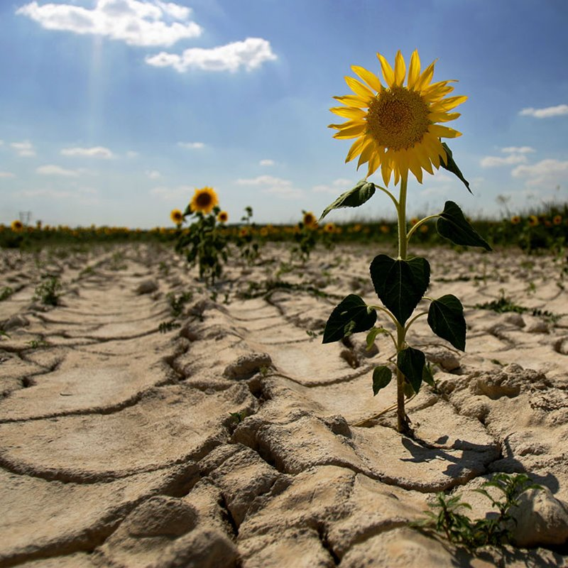
GLOBAL CLIMATE CHANGE
Global average sea level has risen nearly 178 mm over the past 100 years..
Eighteen of the 19 warmest years all have occurred since 2001. The year 2016 ranks as the warmest on record.
Satellite data show that Earth´s polar ice sheets are losing mass (413 gigatonne a year).

