Slide 1
WELL-BEING
(the state of feeling healthy and happy)

Slide 2
Health care
free health care
Where you can find it?
Is Healthcare Ever Free For Visitors?

Slide 3
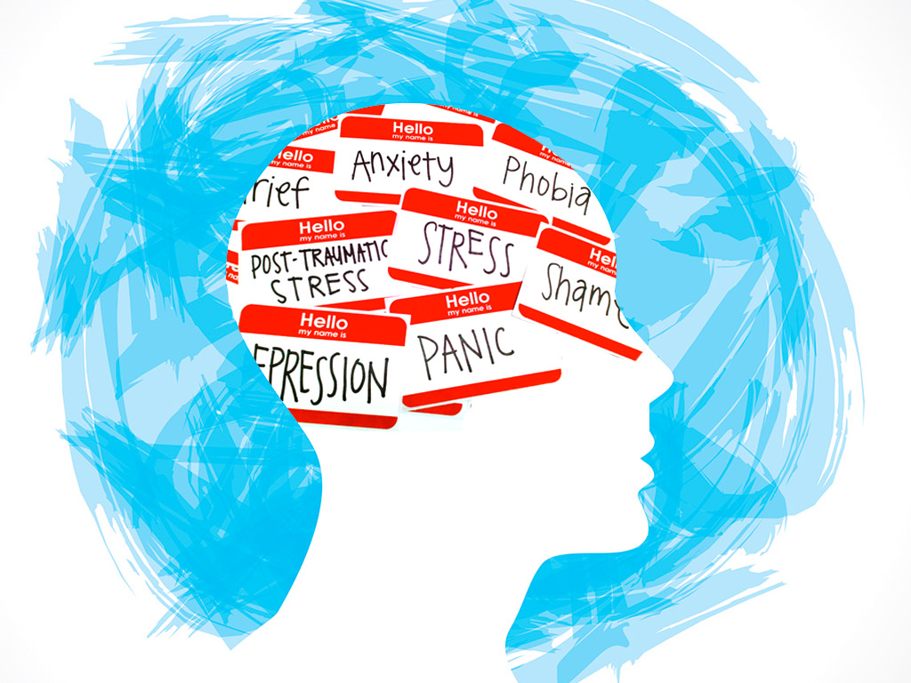
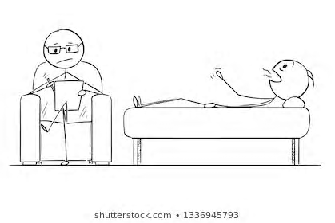
Mental health care
psychologist x psychiatrist
school psychologist x counsellor

Slide 4
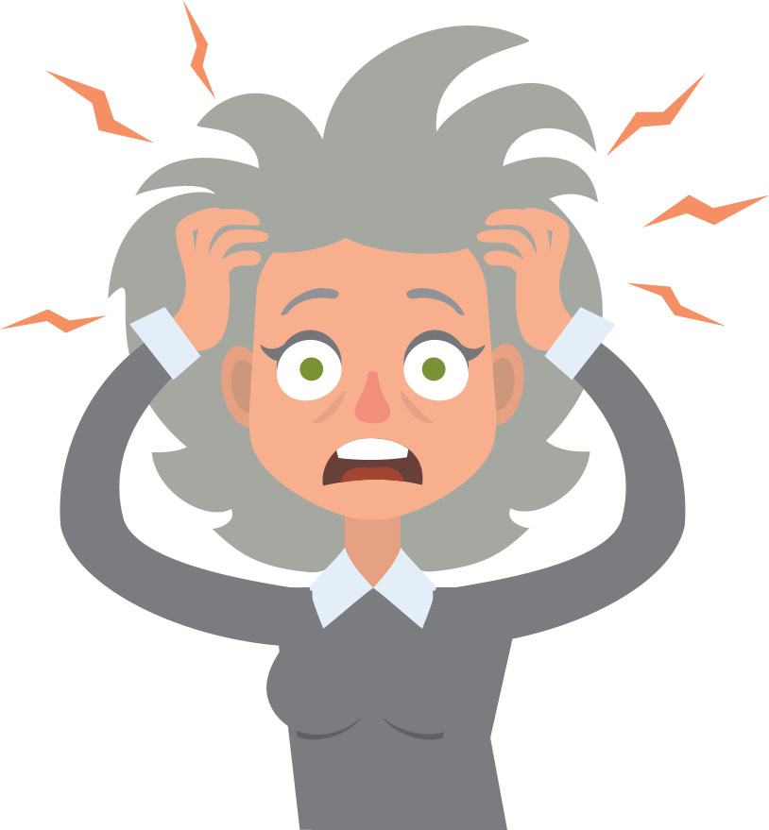
Stress, relaxation
depression, anxiety and personality disorders
physical symptoms
meditation, sports, music, hobbies, yoga etc.

Slide 5
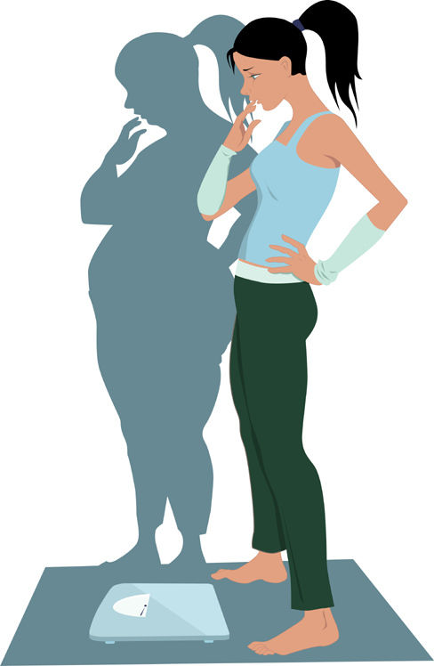
Eating disorders
obsession with food or body shape
anorexia, bulimia, binge eating disorder

Slide 6
Drug abuse
public health problem
legal x illegal

Slide 7
We are not perfect. It is okay not to be happy all the time.
Thank you for your attention.

