Slide 1
Information technology
(IS IT A CURSE OR A BLESSING?)
ASIER LISTA
JAKUB SPENDLIK
NATXO LOSADA
DANIEL RUCKI

Slide 2
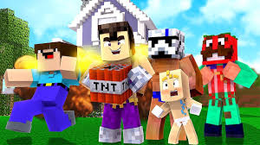
ENTERTAINMENT
Social media (Instagram)
Computer games (Minecraft)
Music (Spotify)
Movies, series (Netflix)
E-books
Gossip (Hola, tn.cz, The Sun)

Slide 3
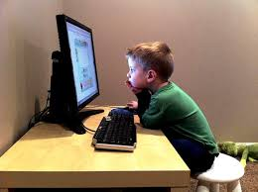
SOCIAL MEDIA NETWORKING SITES-FACTS
Over 80% young people use social media
Most common: Facebook, Instagram, Twitter, Whatsapp, YouTube, Snapchat

Slide 4
SOCIAL MEDIA NETWORKING SITES-POSITIVES
Talking to your friends anytime
Meeting new people
Finding new hobbies
Easier way for searching information
Knowing what are your friends doing
Entertainment

Slide 5
SOCIAL MEDIA NETWORKING SITES-NEGATIVES
Too much publicity
Very little privacy
Time-consuming
Cyberbullying

Slide 6
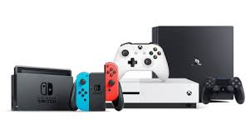
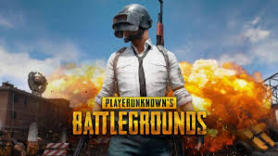
COMPUTER GAMES-FACTS
65% of people own device for playing video games
Most common ways to play: Computer, Playstation, Xbox, mobile, Nintendo
Most common games: Minecraft, GTA, Fortnite, Overwatch, PUBG, CS:GO, Roblox

Slide 7
COMPUTER GAMES-POSITIVES
Playing with friends
Entertainment
Relaxing
Enhancing coordination, logic, memory, multitasking…
Meeting new friends

Slide 8
COMPUTER GAMES-NEGATIVES
Time-consuming (may be addicting)
Money-consuming
Enhancing agressivity

Slide 9
FAKE NEWS, HOAXES
Intentionally false news
Function: manipulation, marketing, practical joke
Easier to spread them on the internet
It´s important to know how to recognize them.

