Slide 1
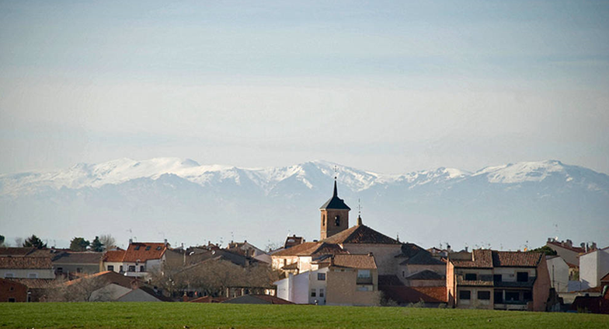
I.E.S. CAMPIÑA ALTA
EL CASAR
GUADALAJARA - SPAIN

Slide 2
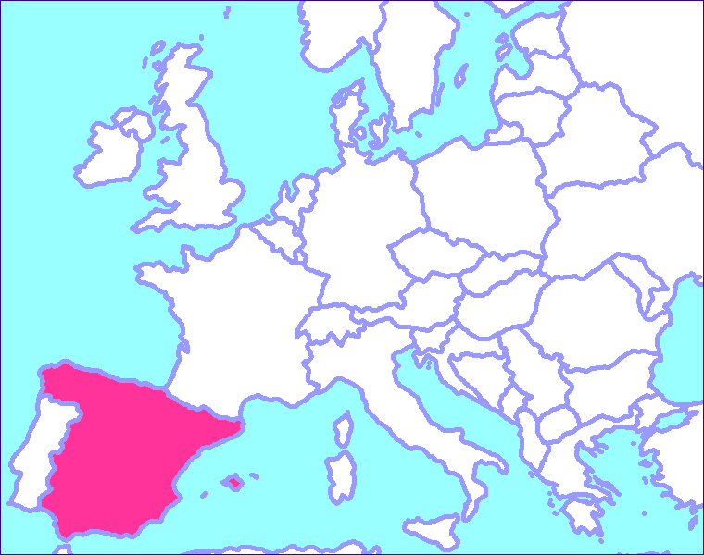
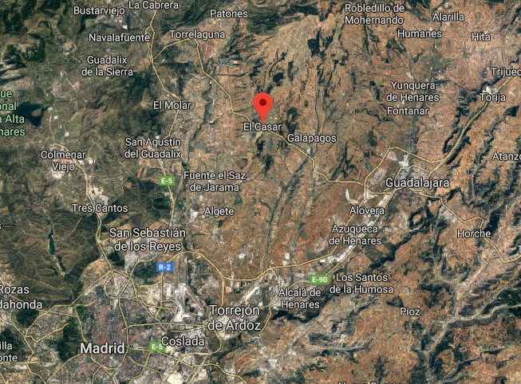
WHERE IS EL CASAR?

Slide 3
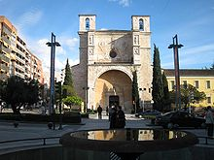
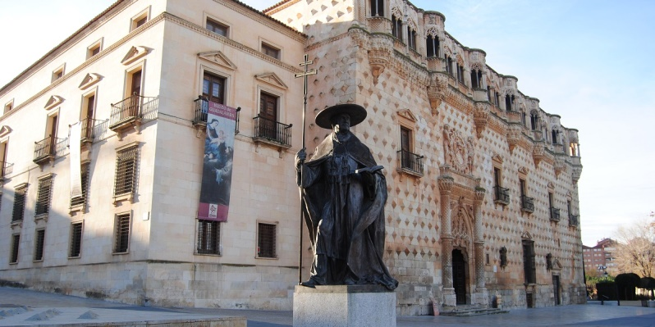
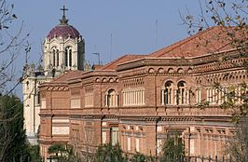
GUADALAJARA
EL CASAR BELONGS TO THE PROVINCE OF GUADALAJARA, IN THE COMMUNITY OF CASTILLA LA MANCHA.
GUADALAJARA IS 28 KM FAR FROM EL CASAR, IT IS THE CITY OF REFERENCE FROM THE ADMINISTRATIVE POINT OF VIEW.

Slide 4
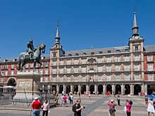
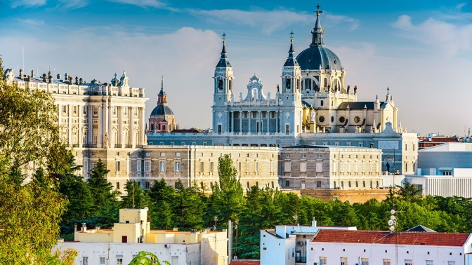
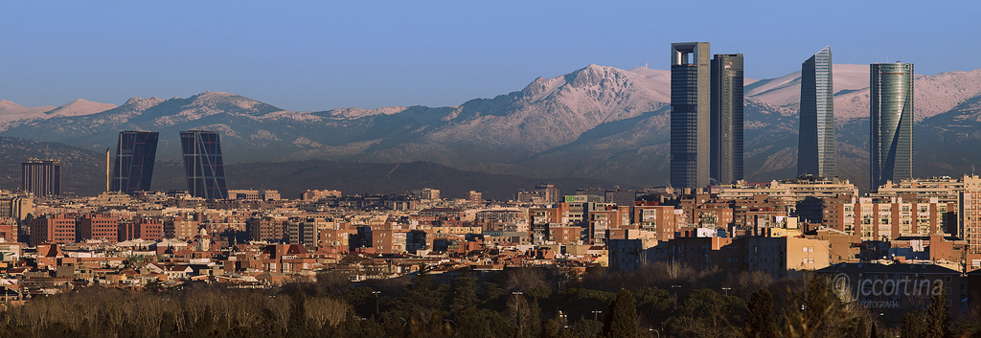
MADRID
MADRID IS 40 KM FAR FROM EL CASAR
IT IS A SOCIO-CULTURAL AND LABOR REFERENCE

Slide 5
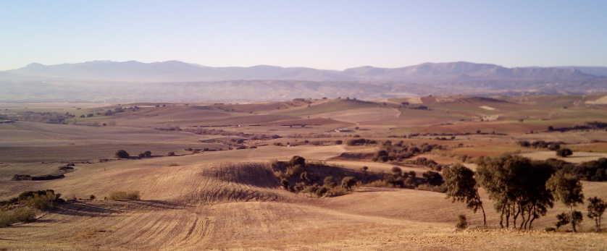
WHAT IS EL CASAR LIKE?
EL CASAR WAS FOUNDED IN THE XI CENTURY
UP TO 20 YEARS AGO IT WAS AN AGRICULTURAL-LIVESTOCK REGION WITH A POPULATION OF AROUND 3,000 INHABITANTS
FROM THAT PERIOD, EL CASAR CONSERVES THE OLD TOWN WITH TYPICAL ARCHITECTURE, TRADITIONS AND FESTIVALS

Slide 6
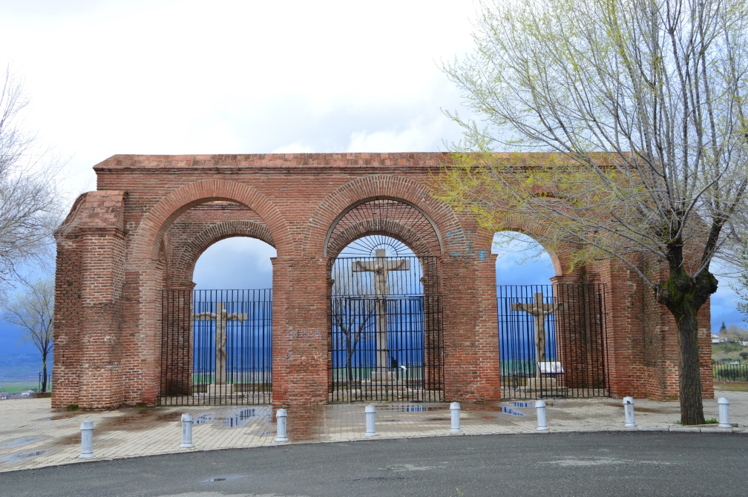
TYPICAL ARCHITECTURE

Slide 7
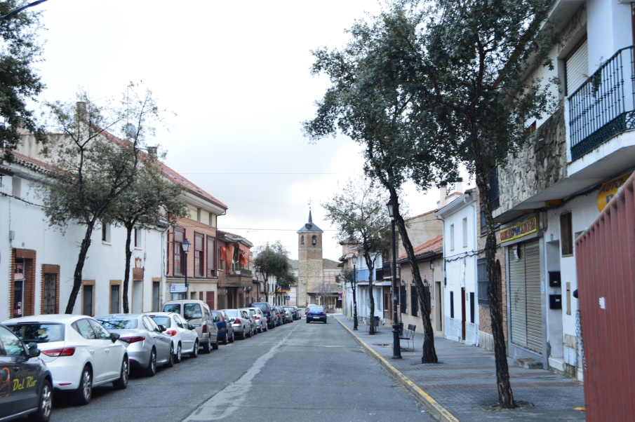
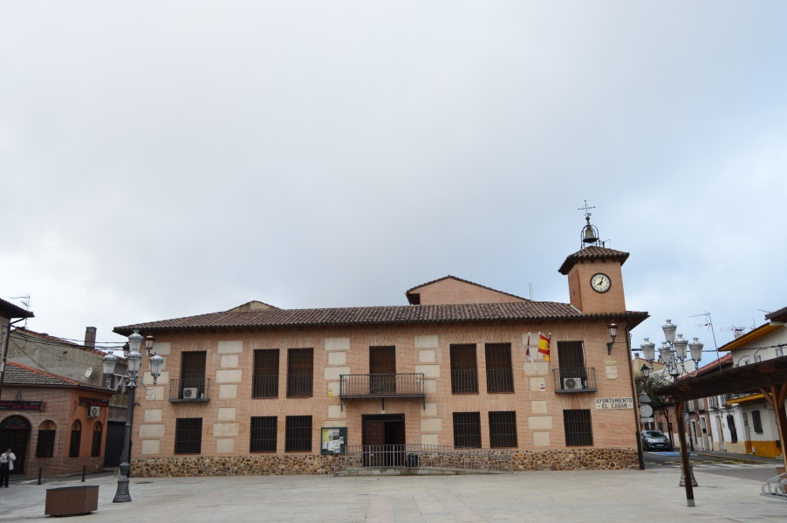
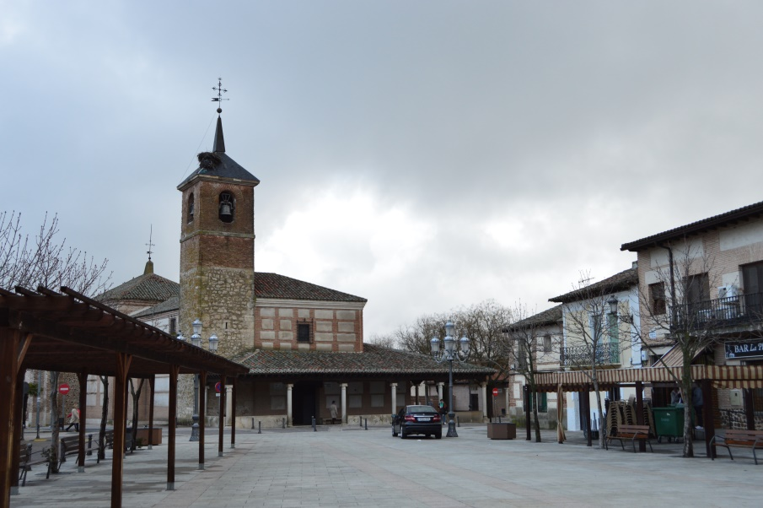
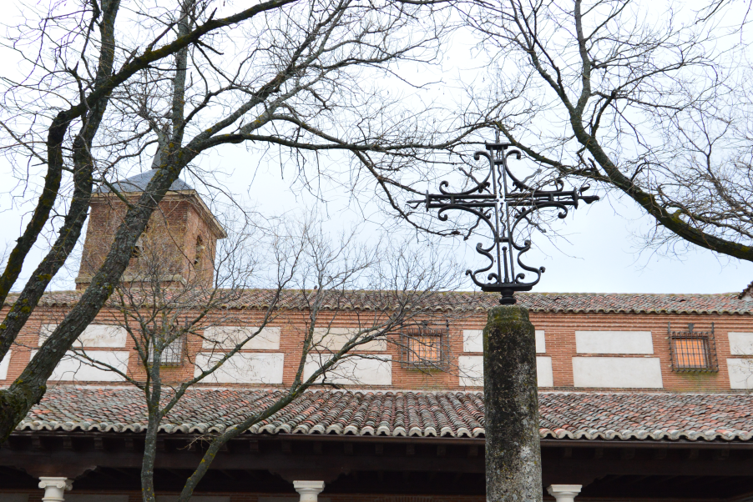
TYPICAL ARCHITECTURE

Slide 8
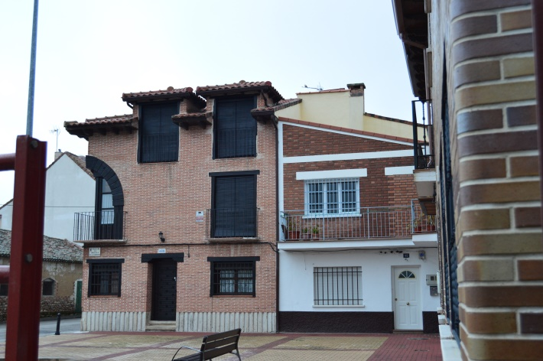
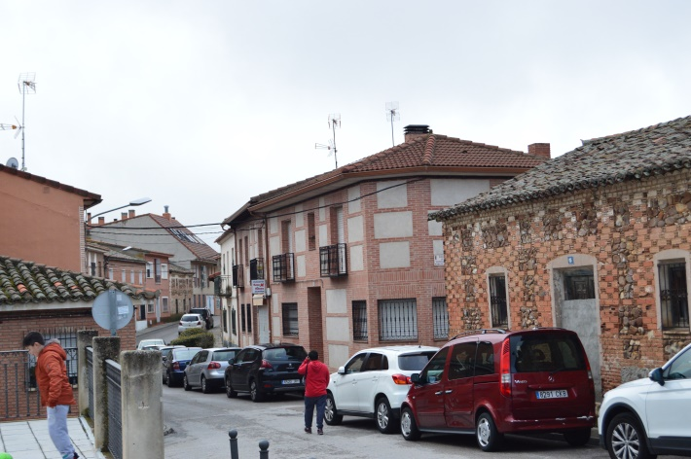
TYPICAL ARCHITECTURE

Slide 9
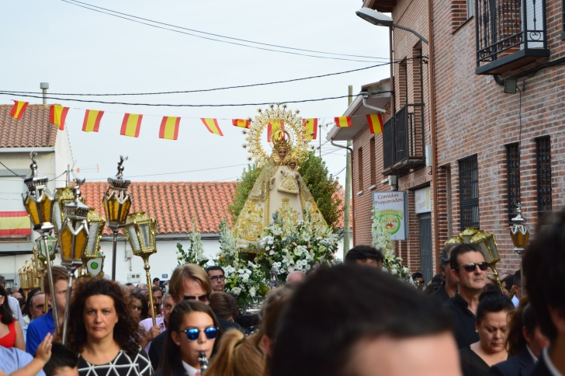
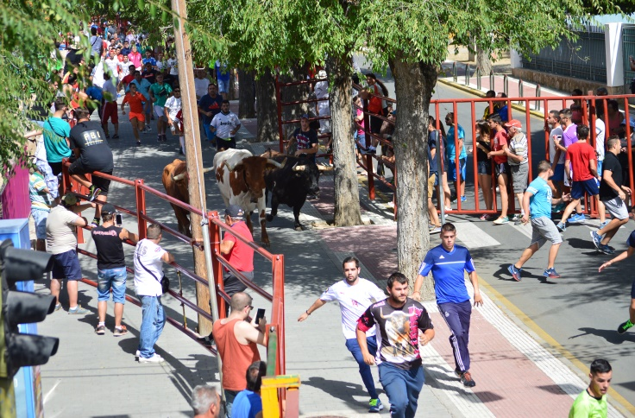
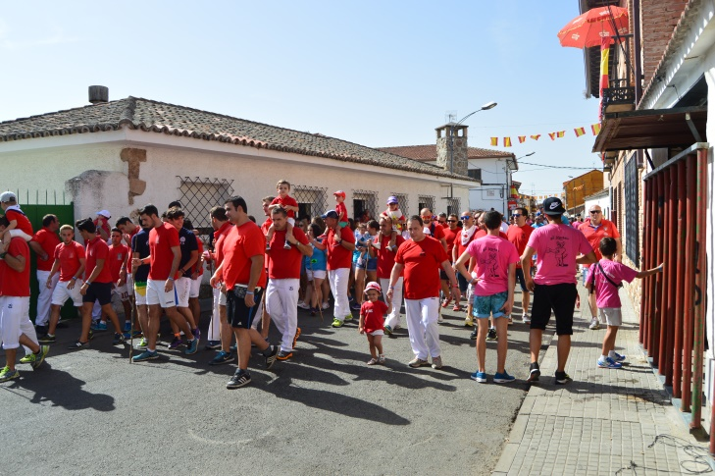
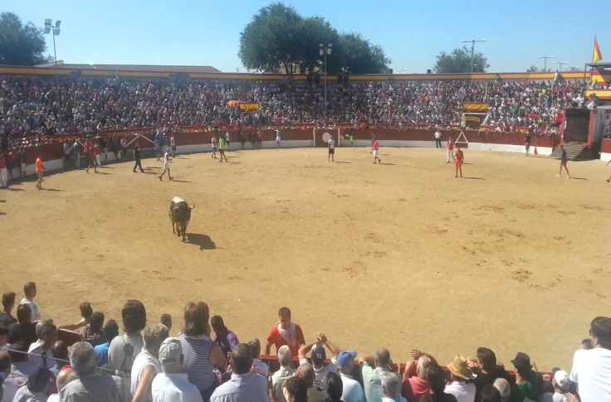
TRADITIONS AND FESTIVALS
“LA ANTIGUA” FESTIVAL

Slide 10
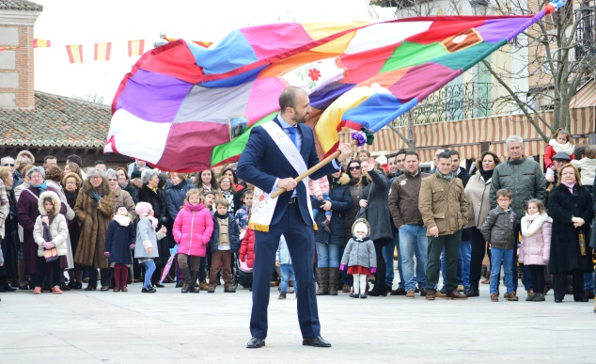
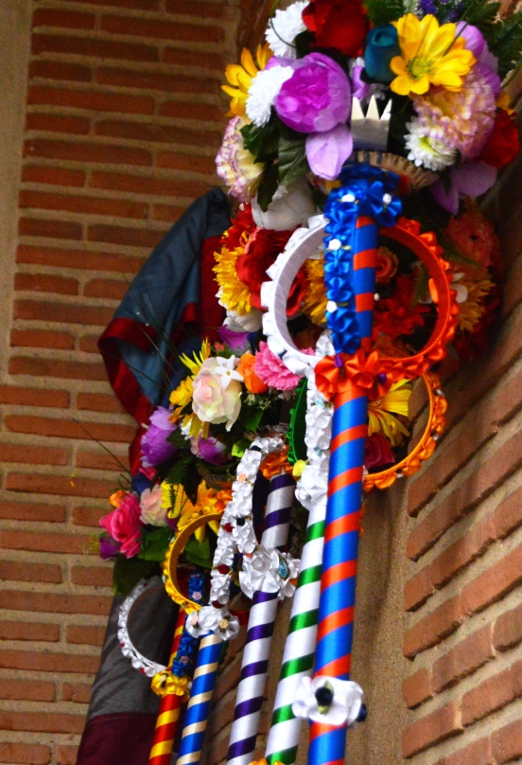
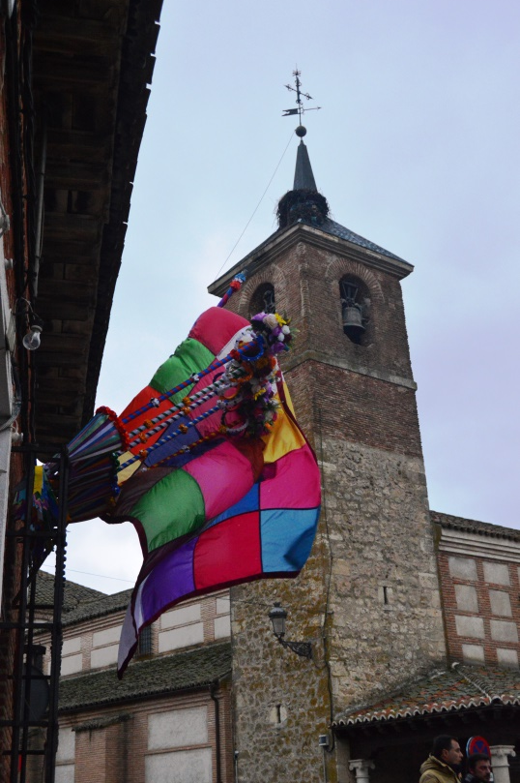
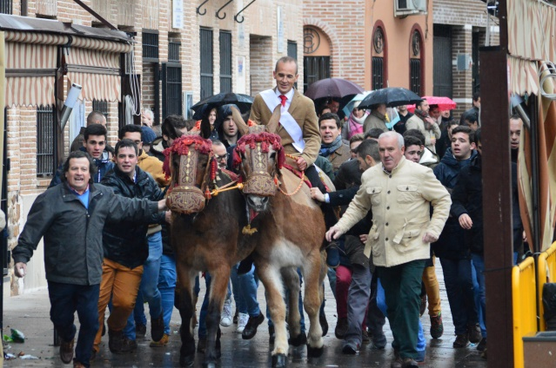
TRADITIONS AND FESTIVALS
“LAS CANDELAS” FESTIVAL

Slide 11
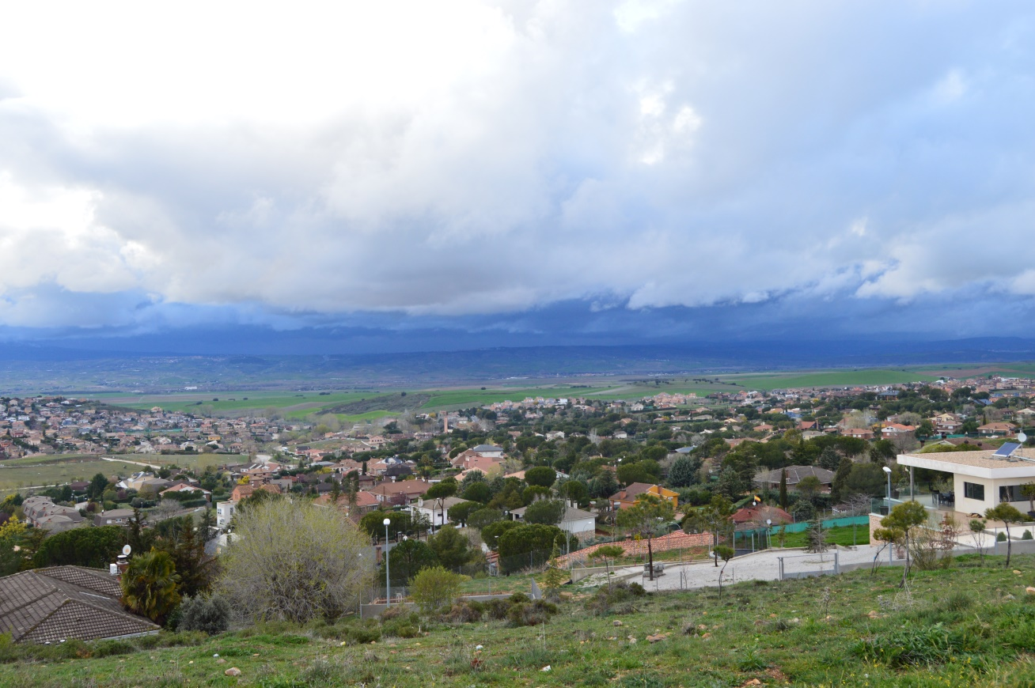
EL CASAR NOWADAYS
FROM 20 YEARS AGO EL CASAR HAS GROWN A LOT. TODAY IT HAS AROUND 15,000 INHABITANTS.

Slide 12
THE PROXIMITY TO MADRID HAS BOOSTED THE CREATION OF SEVERAL RESIDENTIAL AREAS AROUND THE OLD TOWN
NOWADAYS EL CASAR HAS AL THE COMFORTS AND FACILITIES OF A TOWN OF ITS SIZE (SCHOOLS, INSTITUTES, PARKS, HEALTH CENTER, LIBRARY ...)

Slide 13
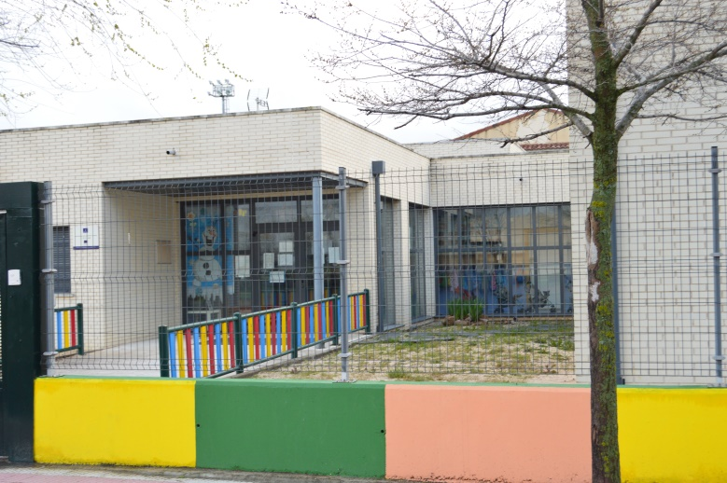
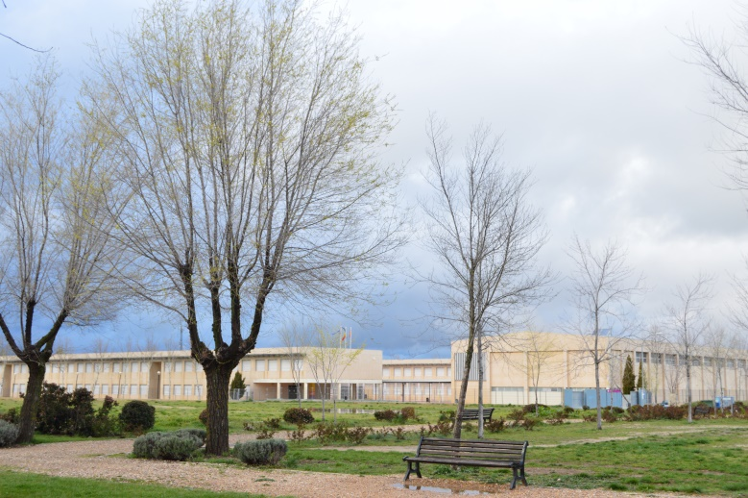
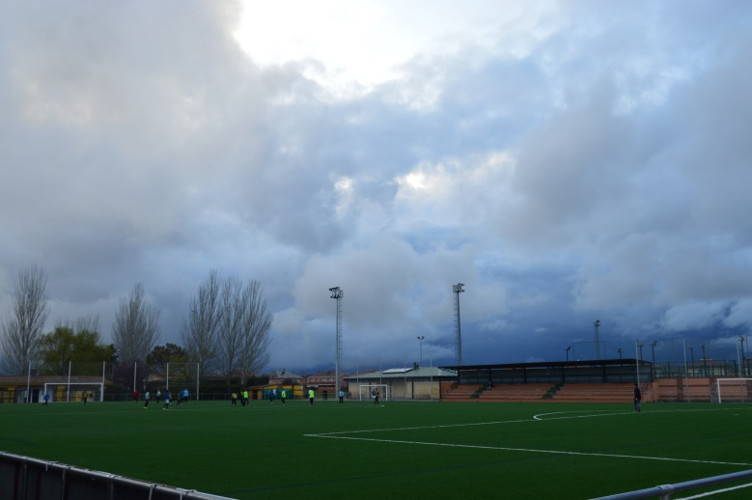
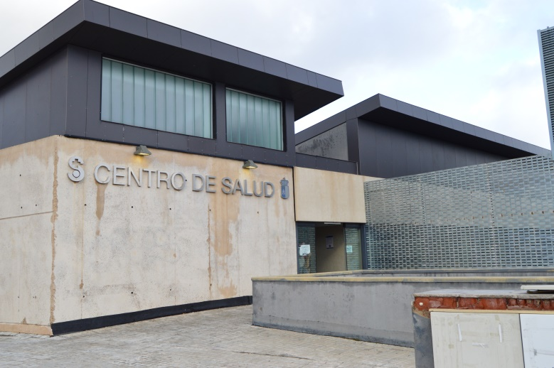

Slide 14
