Slide 1
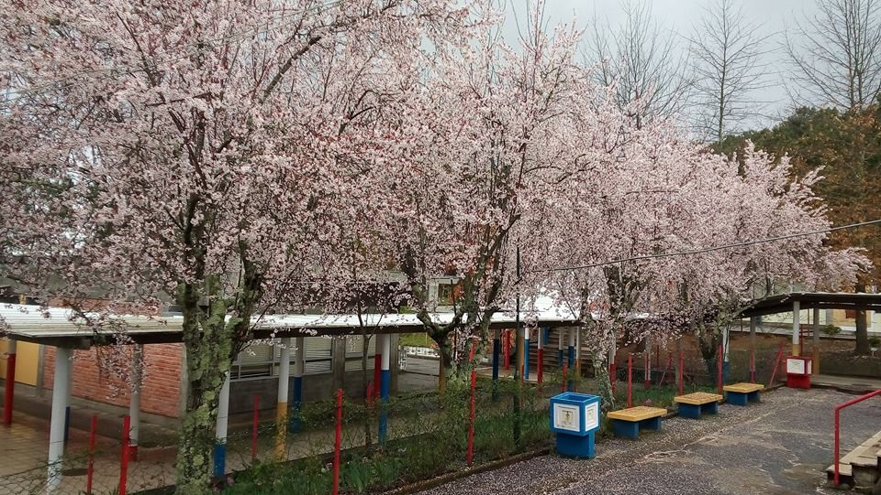
ESCOLA BÁSICA D. DUARTE - Viseu

Slide 2
Main School entrance

Slide 3
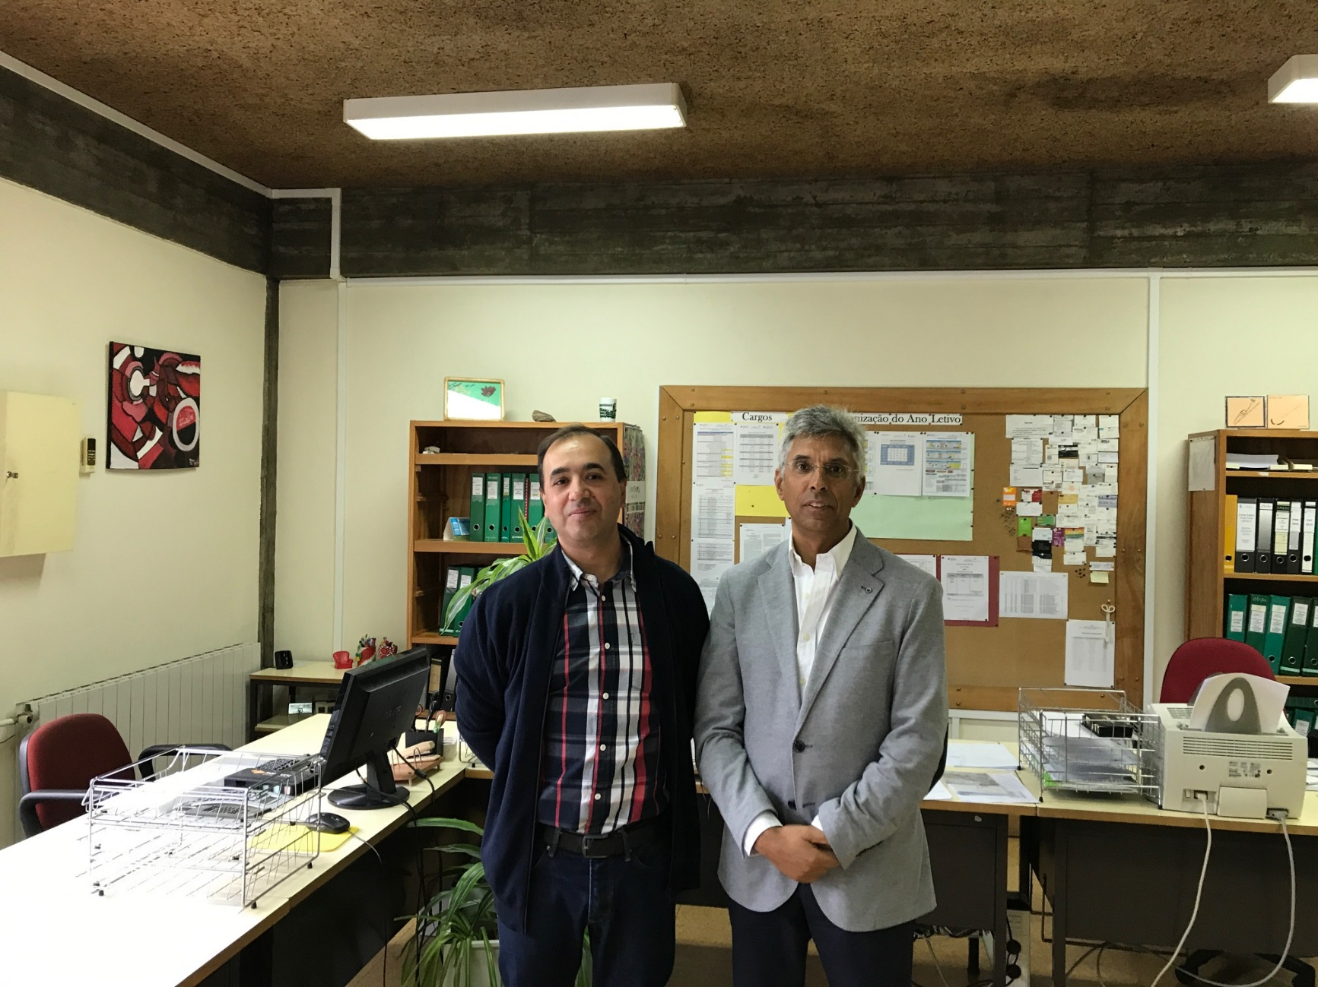
The Headmaster and the School Coordinator

Slide 4
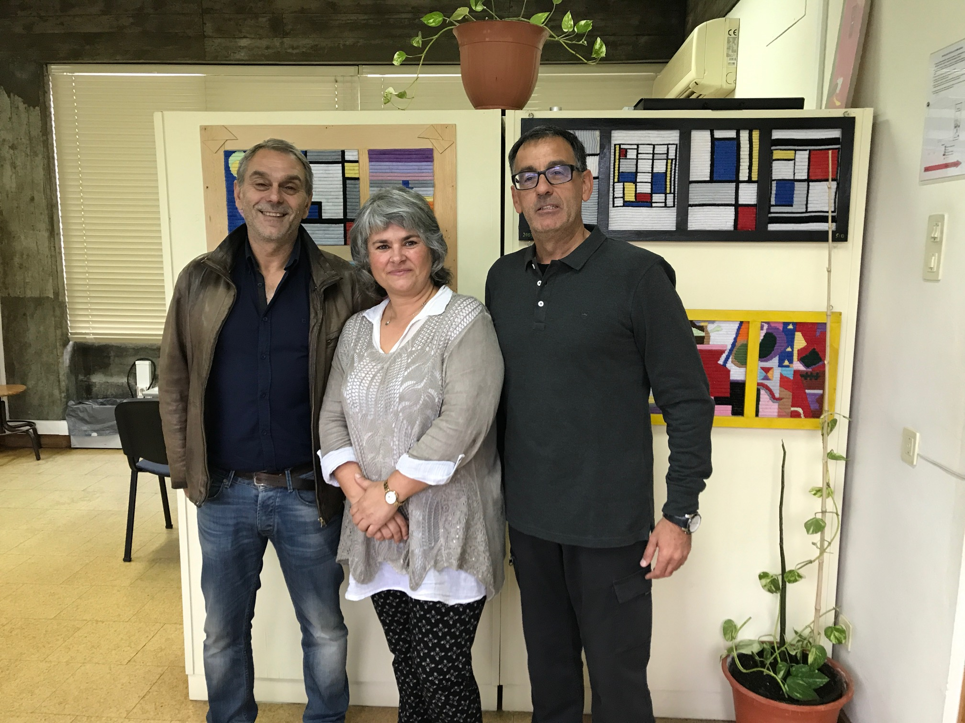
Erasmus+ Team

Slide 5
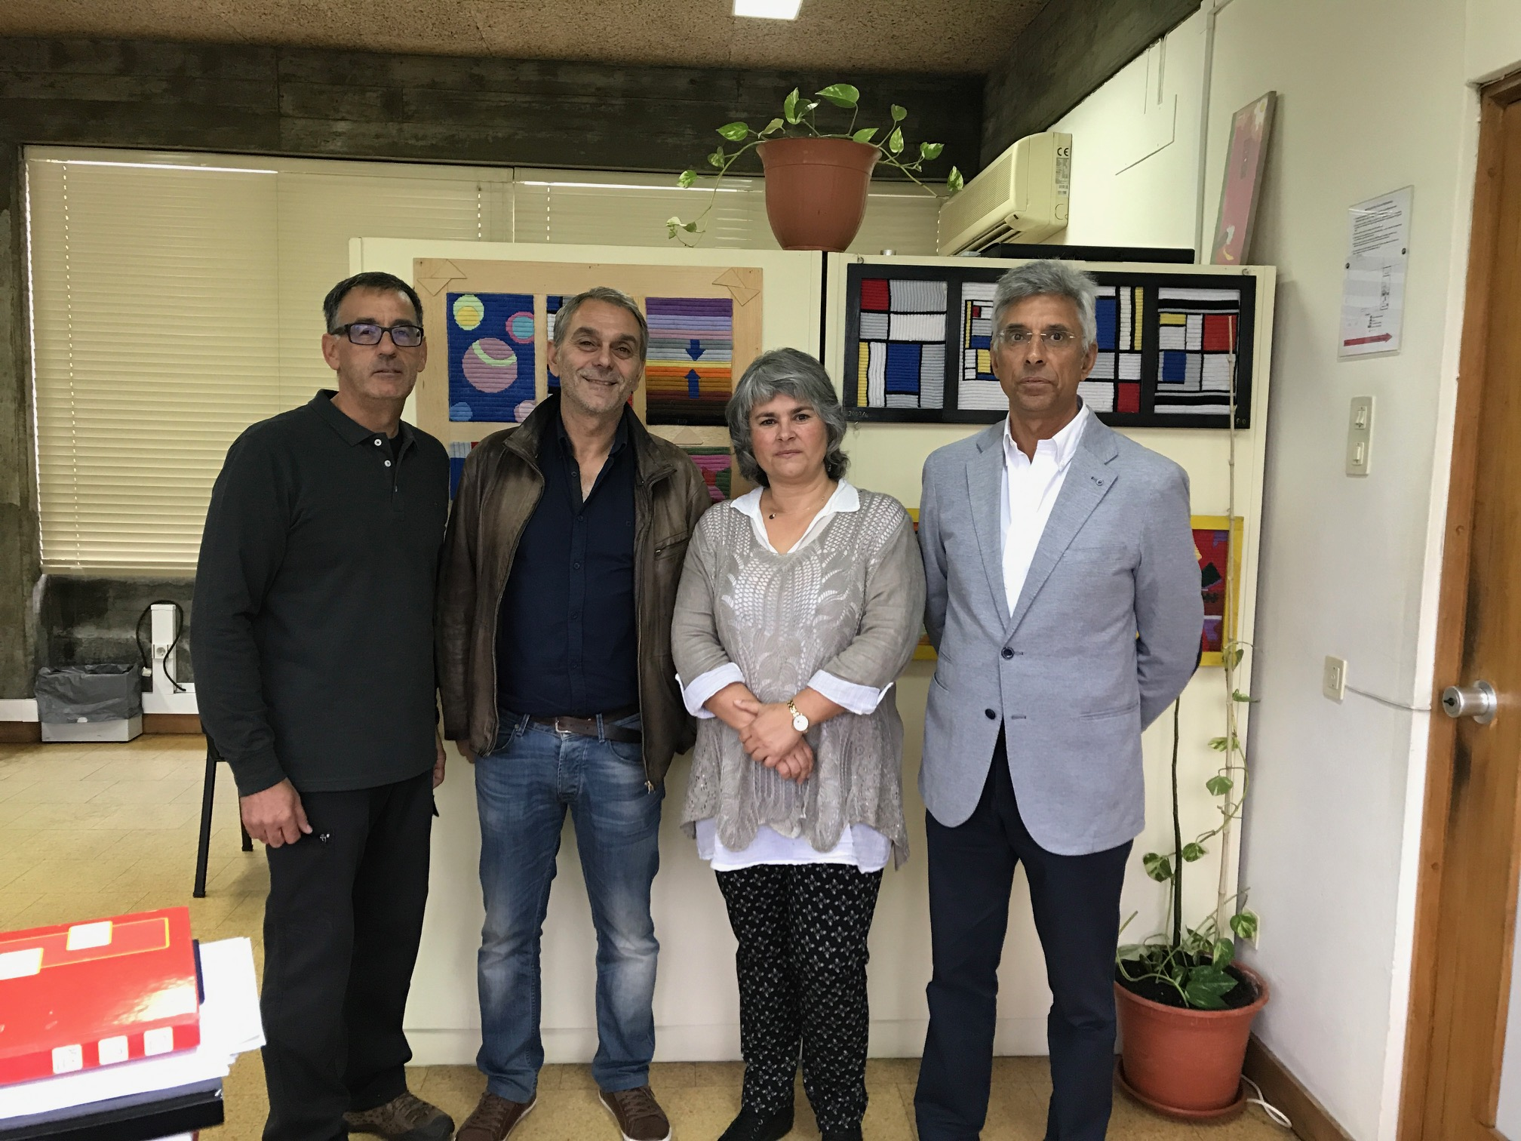
The complete team

Slide 6
School playground

Slide 7
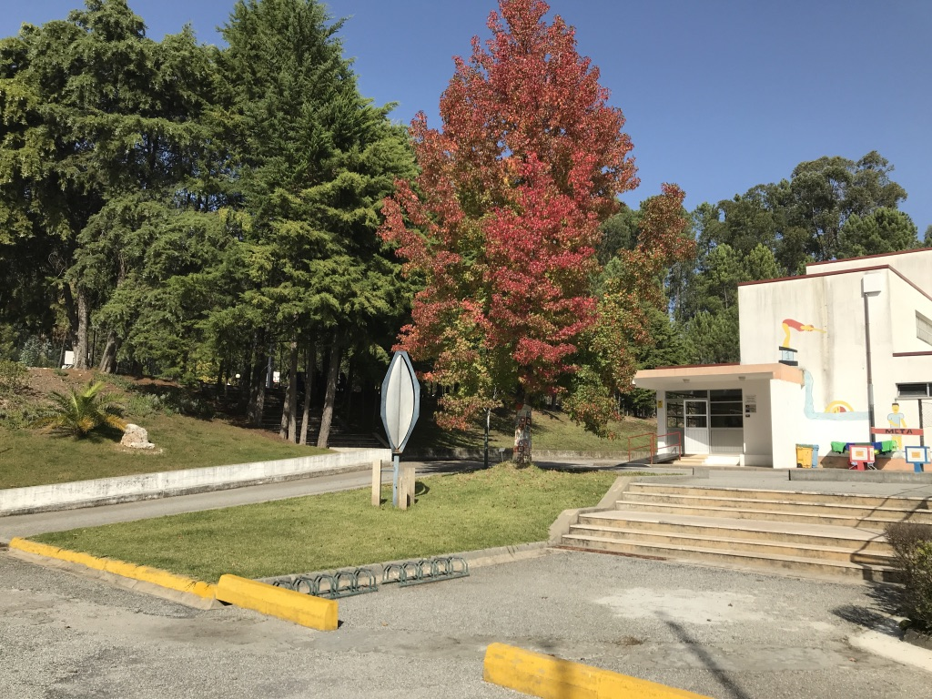
School playground

Slide 8
Indoorplayground

Slide 9
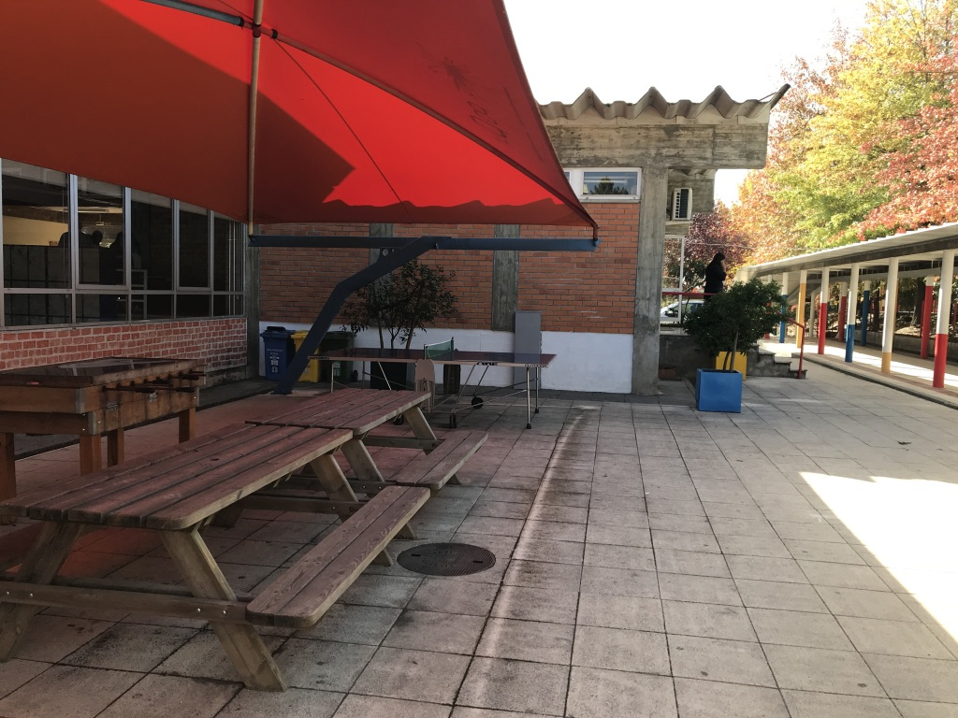
School playground

Slide 10
School yard

Slide 11
School Library

Slide 12
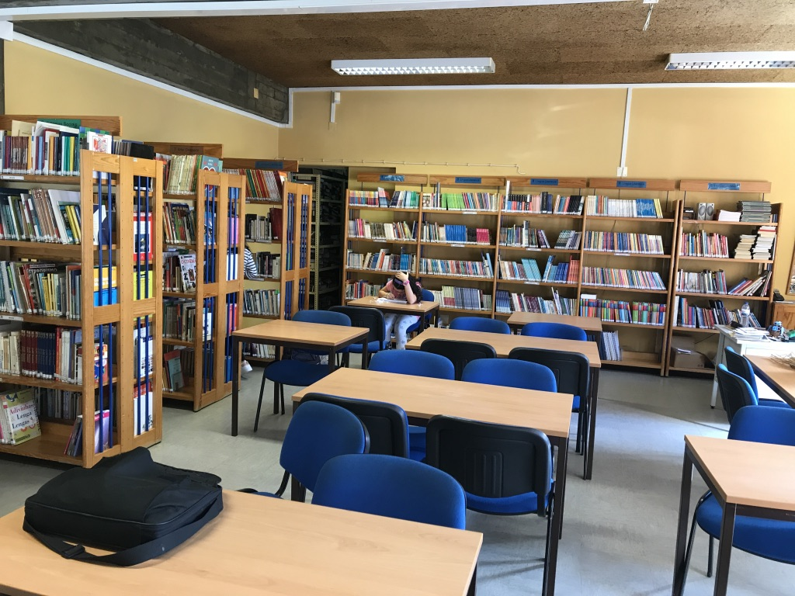
School Library

Slide 13
School playground - Gymnasium

Slide 14
Sports space

Slide 15
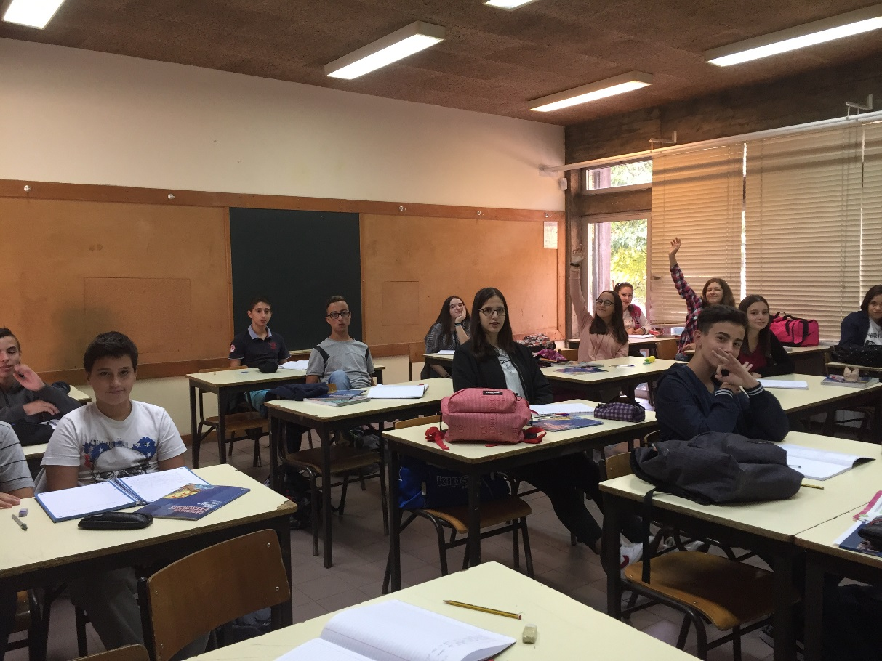
Students – Classroom

Slide 16
Students

Slide 17
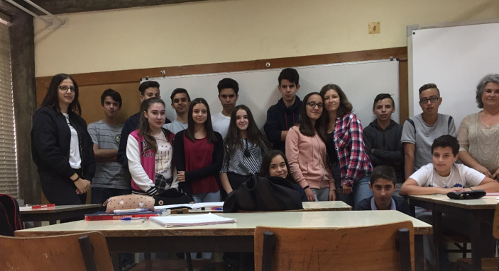
Students

Slide 18
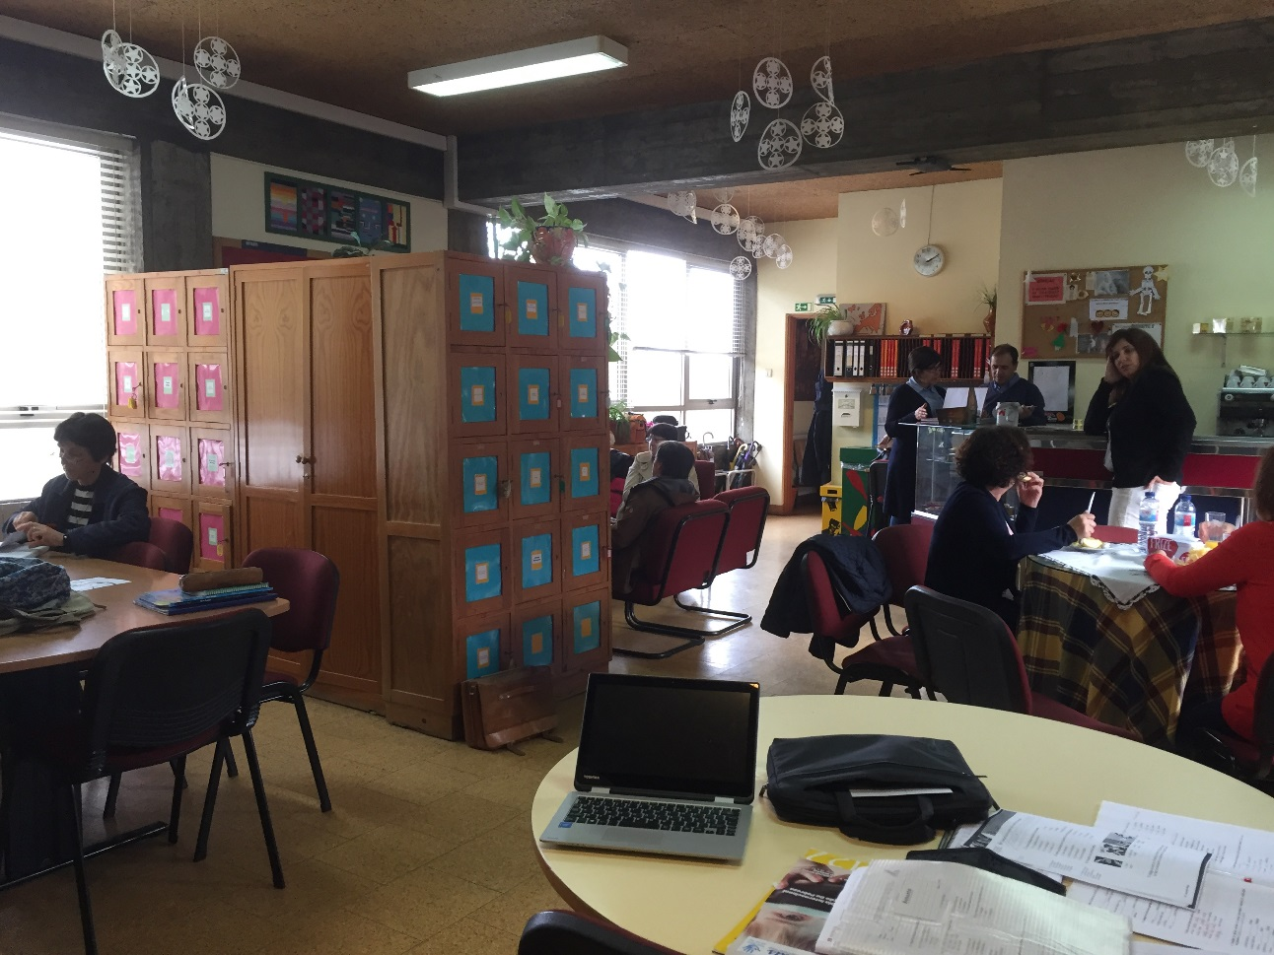
Teachers

Slide 19
Awards for academic merit

