Slide 1
SAFETY SOCIAL NETWORKS

Slide 2
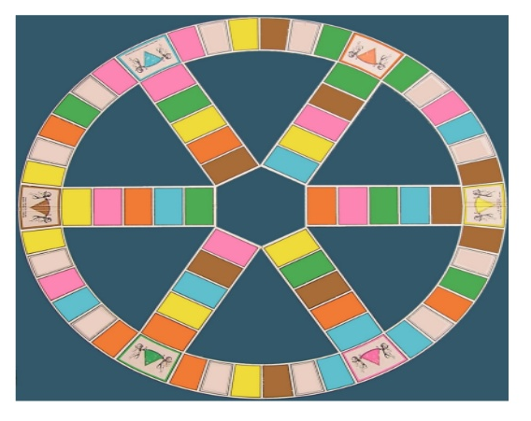
1ST TASK
Privial
http://www.cuidatuimagenonline.com/home/trivial_cuidatuimagenonline.html

Slide 3
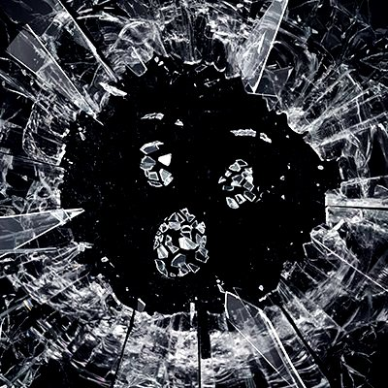
2ND TASK
Is that possible?

Slide 4
Questions
How many social networks do you use in your life?
In “Black mirror” people have social status depend on popularity? Do you agree with that?
Do you believe that fact happens nowdays?
Social relationships are essential in human lives? Why?
Social networks are important for human beings?
In Black Mirror's Chapter characters are happy? Why?
Could you live without social networks?
Social networks are a kind of “new” slavery?
In your opinion, Have we lost face to face contact with social networks?
In future, How do you think that human beings will have social reltationships?

Slide 5
3RD TASK
Privacy Simulator
http://www.simuladordeprivacidad.com/

Slide 6
Who can see our Facebook posts?
For everything we share (photos, post, videos,…), Facebook give us the opportunity to decide who will be able to see it.
However, check each post could be a boring and tedious task. Because of this reason, Facebook give us a default configuration. This configuration will be applied initially to everything we post.
In general, most of the users don´t change this initial configuration, but… Do you konw what happened in your chosen option?

Slide 7
4TH TASK
Be careful with the Webcam
http://www.cuidadoconlawebcam.com/advertencia-webcam-1.shtml

Slide 8
1st Warning: Your webcam always sees you
2nd Warning: Webcam images are real?
3rd Warning: Can you trust?
5th Warning: Your webcam knows so much about you
4th Warning: Your webcam can be activated whenever

Slide 9
NOW
IT´S YOUR TIME

