Slide 1
Portugal

Slide 2
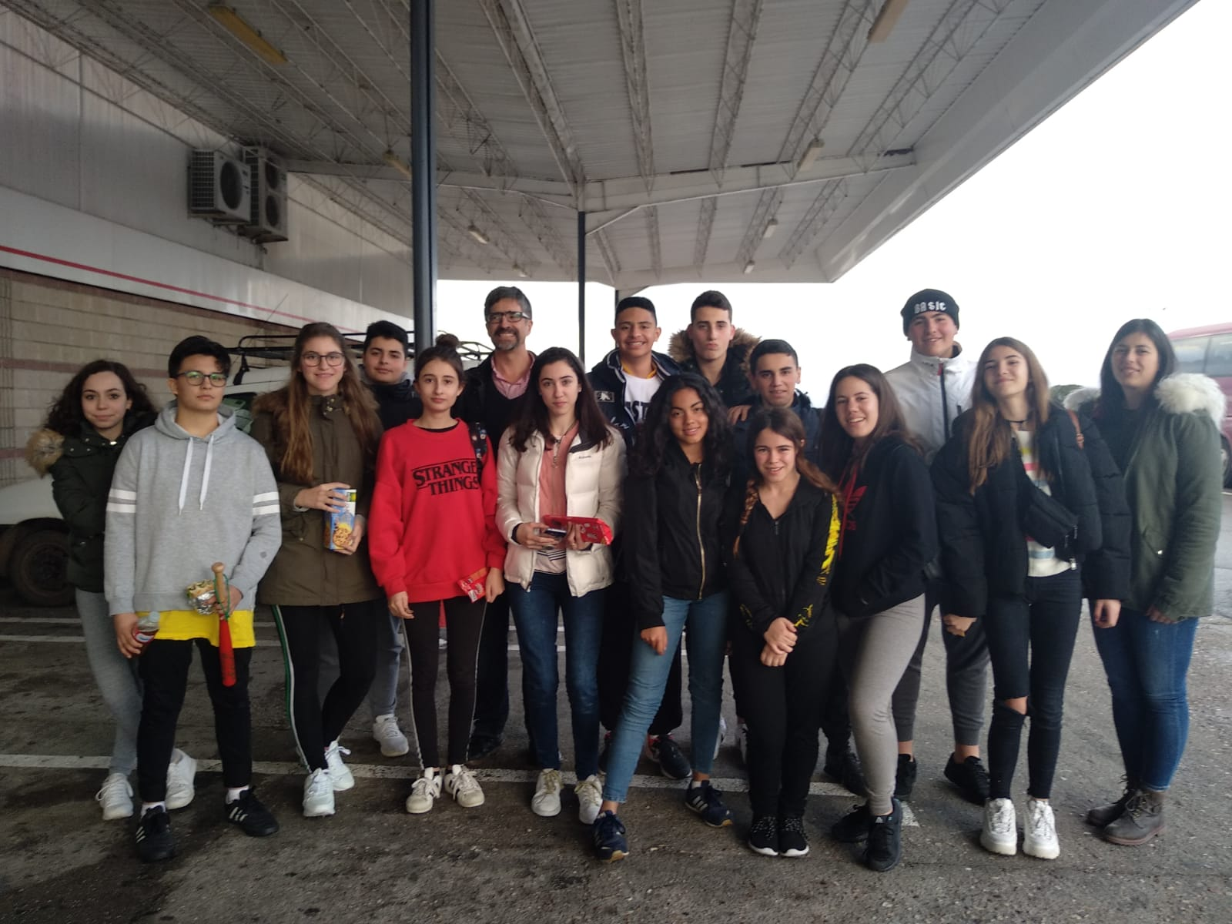
Day 1

Slide 4
Day 2
Monday:
Go to welcome ceremony, after lunch at the school cafeteria.
After workshop, tea party we go with the family.

Slide 10
Day 3
Tuesday:
Go to school and leaving to Viseu by bus.
Reception at Viseu City Hall and Peddy-paper in the city.
Lunch at “Taco Belho” and finish Viseu sightseeing.

Slide 19
Day 4
Wednesday:
Go to integración in our school´s life.
Workshop Segurity in Social Networks.
Lunch to the school and go to home.

Slide 24
Day 5
Thursday:
Go to school and leaving to Oporto.
Visit the portuguese center of Oporto.
Guided to Torre dos Clerigos.
Lunch and visit Oporto`s Riber.

Slide 36
Day 6
Friday:
Games of Social Networks.
Creation of photo poster.
Certificates of the ceremony.
Lunch at the cafeteria and go home

