Slide 1
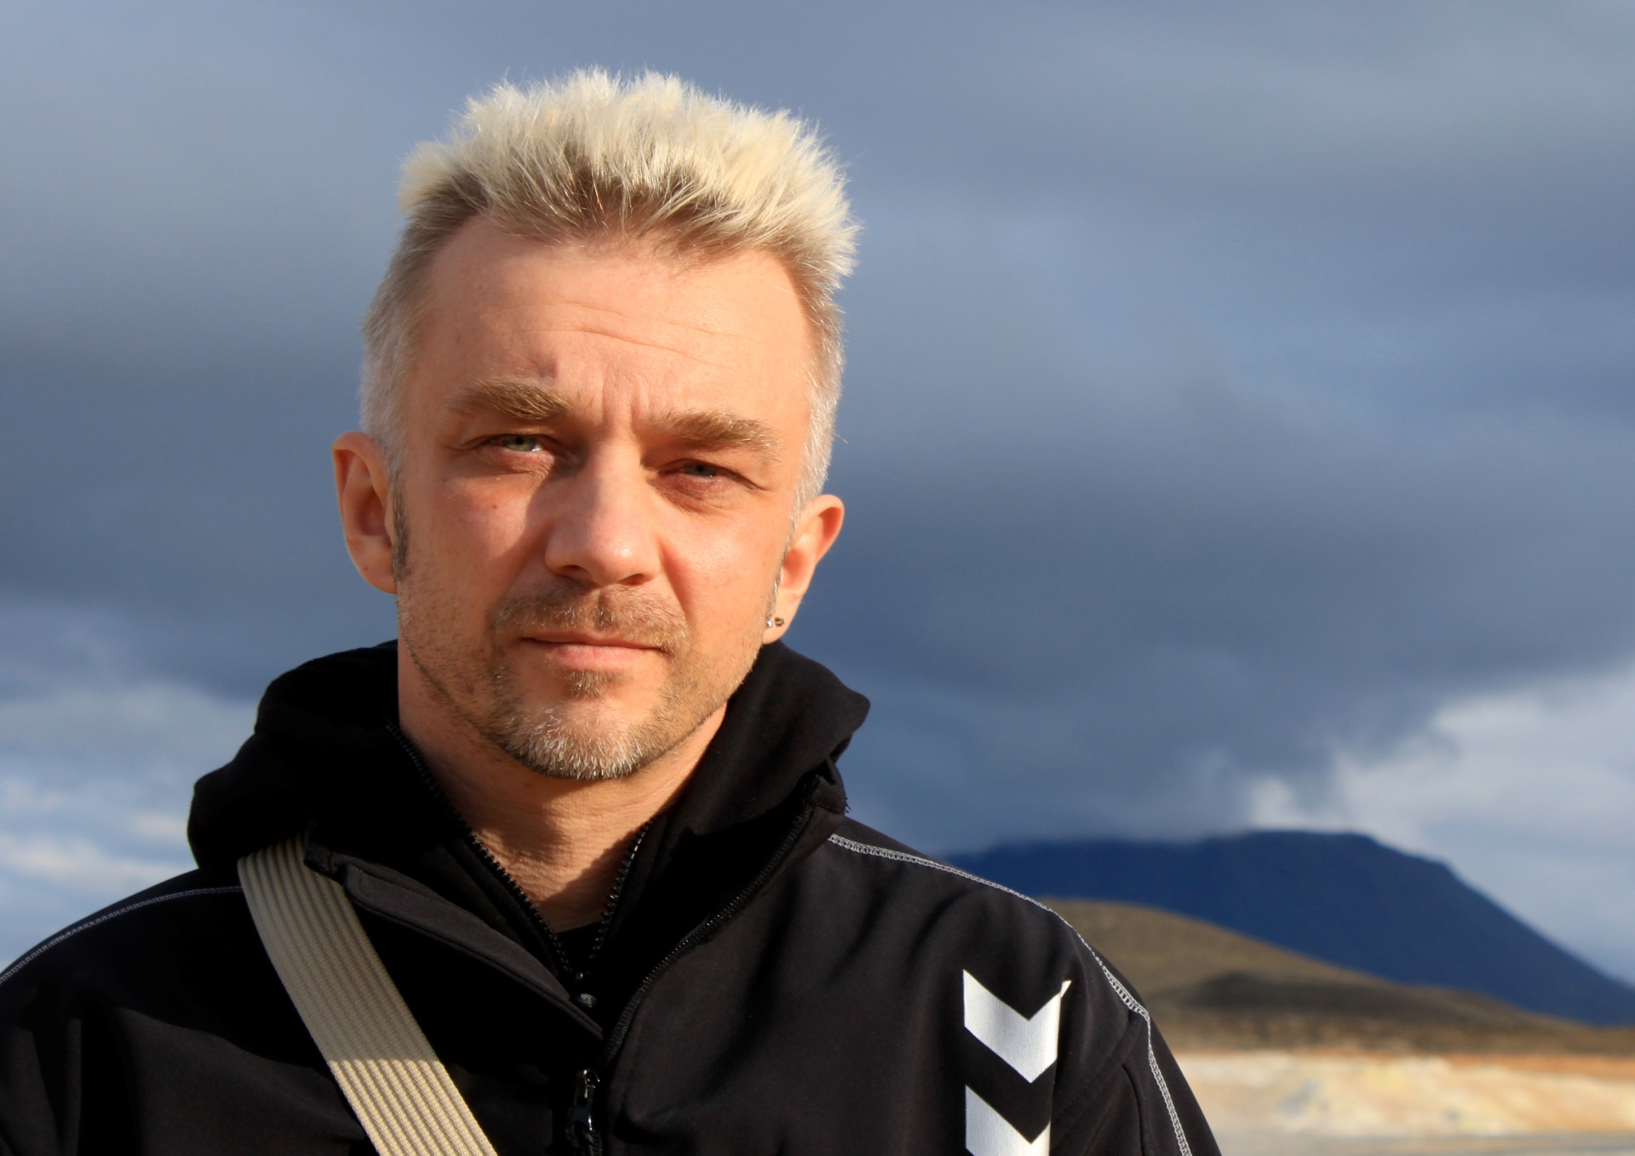
Andrius Mamontovas

Slide 2
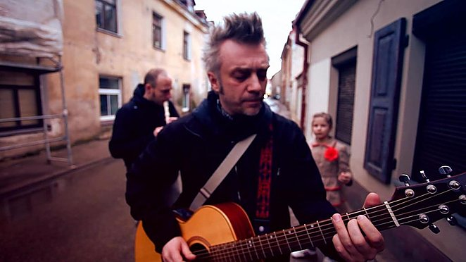
Andrius Mamontovas one of the most deserving singers in Lithuania, producer and actor .

Slide 3
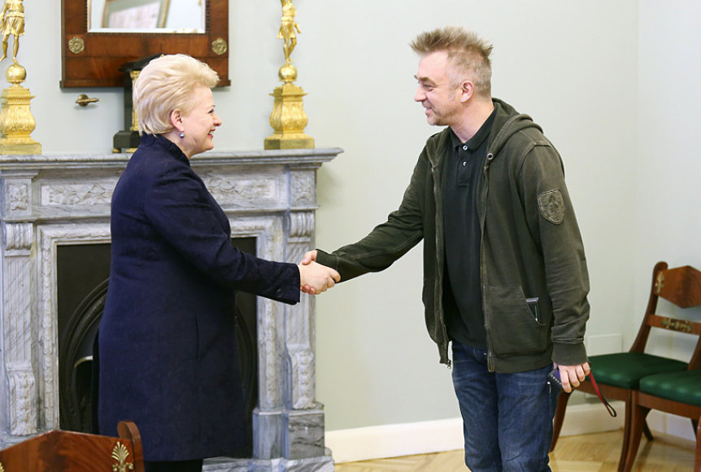
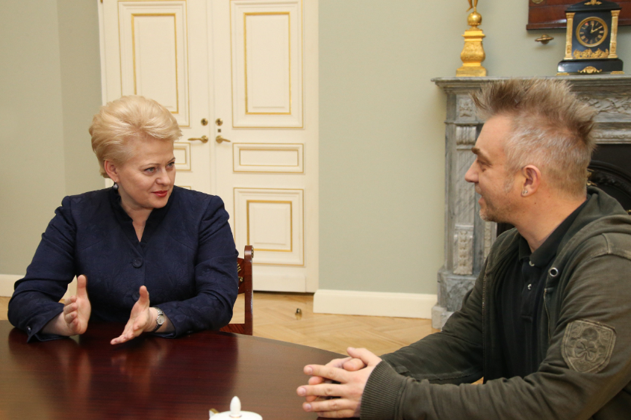
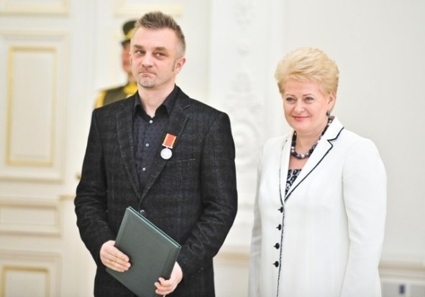
He has received many awards some of them is Order „ for Merits to Lithuania’’ medal and concord order „Pro augenda concordia“ (for fostering concordia) .

Slide 4
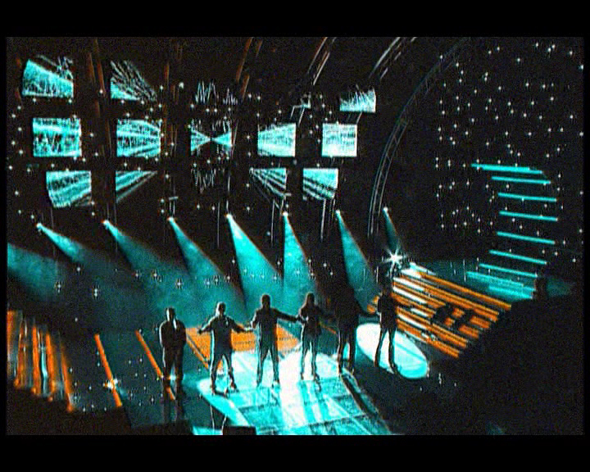
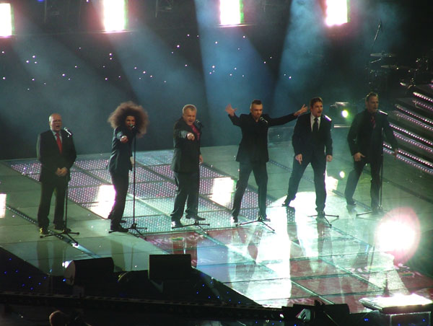
He took part in the Eurovision Song Contest with LT United project .

Slide 5
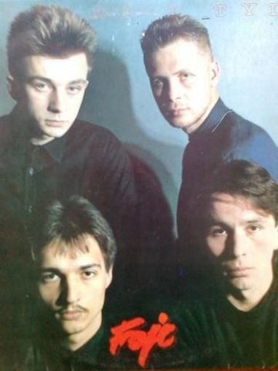
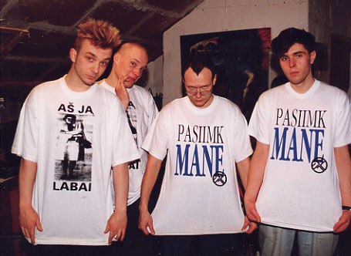
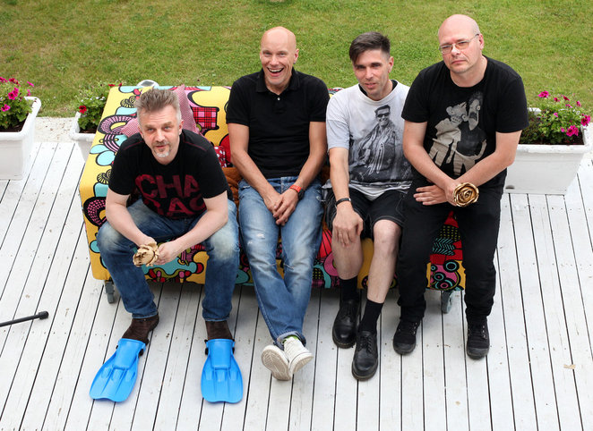
He was permanent (1983-1997) member of Lithuanian rock band ‘’Foje’’

