Slide 1
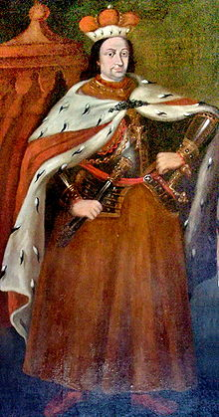
Vytautas the Great
Vytautas the Great was one of the most famous rulers of medieval Lithuania

Slide 2
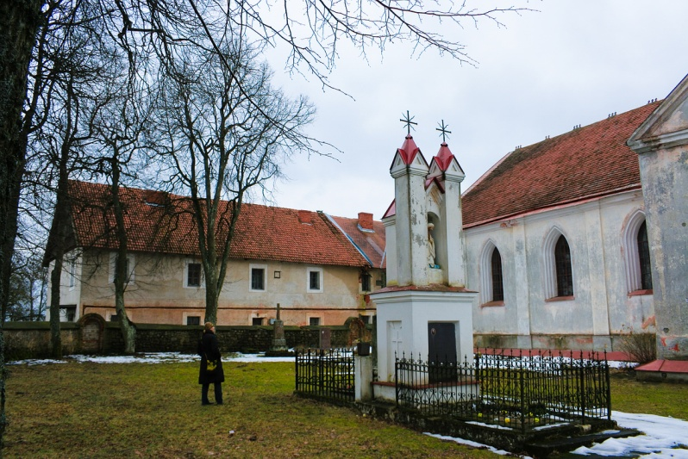
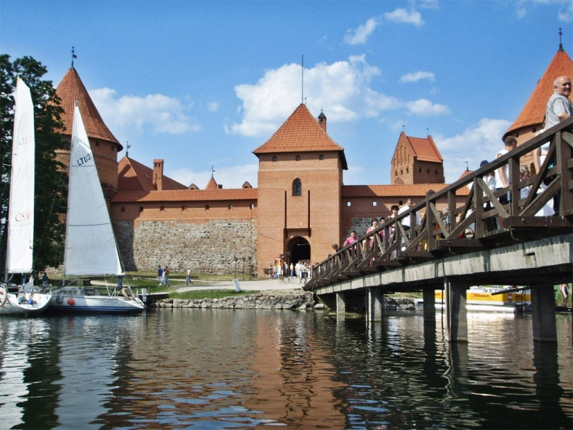
Senieji Trakai and Trakai
He was born on 1350 in Senieji Trakai and died on October 27,1430 in Trakai

Slide 3
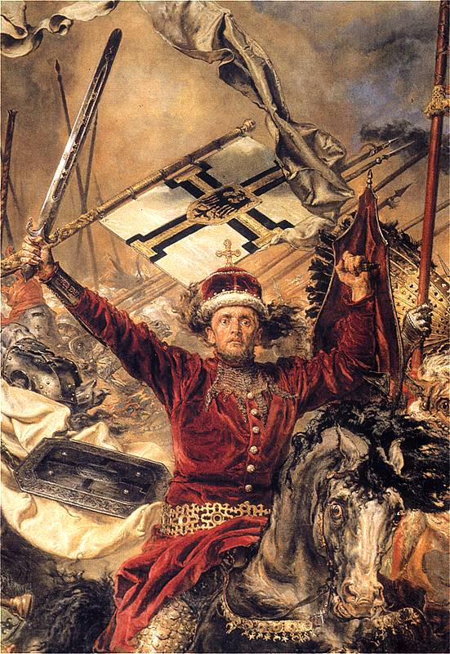
He was famous for defeating the Teutonic order and expanding Lithuania to the Black sea.

Slide 4
Vytautas was part of the ruling dynasty of Lithuania,Gediminids.

Slide 5
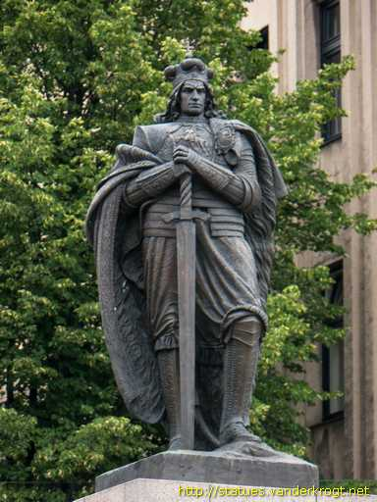
Vytautas in modern Lithuania
In modern Lithuania, Vytautas is revered as a national hero and was an important figure in the national rebirth in the 19th century.

