Slide 1
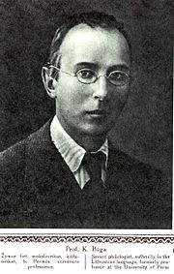
Kazimieras Būga

Slide 2
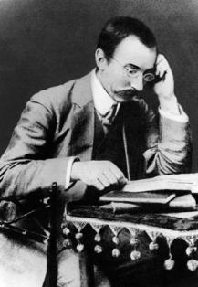
Kazimieras Būga was born in 1879 m. november 6 d. and died in 1924 m. december 2 d.
He was a professor and linguist

Slide 3
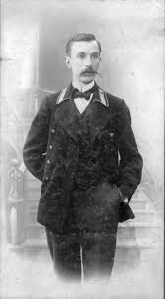
Works About Lithuanian people controllable Lituanica All old Lithuanian relations with Germanic

Slide 4
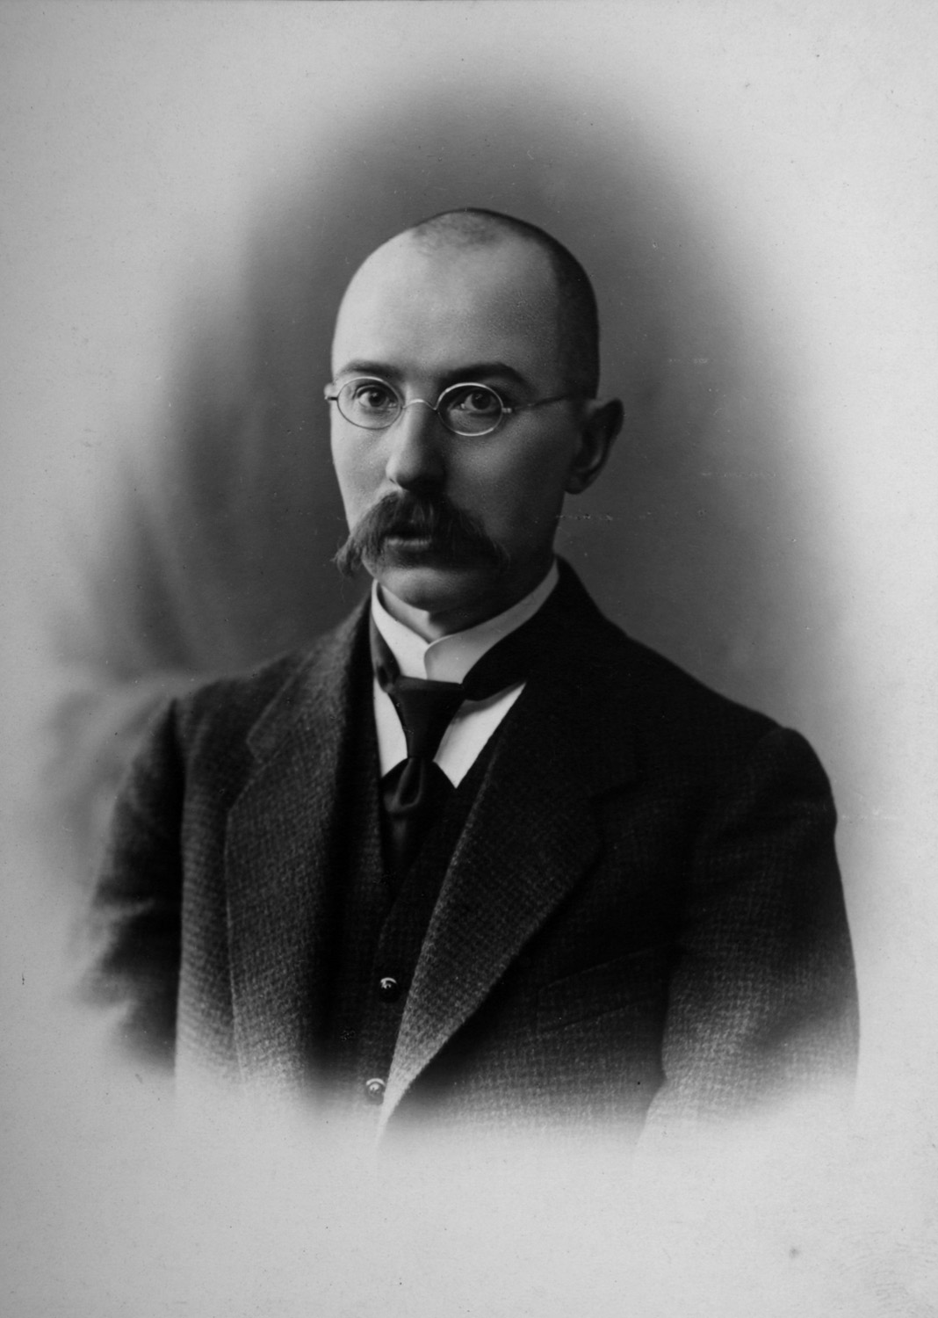
Biography
1897. graduated from the four class. šv. Kotrynos School and, following the will of the parents, the same year he entered the Peterburgo Spiritual Academy, but after a year of her, so the homeless assistance.

Slide 5
The work carried out by Matas Martūnas 7B

