Slide 1
Italian team logo proposals
a.s. 2014/2015

Slide 2
1
By Mazza 3c

Slide 3
2
By Angela T 3C

Slide 4
3
By Archetti

Slide 5
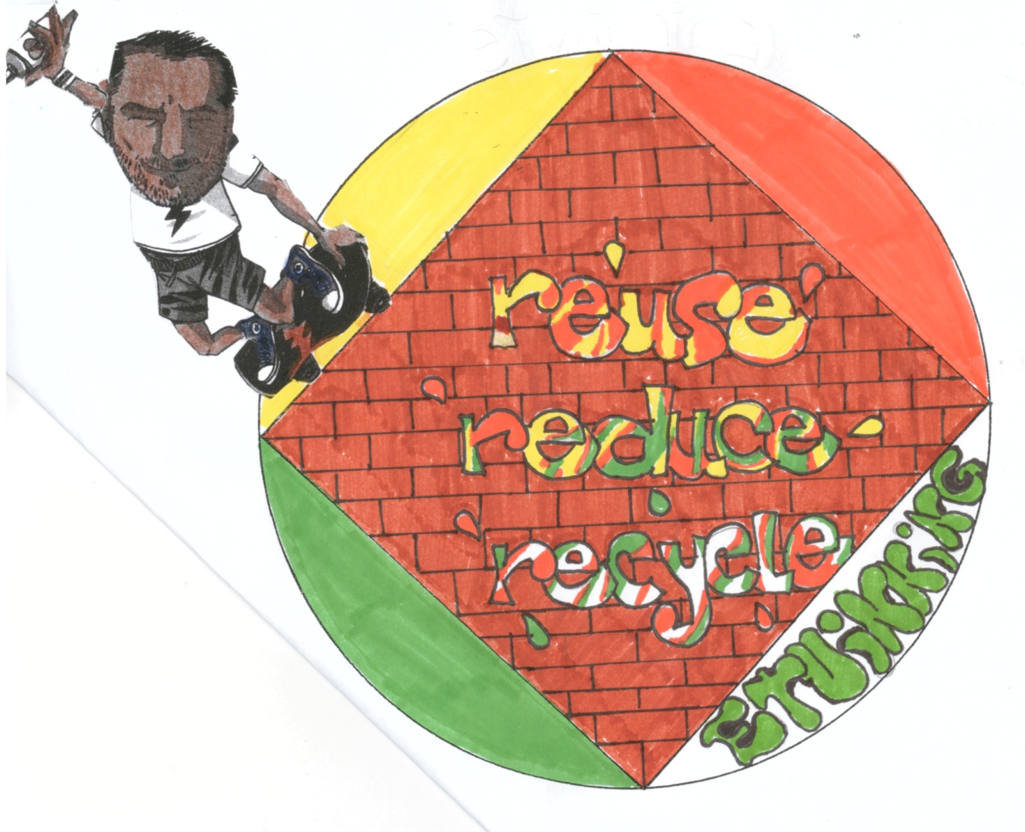
4
By Archetti

Slide 6
5
By Ferrari 3c

Slide 7
6

Slide 8
7
By Personelli 3c

Slide 9
8
By Valota e Zorzetti

Slide 10
9
By Veseli

