Slide 1
Virgilijus Alekna

Slide 2
Awards
Alekna has won two gold medals in the Summer Olympics in the discus throw, the first was in 2000 and the second in 2004.

Slide 3
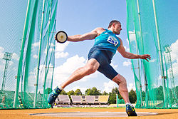
He also won the bronze medal at the 2008 Beijing Summer Olympics.

Slide 4
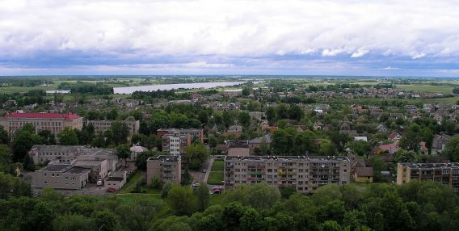
Biography
He was born on 13 February 1972 in Terpeikiai, near Kupiškis

Slide 5
He is married to former long jumper Kristina Sablovskytė-Aleknienė and has two young sons named Martynas and Mykolas.

Slide 6
Injuries
During the 2007 World Championship Virgilijus Alekna competed with an injury. Having sustained the injury on 20 August, he competed in the World Championship's qualification on 28 August and, as a result, suffered a defeat, which broke his 37 victories in a row over the past two years.

Slide 7
By Mindaugas and Dovydas (7a)

