Slide 1
Jonas Mekas
By :Amanda Matulevičiūtė
2015 m.

Slide 2
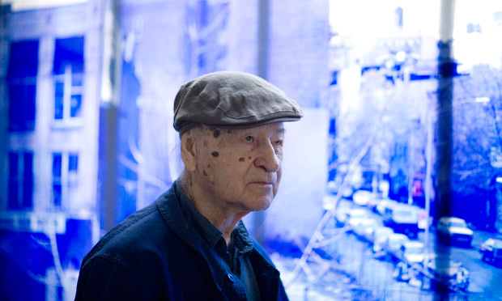
Jonas Mekas , who will be 90 on Christmas Eve, has an intense memory of sitting on his father's bed, aged six, singing a strange little song about daily life in the village in which he grew up in Lithuania.

Slide 3
For an 89-year-old, Mekas has something of the eternal, and eternally rebellious, child about him, but his playfulness marks a seriousness of intent that has kept him working – he is still prolific – for some six decades now. Maverick film-maker Harmony Korine summed up his singular spirit: "Jonas is a true hero of the underground and a radical of the first degree – a shape-shifter and time-fucker… he sees things that others can't… his cinema is a cinema of memory and soul and air and fire. There is no one else like him. His films will live forever."

Slide 4
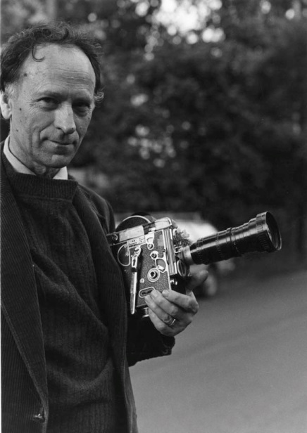
In 50 years, I’ve never heard him say he was tired. He does sleep: I’ve seen it twice—once under an editing table in New York (1963), once on a night train from Italy to France (1967). He has total focus: one thing at a time, whether it’s writing, editing film, bar-hopping, tending his children, managing an office, although he might pull out his camera to film a moment in any those activities. I met him when he was turning 40.

Slide 5
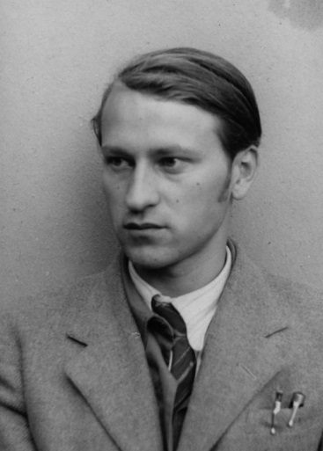
In this country, Jonas Mekas is most closely associated with the American avant-garde film movement that he did so much to cultivate and promote. But looking at his work solely through the lens of the American context misses something of its cosmopolitan and humanist character. A major theme in both his films and poetry is the redemptive power of everyday aesthetic experience in the wake of tragedy. Certainly, this theme is important to a host of American artists.

Slide 6
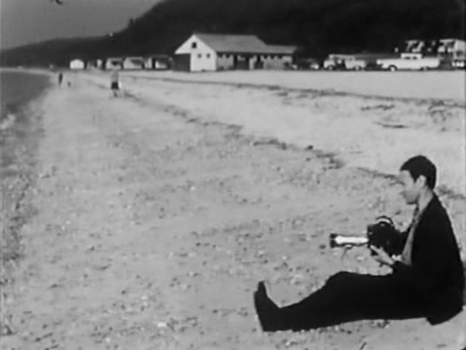
Lithuanian-born artist Jonas Mekas has had a storied career both as a pioneer in American avant-garde cinema and as a film critic and curator. Among other things, he wrote for publications like Film Culture and the Village Voice in the 1950s, and he co-founded New York’s Anthology Film Archives. In honour of his 90th birthday last month, and as a toast to the new year, Early Monthly Segments screens a segment of one of his most personal films.

Slide 7
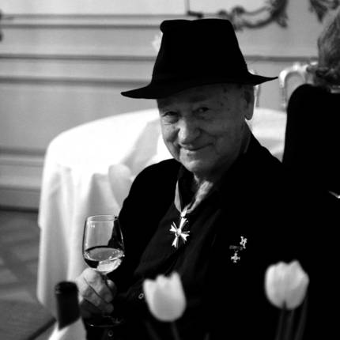
Jonas Mekas wurde am 24. Dezember 1922 in Litauen geboren. 1944 wurden er und sein Bruder Adolfas von den Nazis für acht Monate in ein Arbeitslager gesteckt. Aber auch unter der sowjetischen Besatzung blieb es ihm verwehrt, in der Heimat zu leben. 1946 bis 1948 studierte Mekas Philosophie in Mainz, 1949 emigrierte er mit seinem Bruder in die USA. 1953 begann er, Filme zu drehen. 1954 gründete er die Zeitschrift „Film Culture“, die bis 1996 bestand. Jahrelang hat er aus der Perspektive des New Cinema Filmkritiken in der von Norman Mailer gegründeten Zeitschrift „Village Voice“ geschrieben.

