Slide 1
Arvydas Sabonis
By: Vita Jasaitytė
2015 m.

Slide 2
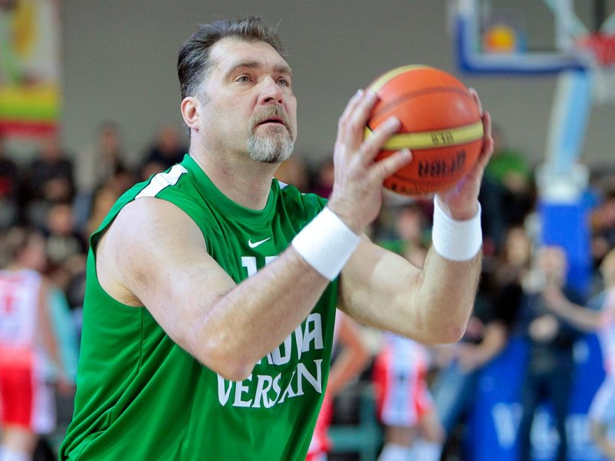
Arvydas Romas Sabonis (born December 19, 1964) is a Lithuanian retired professional basketball player and businessman. Recognized as one of the best European players of his era, he won the Euroscar Award six times, and the Mr. Europa Award twice.

Slide 3
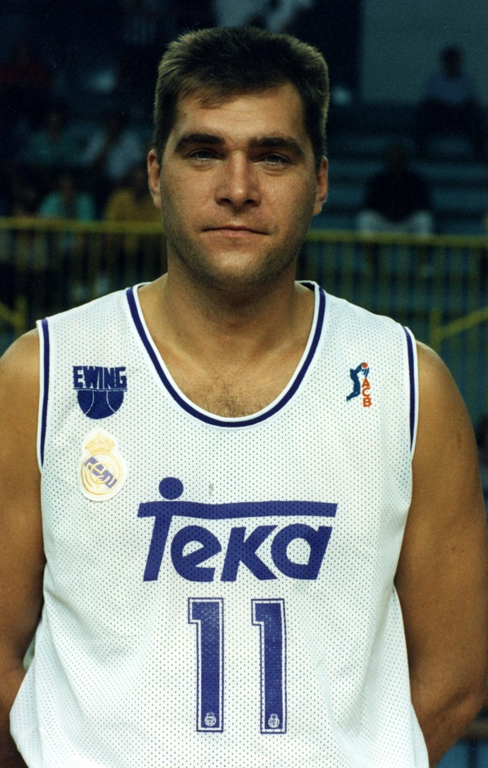
He played in a variety of leagues, and spent seven seasons in the National Basketball Association(NBA) in the United States. Sabonis played the center position and also won a gold medal at the 1988 Summer Olympicsin South Korea for the Soviet Union, and later earned bronze medals at the 1992 and 1996 games while playing for Lithuania. He retired from professional basketball in 2005.

Slide 4
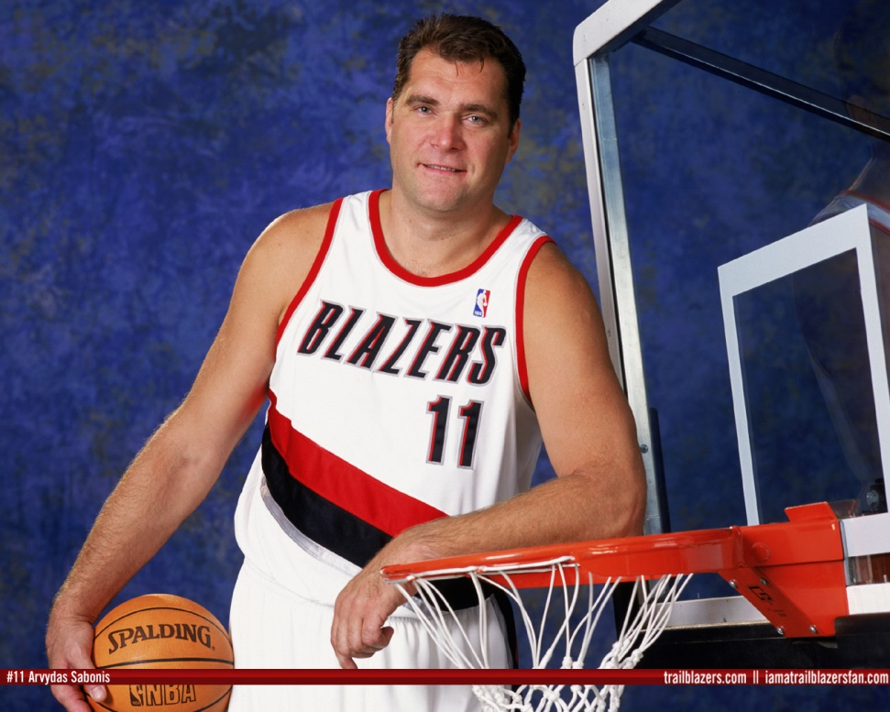
Sabonis is considered one of the best big man passers as well as one of the best overall centers in the history of the game. Bill Walton once called Sabonis a 7'3" Larry Bird due to his unique court vision, shooting range, rugged in-game mentality, and versatility.

Slide 5
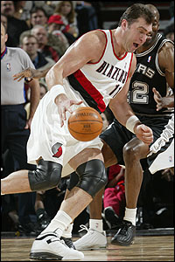
On August 20, 2010, Sabonis was inducted into the FIBA Hall of Fame in recognition of his great play in international competition. On April 4, 2011, Sabonis was named to the Naismith Memorial Basketball Hall of Fame, and he was inducted on August 12, 2011. At that time, he was the tallest player to ever enter the Naismith Memorial Basketball Hall of Fame; one year later, he would be surpassed by 7'4" Ralph Sampson.

Slide 6
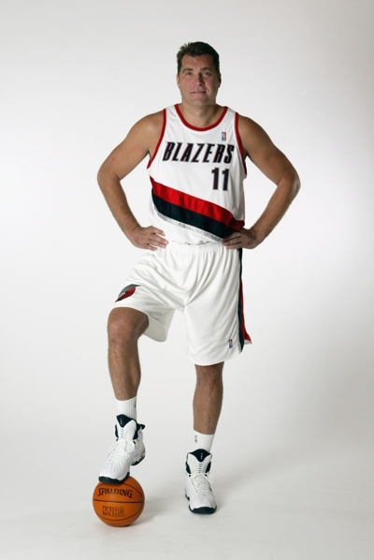
October 24, 2011, Sabonis was voted to be the next president of the Lithuanian Basketball Federation. He resigned from the position on October 2, 2013, but came back on October 10, 2013. Sabonis made his professional debut in 1981 with one of the oldest basketball teams in Lithuania, BC Žalgiris, in his hometown of Kaunas. He won three consecutive Soviet League titles and reached the 1986 Euroleague finals with the team.

Slide 7
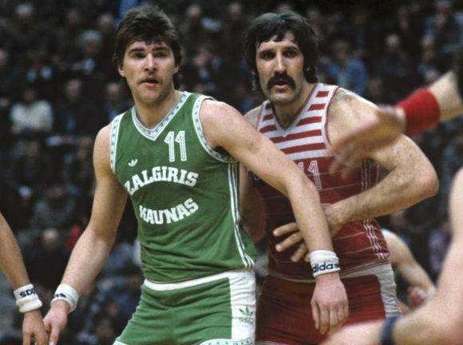
Sabonis was selected by the Atlanta Hawks with the 77th pick of the 1985 NBA Draft. However, the selection was voided because Sabonis was under 21 at the time of the draft. The following spring, he suffered a devastating Achilles' tendon injury. Nevertheless, he was selected by the Portland Trail Blazers with the 24th pick of the 1986 NBA Draft .

Slide 8
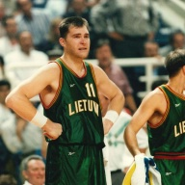
Sabonis was not allowed to play in the NBA by Soviet authorities until 1989. However, he did go to Portland to rehabilitate his injury with Blazers trainers. He also practiced with the team.
In the 1988 Summer Olympics, Sabonis led the Soviet Union to a gold medal with a win against a United States team that featured future NBA All-Stars David Robinson, Mitch Richmond and Danny Manning in the semi-finals. The team later beat Yugoslavia in the finals.

