Slide 1
Sharunas Bartas
Monika Mozūraitytė 7a

Slide 2
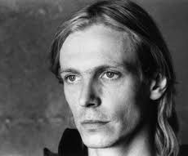
Some facts about him
Sharunas Bartas (born 16 August 1964) is a Lithuanian film director. One of the most prominent Lithuanian film directors internationally from the late 20th century.

Slide 3
Awards:
Audience Award in International Documentary Film Festival Amsterdam, 1990 for "Praėjusios dienos atminimui"
FIPRESCI Prize - Honorable Mention and Prize of the Ecumenical Jury - Special Mention in Berlin International Film Festival, 1992 for „Three days"
FIPRESCI Prize in Viennale, 1995 for "Koridorius"
C.I.C.A.E. Award in Torino International Festival of Young Cinema, 1995 for "Koridorius"
'CinemAvvenire' Award (Best Film on the Relationship Man-Nature) in Venice Film Festival, 2000 for "Freedom"

Slide 4
Filmography:
Tofolaria (1986)
Praėjusios dienos atminimui (1990)
Three days (1991)
Koridorius (1994)
Few of Us (1996)
A Casa (1997)
Freedom (2000)
Visions of Europe (2004)
Seven Invisible Men (2005)
Eastern Drift (2010)

Slide 5
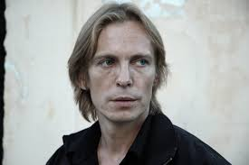
Lithuanian film director:

Slide 6
Lithuanian film director, one of the most outstanding representatives of cinematographers. His contacts with cinema began in 1985 with the TV serial “Sixteen-years-olds” ,where Bartas played one of the main roles. He is a graduate of the Moscow Film School .He made his directorial debut with his diploma film, the short documentary “Tofolaria” and mediocre-length film (which called spectators’ attention)

Slide 7
Thanks you for your attention ☺

