Slide 1
The French Revolution
The important dates
The Constitution
The Statement (declaration) of Human Rights and of the Citizen

Slide 2
The important dates
May 5th, 1789: the General States open in Versailles
June 17th, 1789: the National Assembly
June 20th, 1789: the « jeux de paume »
July 9th, 1789: the National Assembly becomes constituent
July 14th, 1789: storming of the Bastille: prison which represented absolutism
August 11th, 1789: civil and fiscal decree of legality
August 26th, 1789: statement (declaration) of the human right and the citizen
September 3rd, 1790: 1st French Constitution
September, 1792: 1st Republic

Slide 3
The constitution
The constitution fundamental text which fixes the organization of the powers of the State and the sovereignty of the nation.
June 20th, 1789 : The King forbids access to the room where the General Assembly was being held. The representatives of the Third Estate met then in a gymnasium intended for the « jeux de paume », a sport played at that time. They made a commitment not to part before having given France a Constitution.
The French people solemnly proclaimed its attachment to Human Rights and to the principles of national sovereignty such as defined by the Declaration of 1789, confirmed and completed by the introduction of the Constitution of 1946, as well as in rights and duties defined in the Charter of the environment of 20.

Slide 4
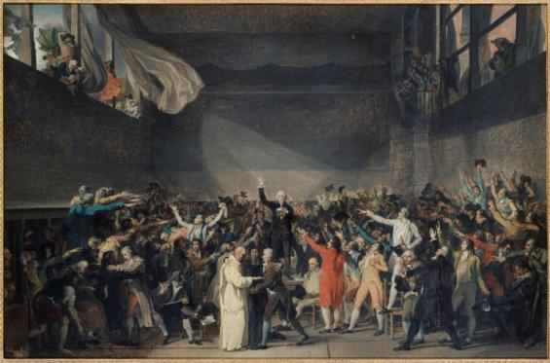

Slide 5
The bill of rights and the citizen
As a consequence, the National Assembly recognizes and declares, in the presence and under the aegis of the supreme Being, the rights of men and of citizens.

Slide 6
Some articles
Art. 1st. People are born and remain free and equal. Social distinctions can only be based on the common utility.
Art. 2. The purpose of any political association is the protection of men’s natural and imprescriptible rights. These rights are: freedom, property, safety, and the resistance to oppression.
Art. 3. The principle of any Sovereignty lies essentially in the Nation. No body, no individual can practice authority which does not emanate from the Nation.

Slide 7
Its legacy
The legacy of the Declaration of the Rights of Men and Citizens are:
The first constitution and all those that followed
And, lately, the word democracy!

Slide 8
Federation Party
It was celebrated in Paris, on July 14th, 1790, one year after the storming of the Bastille. In a climate of national union, a big crowd gathered around the king and members of parliament. Louis XVI attended this party, and took an oath to the Nation and to the law.
Since 1880, this event has been celebrated, every July 14th, as the French National holiday.
Notes:
I would like to stop on the terms:
« National Union »: these are the words used by the President François Holland after the kill of 12 people at Charlie Hebdo last week…

Slide 9
First Republic
The First Republic, officially named French Republic, refers to all the republican systems of France between September, 1792 and May, 1804. Brought by the French Revolution, the First Republic followed the Constitutional monarchy which disappeared on August 10th, 1792 with the storming of the Palace of the Tuileries by the « sans culottes ».
It announced a new era of exercise of power in Europe. September 21st, 1792, members of parliament of the Convention gathered for the first time and decided unanimously on the abolition of the constitutional monarchy in France.
On September 25th, 1792, the Republic was declared " one and inseparable »

