Slide 1
Age of Enlightenment
1) Ideas and Callas Affair
2) Freedom of thought and expression
3) Separation of the 3 powers imagined and claimed by Montesquieu

Slide 2
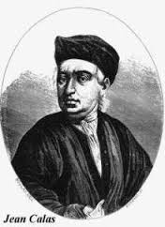
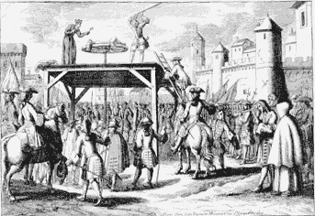
Voltaire and the “Affaire Calas”
Context: Louis XV catholicism : religion of State
Error of justice caused by the religious intolerance and the victim of which was Jean Calas ; he was a trader who lived in Toulouse and he was of Protestant religion.
After being falsely accused of killing his son because he wanted to convert to Christianity, Calas was executed in Toulouse on 10 March 1762.
Voltaire used this judgment to create the Treaty against Intolerance in 1763.
Cause by religions intolerance

Slide 3
Principles defended by the French philosophers of the Enlightenment
Denounced intolerance, life at the court and injustice
Freedom of conscience
Educate people (creation of the Encyclopedia)
3 powers must be separated

Slide 4
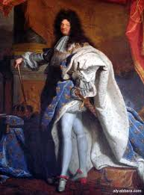
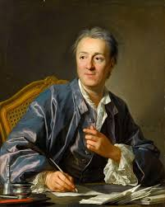
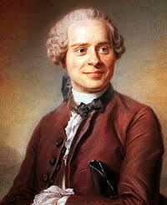
Freedom to think and to express oneself
The Age of the Enlightenment is an intellectual movement of the 17th century. During 16th and 17th century, there were many religious wars and it was an intolerance period. In the XVIII eme century, people were not free to think and to express themselves. It was always necessary to be in agreement with the king.
After the death of Louis the 14th, there are philosopher's movements which are going to try to liberate the thought of people.
In the middle of 18thcentury, Diderot and d’Alembert created the encyclopedie to shine thought of people.
Obscurantism : anything is based on the reason and the thought of people is absent.
Light: is an opposition of the obscurentism ; it consists to liberate thought of people.
The famous philosopher of the 18th century are Diderot, Rousseau, d’Alembert, Montesquieu and Voltaire.
Louis 14 Versailles
Diderot
D’alembert

Slide 5
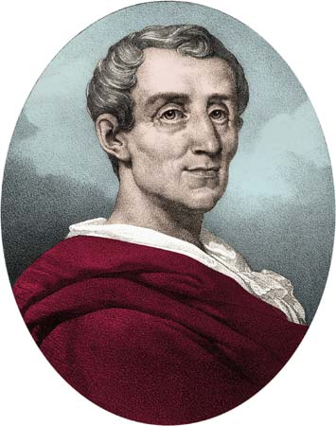
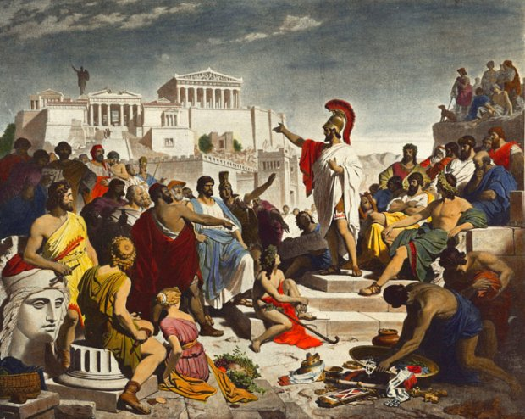
Separation of the 3 powers imagined and claimed by Montesquieu
The first person who had the idea of separating the three powers in France was Montesquieu in XVIIIe century. According to him to separate the powers could limit the injustices.
For him, if a person own the three forms of power, the country is an absolute monarchy.
Montesquieu was inspired by the first form of democracy created by Athenes. It’s in 507 before J.C. to 322 and English Constitution.
Montesquieu
Atheniene democracy

Slide 6
 | Executive power | Legislative power | Judiciary power
What does he do | Made execute the laws | Discuss and passes the laws | considers violations of the law
President and the government
Sénat
Assemblée nationale
Law court

