Slide 1
MUSHROOMS
PREPARED BY:MERVE ÖZTÜRK 5/D

Slide 2
TYPES OF MUSHROOMS
1-TIRMIT MUSHROOM
2-KAR ÇANI MUSHROOM
MELEZ MUSHROOM
ÇAN KABARA MUSHROOM

Slide 3
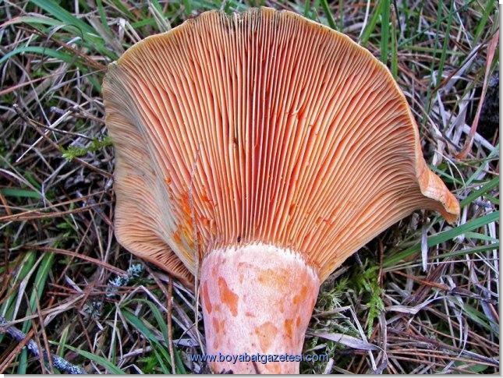
TIRMIT MANTARI
Tırmıt mushrooms are 5-15 cm large.
Tırmıt mushrooms are dry and meat.

Slide 4
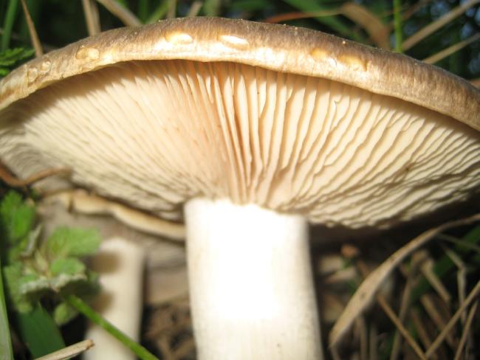
KAR ÇANI MUSHROOM
Karçanı Mushrooms are colour of the white.
Karçanı Mushrooms’s are meat thick

Slide 5
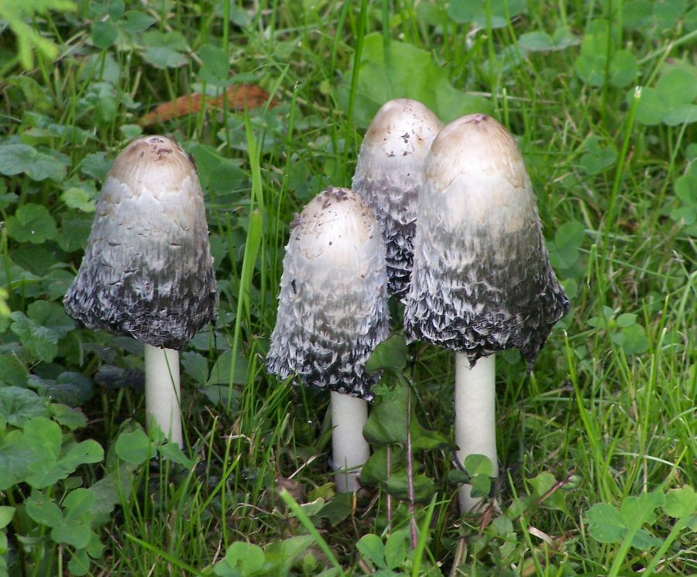
MELEZ MUSHROOM
Melez mushroom is colour yelow and green.
Melez mushroom is 5-15 cm long

Slide 6
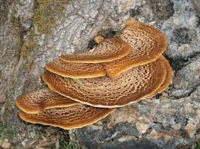
ÇANKABARA MUSHROOM
Çankabara mushroom is comestible.
Çankabara mushroom is season in the autumn.

