Slide 1
EDIBLE MUSHROOM SPECIES

Slide 2
Lactarius volemus
HAT:
Hat is approximately 5-15 cm wide in the upper side matt color varies from red-brown to yellow-brown. Hemispherical when young, ripe takes the form of inverted funnel. Includes curved and wavy edges are slight.

Slide 3
Under the hat in white are often yellowish plaques. Red-brown spots occur when touched. Sports (sports trail) orange rings are yellow.

Slide 4
HANDLE
Handle 4-13 in height and becomes quite thick. Color yellow-brown, rotating stem closer to red-brown.

Slide 5
When the fruit is injured in any way, the injured point consists of milky white liquid drops.
Brown spots on each side of the fruit.
It is so full of meat and mushrooms, cream color is yellow, yellow-brown would be time.

Slide 6
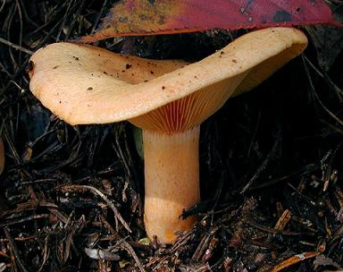
LACTARIUS VOLEMUS

Slide 7
SNOW BELL MUSHROOM
3-7 cm in diameter, Plano convex-convex, usually with a low umbo; margin inrolled at first, hairy with yellowish granules; time, yellow granules scattered white wet adhesive surface, concentrate on the second disc; flesh is thick, soft, white.
Gills decurrent, wax, white, yellow edges are sometimes scattered away.

Slide 8
Saba 2.5 to 7.0 cm long, 0.5 to 1.3 cm, sticky, yellow above yellow granules equal, thick white paste below.
Spores 8-10 x 4-5 microns, elliptical, flat. Spore print is white.
Friends in mixed conifer wood, in the autumn, are found scattered.

Slide 9
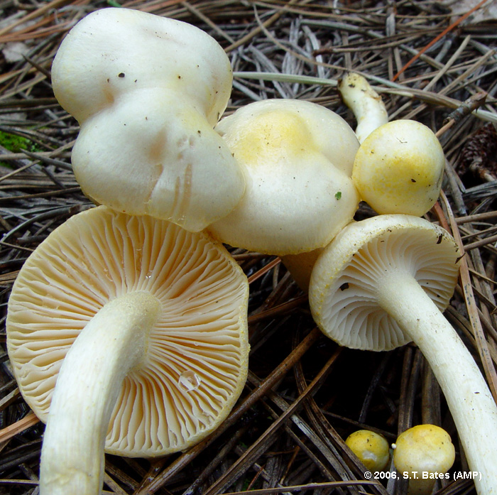
SNOW BELL MUSHROOM

Slide 10
HYBRİD MUSHROOM
Bell-shaped or hemispherical, 5-15 cm büyüklügündedir..bilhass is damp weather sticky. The outermost membrane covering may be peeled easily. As the membrane attaches to the handle with a thin cover, then the cover on the handle remains in a thimble.
Hats gold, lemon, orange, yellow, orange or orange brown.
Short, young, lemon-colored, sulfur-colored, yellow, later becomes olive green.
Small and round, square later. Color sulfur yellow in color, then a green olive. Wounded becomes reddish brown.

Slide 11
Yellow, but quickly turns brown resembling rust. 5-10 cm in length. The rest of the upstream side of the ferrule or brown granular or faint cry of gibidir.kat and golden yellow color, soft and spongy becomes watery, Touching becomes reddish brown.
Hybrid mushroom grows where and when
Between June and November in hybrid and leafy trees stand under conditions encouraging, both in the valley slopes are seen as individual and rare.
The taste of the old mule hybrid mushrooms, sour, good; smell nice, like a little resin. The outer skin should peel off the hat, because it is adhesive that sticks to everything you touch. However, to peel the outer part of young specimens is difficult, there should be deleted Therefore, in relation to the least.

Slide 12
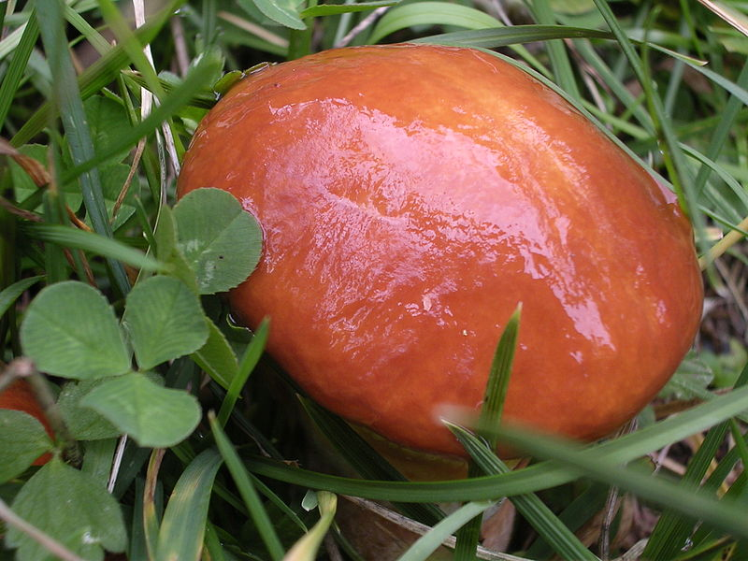
HYBRID MUSHROOM

Slide 13
PİNE MUSHROOM STUD
Pine mushroom hobnail milk deer known as the fungus. Is an edible mushroom species. After the spring, autumn, in the pine forest, sometimes under the pine needles, sometimes it is seen that the deficit grows. One occurs in single or scattered groups.

Slide 14

PİNE MUSHROOM STUD

Slide 15
HONEY MUSHROOM
Hats 3-15 cm. in diameter, very variable, first convex, then flattened and the center is flat, wavy-edged, dirty yellow, straw-colored or dark brown, often turns into olive-red color. Hats are like fish scales on the provisional stamps. Saba 6-15 x 1-1.5 cm., Bottom right part is narrowing, or bulging bottom. First white, then reddish-brown, the ring is towards the top of the handle, this ring before white, then yellowish or pinkish spots stained dark brown and usually occurs on older people. Sports pale cream color, elliptic 8-9 x 5-6 m. Over-leaved and coniferous trees, and one of them has as many clusters on stumps or overturned on forest land are intensively. Seen during the summer until early winter. There are populations in very dense mass. Cooked and eaten a valuable types of fungi.

Slide 16
This mushroom-shaped black long thread Rhizomorf name given to the form that is easily spread by root resembling the shoelace special micelle formation. Rhizomorf are being digested wood wind like an octopus, in particular, is widely between soil or wood bark. This fungus is one of the most dangerous parasites and fungi in almost every type of needle-leaved trees. Also continues to t and loss of life as a saprophyte. Not to the detriment of the fungus is no effective treatment

Slide 17
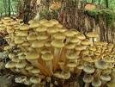
HONEY MUSHROOM

Slide 18
BENİ DİNLEDİĞİNİZ İÇİN TEŞEKKÜR EDERİMMMMM
☺☺ HATİCE SUDE
GÜNYELİ

