Slide 1
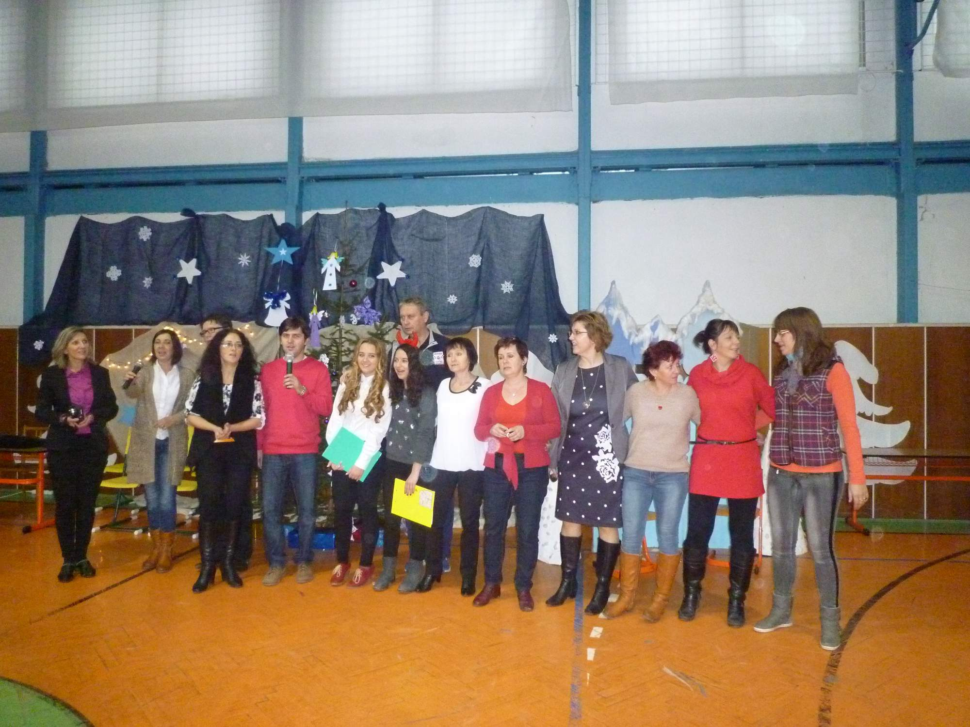
Our school, ZŠ s MŠ Dlhé nad Cirochou, Slovakia.
....The Silent Night.......

Slide 2
Our clever pupils.....

Slide 3
....the 5 th class with its teacher....

Slide 4
...Creative shops, before Christmas...
Christmas decorations...
....cute things.....

Slide 5
And something quite more from our school.....

Slide 6
...some Christmas sweets......

Slide 7
.......thanks for your attention.... Did you like it, I think, yes......

