Slide 1
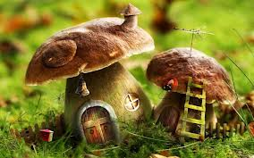
MUSHROOMS
EDIBLE FUNGİ

Slide 2
SOME FEATURES OF MUSHROOMS

Slide 3
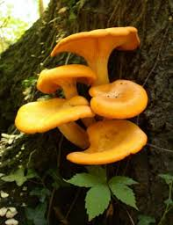
There are not poisonous mushroom that grow on trees Fragrant and delicious when cut a piece from the hat color of the inner part of the unchanging mushrooms are safe Types of mushrooms that grow in the lawns non poisonous

Slide 4
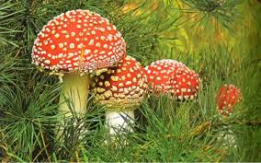
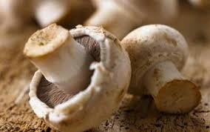
Boil the water with salt or vinegar fungus removes of toxic. Eaten Poison or fungi grows on soil separately. Mushroom yogurt along with food poisoning prevents. Cook removes the toxic fungus

Slide 5
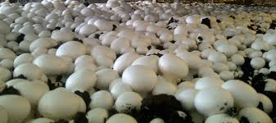
EDIBLE FUNGUS VARIETIES

Slide 6
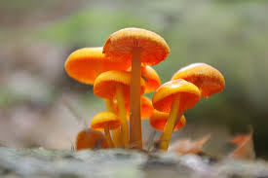
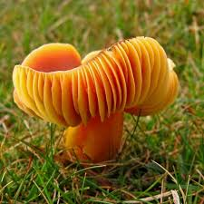
Agaricus campestris
Amanita caesarea
Armillaria mellea
Boletus badius
Boletus bovinus
Boletus edulis
Boletus elegans
Boletus luteus
Cantharellus cibarius
Chroogomphus rutilus
Coprinus comatus
Craterellus cornucopioides
Fistulina hepatica
Hydnum coralloides
Hydnum repandum

Slide 7
AUTHOR: HANIM ŞEVVAL ŞİMŞEK
CLASS: 5/D
SCHOOL NUMBER: 5
( I DON’T LİKE MUSHROOM )

