Slide 1
Hi, we are pupils from 7th class. We want to introduce ourselves.
Tadeaš, Veronika, Soňa, Justína,Timo,Michaela, Viktória, Zuzka

Slide 2
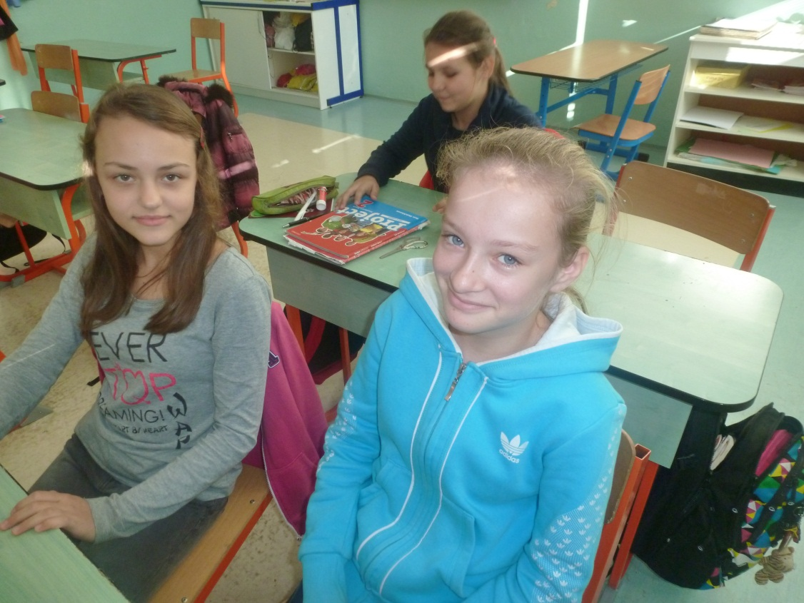
We are Veronika and Michaela. We like learning English. We like drawing and painting.

Slide 3
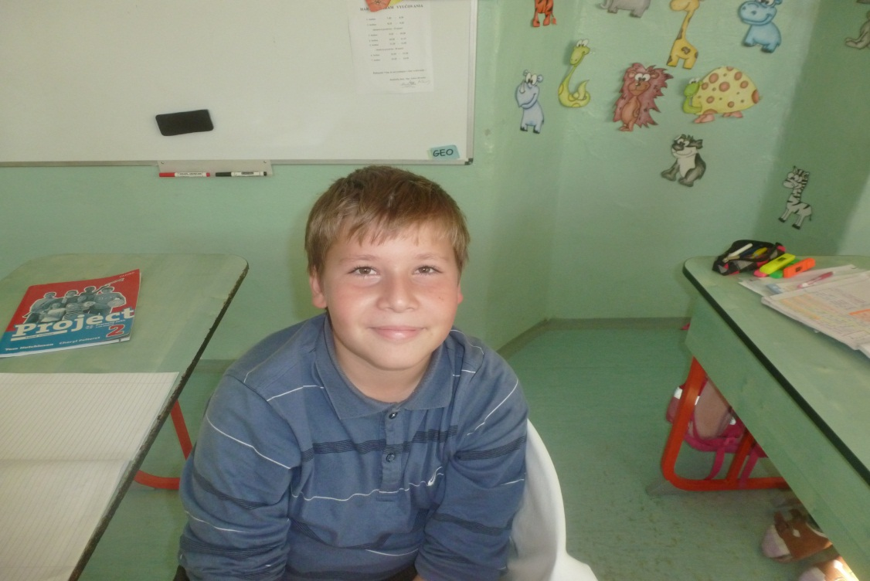
I am Tadeaš. I am 11. I like working in the garden.

Slide 4
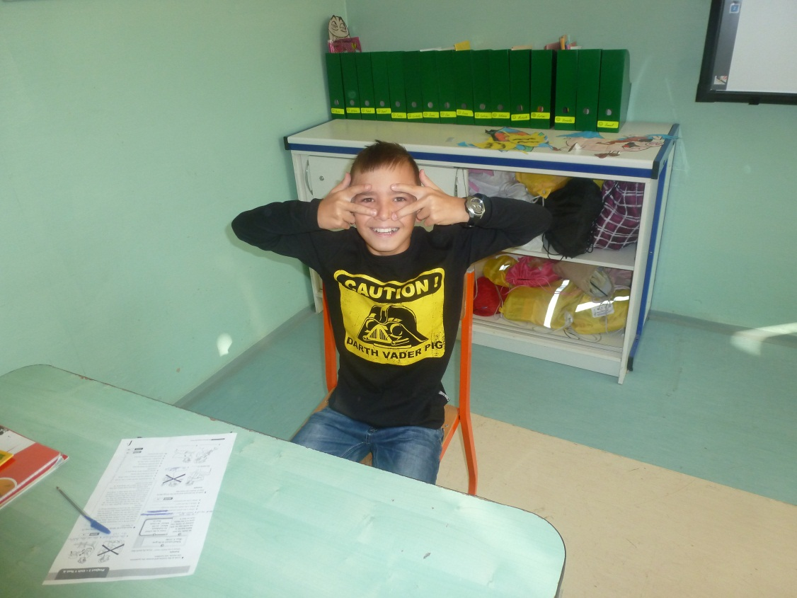
Hi, My name is Timo. I like playing football. I don´t like school.

Slide 5
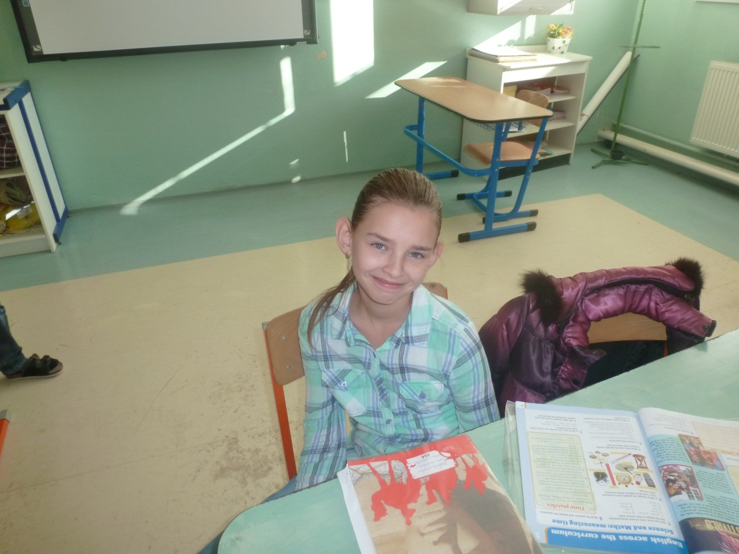
Hi, I am Soňa. I am 12. I have got a very big dog. I like it.

Slide 6
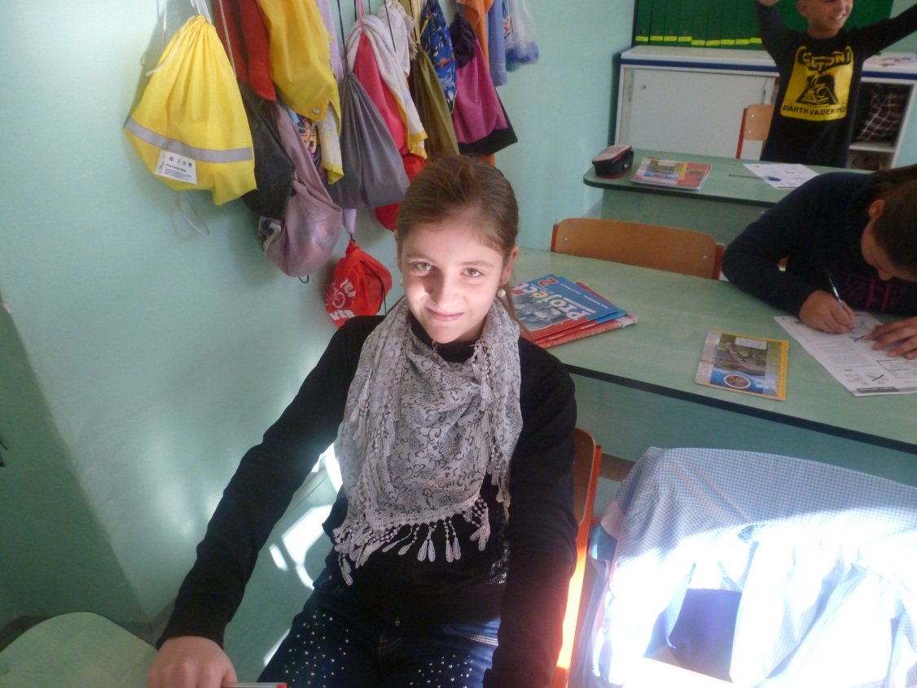
My name is Viktória. I love watching cartoons. My favourite colour is blue.

Slide 7
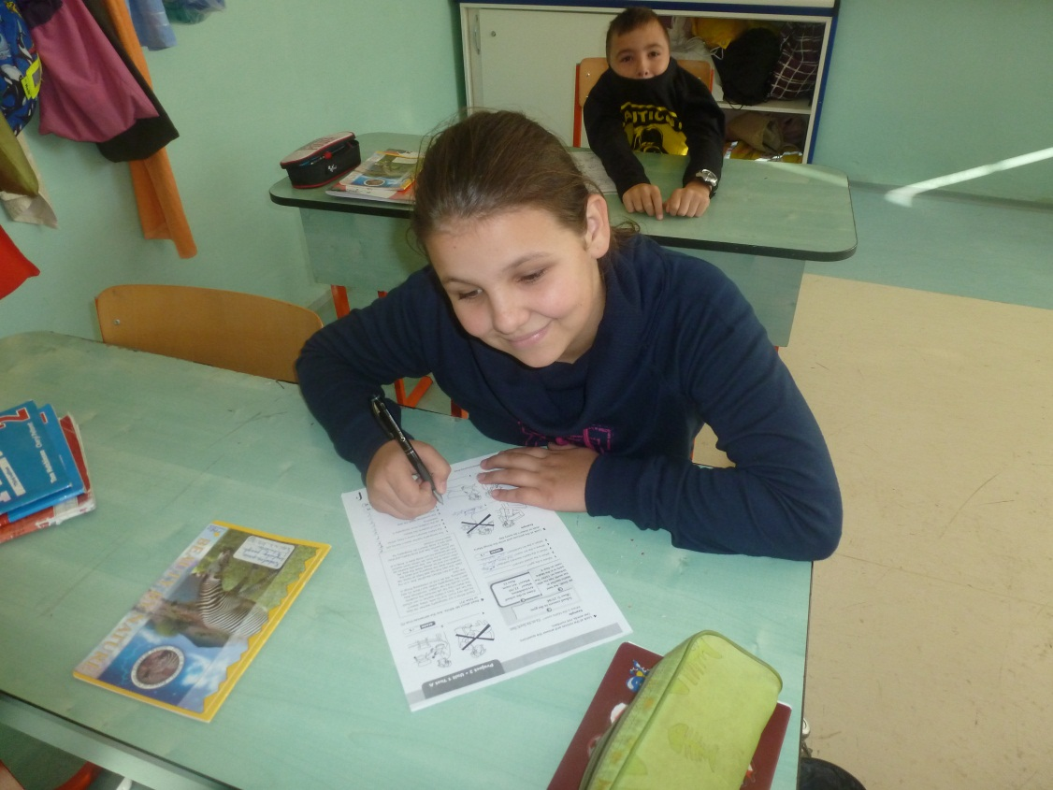
I am Justína. I am from Slovakia. I like dancing and painting.

Slide 8
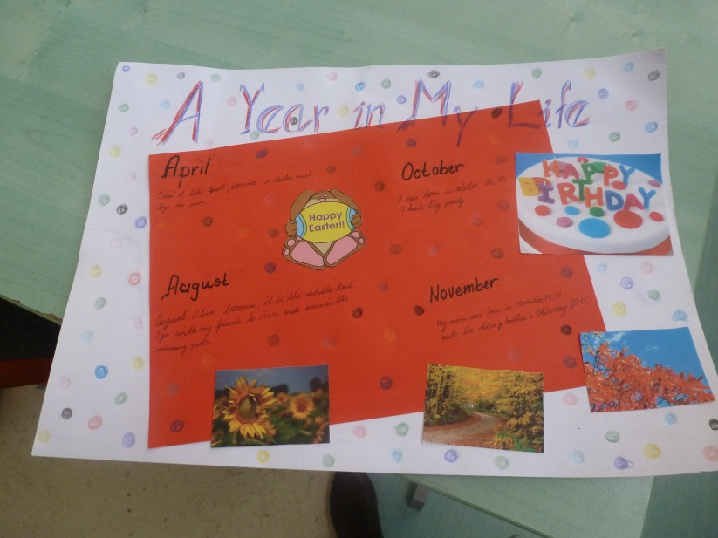
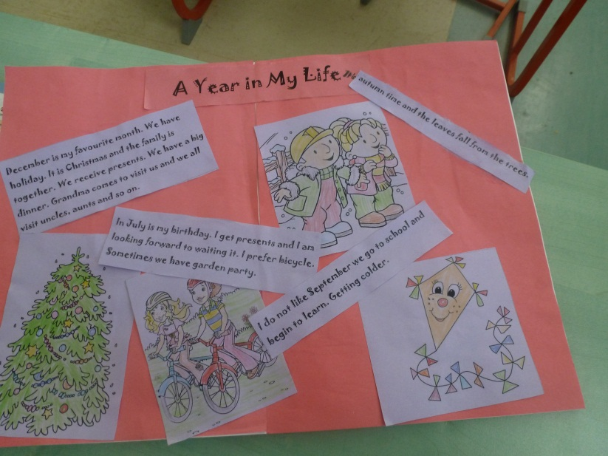
There are some our projects and drawings.

Slide 9
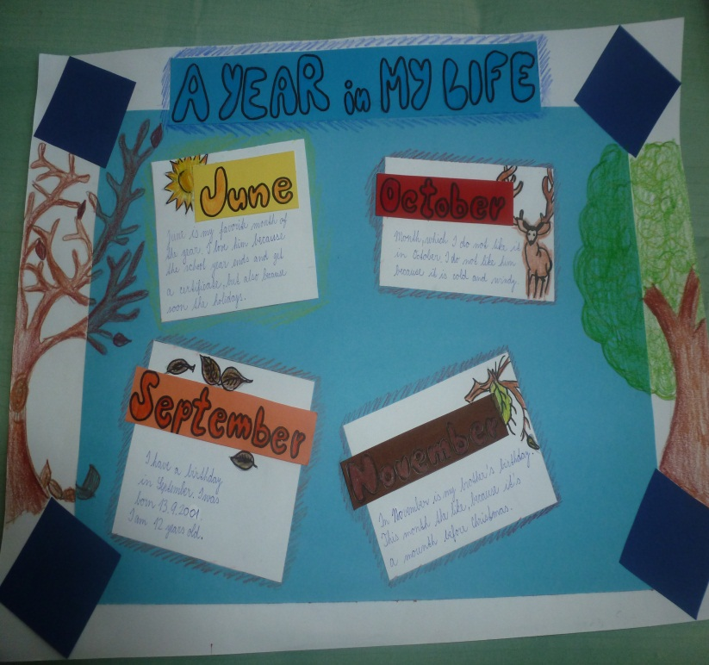
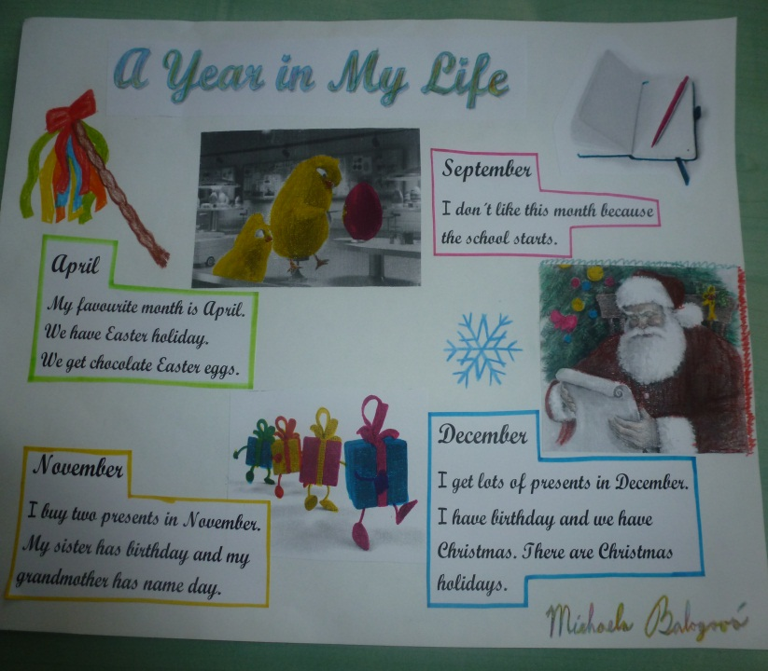

Slide 10
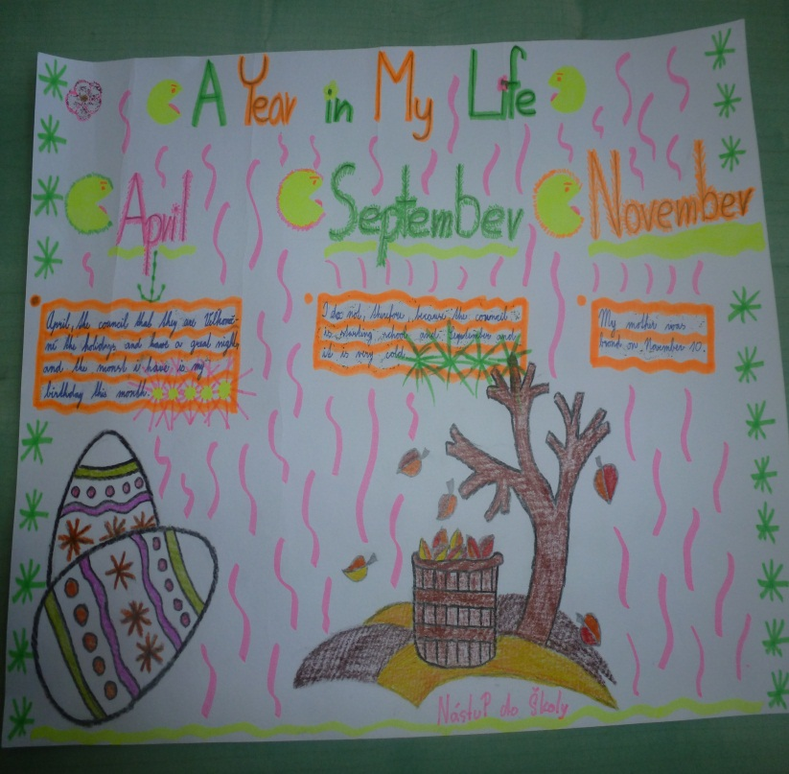
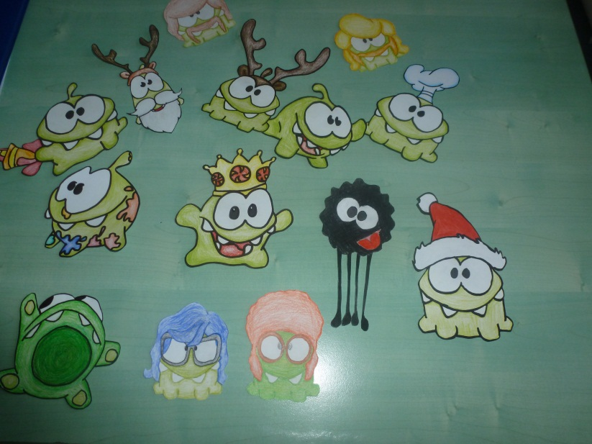

Slide 11
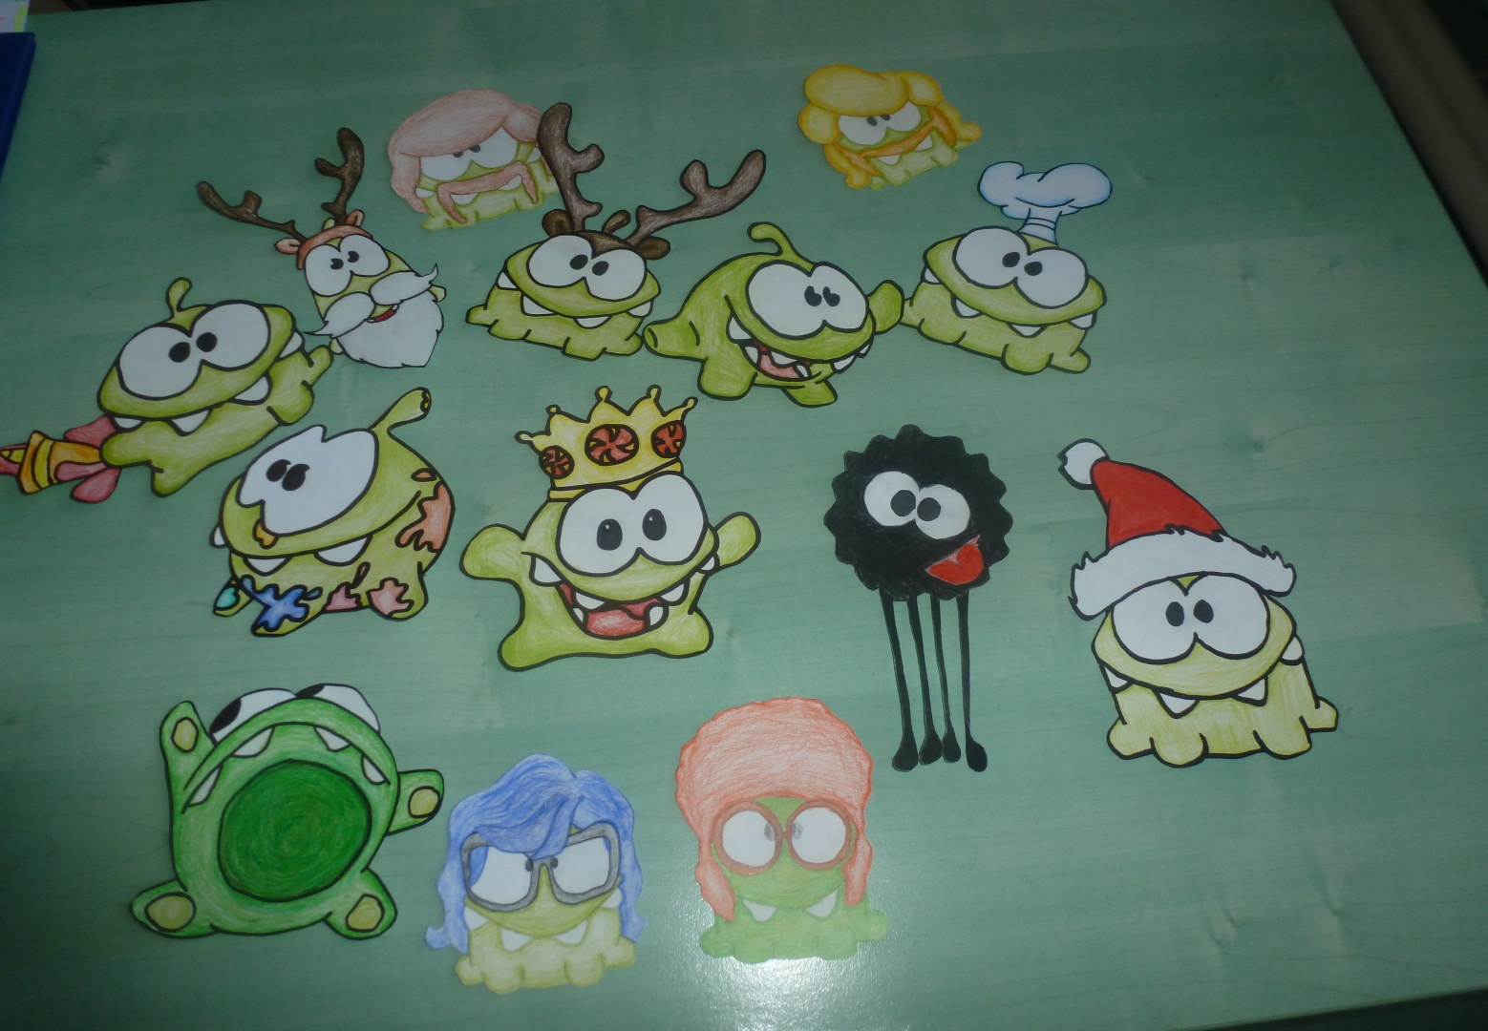

Slide 12
Thanks for your attention.
Bye from Slovakia.

