Slide 1
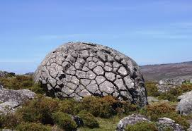
Arouca Geopark Cuisine

Slide 2
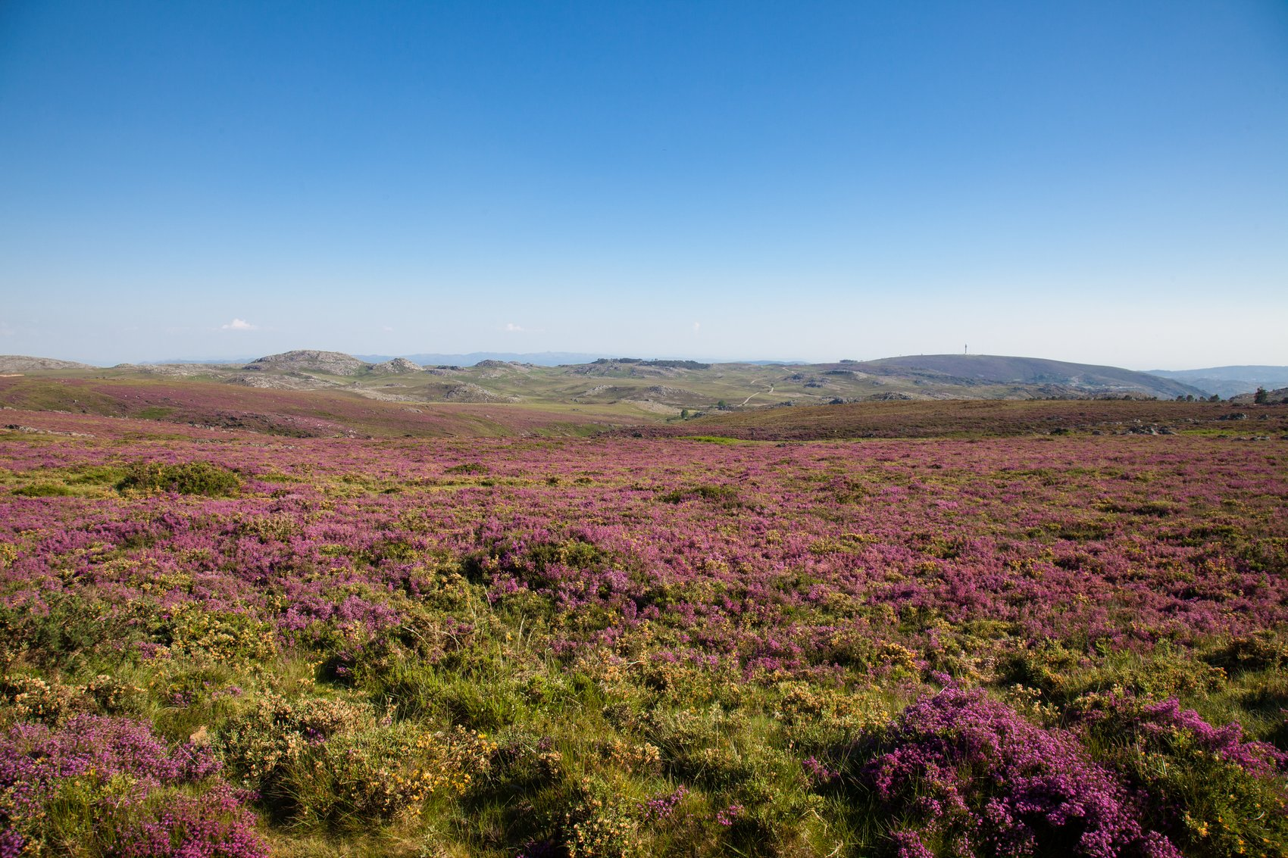
Arouca Geopark Cuisine
Starters
. Green soup
. Codfish cakes
Main dishes
. Portuguese boiled meat with vegetables
. Arouquesa roast veal
Desserts
. Egg chestnuts
. Trilobiscuits

Slide 3
STARTERS

Slide 4
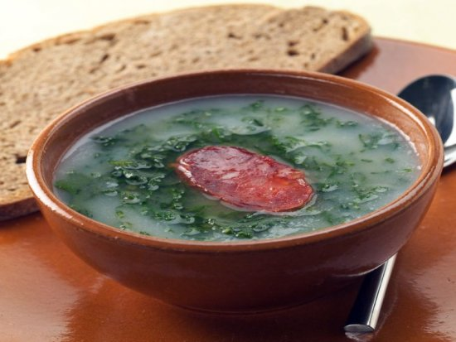
“Caldo Verde” (Green Soup)
Ingredients:
1 dl olive oil
1 onion
2 cloves garlic
1 Chorizo sausage
250 g potatoes
250 g cornbread
200 g kale
1 litre water
Salt to taste
Preparation Time: 40’
Cooking Time: 15’
Serves 4

Slide 5
“Caldo Verde” (Green Soup)
Method
1. Peel the onion, the garlic and the potatoes.
2. Roughly chop the onion and the garlic.
3. Dice the potatoes into pieces.
4. Put the pot on the stove and let it warm up.
5. Add olive oil, onion and garlic. Let it simmer.
6. Add the potatoes and the Chorizo. Let it cook.
7. Remove the sausage and cut into slices.
8. Blend the soup to puree.
9. Season with salt.
10. Wash and chop the kale into thin strips.
11. Add the kale to the soup.
12. Plate the soup, drizzle with olive oil and
serve with corn bread.

Slide 6
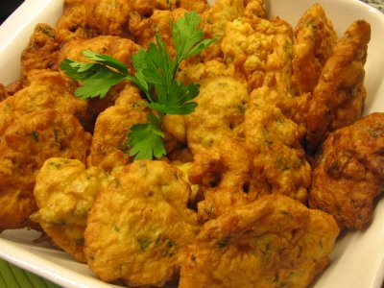
Codfish cakes
Ingredients:
400g boneless salt codfish (Bacalhau)
4 eggs
1 ½ cups flour
1/2 small minced onion
2 tsp fresh minced parsley
1/4 tsp black pepper
1/2 tsp garlic powder
1 tbsp olive oil
Salt to taste
Olive oil for frying
Preparation Time: 30’
Cooking Time: 30’
Serves 4

Slide 7
Codfish cakes
Method
1. Hydrate the Cod in cold water for 1-2 days.
2. Cook the Salt Cod in boiling water for about 5minutes. Let it cool,
and then shred it into flakes.
3. In a bowl, mix onion, parsley, cod, flour, salt, pepper, garlic powder
and the olive oil.
4. Beat the eggs and add to the cod mix. Stir well to incorporate.
5. Add more salt and pepper to taste.
6. Fry small dumplings in olive oil
7. Drain the fat.
8. Serve hot.

Slide 8
MAIN DISHES

Slide 9
Ingredients
500 g potatoes
250 g carrots
250 g cabbage
250 g turnips
1 chorizo (smoked sausage)
200 g smoked ham
1 blood sausage
1kg various cuts of beef, pork, chicken
400 g rice
Salt to taste
Preparation time: 120’
Cooking time: 60’
Serves 4

Slide 10
“Cozido à Portuguesa” (Portuguese boiled meat with vegetables)
Method
1. Shred the cabbage
2. Peel and slice the vegetables
3. Wash the meat and the smoked sausages
and put in a pot with water to boil.
4. Add the vegetables and let it cook.
5. Put a pot on the stove with chopped onion and olive oil to sauté.
Add the rice, boiled water and let cook to make dry rice.
6. As the meats get cooked, remove and cut into pieces.
7. Plate the cooked meat with the vegetables and serve with the dry rice.

Slide 11
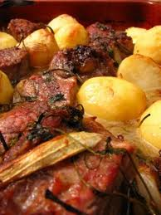
“Vitela arouquesa (Arouquesa roast veal)
Ingredients:
1 kg veal
1 kg potatoes
2 medium onions
6 cloves of garlic
100 ml olive oil
150 ml white wine
1 bay leaf
Margarine to taste
Salt and pepper to taste
Preparation time: 120’
Cooking time: 120’
Serves 4

Slide 12
“Vitela arouquesa (Arouquesa roast veal)
Method
Rub the veal with margarine. Season with salt, pepper, unpeeled
crushed garlic, 50 ml white wine and bay leaf. Let it marinate for
about two hours.
2. Preheat the oven to 180ºC.
3. Peel and wash the potatoes.
4. Cut the onions into round slices and place them in a roasting tray.
Add the potatoes seasoned with a little salt and the veal with the
marinade. Drizzle everything with olive oil and the remaining white
wine. Bake for about an hour.
5. Occasionally drizzle the meat and the potatoes with the marinade.
6. Serve with rice and a mixed salad.

Slide 13
DESSERTS

Slide 14
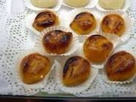
“Castanhas doces” (egg chestnuts)
Ingredients:
200 g sugar
50 ml water
12 egg yolks
10 g margarine
Preparation time: 15’
Cooking time: 60’
Serves 4

Slide 15
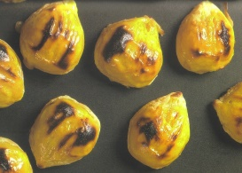
“Castanhas doces” (egg chestnuts)
Method:
Boil the sugar and water for three minutes. Remove from the heat and let it cool a little.
2. Add the egg yolks, stirring well.
Heat the mixture again continuously stirring with a wooden spoon.
Remove from the heat, pour into a dish and leave the mixture to cool.
Shape into little chestnut-sized balls, and using a fork, burn them lightly.

Slide 16
“Trilobiscuits”
Ingredients:
100 g chestnut flour
60 g walnuts
50 g seedless raisins
120 g pumpkin puree
2 tsp fennel
1 tsp baking powder
1 tbsp honey
3 tbsp olive oil
Preparation time: 30’
Cooking time: 15’
Serves 4

Slide 17
“Trilobiscuits”
Method
1. In a bowl, put the chestnut four, the walnuts, the raisins and the pumpkin puree.
2. Add the fennel and the baking powder. Mix well
3. Add the honey and the olive oil. Combine with a spatula to
make a soft dough.
4. Let the dough rest for a few minutes while preheating the
oven to 180C.
5. Transfer the dough to the small heatproof cake pans with
the shape of a trilobite.
6. Bake in the oven until golden brown (about 15 minutes).

Slide 18
Thank you!

