Slide 1
Esztergom and Bratislava

Slide 2
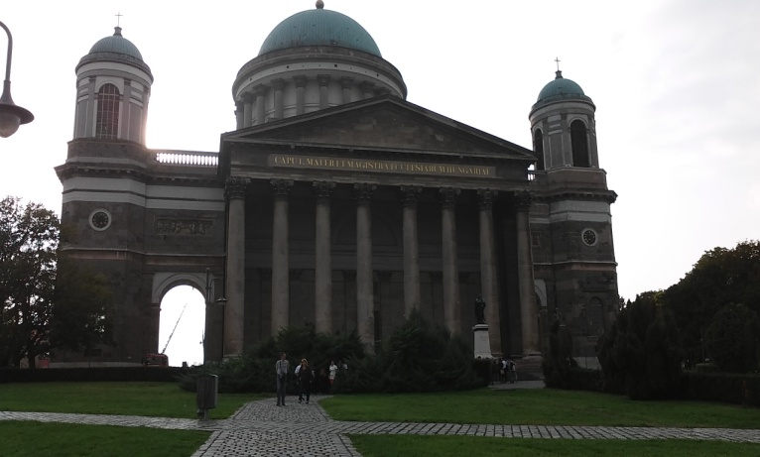
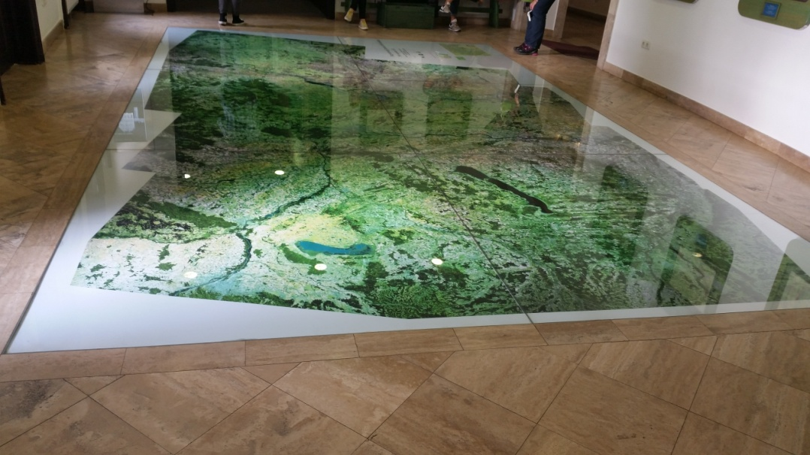
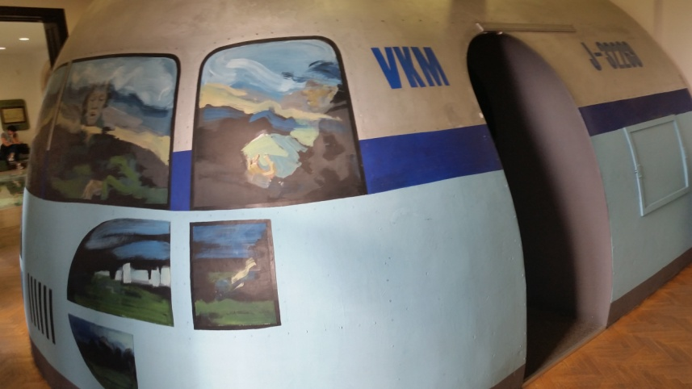
Esztergom
on the other side of the bridge- Hungary
It has a Basilika of St. Adalbert
Danube Museum

Slide 3
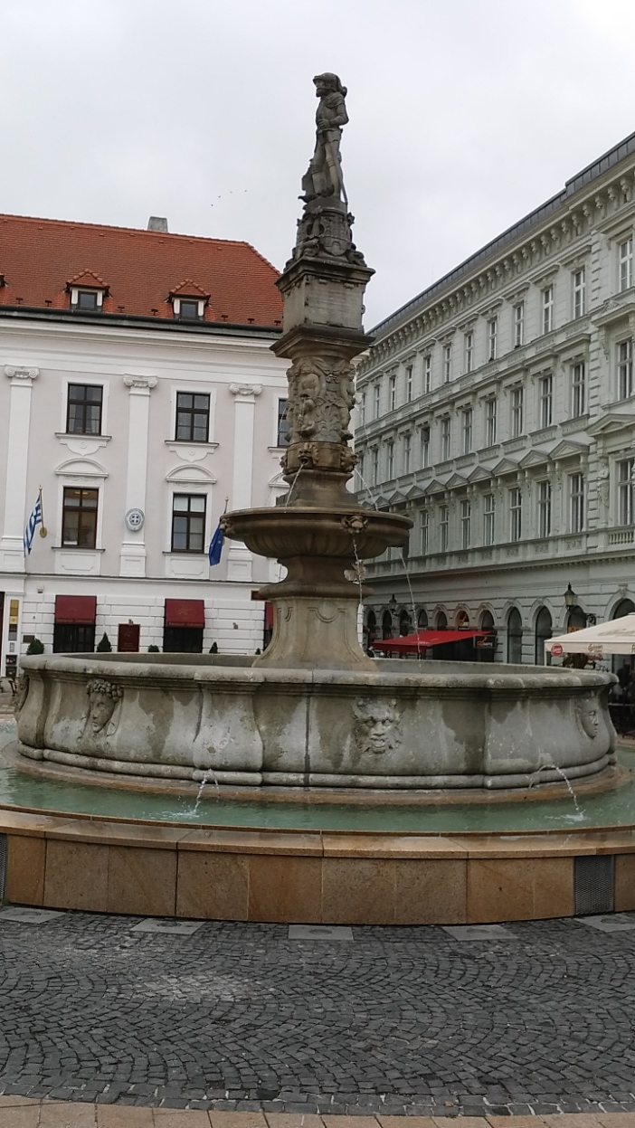
Bratislava
Capital City of Slovakia
Blue Church
Big shopping center Eurovea

Slide 4
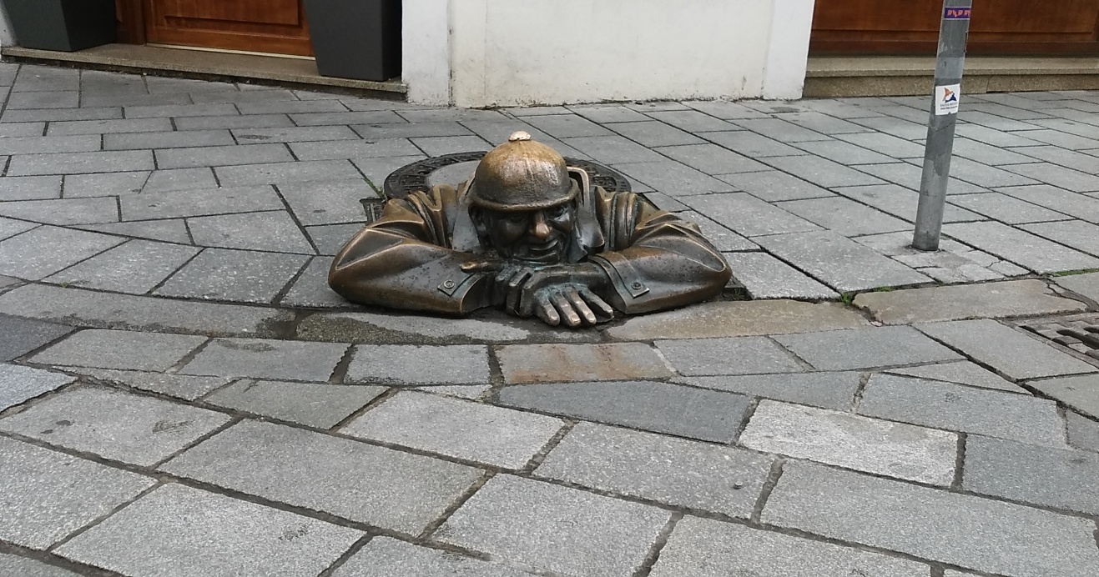
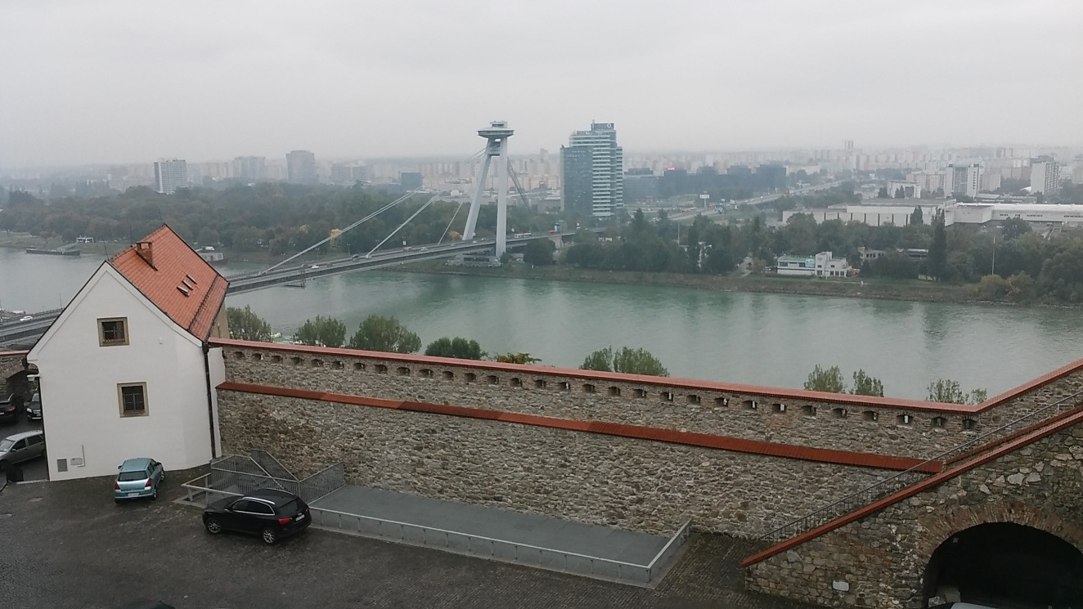

Slide 5
Thaaaaaaaanks ☺

