Slide 1
Reading and interpreting charts
Tabor, October 2016

Slide 2
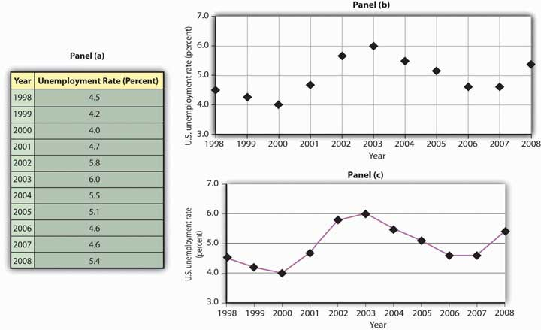
Line graph

Slide 3
Double line graph
How many coins were collected by both Henry and Chris in 2011?
What was the difference in coins collected between Henry and Chris in 2015?
During which years did Henry collect more coins than Chris?
In the years of 2015 and 2061, how many coins were collected by both kids together?

Slide 4
Bar graph
How many pets were sold in July?
Were more pets sold in January or in April?
How many more pets were sold in June than in March?
In August there were sold twice as many pets than in May. How many pets were sold in the summer?

Slide 5
Double bar graph
What is measured in the graph?
What do the numbers in the vertical axis represent?
What is measured by the blue bar?
Which appliance has the most total usage?
On average, how many hours is the computer used on a weekday?
How many hours a day is the heater used on weekends?
Which appliances are used for 5 hours a day more on weekends than on weekdays?
After the refrigerator, which appliance is used the most on weekdays?
Which appliance is used twice as many hours on the weekends as it is on weekdays?
Which appliance is used for more hours on weekdays than on weekends?

Slide 6
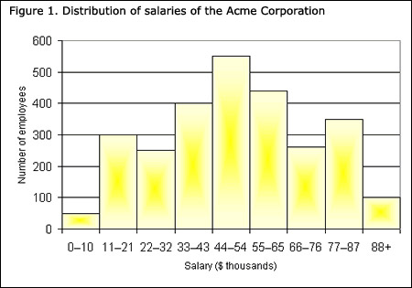
Histograms

Slide 7
Pie charts
Tina spends the most on…
The least spent is on…
The percentage spent on clothing is …
The percentage of her income that Tina spends each month on “bus fare” and “other” expenses combined equals what she spends on…

Slide 8
Pie graph and descriptive chart
What percent of the day Tina spends at work?
The least amount of time is spent on…
What does Tina do more than sleeping?
Childcare together with which other activity consumes more than 50% of Tina’s time per day?

Slide 9
Pictographs
How many DVDs were sold in July & August?
What was the average number of DVDs sold per month?
Which two consecutive months had the fewest number of DVDs sold?
Which two consecutive months had the fewest number of DVDs sold?

Slide 10
Misleading statistics

Slide 11
Misleading statistics

Slide 12
Webography
www.math-aids.com
http://www.tv411.org
http://www.mathgoodies.com
https://ixl.com
http://www.mathworksheetsland.com
http://faculty.atu.edu

