Slide 1
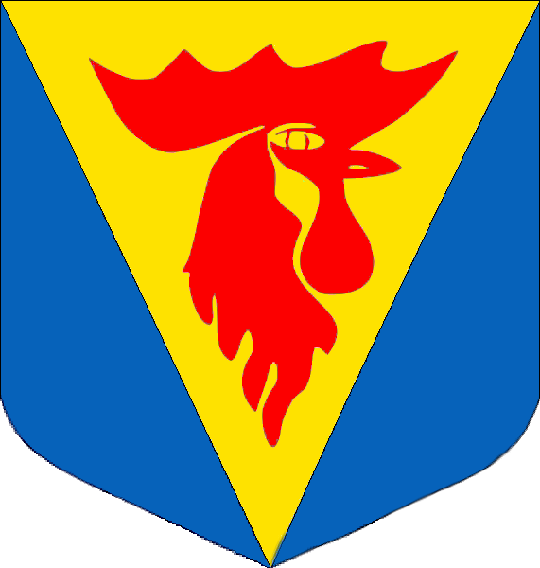
Slovakia – štúrovo 2015 – Gray team
Bettina Ruezhofer, Jaroslava Mládková, Eliška Kašparová, Magyar Anita, Kalina Pekova, Grad Ana-Maria, Robert Hrmo, Dániel Gardenö

Slide 2
Content
Esztergom
Esztergom Basilica
Bratislava
Bratislava castle

Slide 3
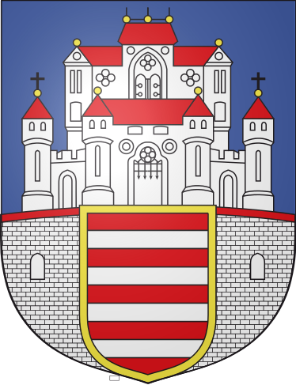
Esztergom
It has 28000 inhabitants.
Situated on the other side of Danube.
Rich history.
Has a lots of historical buildings.

Slide 4
Esztergom Basilica
One of Europe´s biggest cathedral.
Biggest building in Hungary.
It was built on the old temple of Esztergom.
Built it between 1856-69.

Slide 5
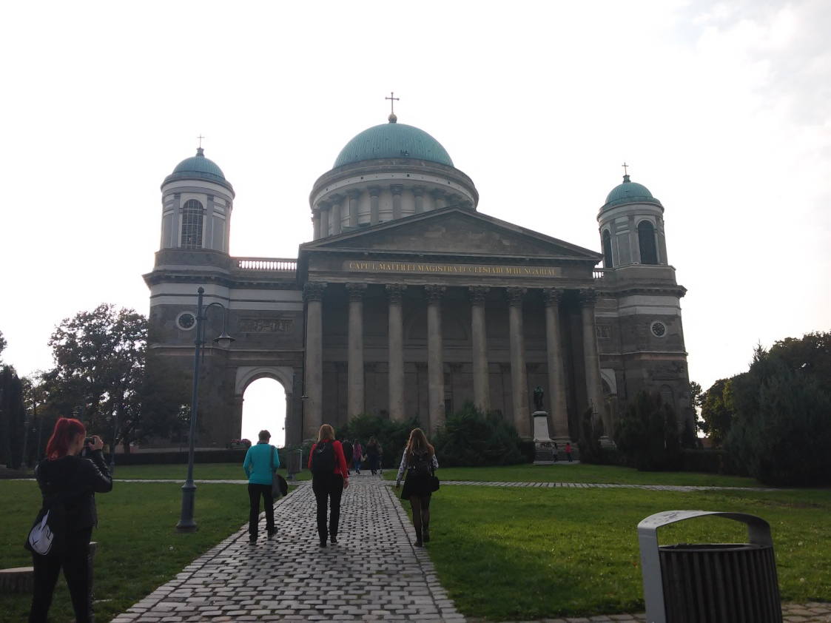
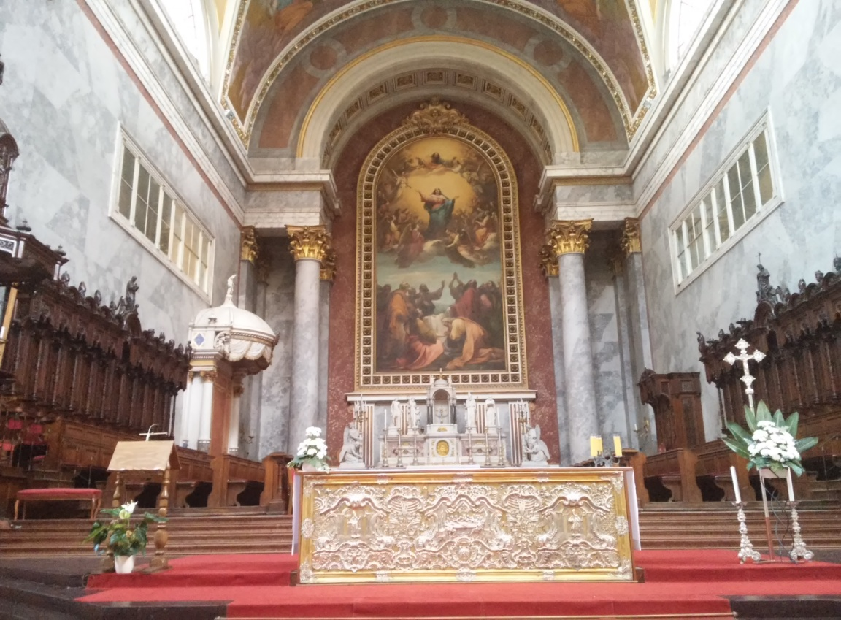
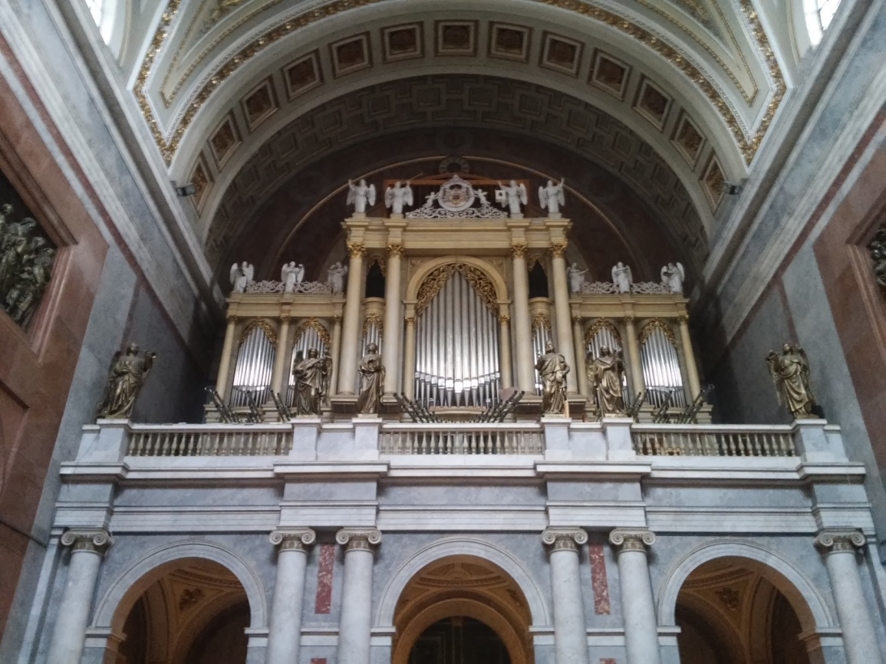
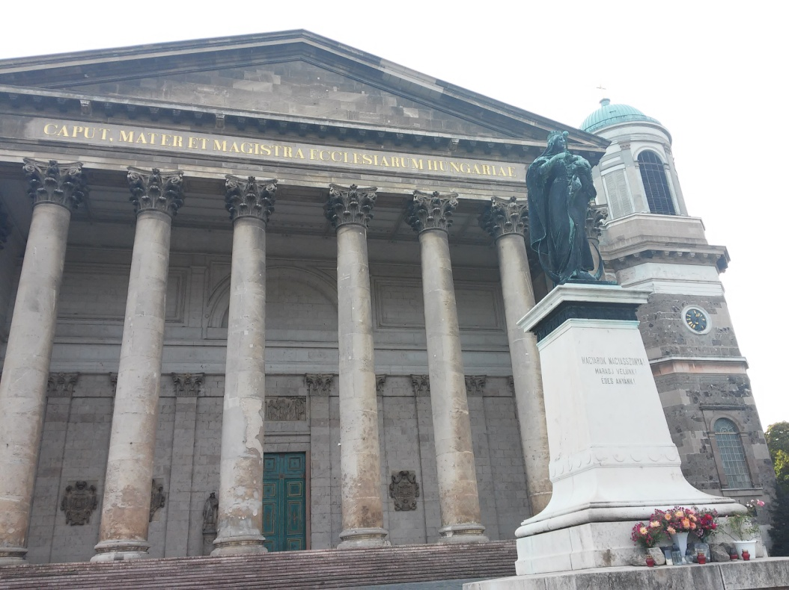

Slide 6
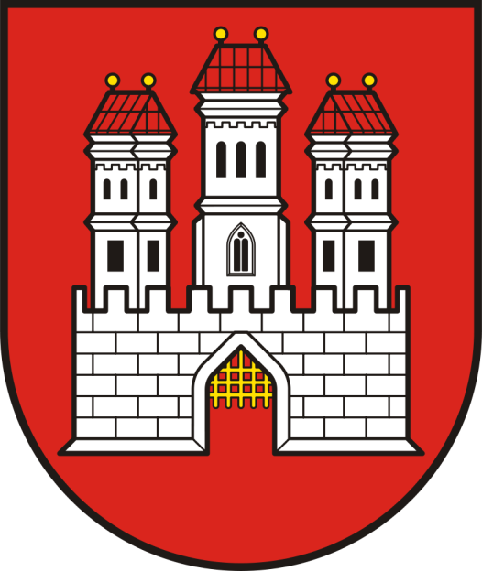
Bratislava
Capital of Slovakia.
Hungarian: Pozsony, German: Pressburg
Capital for Hungarian Monarchy when the Ottomans captured Budapest.
Close to the borders of Hungary and Austria.
Has apr. 650000 inhabitants.
Has nice Old Town district.

Slide 7
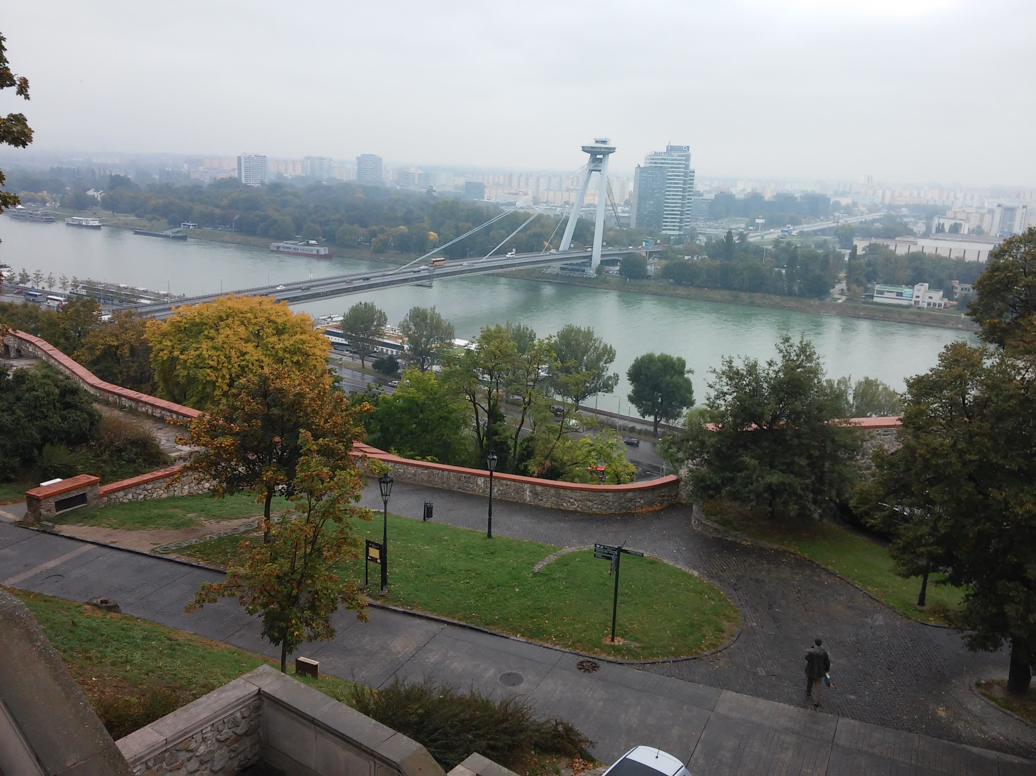

Slide 8
Bratislava castle
Stands directly above the Danube river in the middle of Bratislava.
It was controlled by many nations in the past.
Currently under reconstruction.
It was nearly destroyed by fire in the 19th century.
Rebuilt in 1956-64.

Slide 9
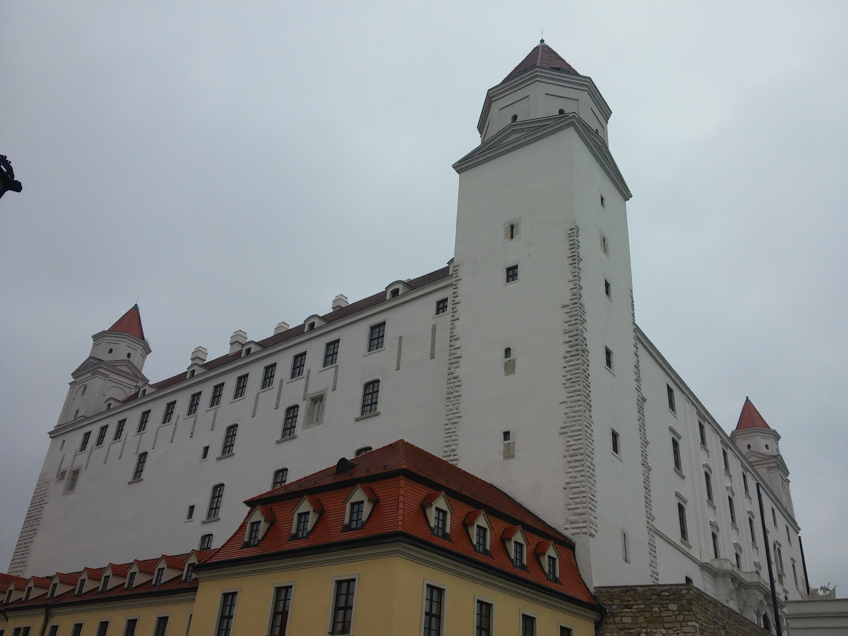

Slide 10
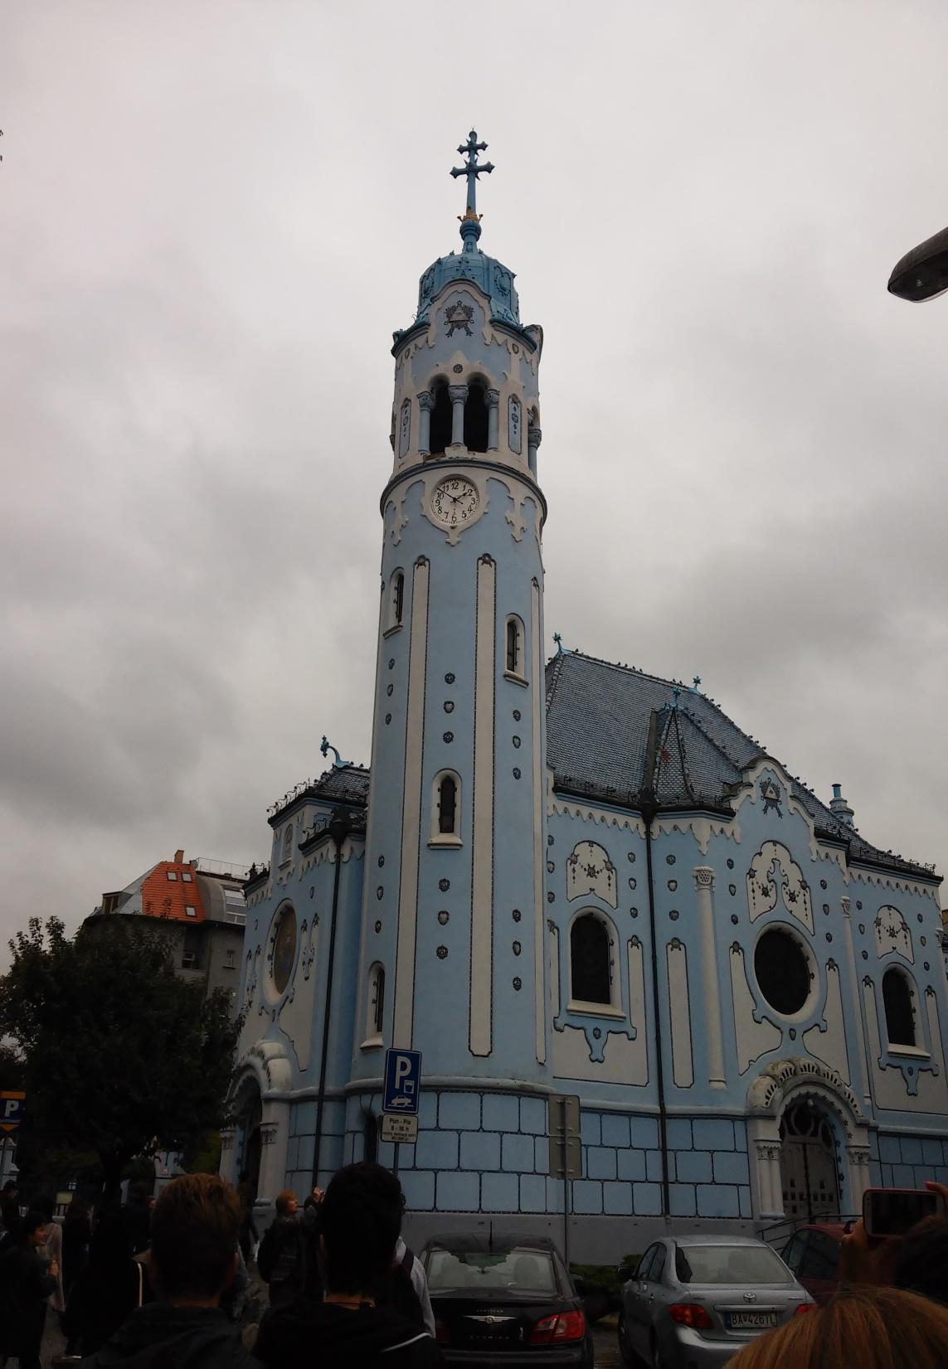
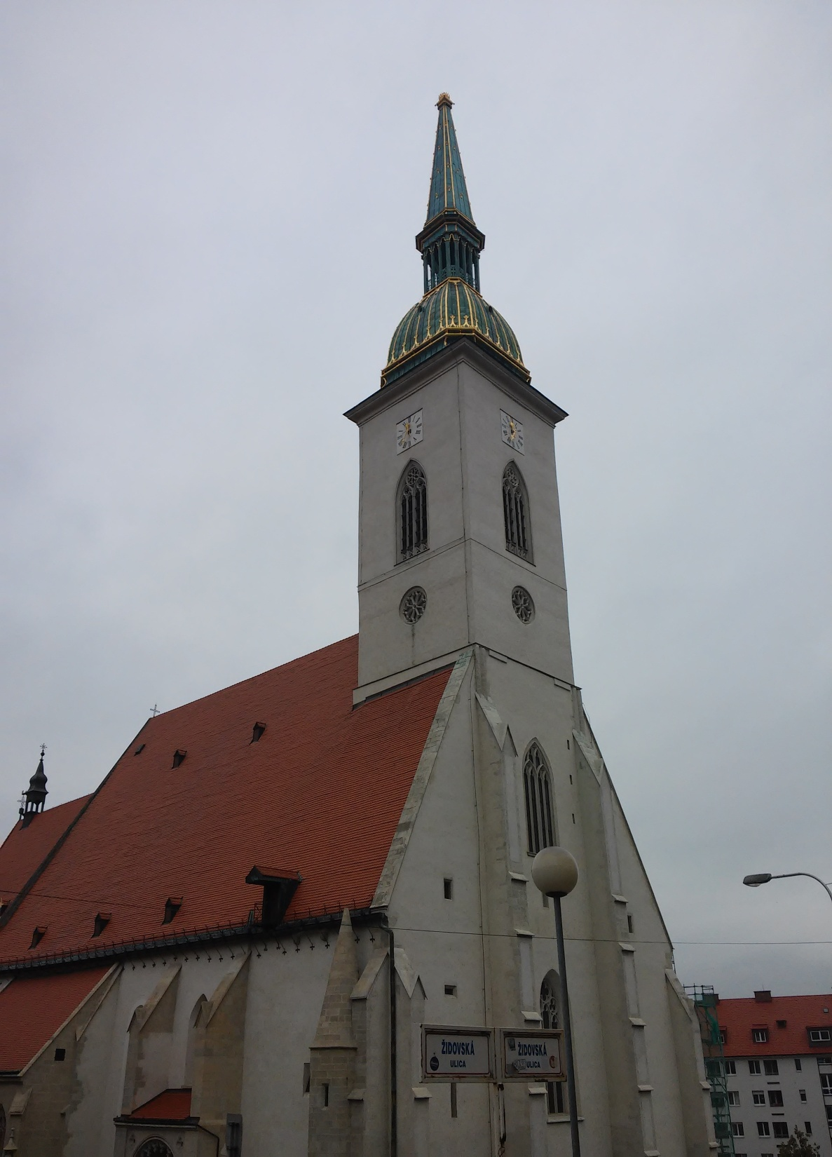

Slide 11
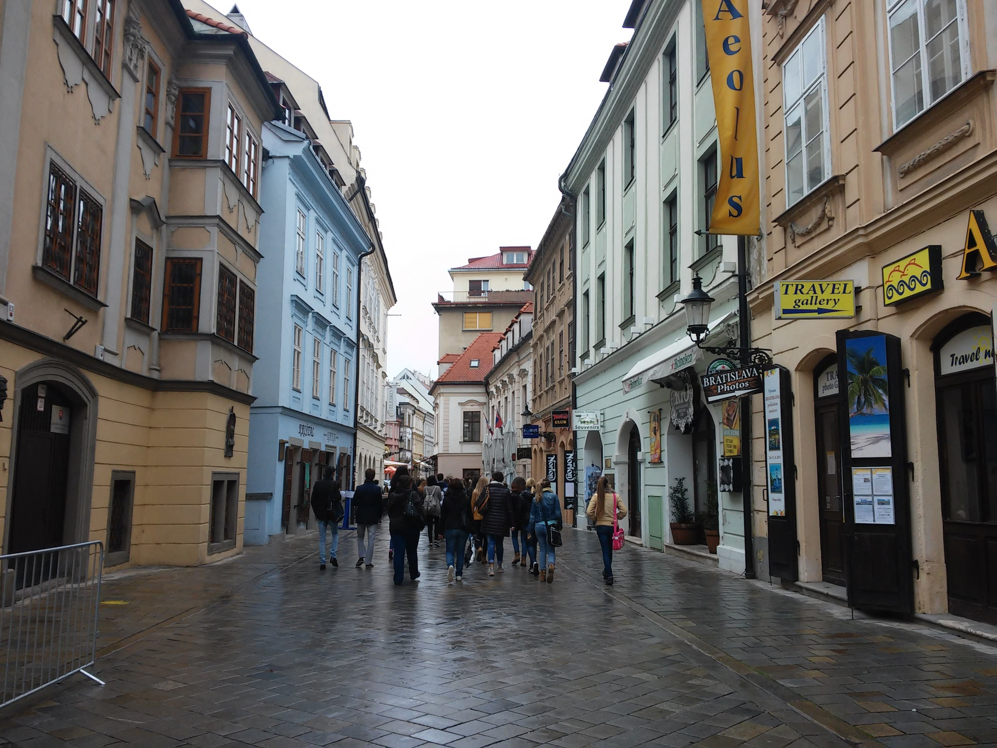

Slide 12
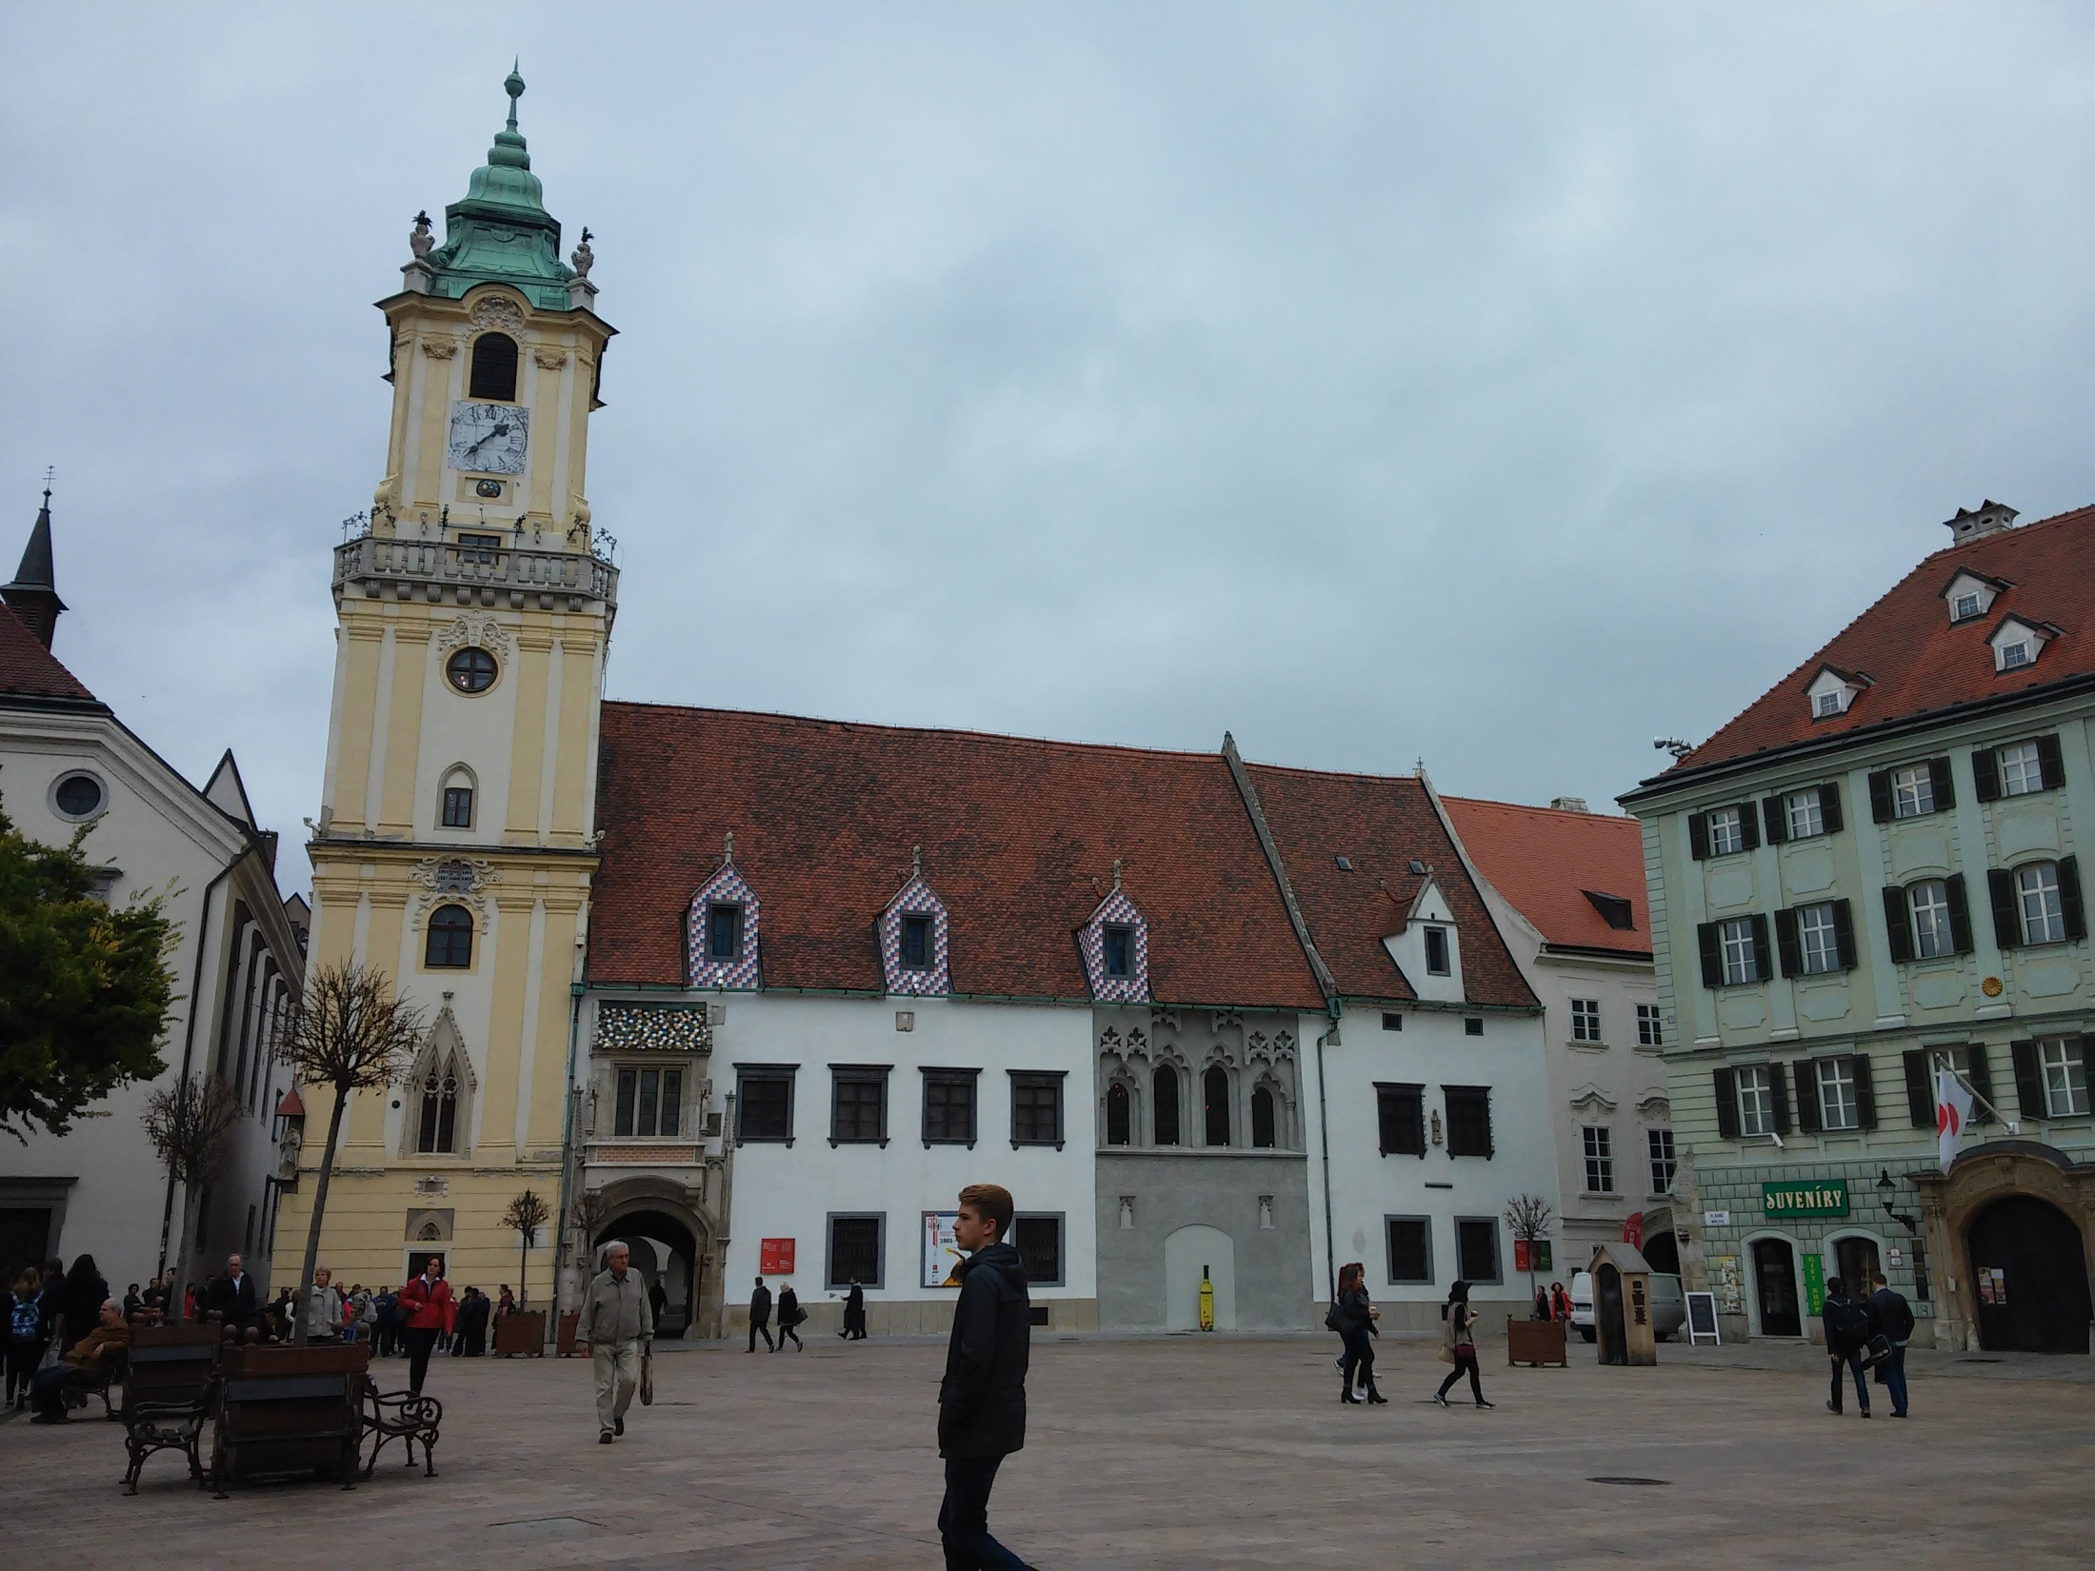

Slide 13
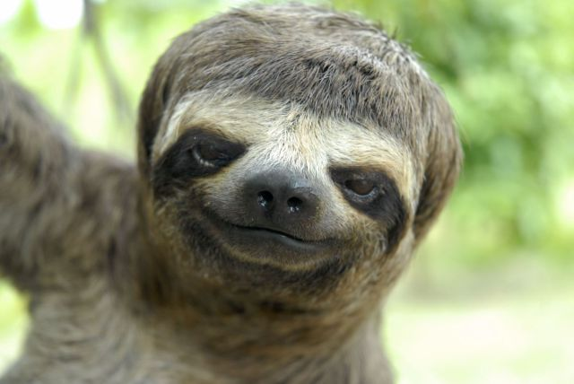
Thank you for paying attention ☺

