Slide 1
Linz
→our school
→regional company

Slide 2
Our school HAK
Business Academy
LINZ INTERNATIONAL BUSINESS SCHOOL
Takes 5 years with „Matura“
You are allowed to study at
University
College
Or join a company

Slide 3
Branches in HAK
From the 3rd school year you can choose between 2 branches:
IB – International Business
Hak Classic
Financial and Risk Management
Marketing
Controlling

Slide 4
HAS SHS
Business school
Takes 3 years
Qualifications for a business job
Not allowed to study
Is easier than HAK
HAS for professional athletes
Takes 4 years
Have to do sports in the morning and after school
Same possibilities as a HAS student

Slide 5
Evening Courses
To improve your job situation
Decide between HAK and HAS
HAK: 8 semesters
HAS: 4 semesters
You have to be 17 years old
They start at 18:00 and end at 21:55

Slide 6
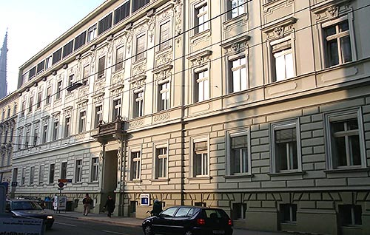
Our School

Slide 7
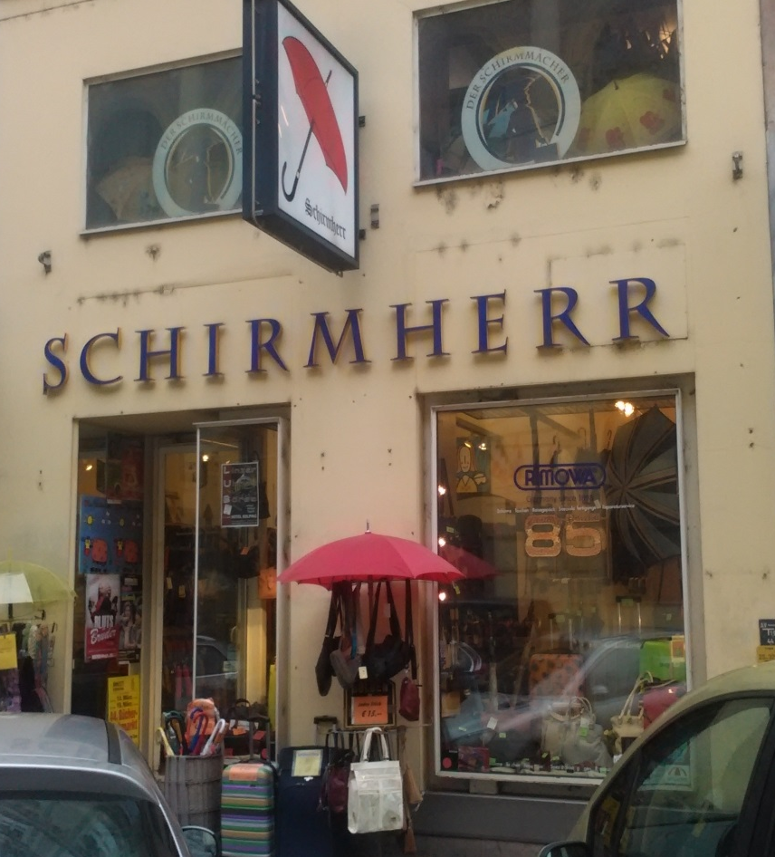
Regional Company „Schirmherr“ (umbrella man)
Opening
In 1913
By Hermann Loos
Locations
Main square for 91 years
Bismarkstraße since 2004
Name development
At first „Schirmmacher“
Since 2001 „Schirmherr“

Slide 8
Information about the owner
He was born in 1943
Apprenticeship with 14
Owner of the shop since 1968
Married since 1966
4 children
2 daughters (twins)
2 sons

Slide 9
Information about the shop
Family business
Accounting is done by his wife
He is his own boss
Famous for
Quality of products
Good advice
The only specialist shop in Linz for
Umbrellas
Suitcases

Slide 10
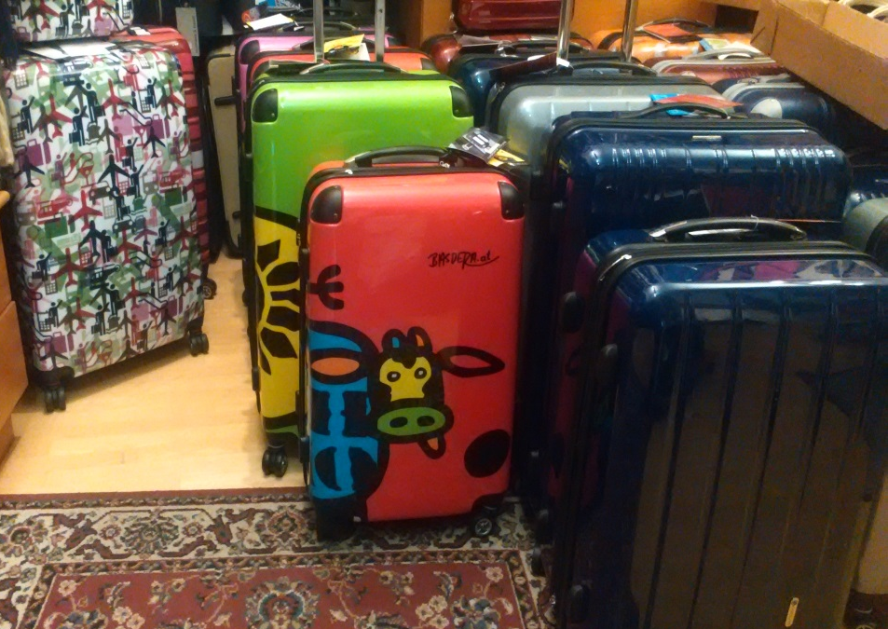
What does he offer?
Bags
Umbrellas
Walking sticks
Suitcases
Repair service

Slide 11
Linz
→our school
→regional company

