Slide 1
Štúrovo
Erasmus+ 2015

Slide 2
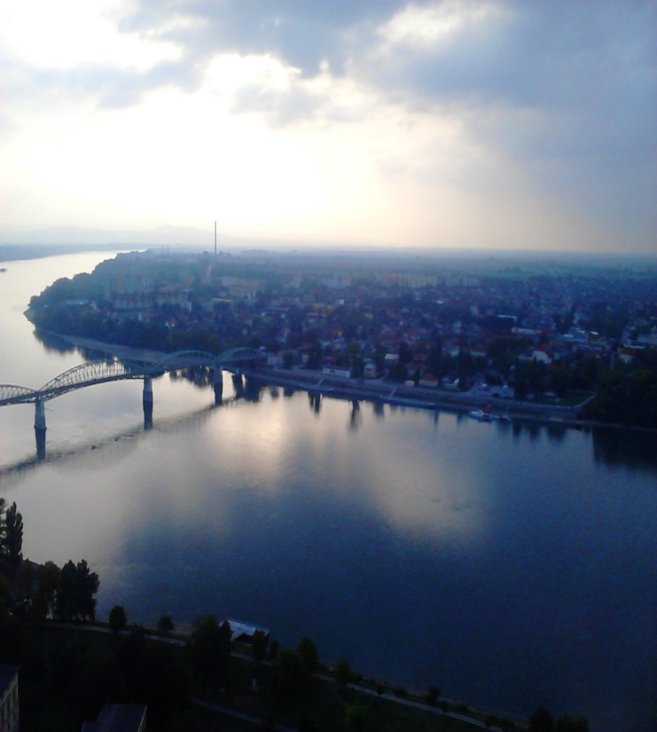
Basic information about Štúrovo
It is a town in Slovakia
It is situated on the River Danube, opposite the Hungarian city of Esztergom.
The Mária Valéria bridge connects the settlements.

Slide 3
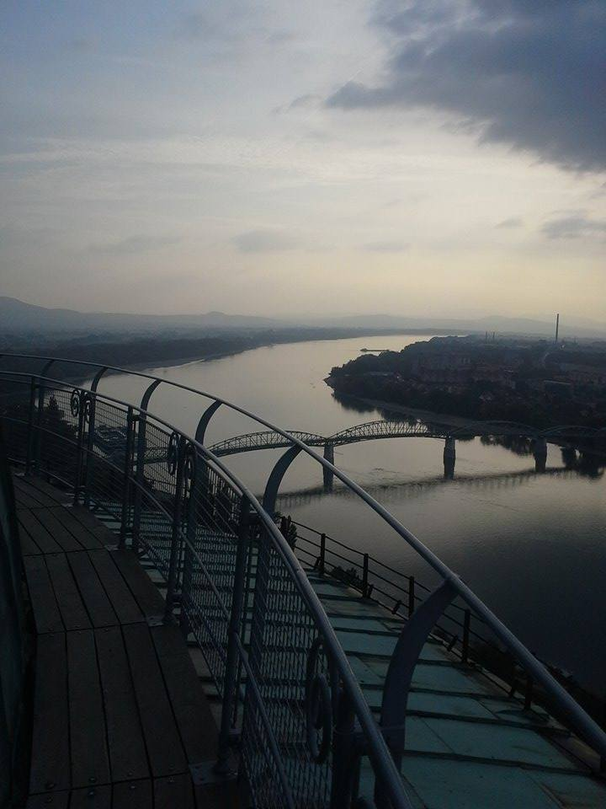
What we saw in Štúrovo
The Mária Valéria bridge
It was named after Archduchess Marie Valerie of Austria.
It was designed by János Feketeházy in 1893.
In 1945 it was destroyed by a detonation but it was rebuilted in 2001

Slide 4
The town hall
The Church of st. Emeric
The church was built in a late Baroque style and was consecrated to honour st. Emeric of Hungary.
The statue of Jan Sobieski
It was put up from the money raised in public subscriptions. It was inaugurated in October 2008.
The gallery
The museum

Slide 5
Gabčíkovo – Water Dam

Slide 6
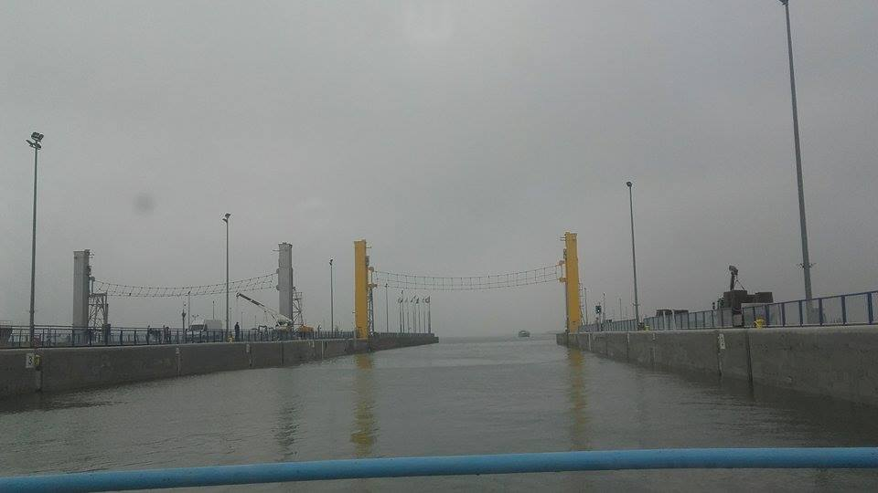
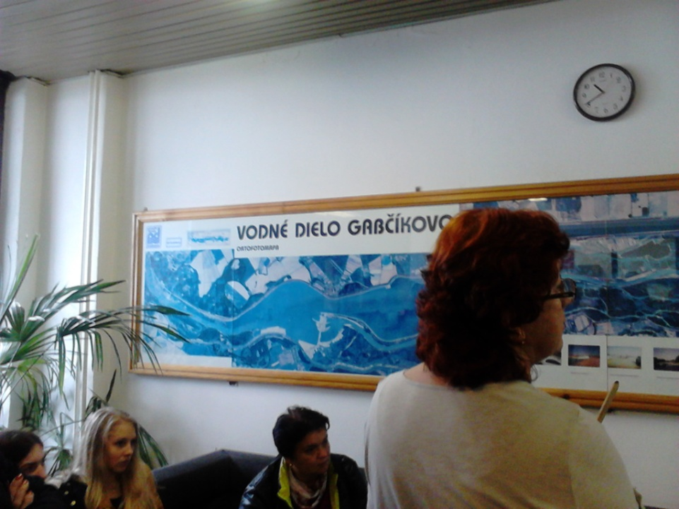
Gabčíkovo is a large barrage project on the Danube. It was intiated by the Budapest Treaty in 1977 between the Czechoslovakia and Hungary

Slide 7
Béla Castle

Slide 8
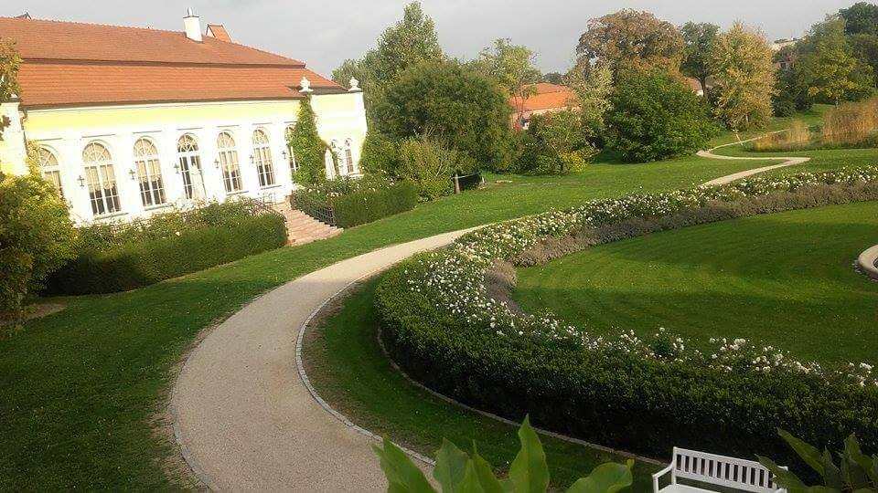
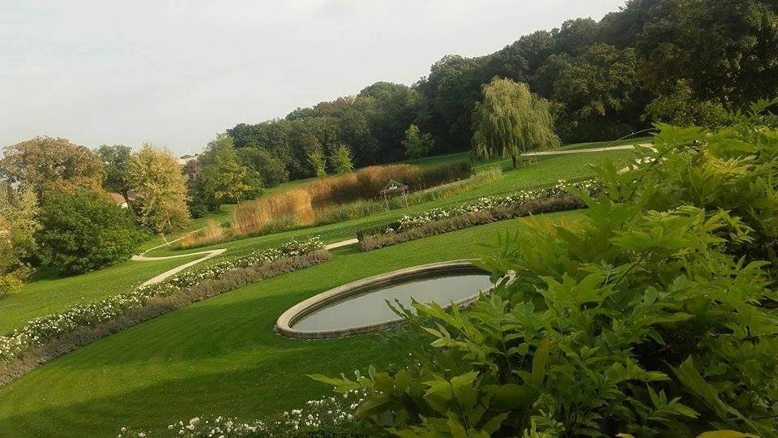
Béla Castle
Tha castle get its name for IV. Béla Hungarian king
The castle has a big park and a church where are taken weddings
It has a wine cellar, riding hall and tennis court too

Slide 9
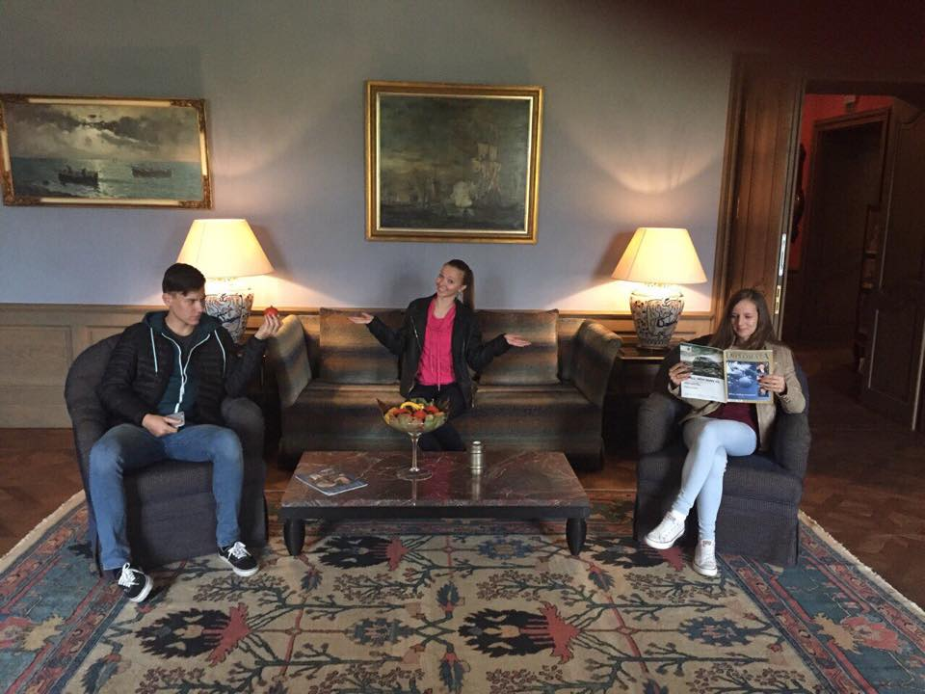
Béla Castle
Today the castle used like a restaurant, museum, weddings places etc.
There is a spa, sauna, gym and library.

Slide 10
Esztergom

Slide 11
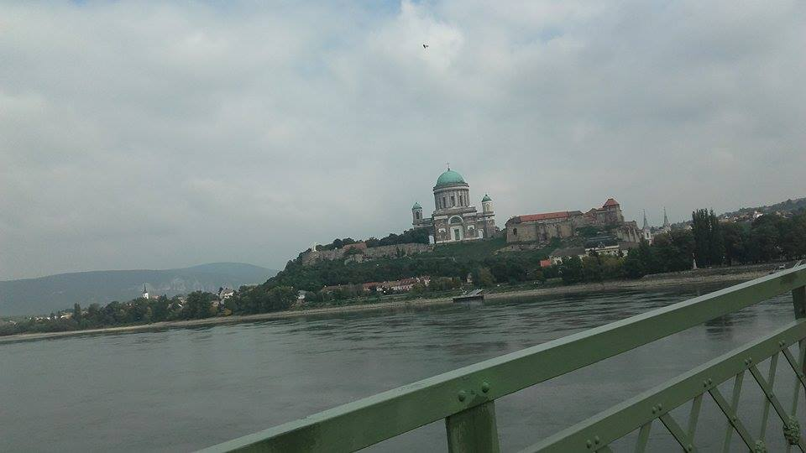
Basic information about Esztergom
It is a city in northern Hungary, on the right bank of the river Danube, which forms the border with Slovakia there
It is one of the oldest towns in Hungary

Slide 12
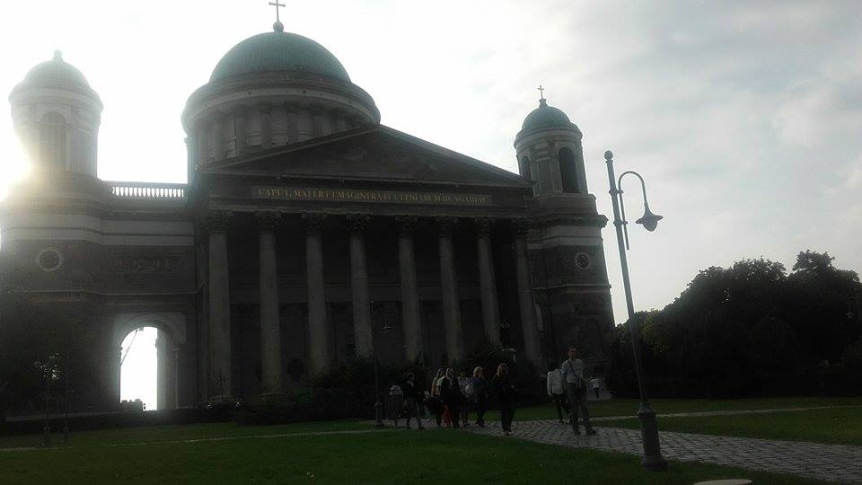
What we saw in Esztergom
Cathedral of Esztergom

Slide 13
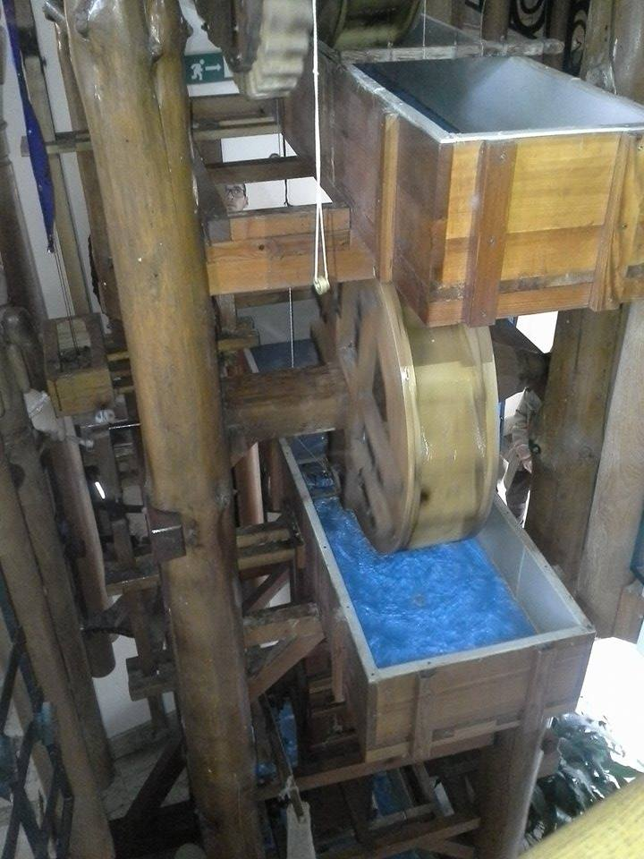
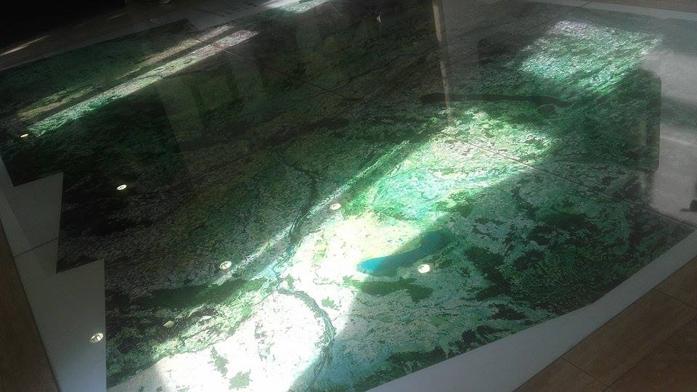
The Danube Museum

Slide 14
Bratislava

Slide 15
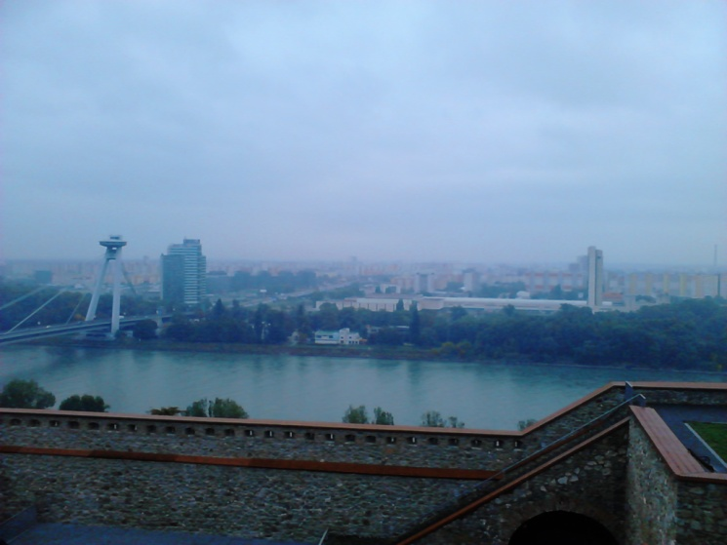
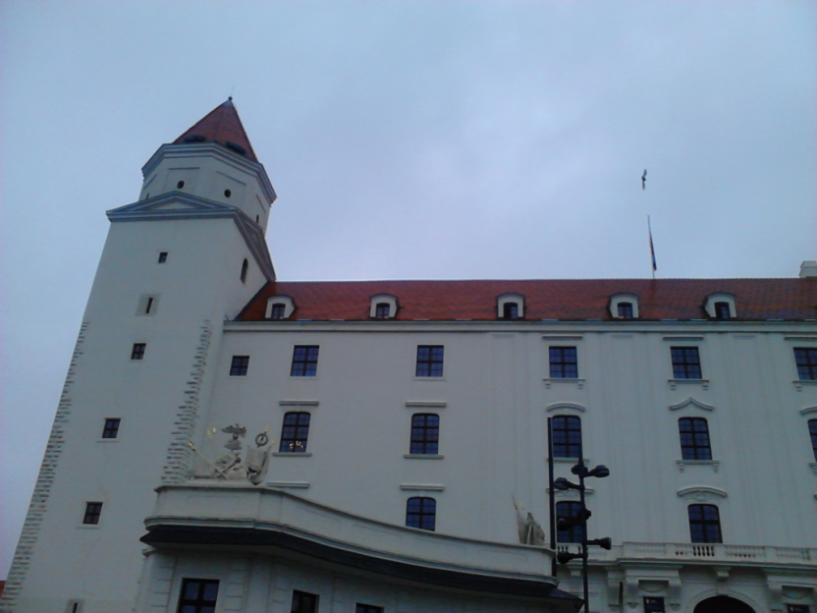
What we saw in Bratislava

Slide 16
Thanks for attention
Ivady Gréta HU, Kateřina Kafková CZ, Sára Kubálková CZ, Szollosi Peter SK, Borsanyi Zsofia SK, Kovacs Benedek SK,
Dragoi Cristina RO

