Slide 1
Esztergom and Bratislava

Slide 2
Esztergom
On Wednesday we were at Esztergom. We saw the Basilica and the Danube Museum. We liked them so much, and had a good time. The view was beautiful.

Slide 3
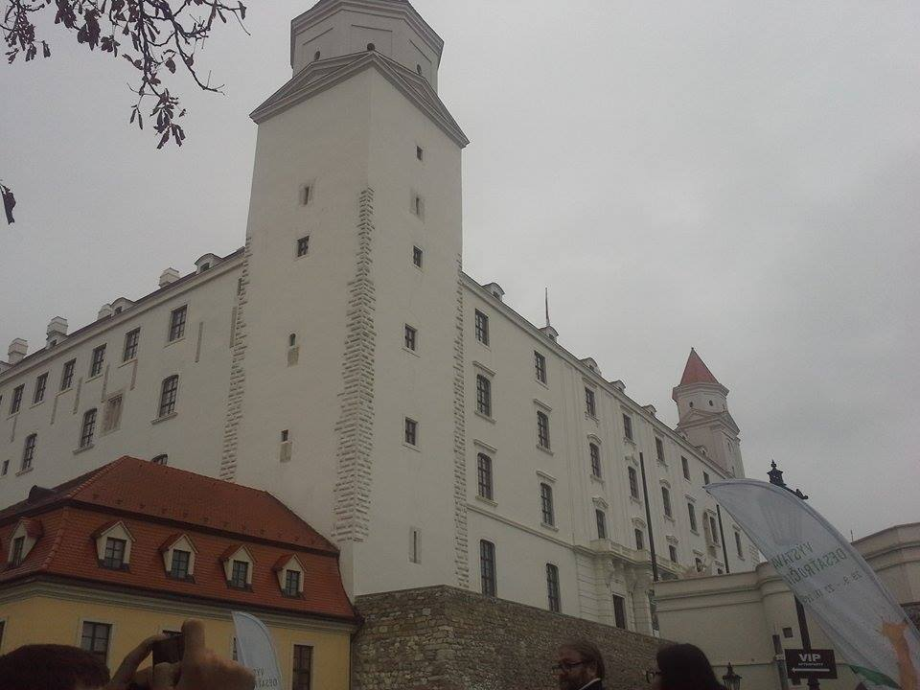
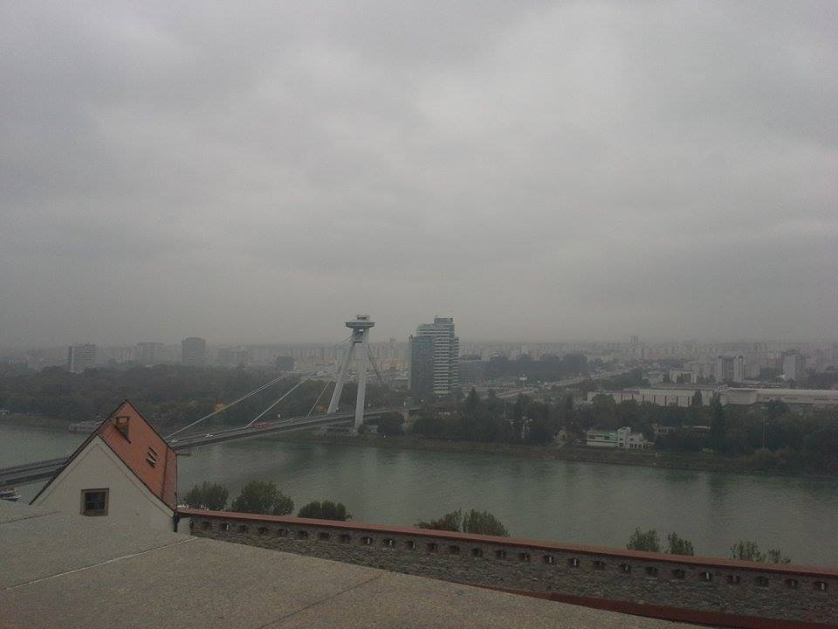
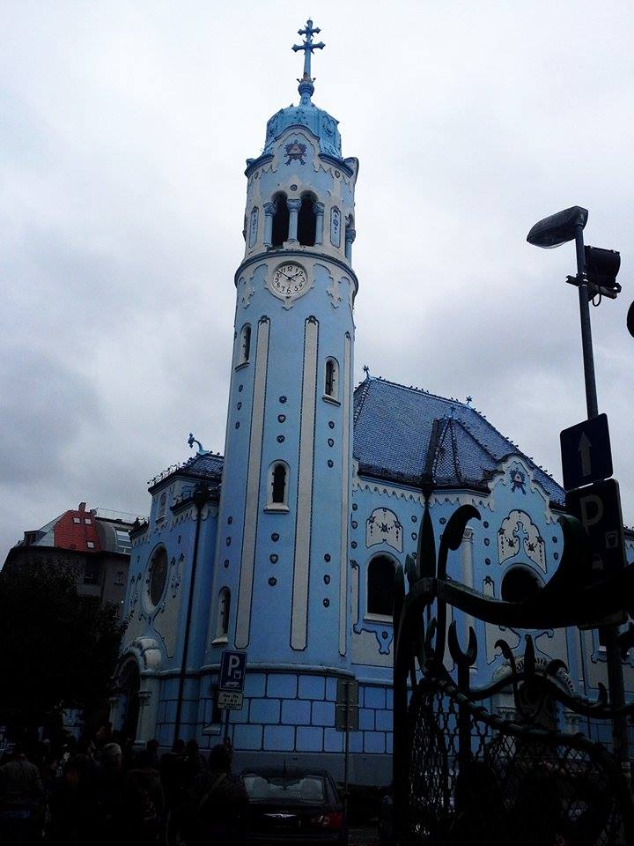
Bratislava
In Bratislava we saw the Hrad Castle. After that, we saw a blue church. It was a new experience for us. It was a beautiful church.

Slide 4
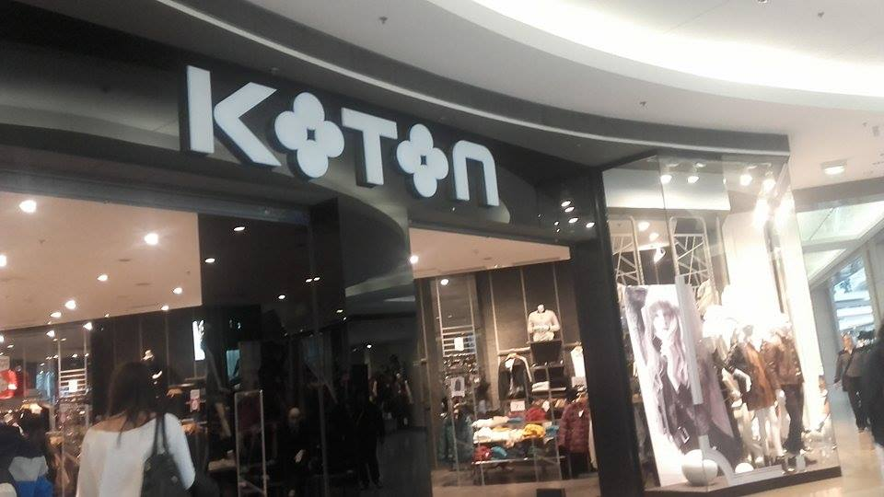
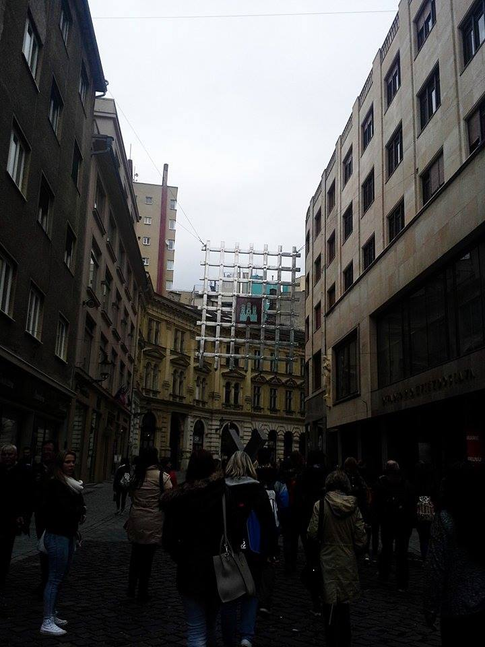
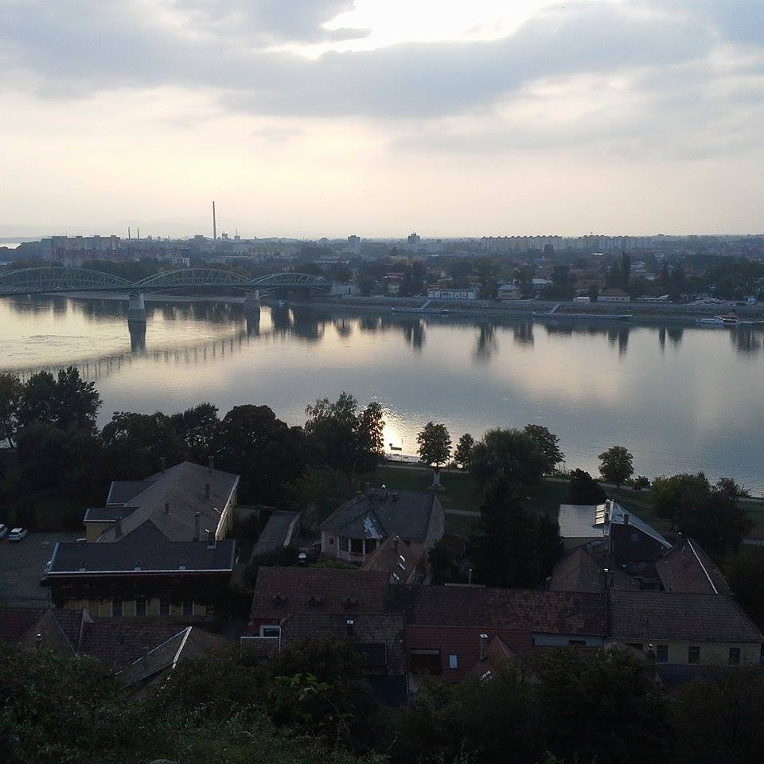
Some pictures about Esztergom and Bratislava

Slide 5
Thank you for your attention! ☺

