Slide 1
A business game
Monopoly, oligopoly, competition

Slide 2
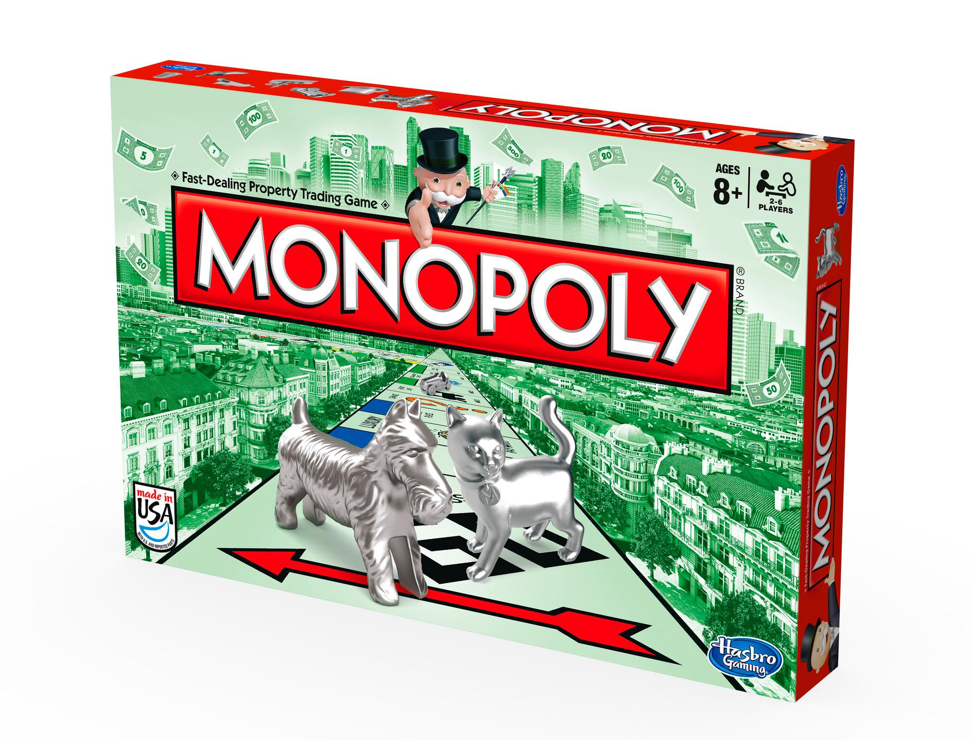

Slide 3
https://youtu.be/nyt7uZ63vMU

Slide 4
MONOPOLY - DEFINITOIN
A monopoly is a market containing a single firm that has or is close to total control of the sector, there is no competition.
A situation in which a single company owns all or nearly all of the market for a given type of product or service.
A single company dictates prices, doesn´t have to invest in marketing so much.

Slide 5
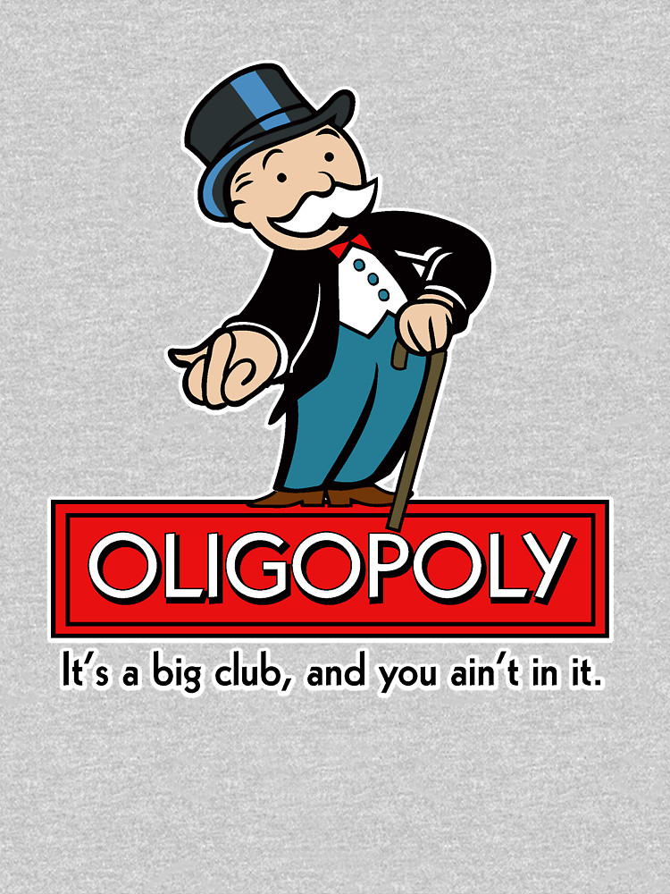
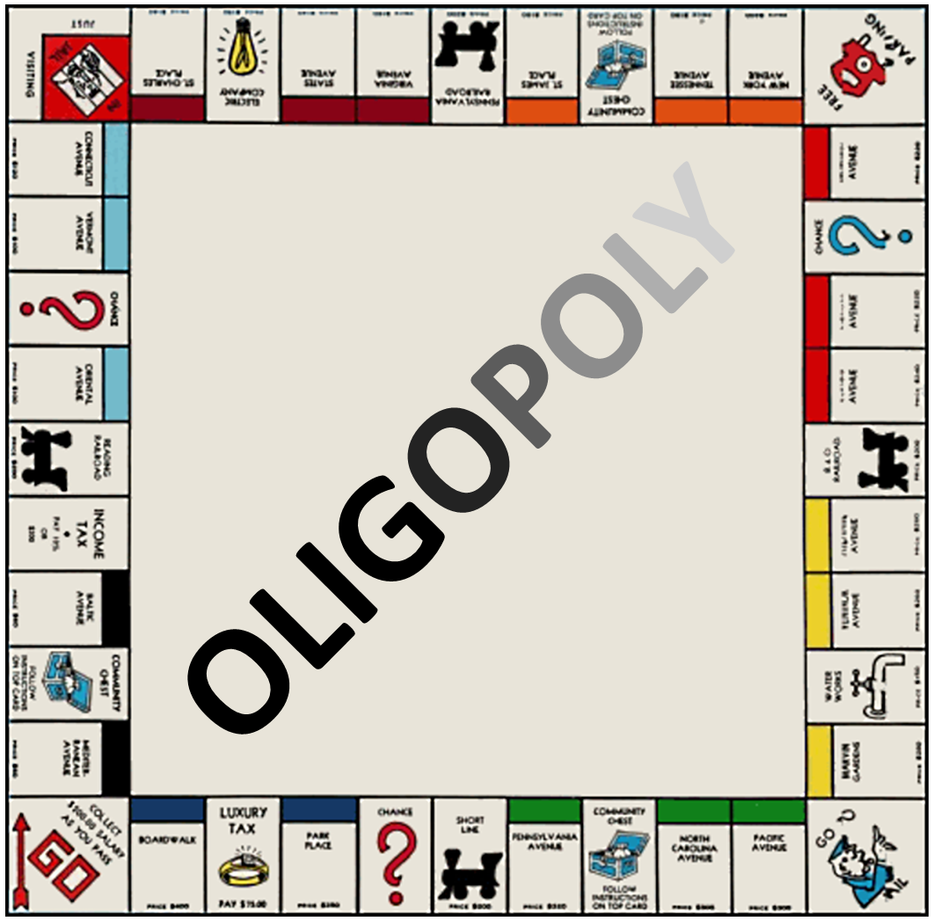

Slide 6
https://youtu.be/MFs5lorvxPw

Slide 7
OLIGOPOLY - DEFINITION
In an oligopoly, there are at least 2 firms controlling the market. Usually a scenario in which a particular market is controlled by a small group of firms.
Oligopoly controls a similar market (phone companies).
Oligopolies reduce competition, they can agree on prices although this agreement is illegal, but they agree on them anyway

Slide 8
Will their agreement be long lasting?

Slide 9
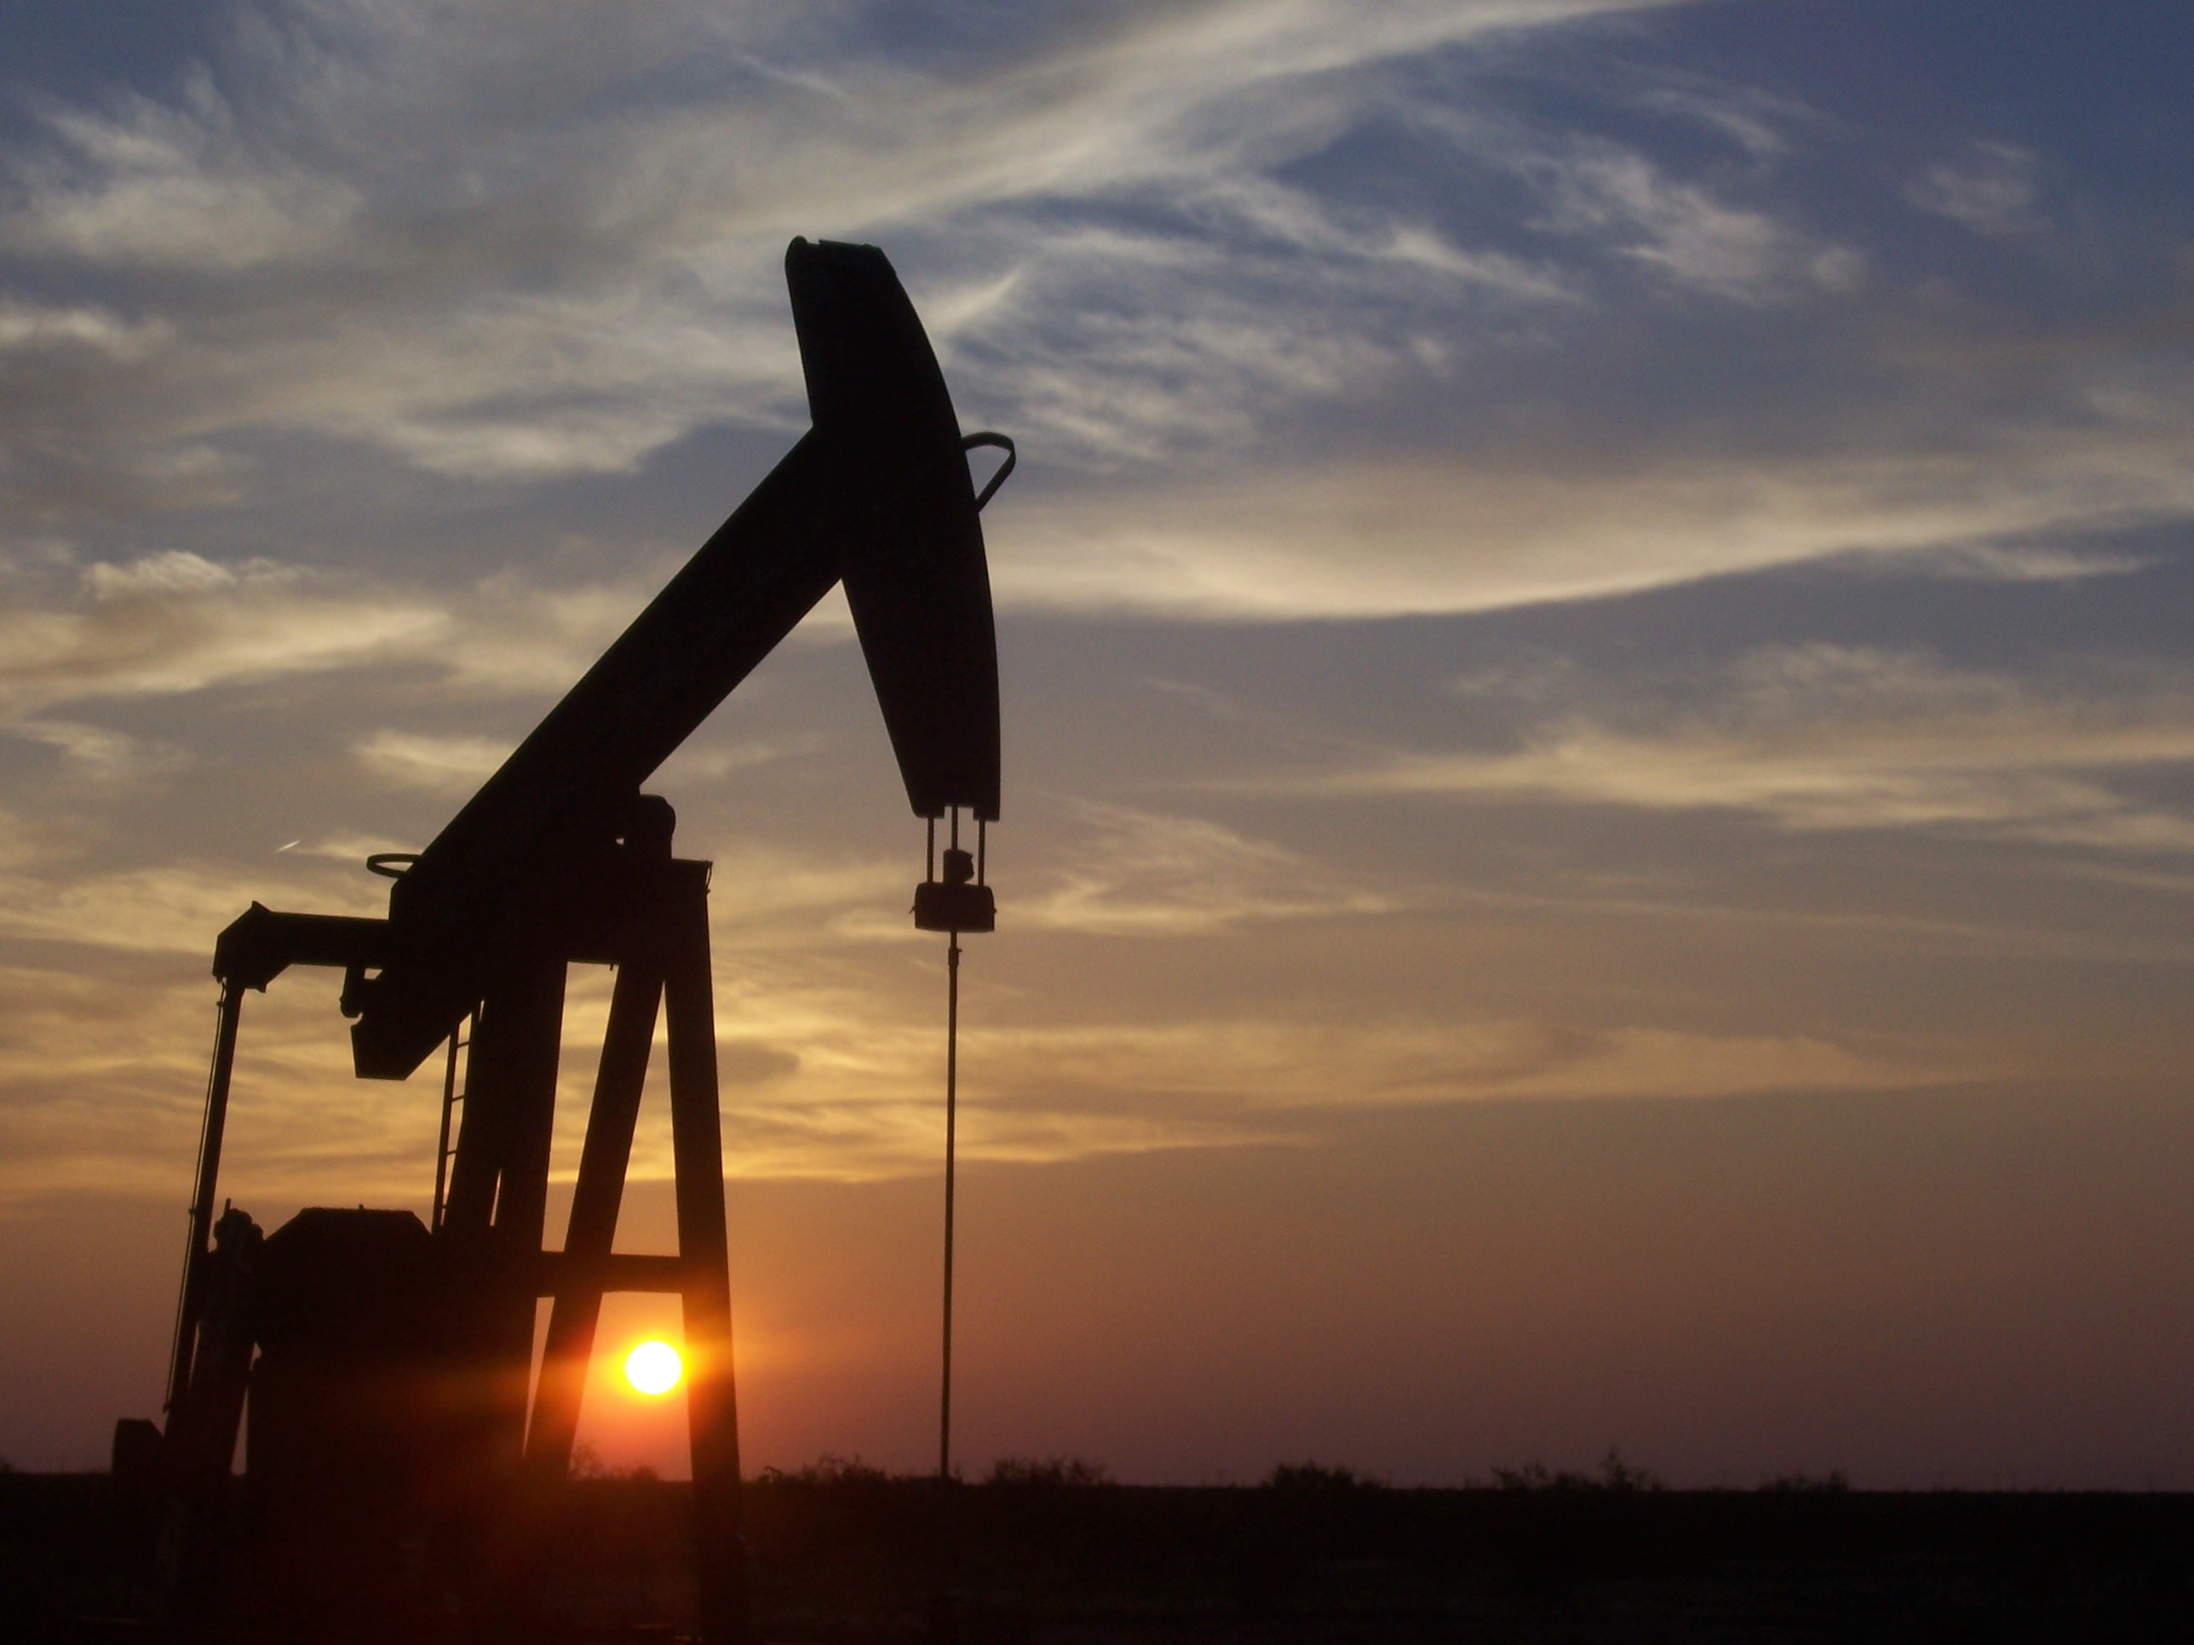

Slide 10
4 X ☹ | every X loses 100 USD ↓
3X and 1Y | every X earns 100 USD ↑ Y loses 100 USD↓
2X and 2Y | every X earns 200 USD ↑↑ every Y loses 200 USD ↓↓
1X and 3Y | X earns 300 USD ↑↑↑ every Y loses 100 USD ↓
4Y ☺ | every Y earns 100 USD ↑

Slide 11
ROUND | GROUP DECISION | RESULT | AMOUNT IN USD
1
2
3
4
5
6
7
8
9
10

Slide 12
ROUND | GROUP DECISION | RESULT | AMOUNT IN USD
11
12
13
14
15
16
17
18
19
20

Slide 13
How do agreements in oligopolies work?
What happens if they rise oil extraction?
What happens if they lower oil extraction?

Slide 14
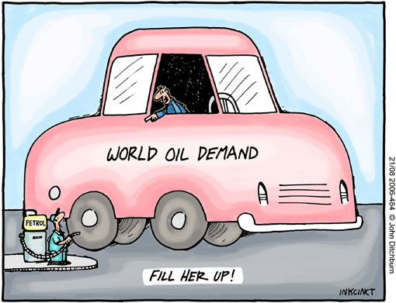

Slide 15
AVERAGE OIL PRICES IN ESCAPE COUNTRIES (SUPER 95 UNLEADED)
ESCAPE COUNTRIES | 1 LITRE/€ | 1 LITRE/national currency
AUSTRIA |  | -
BULGARIA |  | BGN
CZECHIA |  | CZK
HUNGARY |  | HUF
ROMANIA |  | RON
SLOVAKIA |  | -
SLOVENIA |  | -

Slide 16
Thank you for your attention ☺

