Slide 1
Firex-LTD
Slovakia’s
eTwinning Team
Dóra Izsák, Ádám Pásztor, Dániel Gardenö

Slide 2
Content
Origin of the name
Basic information
What do we offer?
Some of our products
Most important role of the firm
Parts of a fire extinguisher
How to operate a fire extinguisher

Slide 3
Origin of the firms name
The name of our company comes from the English word Fire, and the Latin word rex, which means king.
Fireking

Slide 4
Basic informations
Our company was founded in 1994.
It is located in Sturovo, Slovakia.
It’s a family firm.
The employees of our firms are: Annamária Pásztor - works as secretary Miklós Pásztor - works as technik
Proprietors of the firm are: Ján Pásztor and Monika Tóthová.
Firex is the only company, which sells firefighting products in our city.

Slide 5
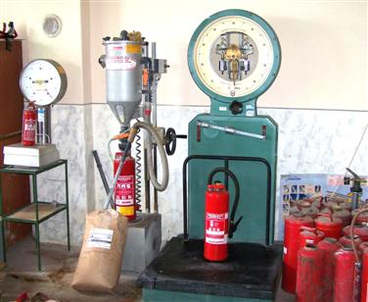
You can control your extinguishers at our company.

Slide 6
What do we offer?
Our company sells products, which prevent house fires.
We also manufacture and repair fire extinguishers.
We even sell cabinets for storing extinguishers at our homes.
We offer fire fighting courses for people.
We even show ways, how to prevent fire.
Our products are certified products.

Slide 7
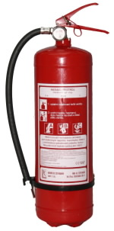
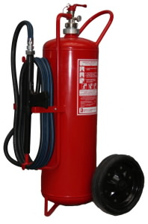
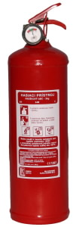
Some of our fire extinguishers

Slide 8
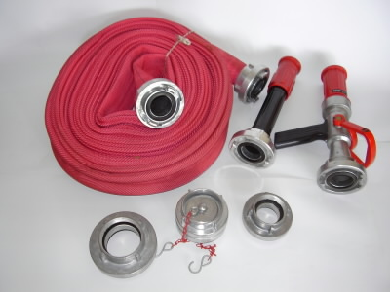
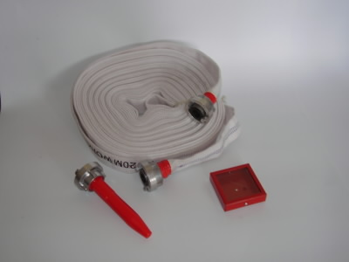
We manufacture hoses, small parts for longer fire extinguishers and companies.

Slide 9
Most important role
Our most important role is to give people knowledge, how to prevent fire, and if it’s too late how to stop it.
We serve out the local towns and cities, bigger factories, schools and many households with our products, and our services.

Slide 10
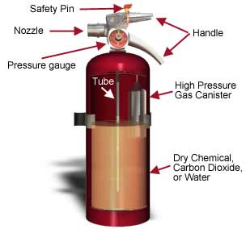
Basic parts of an ordinary fire extinguisher

Slide 11
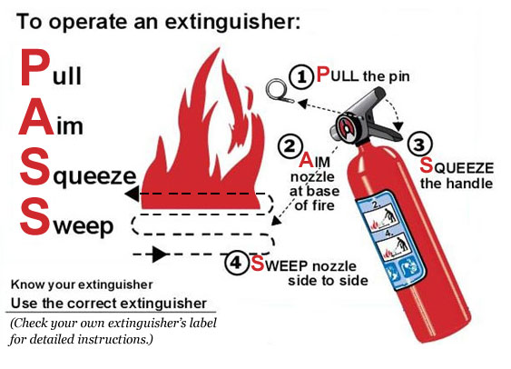

Slide 12
Thank you for paying attention!
Feel free for asking questions!

