Slide 1
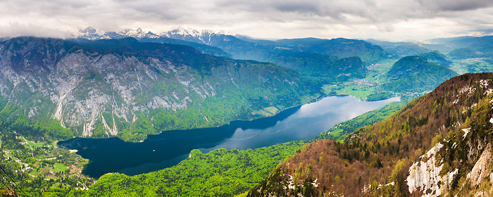
TRIGLAV NATIONAL PARK
SLOVENIA

Slide 2
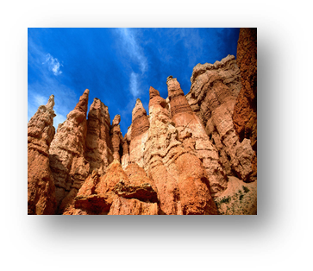
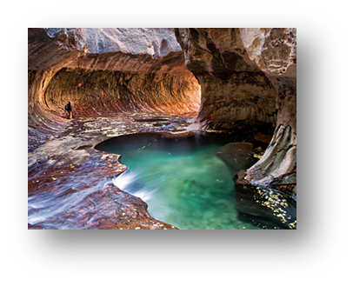
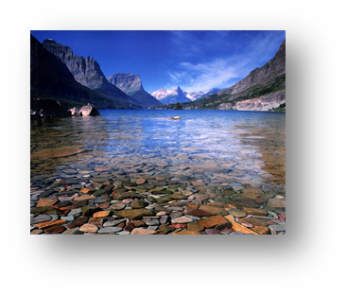
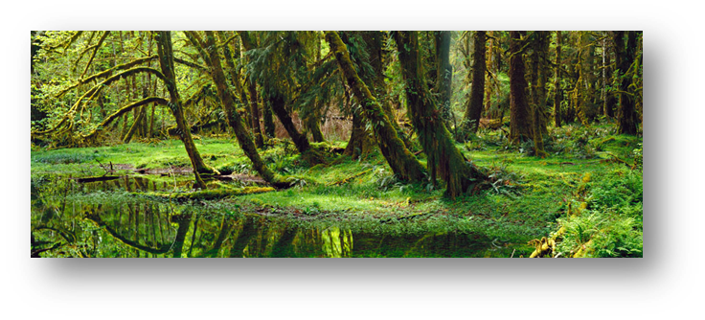
A NATIONAL PARK
Protected geographic area.
The area must contain certain plant life, animals, habitats .
Must contain different eco systems.

Slide 3
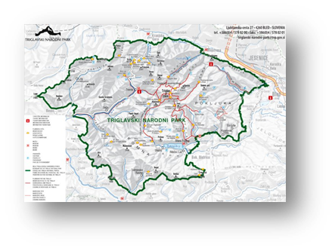
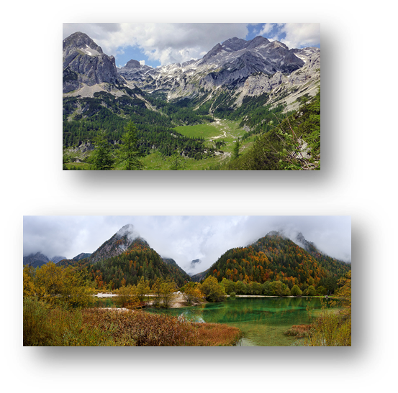
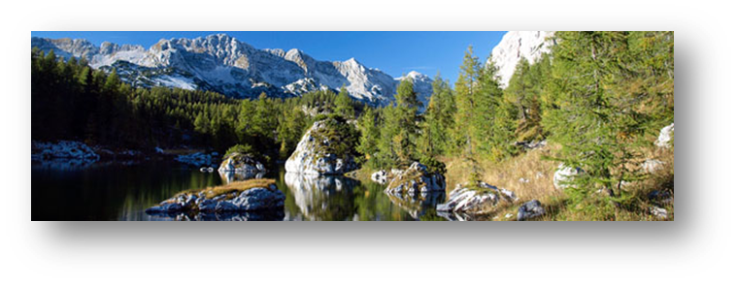
TRIGLAV NATIONAL PARK
Biggest and only national park.
In the Julian alps.
Measures 83.807ha (880km).
The highest point =2864m and lowest =180m.

Slide 4
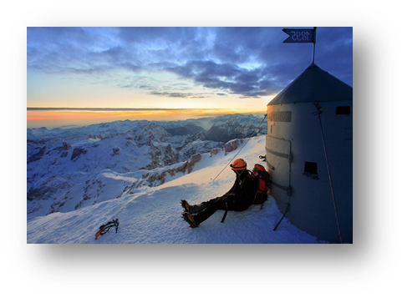
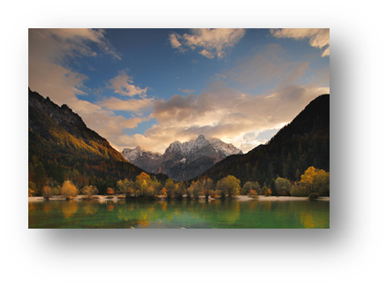
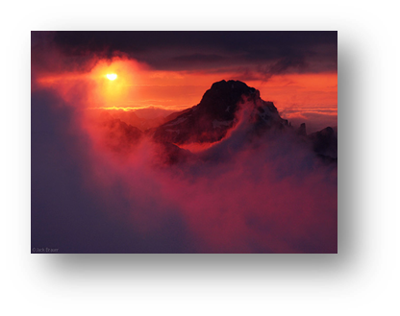
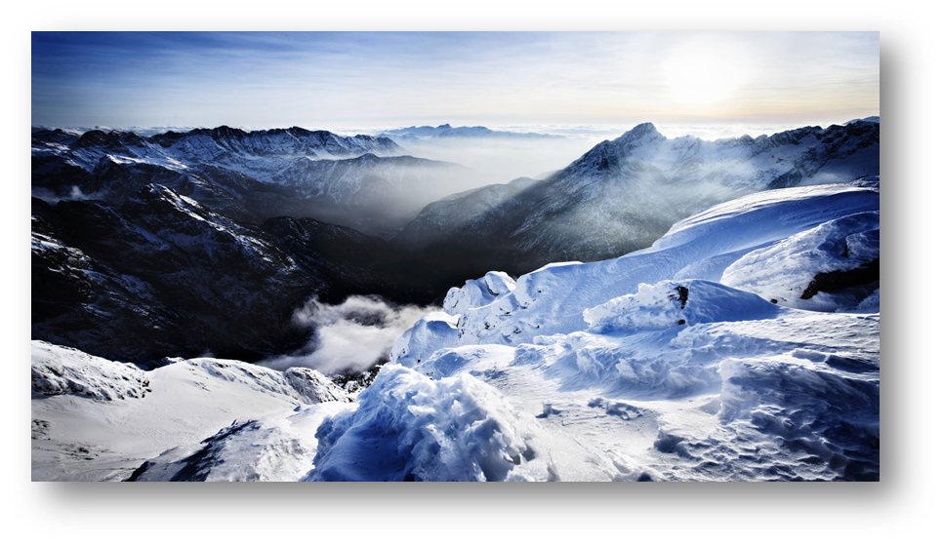
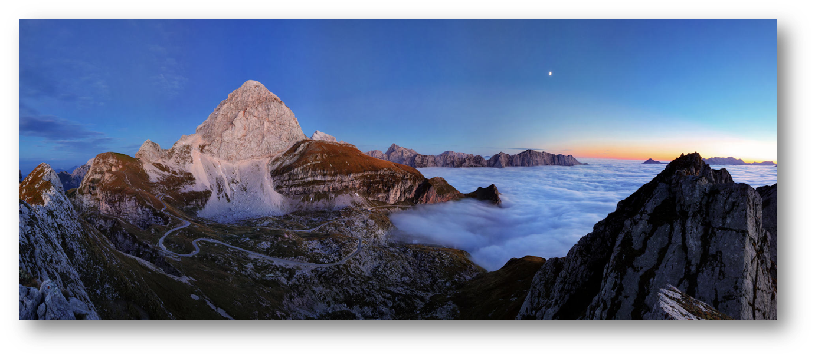
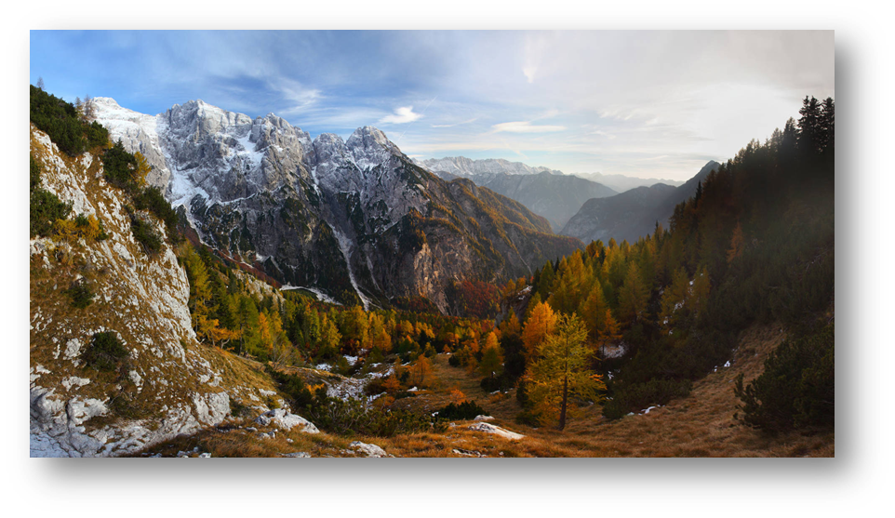
TRIGLAV
It is on the coat of arms.
Lies almost in the center of the park.
On top there is Tower of Aljaž.
Magnificent view of Slovenia.

Slide 5
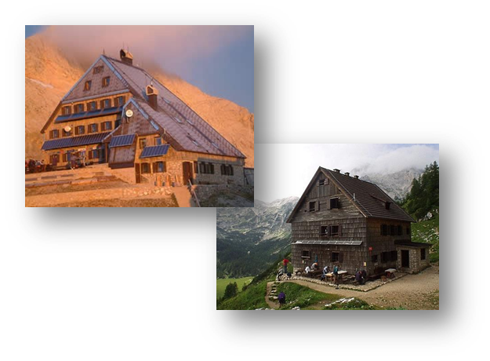
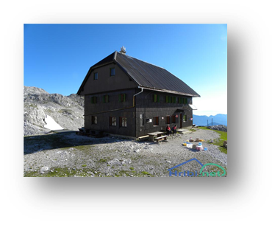
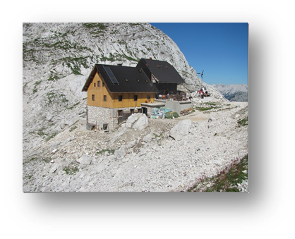
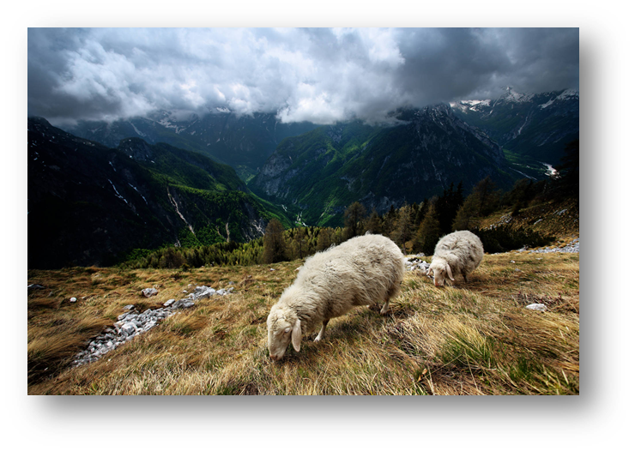
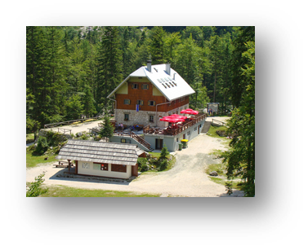
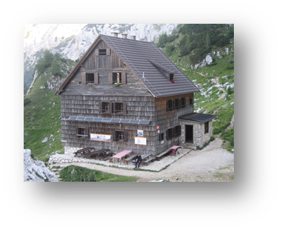
MOUNTAIN HUTS
In the surroundings of Triglav there are many mountain huts such as:
Triglav dom In Kredarica
Dom Planika under Triglav
Dom of Valentin Stanič
hut Tržaška on Dolič
Vodink's dom in Velo Polje
Dom of Aljaž …

Slide 6
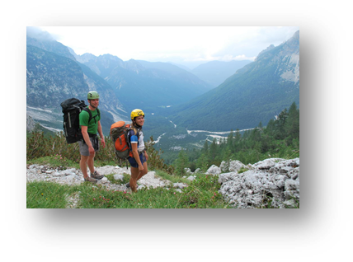
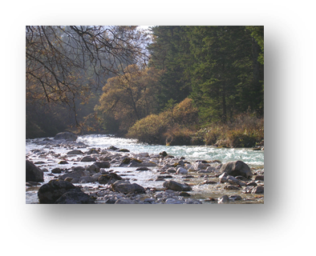
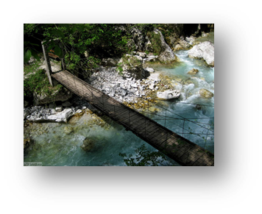
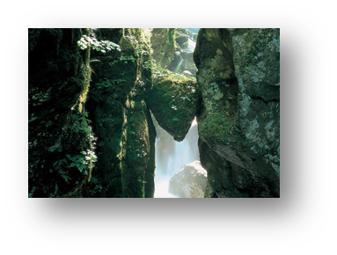
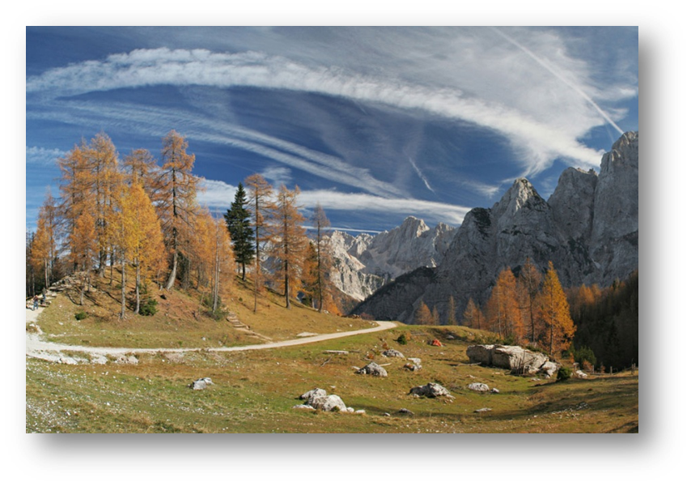
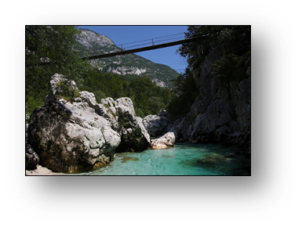
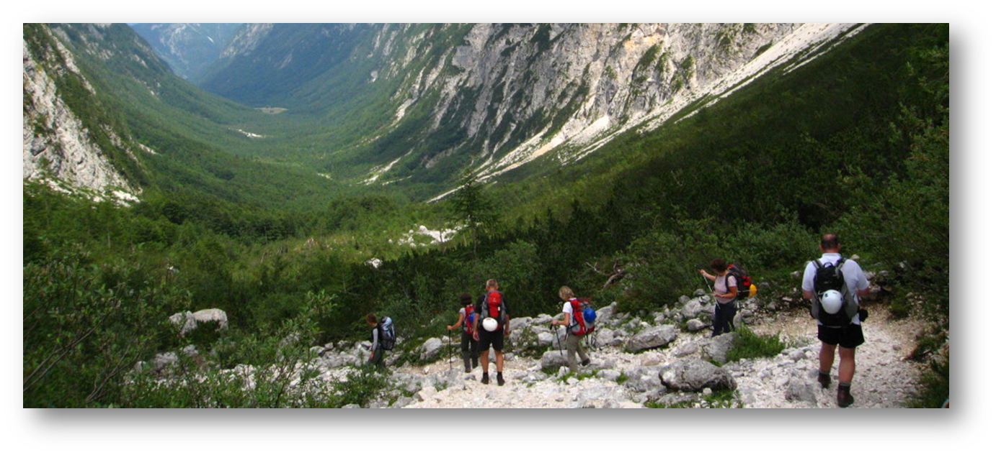
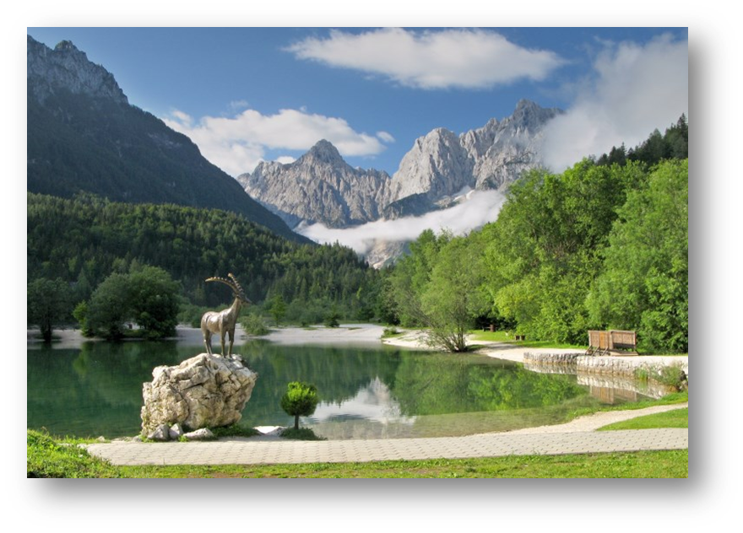
TRAILS
TNP has the following park trails:
the Soča Trail
the Tolminka troughs
the Triglavska Bistrica Trail in the Vrata valley
the Pokljuka Trail
the Radovna Cycle Route

Slide 7
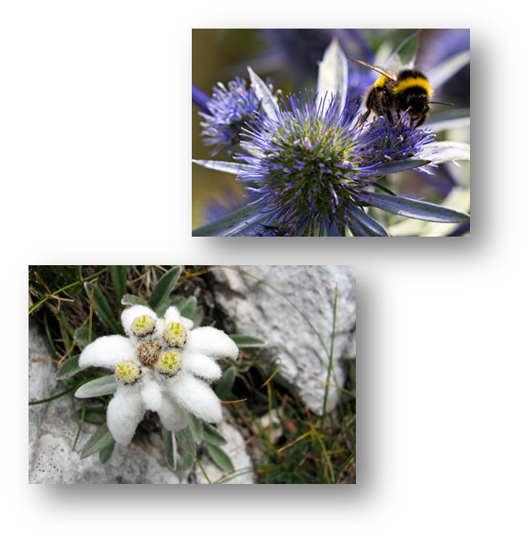
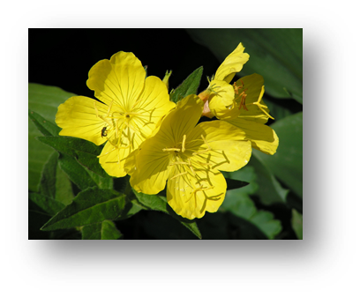
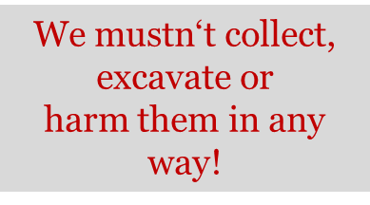
PROTECTED PLANTS
The most famous protected plant is Planika
Alpine sea hollies
Marsh tulips
Primrose and beautiful primrose
Carniolan lilies and others
FROM NATURE WE
ONLY TAKE IMPRESSIONS AND WE ONLY LEAVE FOOTPRINTS!

Slide 8
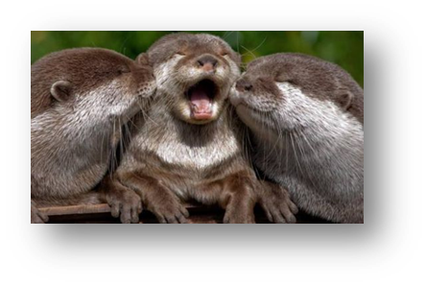
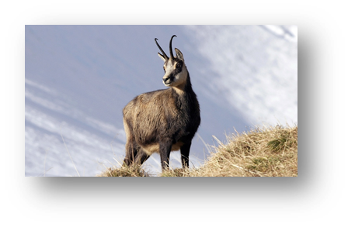
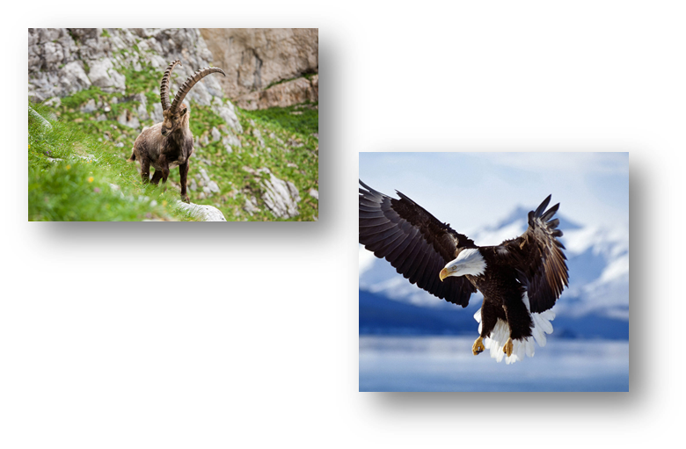
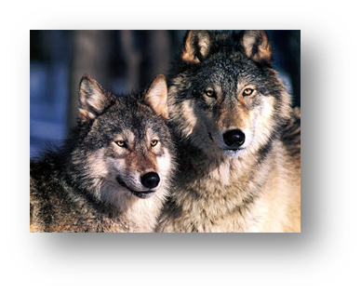
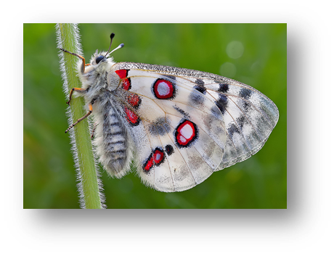
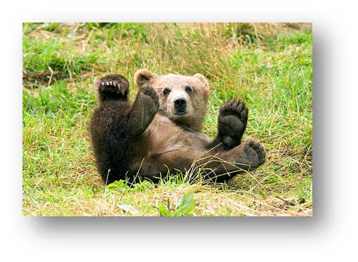
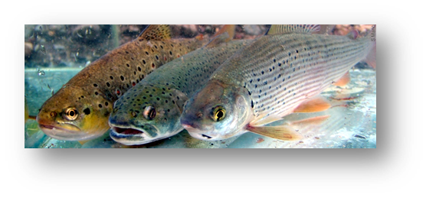
PROTECTED ANIMALS
The otter is the rarest and most endangered species in Slovenia but in TNP you can find
Gams
The Capricorn.
The great mountain eagle.
The marble and brown trout.
Wolf.
Brown bear.
The mountain Apollo butterfly.
Grouse and snow grouse

Slide 9
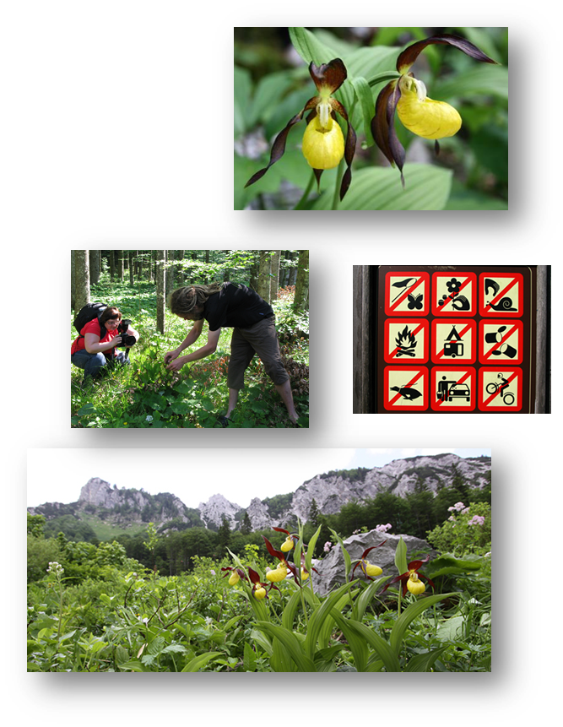
STRICTLY PROTECTED
1/5 of the population of the Beautiful Orchid grows in Triglav National park.
It grows in the pine-hill area.
It has been a strictly protected species in Slovenia since 1922.
Fines range from 100€ to 300€ by the laws of TNP.
Additional restrictions for picking plants from 1000€ to 4000€.
Possibility of initiation of criminal proceedings.

Slide 10
SOURCES
https://meanderbug.com/triglav-national-park-slovenia/#.VgxV6Pmqqkp
http://www.tnp.si/national_park/
http://www.bohinj.si/pohodnistvo/en/events_arhiv.php?eventID=4
http://www.pzs.si/koce.php?pid
http://www.pd-ljmatica.si/Koce/
http://www.slovenia.info/si/Nastanitve/Planinski-domovi-in-ko%C4%8De.htm?koca_planinski_dom=0&lng=1

