Slide 1
Blue group

Slide 2
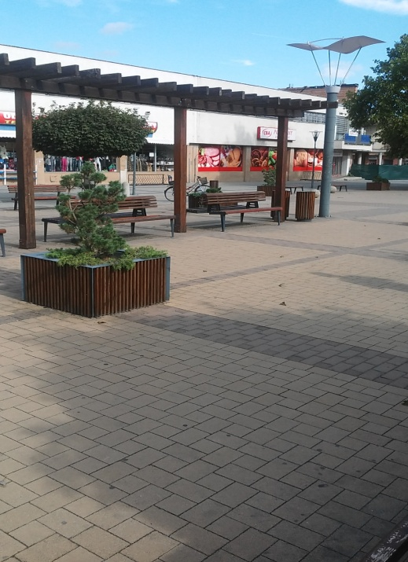
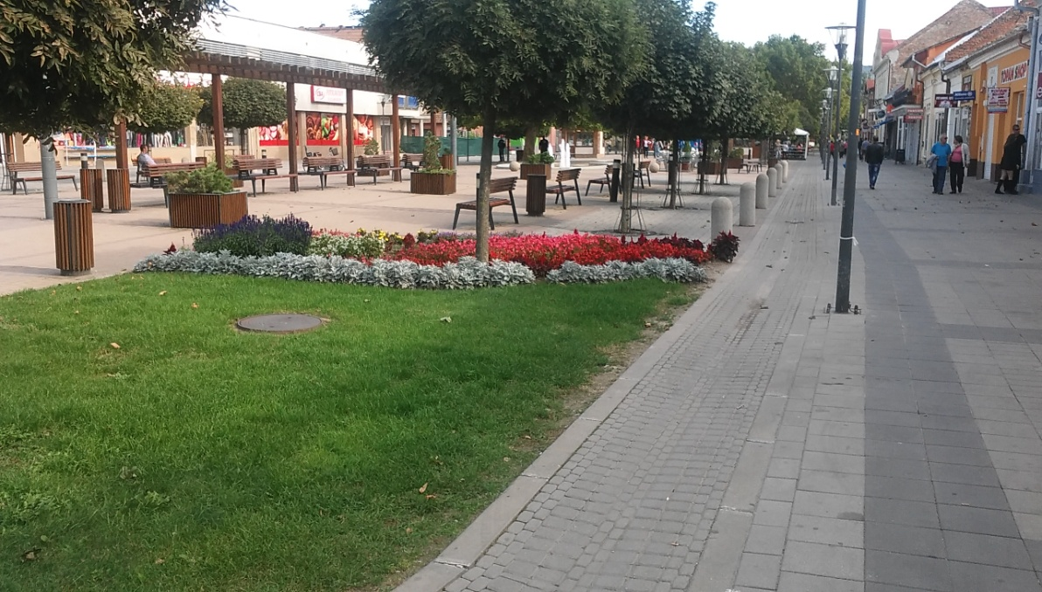
Štúrovo
In the past it was called Kakat
Only 10 000 people live here
Here is the bridge which connects Slovakia and Hungary
It has one of the biggest Thermal Spas in Slovakia
There are 6 schools

Slide 3
Thermal Spa Vadaš
It is one of the most famous spa in Slovakia
There are a lot of slides
It has 7 pools
6 pools are outside and 1 inside
Next to the spa there is a hotel, it has got 3 stars

Slide 4
Fair Šimon Júda
In every October the town organises the fair
There we can find a lot of handmade products
The swings are next to the Thermal Hotel
We could buy special foods and drinks, for example: medovina, trdelník

Slide 5
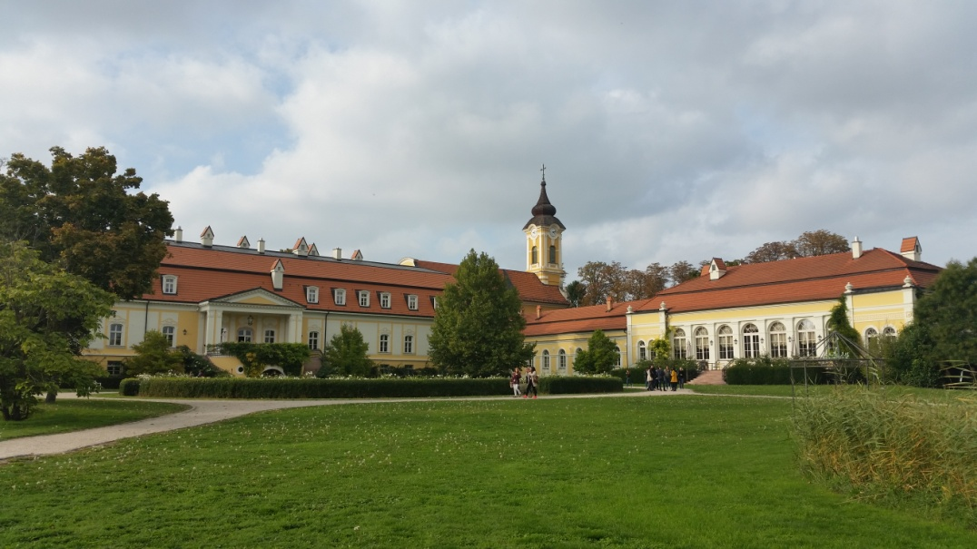
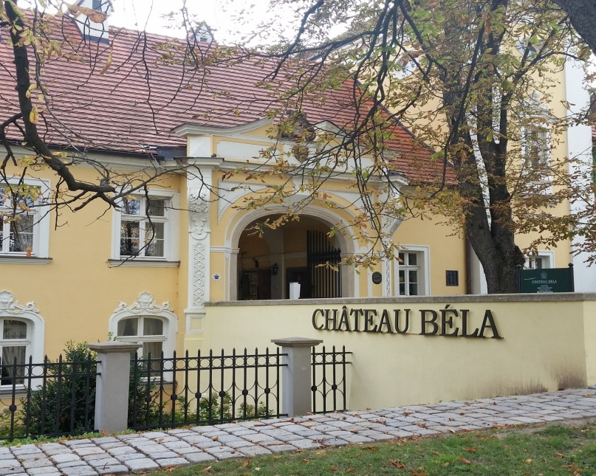
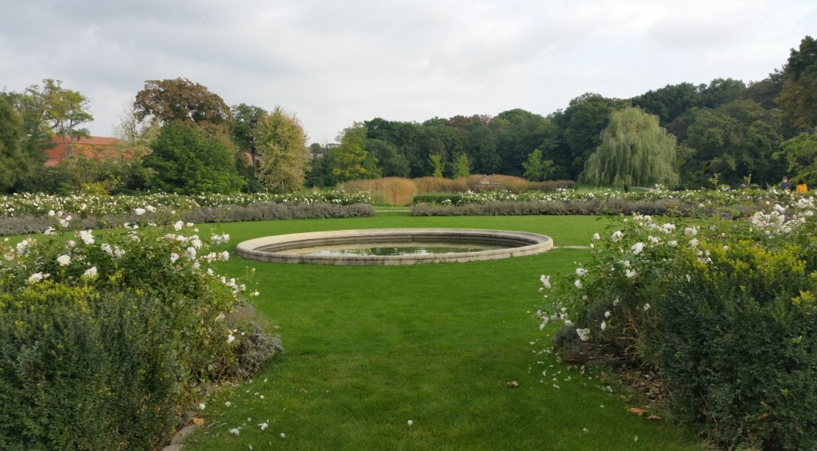
Béla Castle
Its located in Béla
16th century
Its a luxury hotel
It have its own wine
Prince Harry visited it

Slide 6
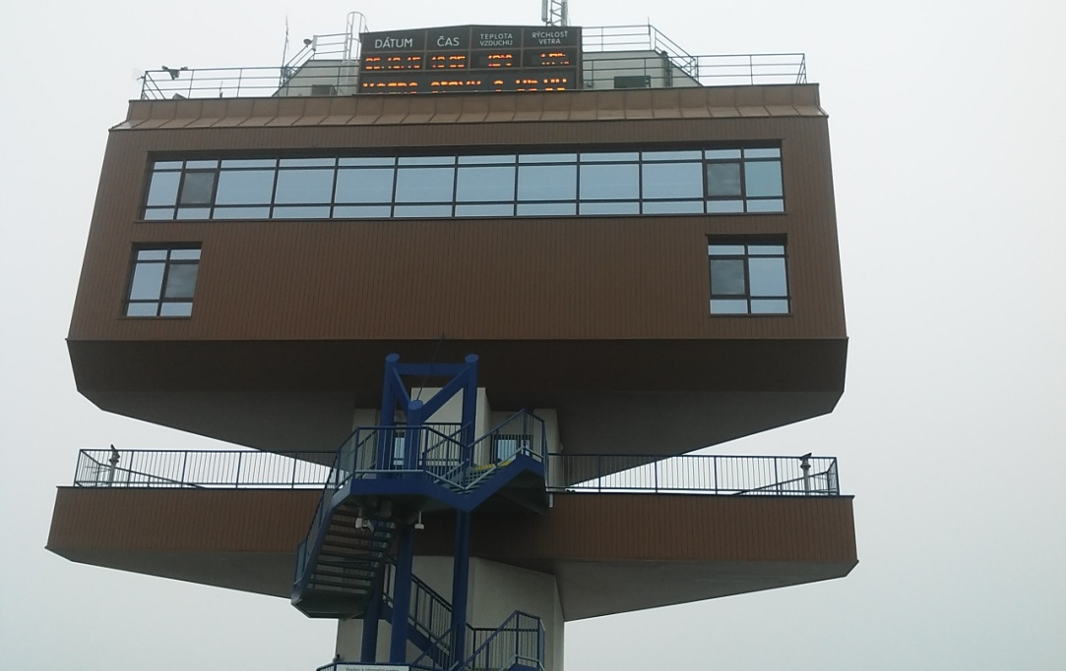
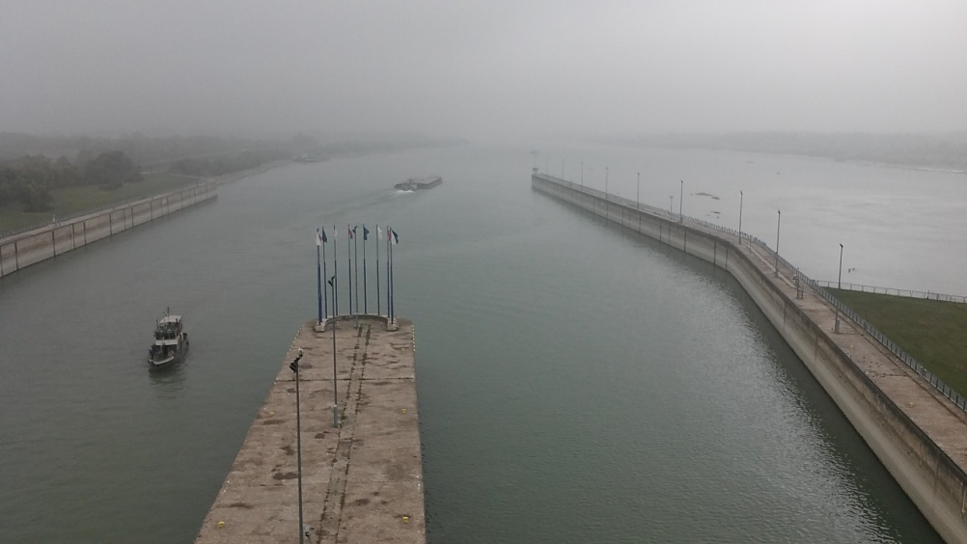
Gabčíkovo
Water station
It is a hydroelectric power plant
Also works as a port

Slide 7
Thank you for your attention!

