Slide 1
Touristic information office
ESCAPE Tábor meeting
9-15 October 2016

Slide 2
Official name in our national language
Turistická informačná kancelária Štúrovo
Hlavná č. 8
94301 Štúrovo
Tel.: +421 (0)36/7524009
E-mail: info@sturovo-info.sk
Web: www.sturovo-info.sk, www.podunajsko.com

Slide 3
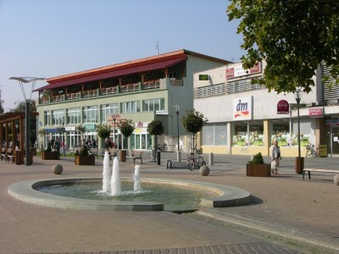
History
1st office – 1st May 2004 founder: Štúrovo
2nd office – 2010 – 2015 founder: Vadaš
In 2016 – OOCR Podunajsko
Destinations between Komárno – Štúrovo
Štúrovo, Mužla, Kravany nad Dunajom, Moča, Patince, Iža, Komárno
Vincent Andráško - director

Slide 4
The founders of the new office
Thermal Bath Vadaš Štúrovo, thermal bath Patince, Wellness hotel Patince and hotel Banderium in Komárno.

Slide 5
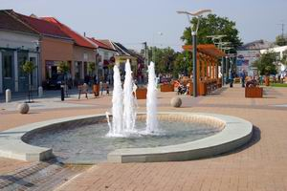
What it offers
If you have questions concerning accomodation, transport, sights, sport, cultural life, organized trips to the nearby destinations
If you want to buy tickets to concert, theatre, other cultural events and maps, catalogues, you can go there.

Slide 6
Opening hours
May, June, September:
Monday – Friday : 10 – 16
Saturday : 9 – 12
July, August:
Monday – Friday : 10 – 17
Saturday : 9 - 12

Slide 7
Benefits for citizens of Štúrovo
If you live in Štúrovo, you can get Štúrovo card
Prepared by: Zsófia Bogdányi, Péter Szőllősi

