Slide 1
Ljubljana
European Green Capital 2016

Slide 2
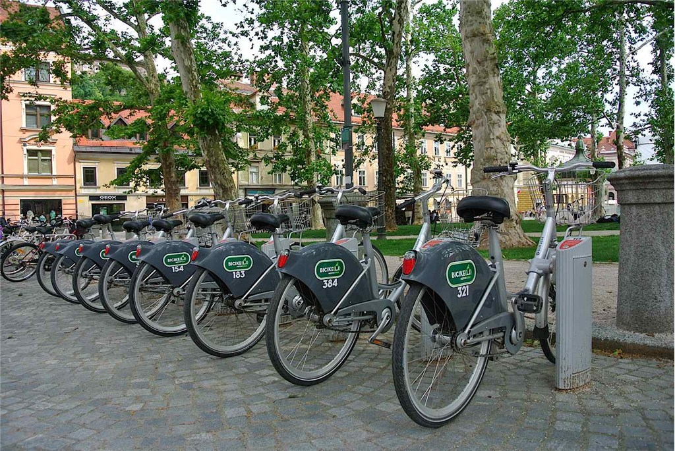
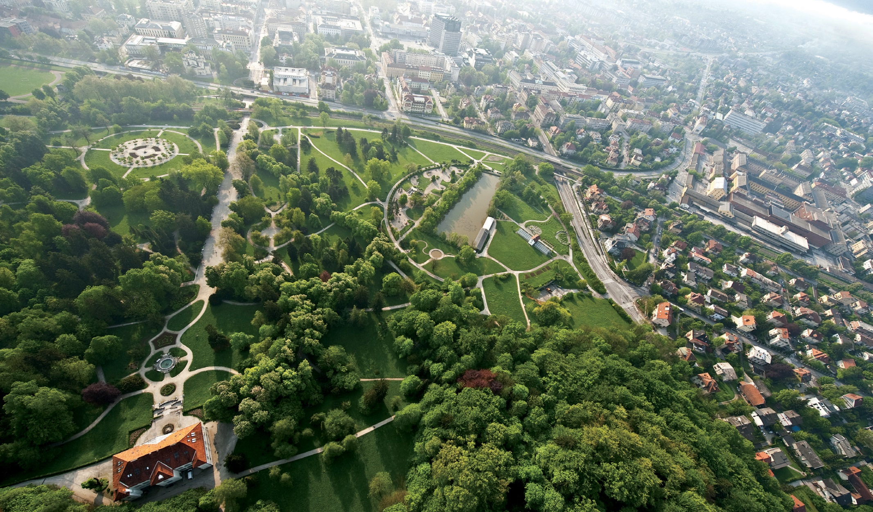
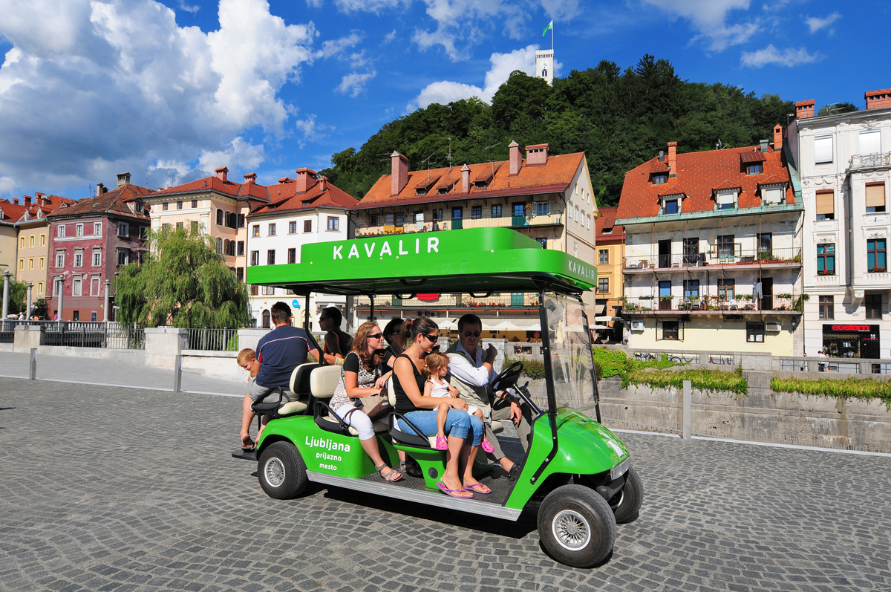
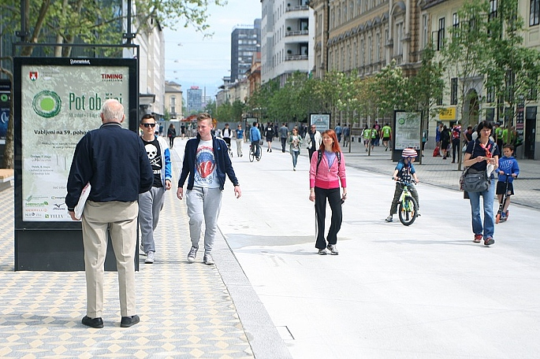
Ljubljana – the green capital

Slide 3
Recognised as green by others...
European mobility week (annually)
Access City Award 2015
European Green Capital Award 2016
Ljubljana Smart City

Slide 4
European Mobility Week
16-22 September
14th year in a row
the only two-time winner of the European Mobility Week Award
diverse activities

Slide 5
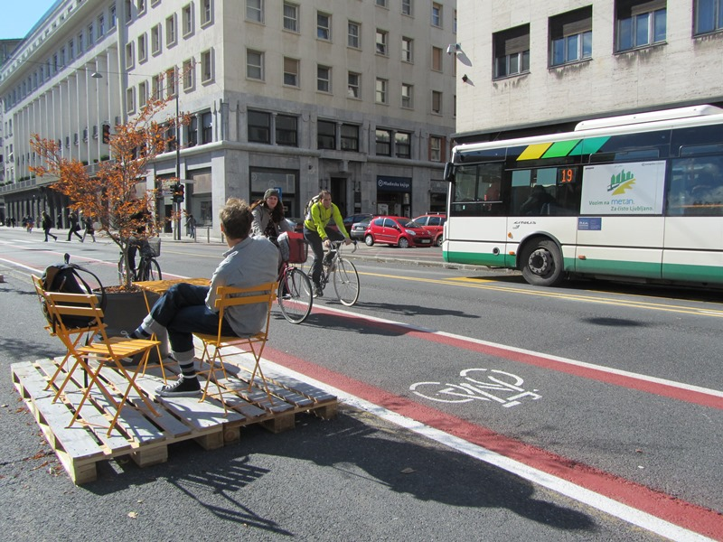
BEFORE - AFTER

Slide 6
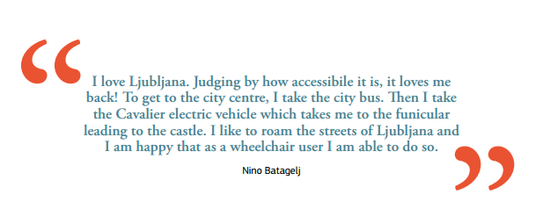
Access City Award 2015

Slide 7
Access City Award 2015
Third prize
A barrier-free city centre
Improving access to transport
On-line accessibility
Considering disabled and older people

Slide 9
https://youtu.be/PAAdi5lghwQ (shorter, promotional)
https://youtu.be/V8EySYYfV0c (longer)

Slide 10
European Green Capital Award 2016
A European Commission initiative.
Won the prestigious title among five finalists.
Cities committed to improving the urban environment.

Slide 11
European Green Capital Award 2016
LJUBLJANA HAS:
improved public transport system
pedestrianized the city centre
closed main traffic artery (Slovenska St.) for private traffic
closed city centre for motorised traffic
enabled the citizens to use Kavalir (electric vehicles)
preserved and protected green areas
has been pursuing zero waste objective
improved parking areas at the outskirts
improved river traffic

Slide 12
https://youtu.be/ZKy5C4F1qY0

Slide 13
Ljubljana – Smart City
The goal of this campaign is to highlight the environmental efficiency of Ljubljana.
„Energy card“ tells the people what is being done to keep Ljubljana green.
Activities aimed at:
better quality of life
better urban solutions
raising awareness
lowering CO2 emissions
less noise pollution

